Slide 1
NATURAL RESOURCES: LAND, SOIL AND WATER RESOURCES

Slide 2
LAND

Slide 3
Natural resources upon which all human activity is based is land
Lithosphere consists of loose surface material called Soil
Combination of organic and inorganic matter.Organic consists of dead and decomposed parts of animals and plants called Humus. Inorganic formed by rock particles and minerals such as lime, iron etc.
90% of the world’s population is inhabited in the plain areas of alluvial soil
Sparse population is seen in areas of high altitudes, deserts, equatorial forests, infertile soil

Slide 4
LAND USE

Slide 5
Land is used for various purposes such as cultivation of crops, building of houses, roads and railways, grazing of animals etc. known as land use pattern
Utilization of land is determined by the continuous interplay
Physical factors- relief, soil, climatic conditions, mineral resources
Human Factors- Density of population, technological and social requirements etc.

Slide 6
Study of land use pattern is important for the economic planning of the nation
Assess the shortcomings in land utilisation
Development goals and availability of natural rsources

Slide 7
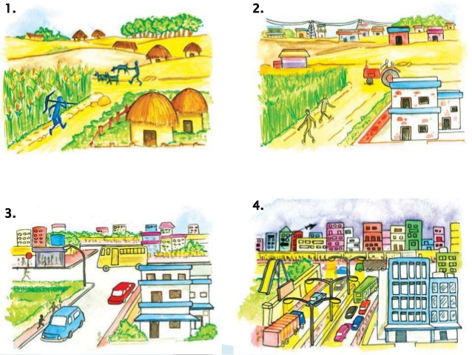

Slide 8
33% area should be under forests
31.6% area of world is under forest cover
24 % are naturally occuring and 7% are man made
Availability of land on earth is limited
Conflict over the access and rights
Tough competition between agriculture and other sectors
Soil erosion, degradation and deforestation

Slide 9
Take initiative to conserve land, discourage deforestation, encourage afforestation
Ensure optimum use of land resources
Land management is a holistic approach for a productive and balanced ecosystem by integrating socio-economic needs of the people

Slide 10
SOIL

Slide 11
A large part of the earth is covered with soil
USES OF SOIL
Valuable to the farmers
Agriculture production is dependent on fertility of soil
Rich and deep soil cover favours Agriculture production
Shallow and lacks fertility Agriculture production will be less
Growth of plants
Animals depend upon soil
Gives shelter to insects and animals
Making bricks

Slide 13
Soil erosion and depletion are the major threats to soil as a resource.
Both human and natural factors can lead to degradation of soil
Factors which lead to soil degradation are deforestation, overgrazing, overuse of chemical feritilisers or pesticides

Slide 14
CONSERVATION MEASURES
Afforestation
Planting of shelter belts
Overgrazing must be check
Check reckless cutting of trees
Building of dams
Terrace farming and contour ploughing
Scientific agriculture practices like rotation of crops, strip cropping etc.

Slide 15
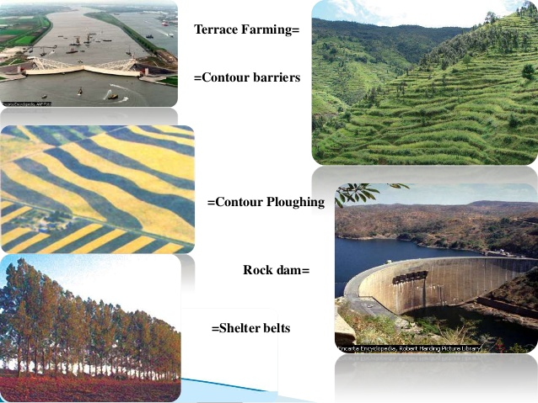

Slide 16
WATER RESOURCES

Slide 17
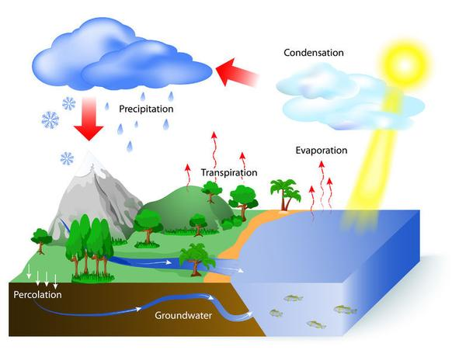
71% OF THE EARTH’S SURFACE COVERED WITH WATER
97% of the earth’s surface is in the oceans and seas
Remaining water found in the following forms:
0.32% lakes, rivers, atmospheric and soil moisture
2.0% ice caps
0.68% ground water
The main source of fresh water is rainfall.
Hydrological cycle

Slide 18
Precipitation of the world is estimated to be 1050 millimetres per year or 2.9 mm per day
Areas of High Rainfall- Equatorial areas in South America, Africa and South East Asia
Areas of Low Rainfall- Tropical Deserts- Sahara, Arabian, Western Australia, Kalahari, Central Eurasia, Polar Areas etc.

Slide 19
Map: world : Distribution of Rainfall

Slide 20
POLLUTION OF WATER
Access to clean and adequate water sources is a major problem facing the world today
Discharge of untreated or partially treated sewage, agricultural chemicals and industrial effluents in water bodies are major contaminants
Most of these chemicals being non-biodegradable reach human bodies through water cause diseases
Disturbs the ecosystem

Slide 21
MULTIPURPOSE RIVER PROJECTS
Projects which serves many objectives at the same time.
Under this a dam or series of dams are constructed across the river for storing water
Used for several purposes- providing irrigation, generating hydroelectricity, afforestation, control floods, navigation etc.
Damodar river valley project and Hirakud Dam in India, Aswan in Egypt, Hoover Valley project in USA

Slide 22
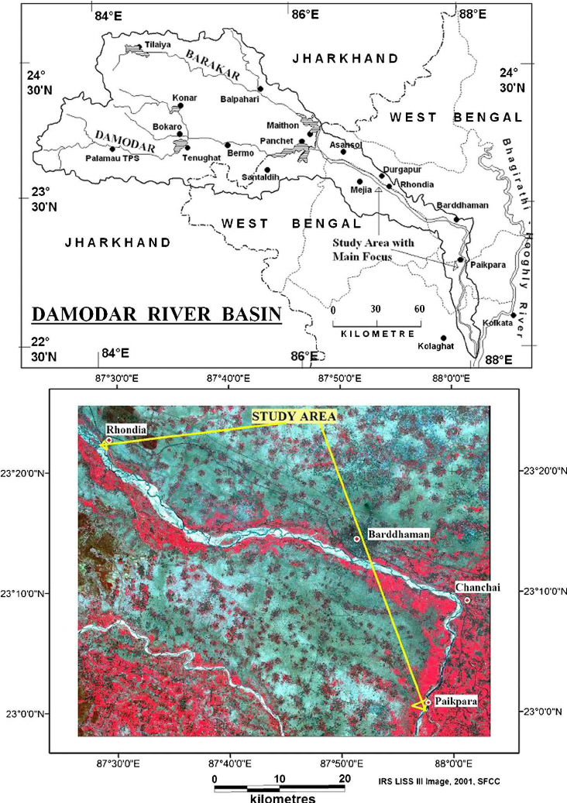
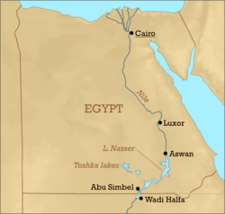
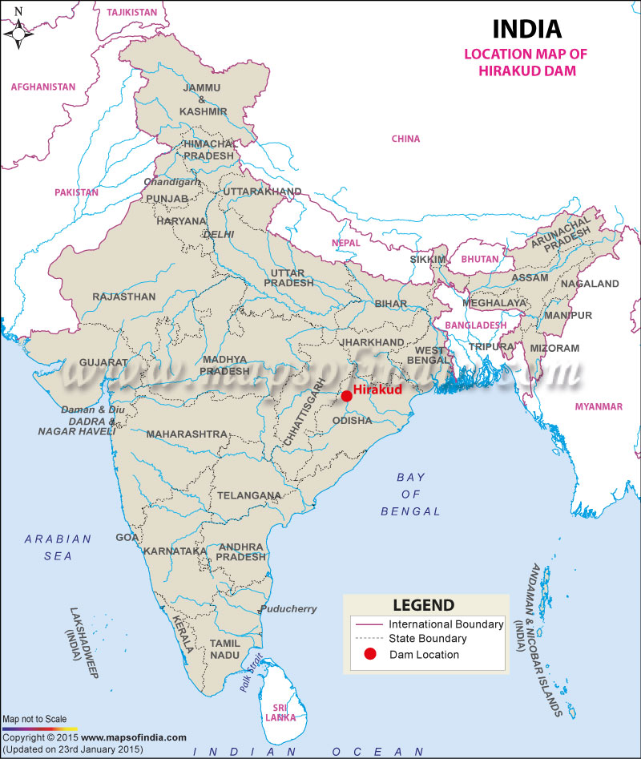
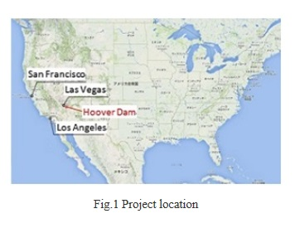

Slide 23
Ecological problems by dams
Extensive forests submerged under water
Aquatic life gets affected
River water gets diverted
Result in soil erosion
Population gets displaced
During excessive rain, floods are caused

Slide 24
CONSERVATION METHODS
Rain water harvesting
Having vegetation cover
Recycling of water
Adopt modern methods of irrigation Such as drip or trickle irrigation technique and sprinkler method of irrigation
Making dams across the rivers
Install water fixtures such as sensor taps
Maintenance of lakes and ponds to increase the aquifer
Educating and sensitising people to conserve water

Slide 25
THANK YOU

