Slide 1
WELCOME BACK TO THE VIRTUAL CLASS
OF
INFORMATIC PRACTICES

Slide 2
WHAT is QUERY?
A query is a request for data or information from a database table or combination of tables. In other retrieving data or information from a single or multiple tables according to the requirement.
Select Clause is used to handle query.

Slide 3
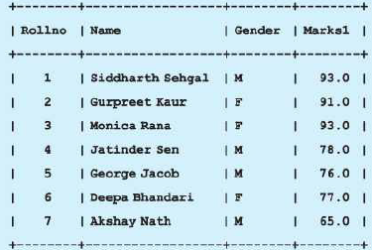
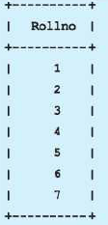
Query Handling using Select Command
Retrieving all columns of a table
mysql> SELECT * from student;
Retrieving a single column
mysql> SELECT rollno from student;

Slide 4
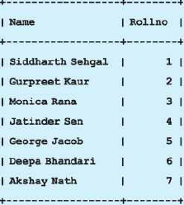
Query Handling using Select Command
Retrieving a multiple columns but not all
mysql>SELECT name,rollno from student;

Slide 5
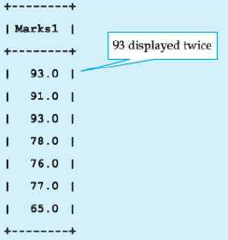
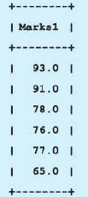
Eliminating duplicate values (only for display)
mysql>SELECT marks1 from student;
mysql>SELECT distinct marks1 from student;

Slide 6
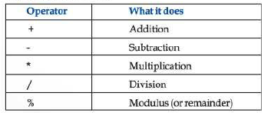
Using Arithmetic Operations with Select Command
Arithmetic Opertions can be used only with numeric datatype columns.
When we use any operator or conditions with select command they are only for display that means they never changes the data of table in original. So following are the arithmetic operations that can be used

Slide 7
Try These commands by yourself
mysql>SELECT name, marks1+5 from student;
mysql>SELECT name, marks1+0.5*marks1 from student;
mysql>SELECT name, marks1-10 from student;
mysql>SELECT name, marks1/2 from student;
mysql>SELECT marks1 as “Marks Obtained” from student;
You will see every time calculation is done on the original marks1 which you have entered using insert command.
The result of last will show the data of column marks1 but named as Marks Obtained which is name of display for column marks1

