Slide 1
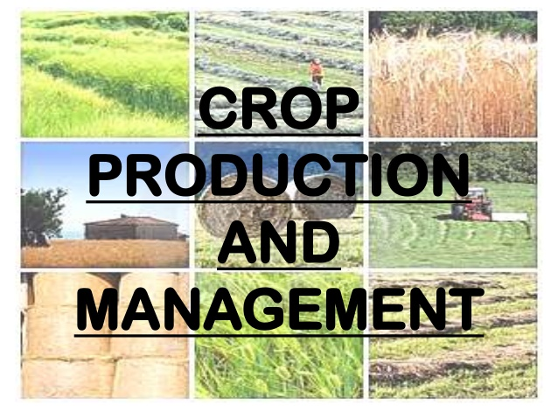
Class IX BIOLOGY

Slide 2
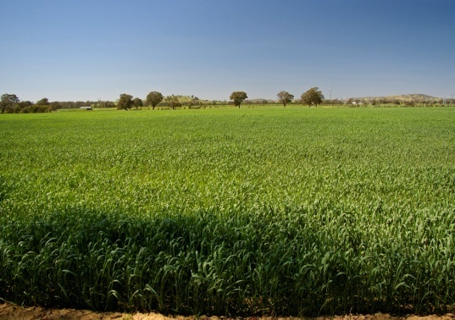

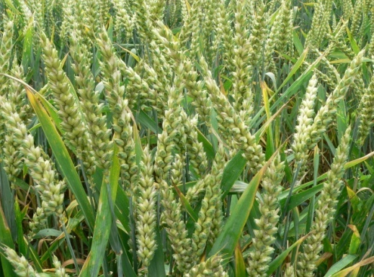
Need to improve crop production
As population of India is increasing day by day there is also a need to increase the production of crops.

Slide 3
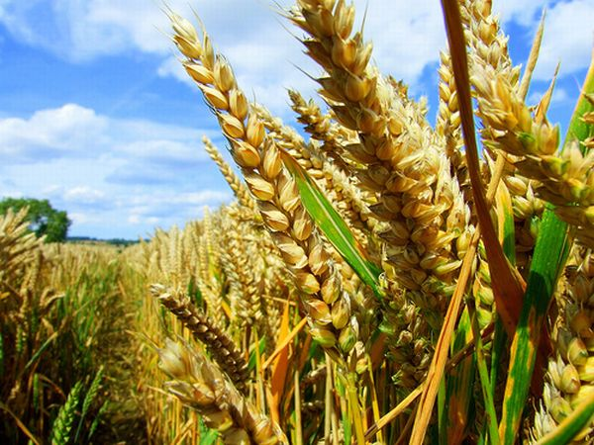
What are the various ways to improve crop production
The major group activities for improving crop yield can be classified as :
                Crop variety improvement
                Crop production improvement
                Crop protection management

Slide 4
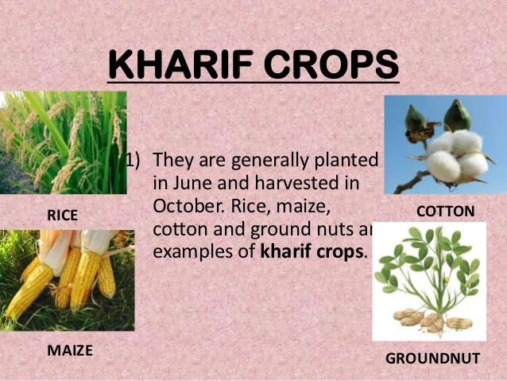

Slide 5
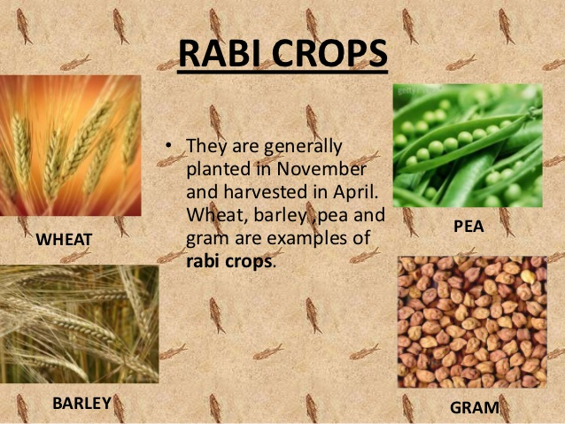

Slide 6
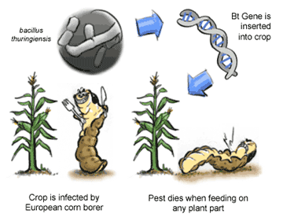
Crop variety improvement
The approach in crop variety improvement depends on finding a crop variety that can give a good yield. Varieties for strain crops can be selected by breeding for various characteristics such as disease resistance , response to fertilisers, production quality and high yields .One way of incorporating desirable characters into crop varieties is by hybridization.

Slide 7
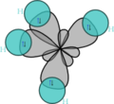
Hybridisation
Hybridisation refers to crossing between two genetically dissimilar plants each having at least one desired to incorporate both desired characters in single variety . This crossing may be inter varietal (between two different species) and inter specific (between two different species of same genus).

Slide 8
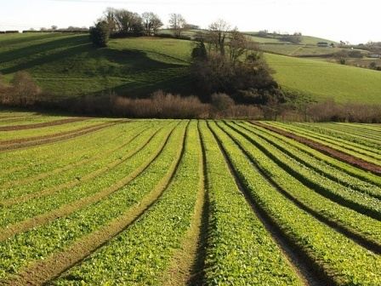
Desired characteristics in crops
Higher yield .
Better Quality .
Resistance to biotic and abiotic factors
Reduction in maturation period.
Wider adaptability.

Slide 9
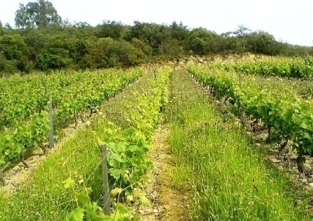
Crop production management
  In India, farming ranges from small to very large farms. Different farmers thus have less land , money and access to information and technologies. There is a correlation between higher inputs and yields .Thus the farmers purchasing capacity for inputs decides cropping system and production practices. Therefore production practices can be at different levels .They include ‘no cost’ production, low cost production and high cost production practices.

Slide 10
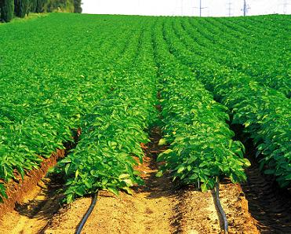
What does crop production management include
Nutrient management
Irrigation
Cropping patterns

Slide 11
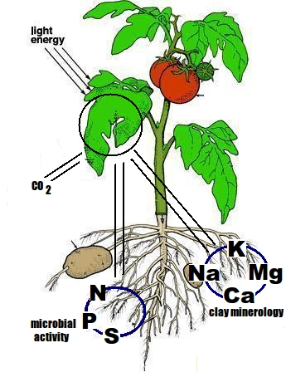
Nutrient management
Just as we need food for development ,growth and well being plants also require nutrients for growth .Nutrients are supplied to plants by air water and soil. There are sixteen nutrients essential for plants .Soil provides them thirteen nutrients and rest all they get from surroundings. That is why to maintain the fertility of soil manure and fertilisers are added to it.

Slide 12
Macronutrients:
The essential elements, which are utilized by plants relatively in large quantities, are called macronutrients.
Micronutrients:
The essential elements, which are used by plants in small quantities, are called micronutrients.
Effect of Deficiency of nutrients
Deficiency of these nutrients affects physiological processes in plants including reproduction, growth and susceptibility to diseases.
Source | Nutrients | Type
Air | Carbon (C), Oxygen (O) | Macronutrient
Water | Hydrogen (H) | Macronutrient
Soil | Nitrogen (N), Phosphorous (P), Potassium (K), Calcium (C), Magnesium (Mg), Sulphur (S) | Macronutrient
 | Iron (Fe), Maganese (Mn), Boron (B), Zinc (Zn), Copper (Cu), Molybdenum (Mo), Chlorine (Cl) | Micronutrient

Slide 13
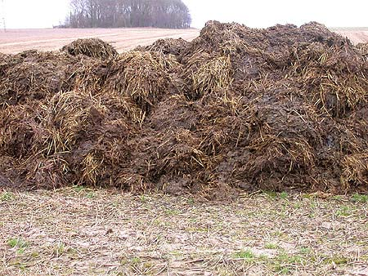
Manure
Manure contains large amount of organic matter and also supplies small quantities of nutrients to the soil. Manure is prepared by the decomposition of animal excreta and plant waste. It increases the fertility of soil and improves the structure of the soil .In sandy soils it increases the water holding capacity and in clayey soil organic matter helps in drainage .Manure is of two types. Green manure and compost and vermi compost .

Slide 14
Green manure and compost manure
Green manure -Prior to the sowing of crop seeds some plants like sun hemp or guar are grown and then mulched by ploughing them into the soil these plants form green manure which helps in increase of nitrogen and phosphorus in soil.
Compost and vermi-compost--The process in which farm waste material like livestock vegetable waste sewage waste etc .is decomposed in pits is known as composting .To fasten the decomposition of waste the red worms are put in the pit this process is known as vermi compost.

Slide 15
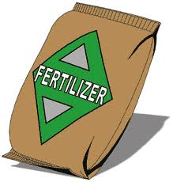
Fertilisers
Fertilisers are commonly used plant nutrients. They are made in factories and are man made . They supply nitrogen phohosphorus and potassium to plants . They are ensured to use good vegetative growth giving rise to healthy plant . Fertilisers are factor of higher yields of high cost . But excessive use of fertilisers have adverse effect on soil . Fertilisers get washed away with excessive irrigation. Fertilisers also harm the useful micro organisms of soil . The fertilisers give short term benefits whereas manure gives long term benefits.

Slide 16
Organic farming is a method of farming using less or no amount of fertilizers, herbicides, pesticides etc. This method uses only organic matters like organic manures, farm-wastes. It uses blue green algae in preparation of bio fertilizers.

Slide 17
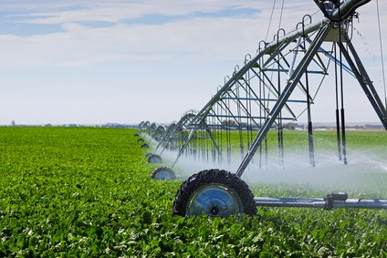
Irrigation
Most agriculture in India is rain led ,that is why the success of crops in most areas is dependant on timely monsoons . Hence poor monsoons cause cause crop failure . Ensuring that the crop get water at the time of growing time can give higher yield .

Slide 18
Methods of irrigation
Wells – There are two types of wells namely dug wells and tube wells. Water is collected from water bearing strata . Tube wells can tap more amount of water than dug ones.
Canals – this usually an elaborate and extensive irrigation system. In this system canals receive water from rivers. The main canal is divided into branches having further distributaries to irrigate fields.
River lift system-In areas where canal flow is insufficient the water is directly drawn from river .
Tanks- These are small storage reservoirs which intercept and store the run off of smaller catchment areas

Slide 19
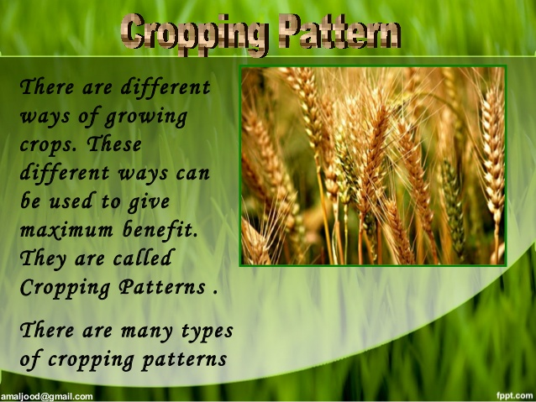
Cropping Systems

Slide 20
Cropping patterns
Crop Rotation: Example Planting maize one year, and beans the next. Crop Rotation means changing the type of crops grown in the field each season or each year (or changing from crops to fallow).
Crop rotation is a key principle of agriculture conservation because it improves the soil structure and fertility, and because it helps control weeds, pests and diseases.

Slide 21
Croping patterns
Intercropping: Examples- Planting alternating rows of maize and beans, or growing a cover crop in between the cereal rows. Intercropping means growing two or more crops in the same field at the same time.
Mixed Intercropping: Distribution of the seeds of both the crops, or dibbling the seeds without any row arrangement. This process is called mixed intercropping. It is easy to do but makes weeding, fertilization and harvesting difficult. Individual plants may compete with each other because they are too close together.

Slide 22
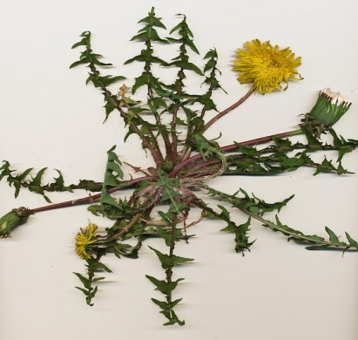
Crop protection management weeds
Field crops are infested by a large number of weeds , insect pests and diseases. If weeds and pests are not controlled at the appropriate time then they can damage the crops so much that most of the crop is lost
Weeds are unwanted plants in the cultivated field , for example, gokhru ,gajarghaas , motha etc.
Weeds take up the nutrients and reduce the growth of the crop .Weeds should be taken out at right time as they cause problem at the time of maturation of the crop. Weeds can be removed out by use of weedicides . It can also been removed deep ploughing at the time of summer

Slide 23
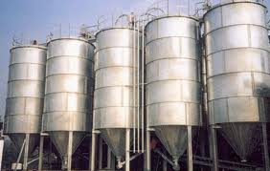
Storage of grains
Storage losses in agriculture produce can be very high. Factors responsible for such losses are
biotic:insects, rodents, fungi, mites and bacteria
abiotic factors: inappropriate temperatures and moisture in the place of storage. These factors cause reduction in weight all leading to poor marketability. These factors can be controlled by proper and systematic management. The use of chemicals can kill pests and save the crop from loss.

Slide 24
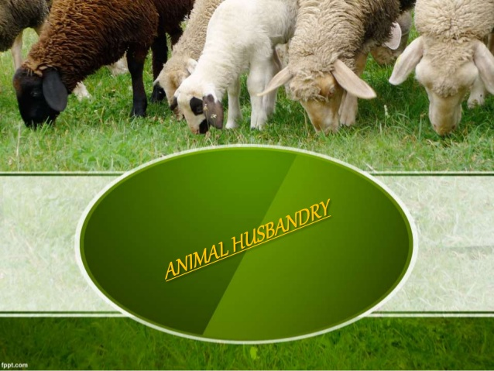

Slide 25
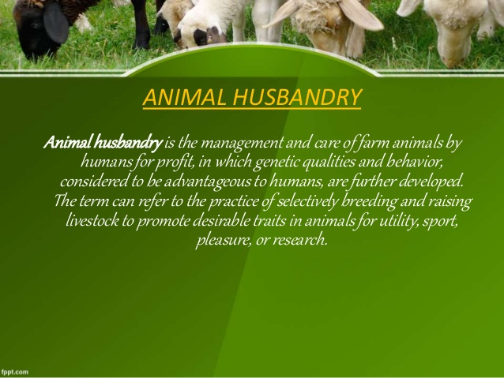

Slide 26
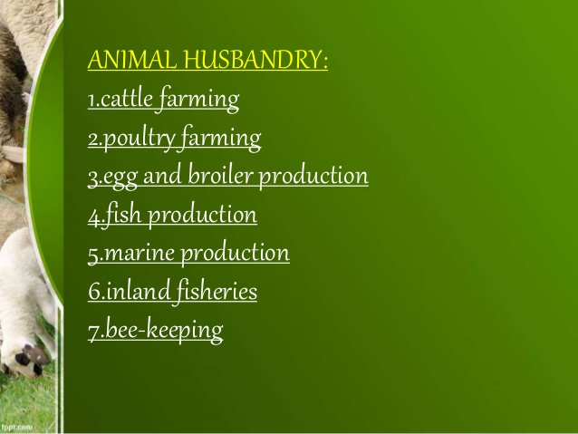

Slide 27
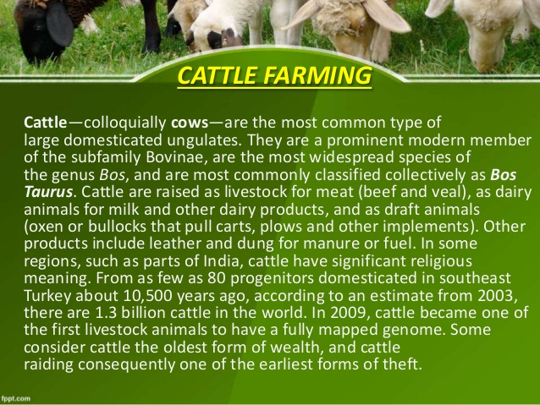

Slide 28
Cattle Farming
Cattle farming is done for two purposes:
Dairy: for getting milk.
Draught: animals are used for agricultural tasks like tilling, irrigation and carting.
On the above basis, the cattle are divided into two categories:
Milch breeds (dairy animals): These include the animals which are kept for obtaining milk. Indian milch cattle belong to two different species- Cows (Bos indicus) and Buffaloes (Bos bubalis).
Draught animals: These animals are used in agriculture and transportation

Slide 29
Breeds of cow |  |  | Breeds of buffaloes
Indigenous breeds | Exotic breeds | Cross-breeds | Murrah, Meshsana and Surti
Sahiwal, Gir, Red Sindhi, Tharparkar | Jersey, Brown Swiss, Holstein-friesian | Karan Swiss, karan Fries, Frieswal

Slide 30
Food requirement of dairy animals: It is of two types:
Maintenance requirement: The food which helps in maintaining normal metabolic activities of the body.
Milk producing requirement: The food which is required during the lactation period. Components of cattle feed- roughage and concentrate.
Roughage: It largely contains fibres such as green fodder, silage, hay and legumes like berseem, cowpea.
Concentrates: It is low in fibres but contains relatively high proteins and other nutrients. It includes cotton seeds, oilseeds, oats, barley, gram and their by-products like wheat, beans and molasses etc.
Cattle need balanced rations containing all nutrients in proportionate amounts. Besides such nutritious food material, certain feed additives containing micronutrients promote the health and milk output of dairy animals.

Slide 31
Diseases of cattle:
The diseases of dairy animals are broadly classified as:
Diseases caused by parasites (external parasites are tick mite, lice and internal parasites are worms)
Communicable (infectious) diseases caused by pathogens like bacteria, viruses, fungi etc.
Non-communicable (non-infectious) diseases caused due to deficiency of nutrients or malfunctioning of body organs.

Slide 32
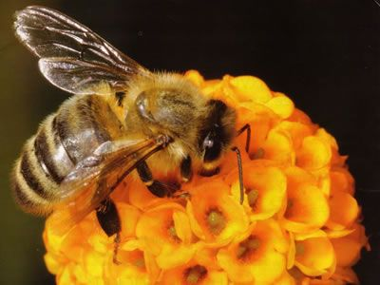
BEE KEEPING

Slide 33
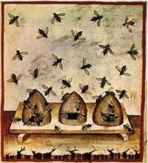
The act of rearing, raising and caring of honey bee on a large scale to obtain honey and wax from them is called apiculture.

Slide 34
Varieties of bees used for profitable honey production are as follows:
Apis dorsata (Rock bee)
Apis florea (Little bee)
Apis indica (Indian bee)
Apis mellifica (European bee)
The quality depends upon the following factors:
Pasturage or the kind of flowers availableto the bees to collect the nectar and pollen grains.
Kind of flowers available determines the taste.

Slide 35
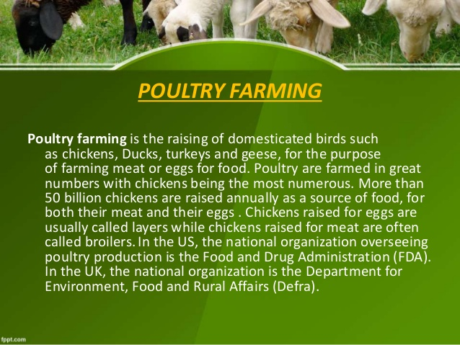

Slide 36
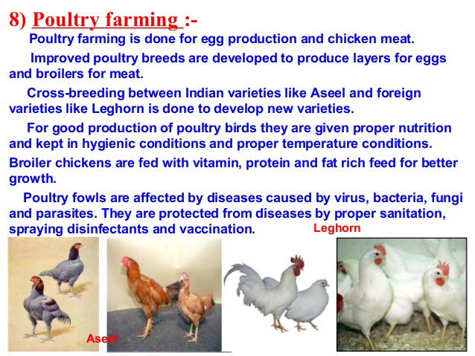

Slide 37
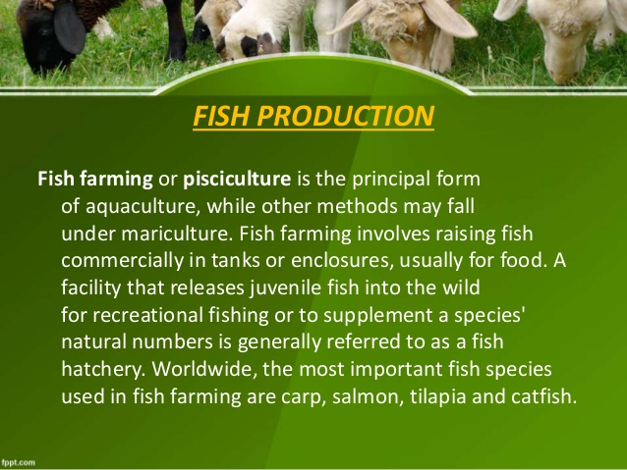

Slide 38
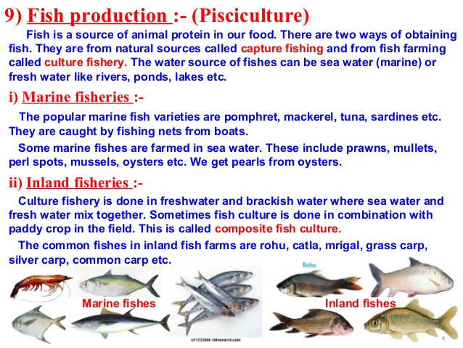

Slide 39


