Slide 1
MATHEMATICS CONTENT – 4
CLASS IX
OPERATIONS ON REAL NUMBERS
Date: 31.03.2020
You have learnt in earlier classes, that
Rational numbers satisfy the commutative, associative and distributive laws for addition and multiplication. Moreover, if we add, subtract, multiply or divide (except by zero) two rational numbers, we still get a rational number (that is rational numbers are ‘closed’ with respect to addition, subtraction, multiplication and division)
Irrational numbers also satisfy the commutative, associative and distributive laws for addition and multiplication. However, the sum, difference, quotients and products of irrational numbers are not always irrational.

Slide 2
Remember
The sum or difference of a rational number and an irrational number is irrational.
Example: 2 - √3; 21 + √2
The product or quotient of a non zero rational number with an irrational number is irrational.
Example: 7√5; 8 ÷ √3
If we add, subtract, multiply or divide two irrationals the result may be irrational or rational.
Example: (√125 x √5) , √6 + (- √6) , √2 - √2 and √17 ÷ √17 are all rational numbers.
2 √3 + (- √3), (2 √7 - 5 √7), (2 √5 x √2) and (2√6 ÷ √3) are all irrational numbers.
(Write the above points in notebook)

Slide 3
The following identities to be written in notebook
Do in notebook EX 1.5 Q1 and Q2.

Slide 4
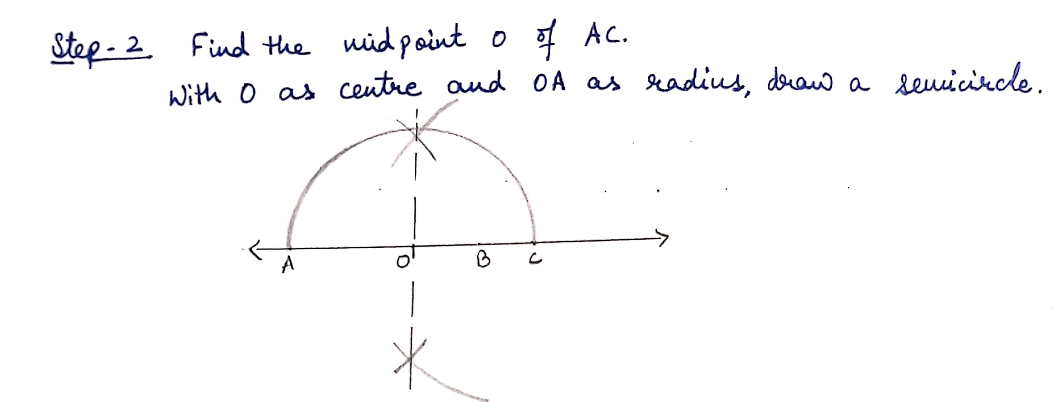
Representation of √x for any given positive real number x on number line

Slide 7
RATIONALIZATION
https://www.youtube.com/watch?v=m54wCRVWf2g
Now do Q4 of Ex 1.5 in notebook
Example: Rationalize the denominator of 1/ √2
$\frac{1}{\sqrt{2}}$ x $\frac{\sqrt{2}}{\sqrt{2}}$ = $\frac{\sqrt{2}}{2}$
Lets see some more examples to understand the concept

Slide 8
Do Ex 1.5 Q3 and Q5 in your notebook.

Slide 9
Worksheet
Rationalize the denominators of the following
(i) $\frac{1}{2+ \sqrt{3}}$
(ii)$\frac{\sqrt{3 }+\sqrt{2 }}{\sqrt{3 }−\sqrt{2 }}$
(iii) $\frac{1}{2+ \sqrt{3}}$
(iv) $\frac{3 −2√2}{3+2√2}$
Find the value of √4.3 geometrically.

Slide 10
