Slide 1
Topics to be covered are:
Square root of numbers(not perfect squares) correct up to given places
Word problems on finding square root by Estimation Method.
HOTS questions
Link for Chapter-1(Secondary Mathematics Class- VIII): https://drive.google.com/file/d/0B2WnuEWPvPWVSlpyWXM5V1NUN1E/view

Slide 2
Note that: we have to find square root of 2$\frac{1}{5}$ correct upto two decimal places. So we will find square root upto 3 decimal places. In the third place, we have 3 (which is less than 5) and therefore in the final result, 3 is ignored.

Slide 3
WS-5
QUE:4 Find the square root of the following(correct up to 3 decimal places)
7
√7 = 2.6457
= 2.646(correct up to 3 decimal places)
Therefore, √7 = 2.646
NOTE THAT: we have to find square root of 7 correct up to three decimal places. So we will find square root up to 4 decimal places. In the fourth place, we have 7 (which is greater than 5) and therefore in the final result, 5 is increased by one i.e. it becomes 6

Slide 4
(iv) 367$\frac{2}{7}$
= $\frac{2571}{7}$ = 367.28 57 14 28 5
=367.28571429
√367.28571429
= 19.1646
= 19.165(correct up to
3 decimal places)
Therefore , √367.28571429 = 19.165

Slide 5
WS-5
Q6. Area of square piece of cloth = 9m²
Number of scarves made = 16
Therefore, Area of each scarf made = $\frac{9}{16}$m²
Side of each side of scarf = √$\frac{9}{16}$ = $\frac{√9}{√16}$ = $\frac{3}{4} m$
So, Side of each side of scarf = $\frac{3}{4} m$

Slide 6
Q7) Area of square plot = 800m²
Estimated length of each side = √800 m
so, we will find √800 through estimation
The perfect square near to 800 are 784 and 841
i.e. 784 < 800 < 841
or 28² < 800 < 29²
Let us try, 28.1
(28.1)² = 789.61
Try, 28.2
(28.2)² = 795.24
Try, 28.3
(28.3)² = 800.89

Slide 7
Therefore, 795.24 < 800 < 800.89
or, (28.2)² < 800 < (28.3)²
But 800 is much closer to 800.89 than 795.24
So, √800 = 28.3
Therefore, side of square plot = 28.3m
BRAIN TEASERS
QUE4) Area of square field = 101$\frac{1}{400}$m²
= $\frac{40401}{400}\text{m}\text{2}$
Let each side of square = x meters

Slide 8
= 10$\frac{1}{20}$ m

Slide 9
Q8) Total number of men = 64019
Number of extra men = 10
Therefore, number of men arranged in square = 64019 – 10
= 64009
Number of men in each row = Number of rows = √64009
253
Therefore, number of men in front row = 253

Slide 10
SOME MORE QUESTIONS

Slide 13
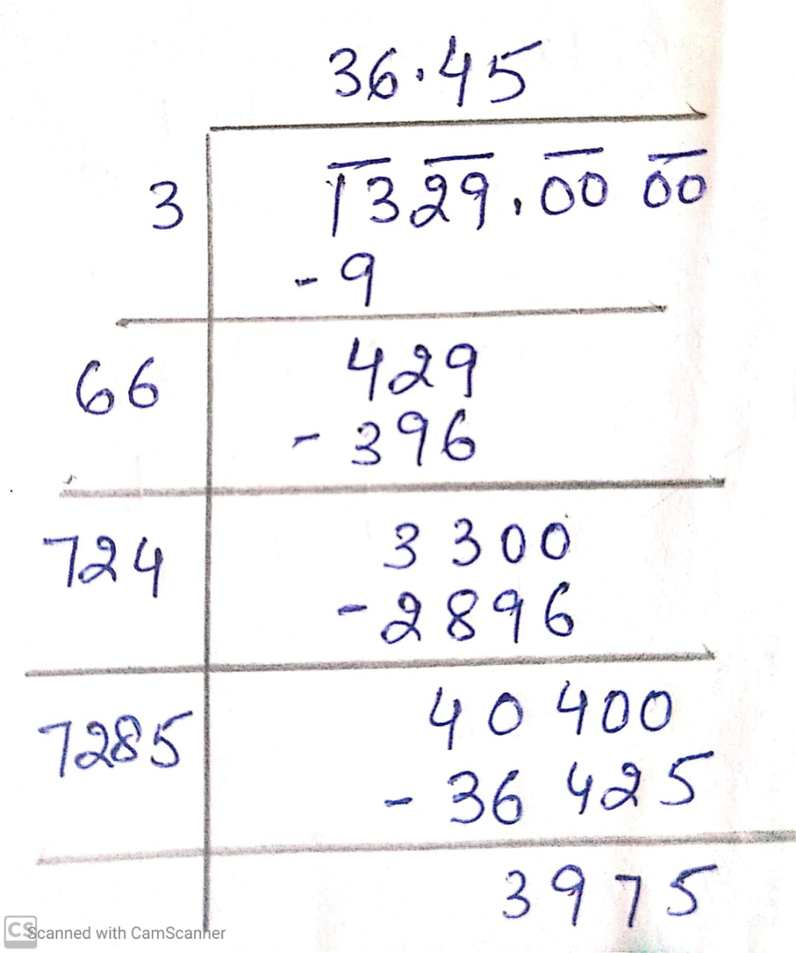
HOTS
Q1)
Cost of levelling square lawn at Rs. 15 per sq. meter = Rs. 19935
Area of square lawn = $\frac{19935}{15}$ = 1329 m²
Side of square lawn = √1329 = 36.45 m
Perimeter of square lawn = 4 x side
= 4 x 36.45
= 145.8 m
Total cost of fencing the square lawn at Rs. 22 per meter
= Rs. 22 x 145.8
= Rs. 3207.6

Slide 14
HOTS
Q2. √2 = 1.414 , √5 = 2.236 , √3 = 1.732
i) √72 + √48
= √(2 x 36) + √(3 x 16)
= 6√2 + 4√3
= (6 x 1.414) + (4 x 1.732)
= 8.484 + 6.928
= 15.412
ii) √$\frac{125}{64}$
= $\frac{\text{√}\text{125} }{\text{√}\text{64} }$
= $\frac{\text{√}\text{(}\text{5 }\text{x}\text{ 25)}}{\text{√}(8 x 8)}$
=$\frac{\text{5√5}}{8}$
=$\frac{\text{5 }\text{x}\text{ 2.236}}{8}$
= 1.3975

Slide 15
ENRICHMENT QUESTIONS
Q1. Let one number be a
The other number = 16a
According to question,
a x 16a = 1296
16 a² = 1296
a² = $\frac{1296}{16}$ = 81
a = √81 = 9
Ans: Hence, one number = 9 and the other number = 16 x 9 = 144
NOTE: Complete all the examples and solved questions given above in CW notebook.

Slide 16
HOMEWORK: (To be done in HW notebook)
Value based Q1 and Value based Q2
BT QUE 1(B) (a) – (e)
BT Q2, Q3, Q4, Q6, Q7
Enrichment Questions- Q2 and Q3
PRACTICE QUESTIONS: (To be done in HW notebook)
Find the value of:
a) $\frac{√80}{√405}$ b) $\frac{√1587}{√1728}$ c) √72 x √338 d) √45 x √20

