Slide 1

SUBJECT-MATHEMATICS
CLASS-IV
CHAPTER-VOLUME

Slide 2
CHAPTER TEXT BOOK LINK
CLASS-IV, CHAPTER- VOLUME, PRIMARY MATHEMATICS (DAV)
https://drive.google.com/file/d/1Qs2XM7HSMOnO-19KDbUutEmsuEfojD_h/view?ts=5eaf04c0

Slide 3
LEARNING OBJECTIVES
Understanding the concept of volume
Understanding the measurment of volume
Understanding the units of volume
Measuring the volume of a cuboid and a cube.
Finding the volume of a cube
Finding the volume of a cuboid
Solving word problems based on volume

Slide 4
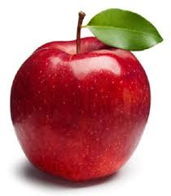

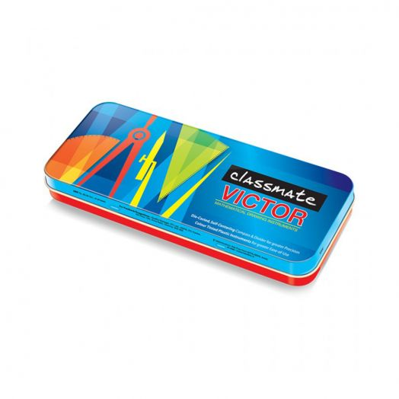
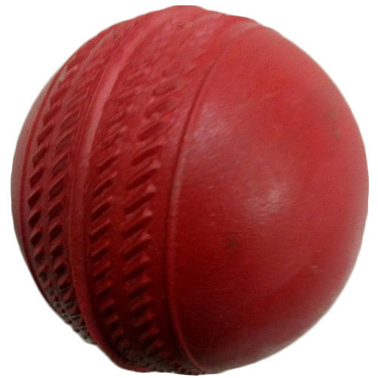
INTRODUCTION
Students, look at these objects.
All these solids occupy a certain amount of space.

Slide 5
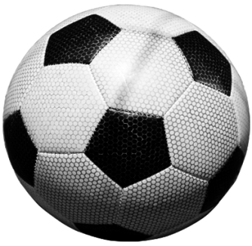

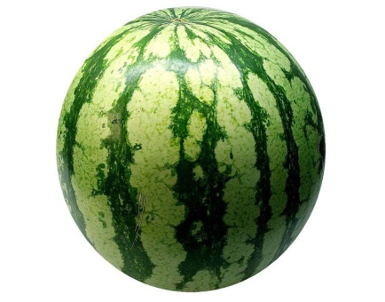
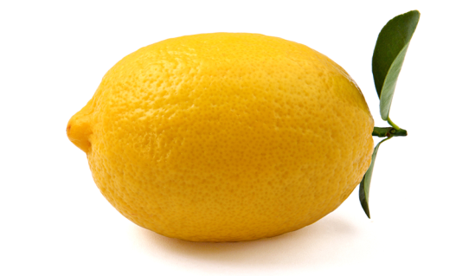
Now you can say-
1. Which of the following objects occupies more space ?
Football or cricket ball
2. Which of the following fruits occupies more space ?
Water melon or Lemmon

Slide 6

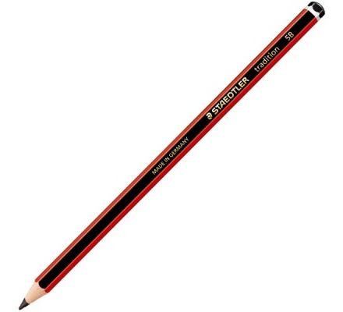
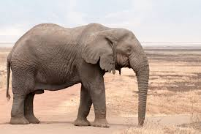
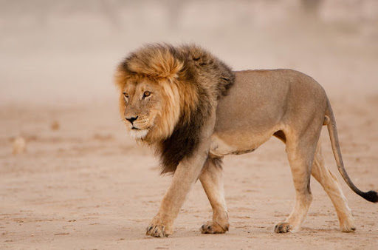
3. Which of the following objects occupies more space ?
Book or pencil
4. Which of the following animals occupies more space ?
Elephant or Lion

Slide 7
In No-1, the football occupies more space than the cricket ball.
So the football has more volume than the cricket ball.
In No-2, the water melon occupies more space than the lemon.
So the water melon has more volume than the lemon.
In No-3, The pencil occupies less space than the book.
So the pencil has less volume the book.
In No-4, the elephant occupies more space than the lion.
So the elephant has more volume than the lion.
Remember: Amount of space occupied an object is called its volume.

Slide 8
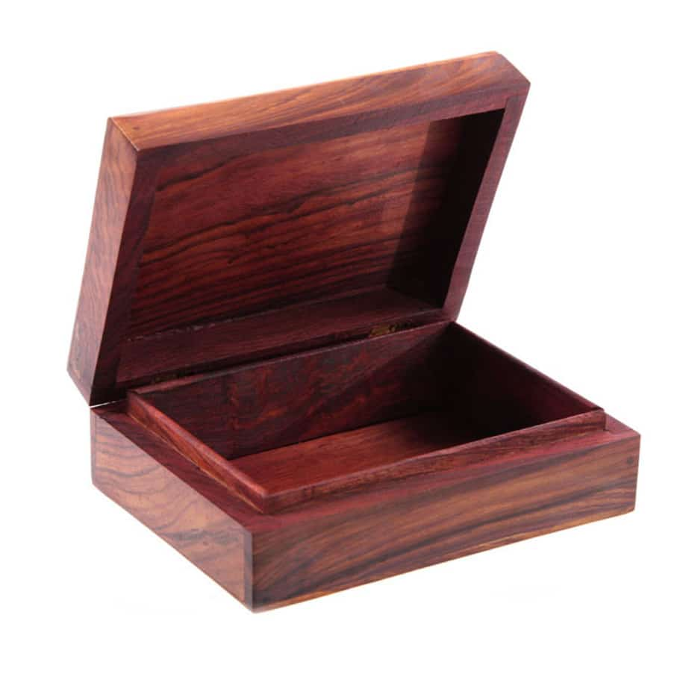
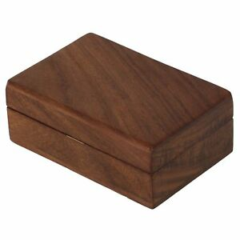
Take two boxes of same shape and same size. But one is empty and another is full of books. Which has more volume ?
Volume of an object depends on the outer physical size.
Empty or full objects of same size and shape have the same volume.

Slide 9

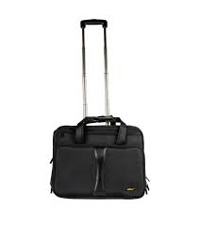
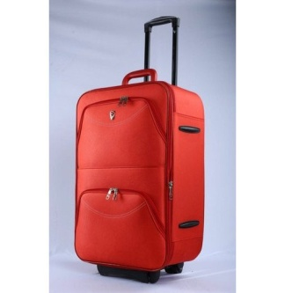
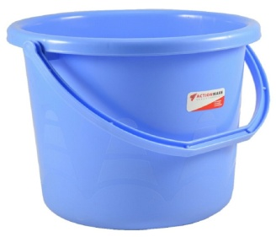
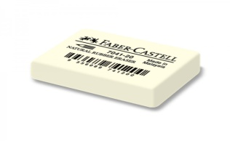
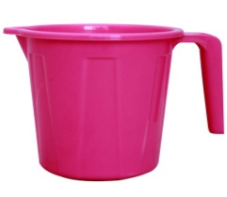
Worksheet-1
1. Which of the following has more volume ?
a. Cricket ball or table tennis ball
b. Dice or brick
c. Potato or pumpkin
d. Room and almirah
e. The earth or the moon
2. In each of the following pairs which objects has lesser volume ?
i
ii
i
ii
i
ii

Slide 10
Worksheet-1
3. Which of the following are true?
A cricket ball and a football have the same volume .
A empty chalk box has less volume than a chalk box of same shape and size and full of chalks.
(c ) Two oil cans of same size , one empty and one full of oil have the same volume.
(d) A half litre of polypack of milk and a one litre polypack of milk have the same volume.

Slide 11
MEASUREMENT OF VOLUME

Slide 12
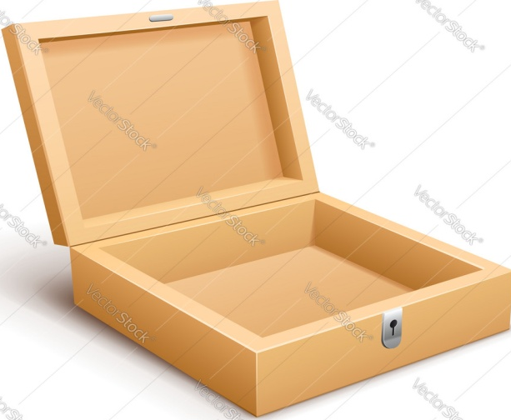
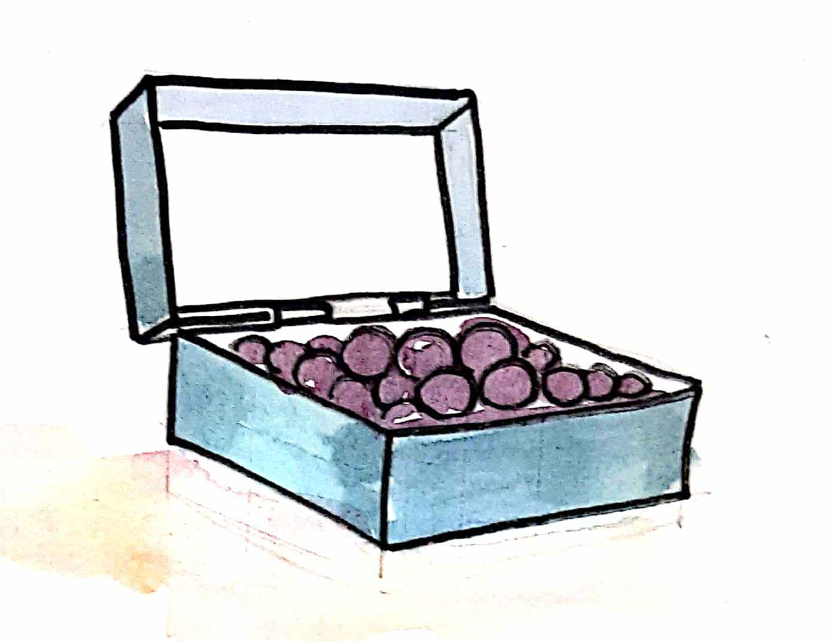
Let us measure the volume of this empty box.
Now fill this box with marbles to find its volume.
We have used 32 marbles to fill this box.
So volume of this box = 32 marbles.

Slide 13
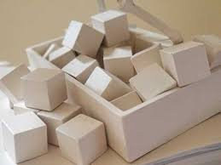
Here, some spaces is left between the marbles.
So volume of the box cannot be 40 marbles. We need an accurate unit for measuring the volume.
Let us fill the box with cubes to find its volume.

Slide 14
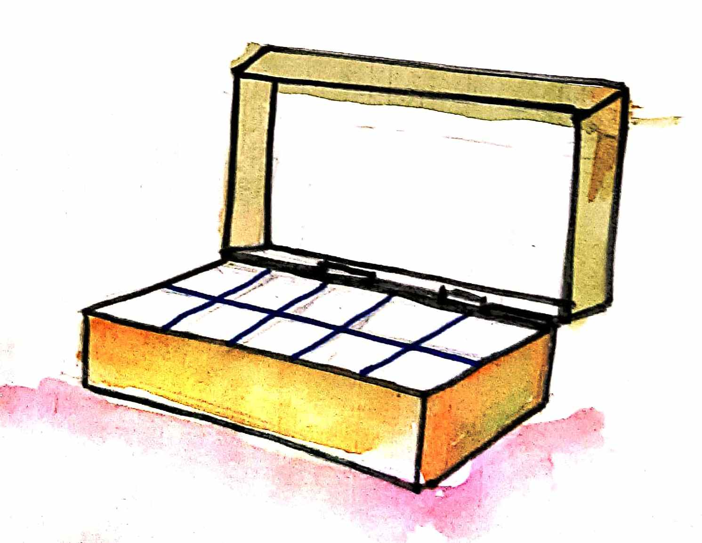
Here we have used 20 cubes to fill the box.
Here, no spaces is left between the cubes.
So volume of this box = 20 cubes.

Slide 15
If we use the cubes to fill the box, no place will be left between the cubes and inside the box. So we choose a cube as the best unit for measuring volume.
Why do we use cubes to measure the volume ?
A cube is the best unit to measure the volume.

Slide 16
The volume of a solid is measured by counting the number of unit cubes it contains.

Slide 17
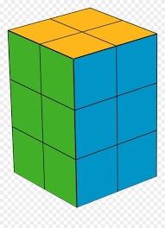
Let us measure the volume of the following solids in terms of the unit of volume (Cubes)
4 cubes
8 cubes
12 cubes
8 cubes

Slide 18
Let us measure the volume of the following structures in terms of the unit of volume (Cubes)
12 cubes
11 cubes
13 cubes

Slide 19
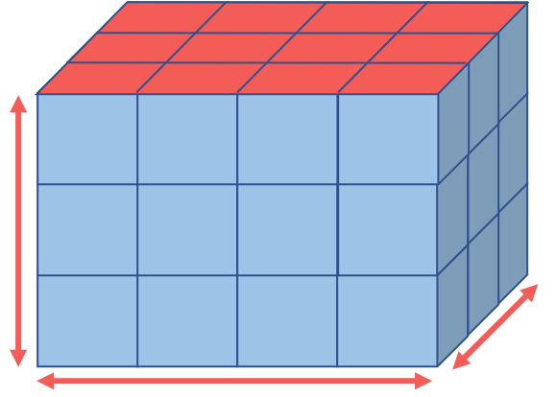
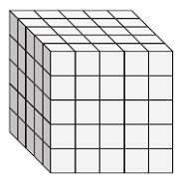
Worksheet-2
Find the volume of the following solids in terms of the unit of volume (cubes)
    (a) (b) (c) (d)
2. Which of the following is the unit to measure volume ?
(a) (b) (c)
1 cm
1 cm
1 cm
1 cm
1 cm
1 cm
1 cm

Slide 20
UNITS OF VOLUME

Slide 21
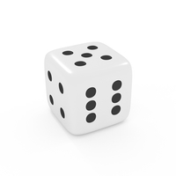
Similarly, to. find the volume of a solid we need to divide it into cubes
For finding the area we divide the region into squares.
1 cm
1 cm

Slide 22
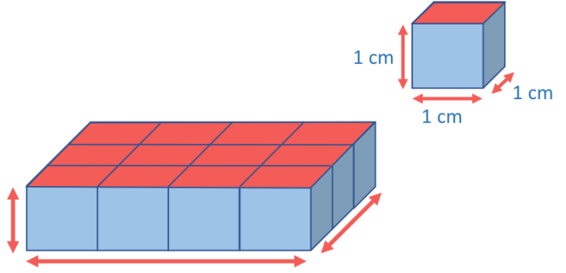
In order to find the volume of this solid let us use cubes with each edge equal to 1 cm.
Here, the solid contains twelve cubes. Each edge of the cube is 1 cm
So the volume of this solid is equals to 12 cubic centimetres or 12 cu.cm

Slide 23
The units used to measure volume are-
Cubic millimetre (cu.mm)
Cubic centimetre (cu.cm)
Cubic metre (cu.m)
Here : 1 cu. mm = 1 mm × 1 mm × 1 mm
1 cu. cm = 1 cm × 1 cm × 1 cm
1 cu. m = 1 m × 1 m × 1 m

Slide 24
The units of side and volume :
Units of side | Units of Volume
Millimetre (mm) | Cubic millimetre ( cu. mm)
Centimetre (cm) | Cubic millimetre ( cu. mm)
Metre (m) | Cubic metre ( cu. m)

Slide 25
VOLUME OF A CUBOID
AND A CUBE

Slide 26
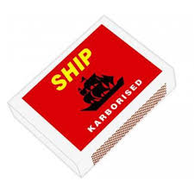
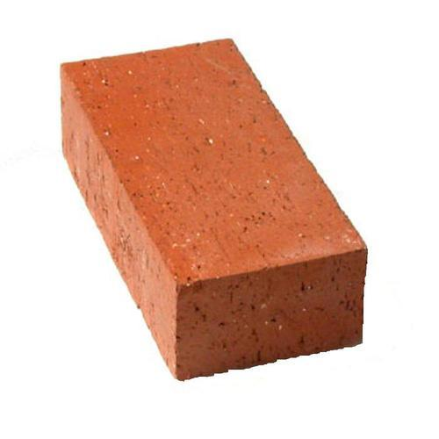
CUBOID
A Cuboid is a box-shaped solid object with a length, a breadth and a height.
Height
Breadth
Length
Examples of a cuboid
Match box
Book
Book
Brick

Slide 27
VOLUME OF A CUBOID
There are 16 cubes in this cuboid. So the volume of this cuboid is 16 cubic centimetres or 16 cu.cm.
The volume of this cuboid can be measured by counting the number of cubes of edge 1 cm.
We can also multiply 4 ×2 × 2 = 16 cubic centimetres or 16 cu.cm
1 cm
1 cm
1 cm

Slide 28
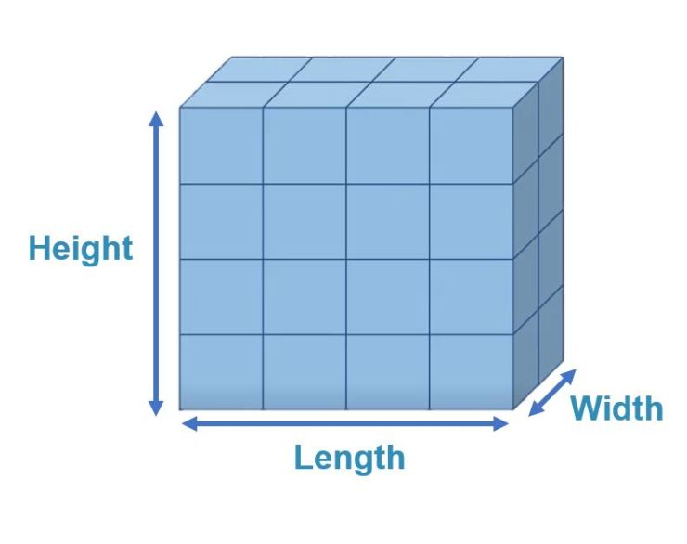
VOLUME OF A CUBOID
There are 32 cubes in this cuboid. So the volume of this cuboid is 32 cubic centimetres or 32 cu.cm.
The volume of this cuboid can be measured by counting the number of cubes of edge 1 cm.
We can also multiply 4 × 4 × 2 = 32 cubic centimetres or 32 cu.cm
We know that, This cuboid has-
Length = 4 cm, Breadth = 4 cm and Height = 2 cm
1 cm
1 cm
1 cm

Slide 29
VOLUME OF A CUBOID
We can find the volume of the cuboid by multiplying the Length x Breadth x Height.
Height
Breadth
Length
Volume of a cuboid = Length × Breadth × Height

Slide 30
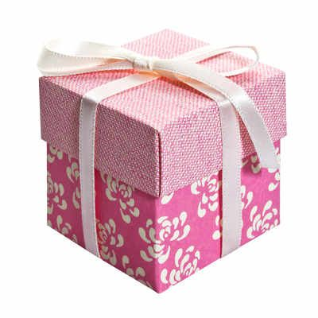
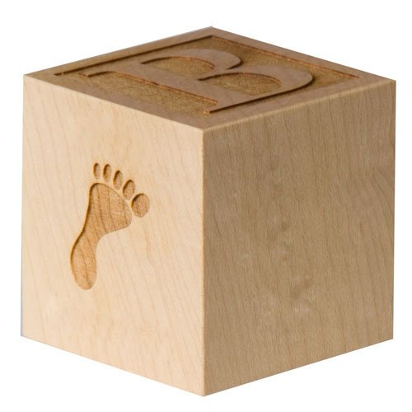
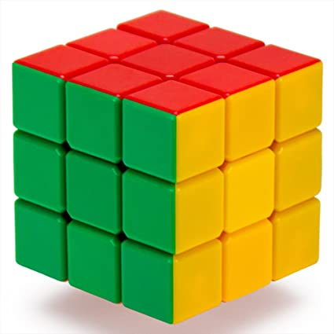
CUBE
A Cube is a box shaped solid object in which all the edges are equal.
Edge
Edge
Edge
Examples of a cube
Dice
Box
Gift box
Rubik’s Cube

Slide 31
VOLUME OF A CUBOID
There are 8 cubes in this cube. So the volume of this cube is 8 cubic centimetres or 8 cu.cm.
The volume of this cube can be measured by counting the number of cubes of edge 1 cm.
We can also multiply 2 ×2 × 2 = 8 cubic centimetres or 8 cu.cm
1 cm
1 cm
1 cm

Slide 32
VOLUME OF A CUBE
We can find the volume of a cube by multiplying the Edge x Edge x Edge.
Edge
Edge
Edge
Volume of a cube = Edge × Edge × Edge

Slide 33
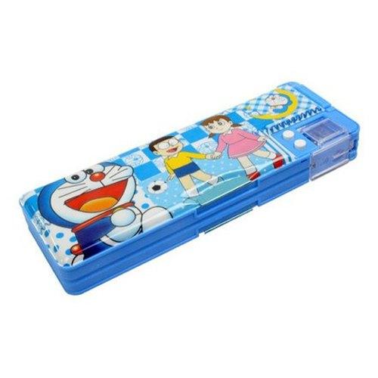
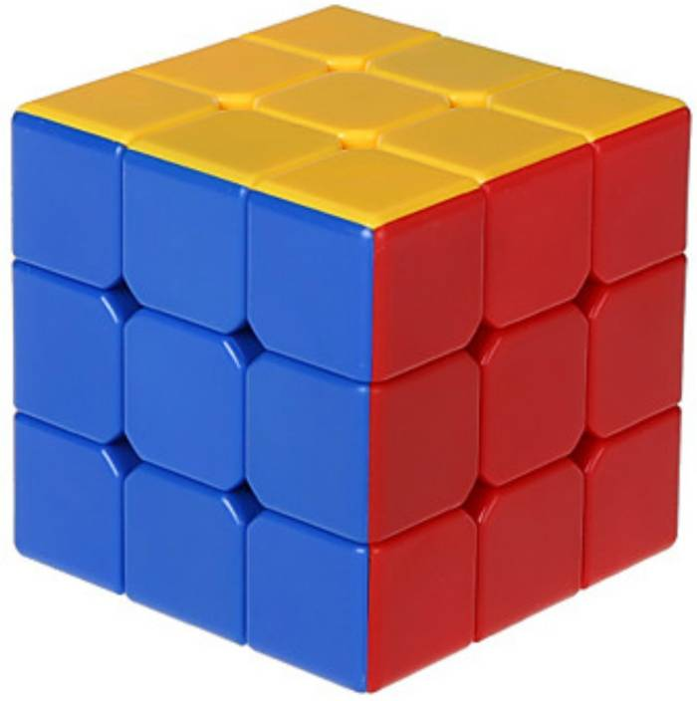
ACTIVITY
1. Measure the dimensions of a pencil box and find its volume.
Pencil Box
2 . Measure the dimensions of a Rubik’s cube and find its volume.
Rubik’s Cube

Slide 34
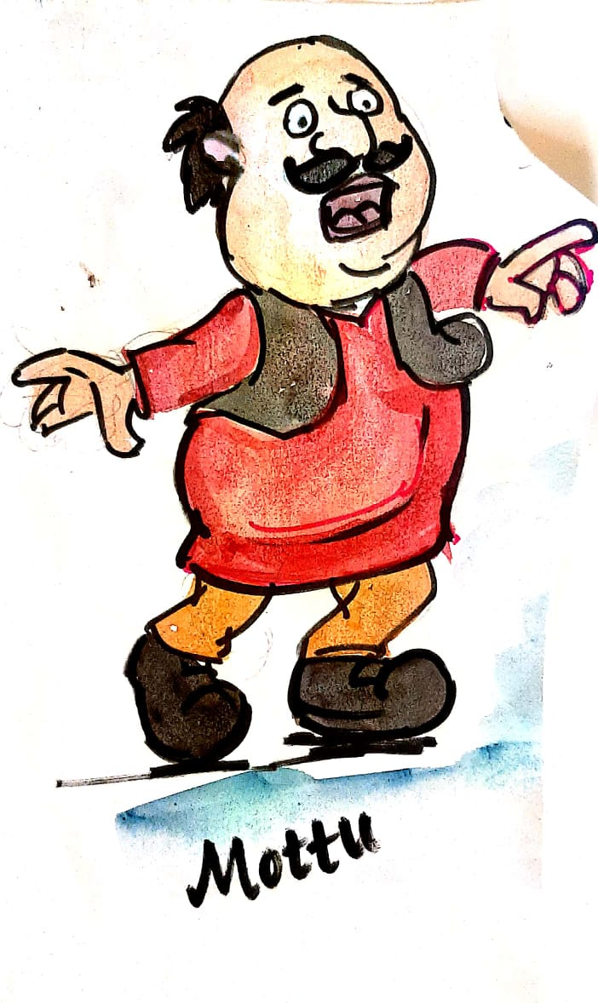
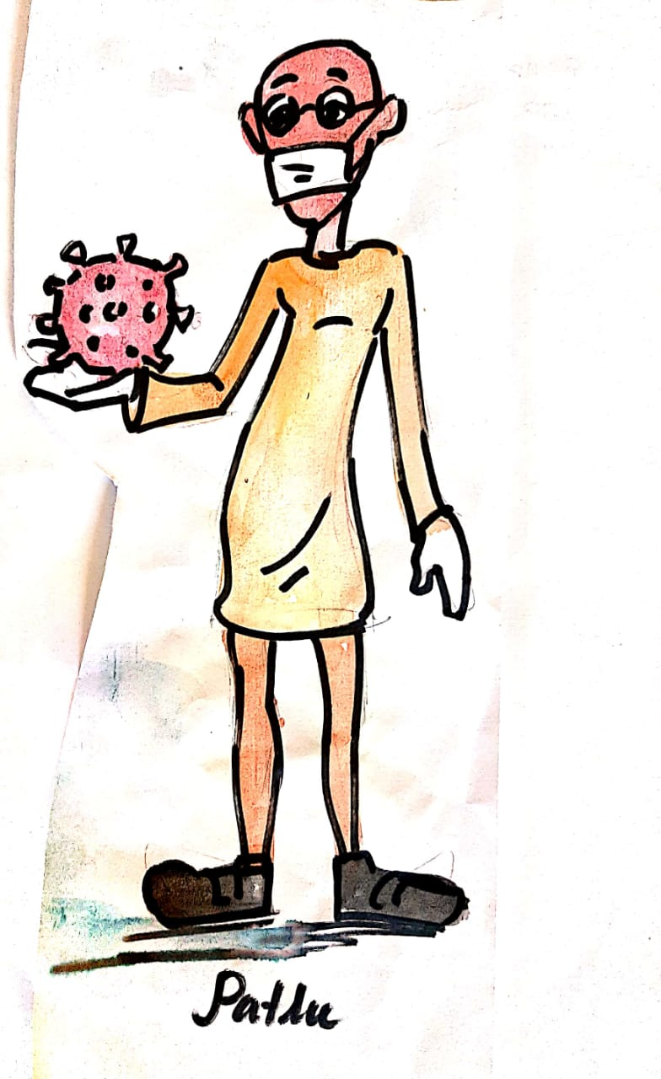
ART INTEGRATION
Mottu has more volume than Patlu.

Slide 35
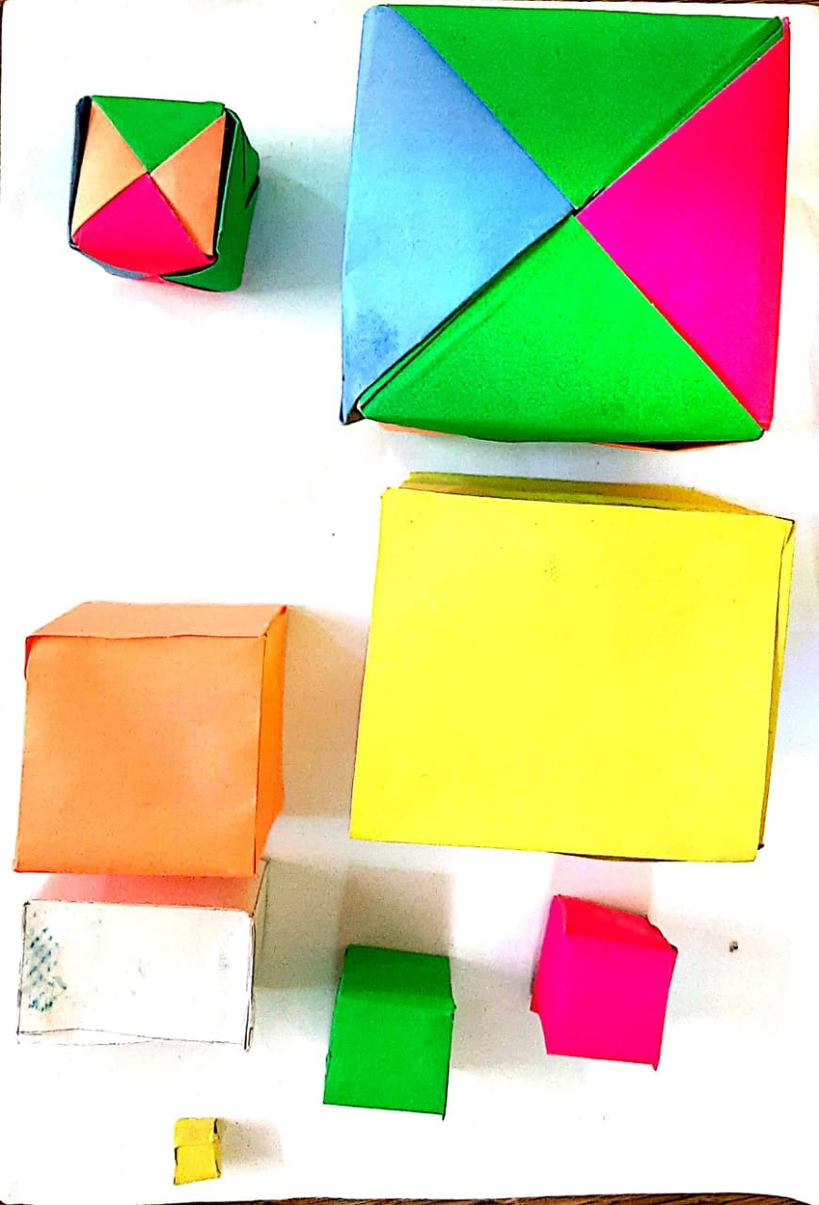
ART INTEGRATION
Making paper cubes
Teacher’s Video: https://youtu.be/qB44amj-zzU

Slide 36
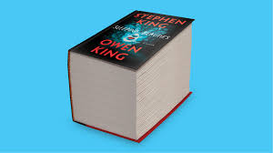
Word Problems
Example-1 :
The length, breadth and height of a book are 12 cm, 8 cm and 6cm respectively. What is the volume of the book.

Slide 37
Solution
Length of the book = 12 cm
Breadth of the book = 8 cm
Height of the book = 6 cm ( ½ )
Volume of the book = Length× Breadth × Height
= 12 cm × 8 cm × 6 cm
= 576 cu. cm (2 ½ )
The volume of the book is 576 cubic centimetre.

Slide 38
Word Problems
  Example- 2:
  A child playing with building blocks, which are of the shape of cubes, has build a structure as shown in the figure. If the edge of each cube is 3 cm, find the volume of the structure built by the child .
Figure

Slide 39
Solution
Edge of each cube = 3 cm
Volume of each cube : Edge × Edge × Edge (½ )
Volume of each cube = 3 cm × 3 cm × 3cm = 27 cubic cm = 27 cu.cm. (1½ )
Number of cubes in the structure- 15 (1)
Therefore volume of the structure= 15 × 27 cubic. cm = 405 cu.cm (1)

Slide 40
Word Problems
Example-13:
The length, breadth and height of a cuboidal water tank are 15 m, 12 m and 8 m respectively. If half of the tank is filled with water, find the volume of water in the tank.

Slide 41
Solution
Length of a cuboidal water tank = 15 m
Breadth of a cuboidal water tank =12 m
Height of a cuboidal water tank = 8 m ( ½ )
So volume of the brick is 15 m × 12 m × 8 m = 1440 cu. m ( 2 )
Volume of half of the water tank = 1440 cu.m/2 = 720 cu.m (1½ )
Therefore volume of water in the tank = 720 cu.m

Slide 42
Worksheet-3
Solve the following word problems.
1. Find the volume of the following cuboids whose dimensions given below.
(a) Length = 5 cm , breadth = 4 cm, height = 3 cm
(b) Length = 10 cm , breadth = 8 cm, height = 5 cm
(c) Length = 12 m , breadth = 10 m, height = 8 m
Find the volume of these cubes whose edges are given below.
(a) 5 cm (b) 8 cm (c) 11 m
3. Find the volume of a brick of length 20 cm, breadth 10 cm and height 7 cm.
A dice has edge of 3 cm. Find the volume of the dice.
A dictionary has a length 22 cm, breadth 14 cm and height 8 cm. Find the volume of the dictionary.
Find the volume of a sugar grain of edge 1 mm.

Slide 43
LEARING OUTCOMES
Students will able to-
Understand the concept of volume.
Understand the measurement of volume.
Understand the units of volume.
Students would be able to-
Develop the ability to measure the volume of a cuboid and a cube.
Find out the volume of a given cuboid and a cube.
Perform numerical skills of solving word problems based on volume and develop critical thinking and collaboration competencies in the process.

Slide 44
Concept Map
Units of Volume
Word problems
VOLUME
Measuring Volume
The units of volume are
Cubic millimetre (cu.mm)
Cubic centimetre (cu.cm)
Cubic metre (cu. m)
Volume of a cuboid and a cube
Volume of a cuboid = Length ×Breadth × Height
Volume of a cube = Edge × Edge × Edge

Slide 45
SUB-MATHEMATICS, CLASS-IV, CHAPTER-VOLUME,
WORKSHEET(BASIC)
Choose the correct answer.
1. Amount of space occupied by a solid is called its-
(i) side (ii) area (iii) perimeter (iv) volume
2. Which of the following has the greatest volume?
(i) football (ii) cricket ball (iii) table tennis ball (iv) golf ball
3. The units used to measure volume is-
(i) cu. mm. (ii) cu. cm. (iii) cu. m. (iv) all of these
4. The best unit to measure volume is –
(i) sphere (ii) cuboid (iii) cube (iv) square
5. Volume of a cube of edge 1 m is
(i) 1m (ii) 1 sq. m (iii) 1 cu.m (iv) 3 m

Slide 46
Fill in the blanks.
6. Cube is the best unit for measuring ______________.
7. Volume of a cube = Edge × ____________ × ______________
8. Volume of a cuboid = Length × ____________ × ____________
9. Volume of a cube of edge 1 cm is _____________.
10. If a box is filled with 8 cubes of edge 1 cm each, its volume is _________.
Answer the following questions.
11. Find the volume of a cuboid whose dimensions are given as-
Length = 5 cm, breadth = 3 cm and height = 2cm
12. Find the volume of a cube of edge 4 cm.
13. Find the volume of a cuboid whose dimensions are given as
Length = 10 cm , breadth = 5 cm and height = 3cm
14. Find the volume of a cube of edge 6 cm.
15. Find the volume of a cuboid whose dimensions are given as
Length = 15 cm , breadth = 8 cm and height = 5 cm
16. Find the volume of a cube of edge 10 cm.
17. Find the volume of a cuboid whose dimensions are given as
Length = 17 cm , breadth = 14 cm and height = 12cm

Slide 47
18. Find the volume of a cuboid whose dimensions are given as
Length = 30 cm , breadth = 25 cm and height =18cm
19. Find the volume of a cube of edge 13 cm.
20. Find the volume of a cubical box of edge 15 cm.
21. Find the volume of a box of length 9 cm, breadth 5 cm and height 3 cm.
22. A dice has an edge of 4 cm. Find the volume of the dice.
23. An encyclopedia has a length 30 cm, breadth 20 cm and height 8 cm. Find the volume of the encyclopedia.
24. Find the volume of a cubical box of edge is 8 cm.
25. Find the volume of a brick of length of 18 cm, breadth 9 cm and height 6 cm.
26. Each side of a cubical gift box is 11 cm. Find its volume.
27. The length, breadth and height of a cuboidal room is 12 m, 8 m and 4 m respectively. Find the volume of the room ?
28. The length, breadth and height of cubical vessel are 10 m, 8 m and 5 m respectively . Find the volume of the liquid that the vessel can hold.
29. Which has more volume? A cuboid of length 7cm, breadth 5 cm and height 4 cm or a cube of edge 6cm.
30. Which has more volume and by how much? A cuboidal box of length 8cm, breadth 7 cm and height 5 cm or a cubical box of edge 5 cm.

Slide 48
SUB-MATHEMATICS, CLASS-IV, CHAPTER-VOLUME,
WORKSHEET( STANDARD)
Choose the correct answer.
1. The measure of space a solid occupies is called its-
(i) volume (ii) area (iii) perimeter (iv) none of these
2. Which of the following has the least volume?
(i) football (ii) cricket ball (iii) table tennis ball (iv) golf ball
3. Which of the following units is not used to measure volume?
(i) cu. mm. (ii) cu. cm. (iii) cu. m. (iv) sq. m.
4. Cube is the best unit for measuring-
Area (ii) volume (iii) perimeter (iv) length
5. volume of a cube of edge 1 mm is-
(i) 1mm (ii) 1 sq.mm (iii) 1 cu.mm (iv) 3 mm
Fill in the blanks.
6. ____________ of a solid depends on the outer physical size.
7. Volume of a cube = __________ × ____________ × Edge .

Slide 49
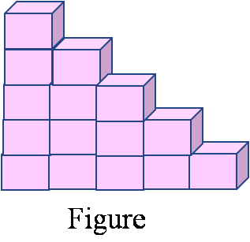
  8. Volume of a cuboid = __________ × ____________ × Height
  9. Volume of a cube of edge 1 cm is_____________.
  10. If a box is filled with 18 cubes of edge 1 cm each, its volume is ____________.
Answer the following questions.
  11. Find the volume of a cuboid whose dimensions are given below.
Length = 30 cm , breadth = 24 cm and height = 15 cm
  12. Find the volume of a cube of edge 17 cm.
  13. Find the volume of a brick of length 24 cm, breadth 12 cm and height 8 cm.
  14. A cuboidal water tank is 6 metre long, 5 metre wide and 4 metre deep. Find the volume of the tank.
  15. Two cubes each with side 8 cm joined to form a cuboid . What is the volume of the cuboid so formed?
  16. An aquarium is the form of a cuboid whose length is 80 cm, breadth is 30 cm and height is 40 cm. Find the volume of the aquarium?
  17. A cubidal wooden box is 95 cm long, 72 cm wide and 64 cm high . Find the volume of the box.
  18. A godown is in the form of a cuboid of length 60 m, breadth 40 m and height 30 m . Find the volume of the grains that can be stored in the godown.
  Which has more volume? A cuboidal vessel of length 17cm, breadth 15 cm
  and height 12 cm or a cubical vessel of edge 14 cm.
  20. A child playing with building blocks, which are of the shape of cubes, has
  build a structure as shown in the figure. If the edge of each cube is 3 cm, find
  the volume of the structure built by the child .

Slide 50
SUB-MATHEMATICS, CLASS-IV, CHAPTER-VOLUME,
WORKSHEET( ADVANCED)
1. The length of a cuboid is 15 cm, breadth is 10 cm and height is 2cm less than breadth. Find the volume of the cuboid.
2. A cubical box of edge 12 cm is one-fourth filled with salt. Find the volume of salt in the box.
3. The edge of a cubical box is 6 cm. Half of the box is filled with sand. Find the volume of the sand.
4. A cube has an edge of 8 cm. If each edge of the cube is doubled find the volume of the new cube.
5. A cuboidal box of dimensions 60 cm × 50 cm × 30 cm. How many small cubes with side 1 cm can be placed in the box ?
6. A match box has a length of 4 cm, breadth 3 cm and height 2 cm. What will be the volume of a packet containing 12 such match boxes ?
7. Two cubes each with side 14 cm joined to form a cuboid . What is the volume of the cuboid ?
8. A solid cube of an edge 12 cm is cut in to 8 cubes of equal volume. What will be the volume of each cube?
9. A godown is in the form of a cuboid of volume 72,000 cu.m . If the length and breadth of the floor of the godown is 60 m and 40 m respectively, find its height.
10. The length, breadth and height of a cuboidal water tank are 15 m, 12 m and 8 m respectively. If half of the tank is filled with water, find the volume of water in the tank.

Slide 51


