Slide 1
MATHEMATICS
CLASS: IV
TIME AND CALENDAR

Slide 2
PDF CHAPTER LINK
https://drive.google.com/file/d/1K3YRANdCEMQPTlhWkAwgkgK86uXjiPjn/view?usp=sharing

Slide 3
TOPICS TO BE COVERED
1. Leap year
2. Time in minutes and seconds
3. Addition of time in hours and
minutes.
4. Subtraction of time in hours
and minutes.
5. Application of the concept in
daily life.
( word problems)

Slide 4
LEARNING OBJECTIVES
Students will be able to :
Learn how to tell time and date.
understand the concept of leap year.
identify the difference between leap year and non leap year.
find the relation between different units (day, hour, minute, second)
perform addition and subtraction of time in hours and minutes.
Solve problems involving elapsed time and future time
apply the knowledge of time in real life situations.

Slide 5
STRATEGIES USED
Interactive method
Self made videos
PPT
Self planned activities
Online quiz test
Worksheets ( 3 levels)

Slide 6
MINIMUM LEVEL OF LEARNING
Clocks are used to measure time.
A clocks has numbers from 1 to 12 written on it.
short hand of the clock tells us the hours and known as hour hand.
Long hand of the clock is known as minute hand as it tells us the minutes.

Slide 7
MINIMUM LEVEL OF LEARNING
1 day = 24 hours
1 hour = 60 minutes
1 week = 7 days
1year = 12 months
Time from 12 midnight to 12 noon is written as a.m. and 12 noon to 12 midnight is written as p.m.
We say 12 noon or 12 midnight. We don’t use a.m or p.m with 12.

Slide 8
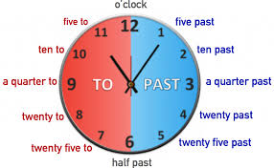
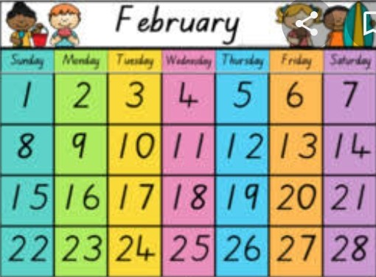
LET’S DO AN ACTIVITY
https://drive.google.com/file/d/1k43nE9SzT4tLRym9kpEeAWVSEkrlgpeN/view?usp=drivesdk

Slide 9
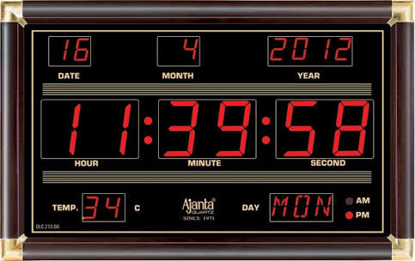

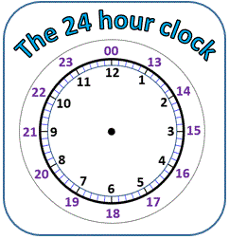
READING DIFFERENT
TYPES OF
CLOCK
DIGITAL CLOCK
ANALOG CLOCK
24 HOUR CLOCK

Slide 10

LEAP YEAR

Slide 11

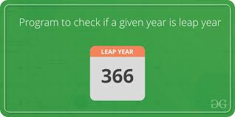
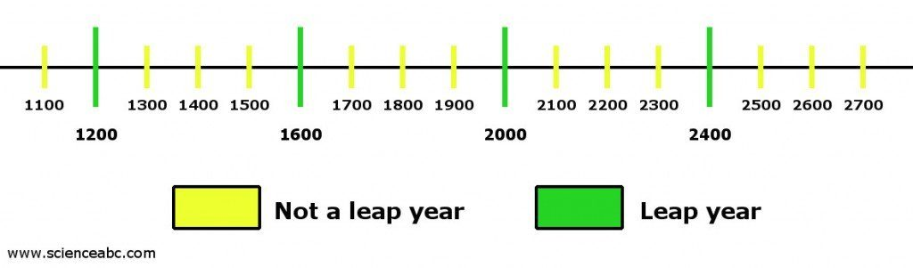
Q: How many days are there in the month of
February in leap year?
Q: How many days are there in Leap year?
There is one day extra day in leap year i.e in the month of February.

Slide 12
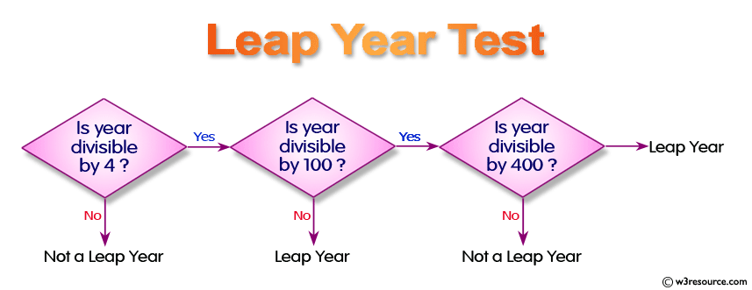
Is it a Leap year?

Slide 13
IS IT A LEAP YEAR??
Example : 1456 ÷ 4
3 6 4
4 1456
-12
25
-24 So, It is a Leap Year.
16
-16
0

Slide 14
For centurial years
For centurial years it should be divisible by 400 not by 4.
Ex:1200÷400 = 3
So, it is a leap year
1500 is not divisible 400
So, it is not a leap year.

Slide 15
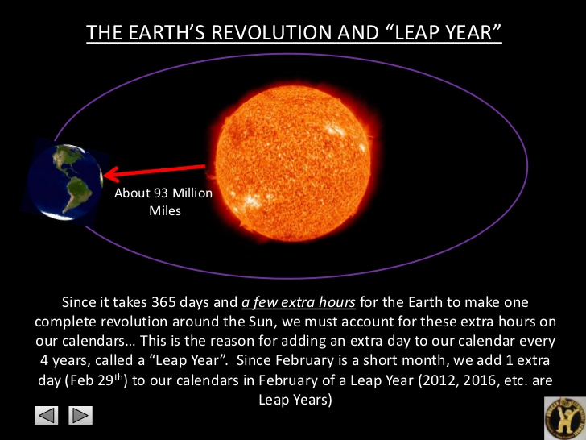
Do You Know?

Slide 16
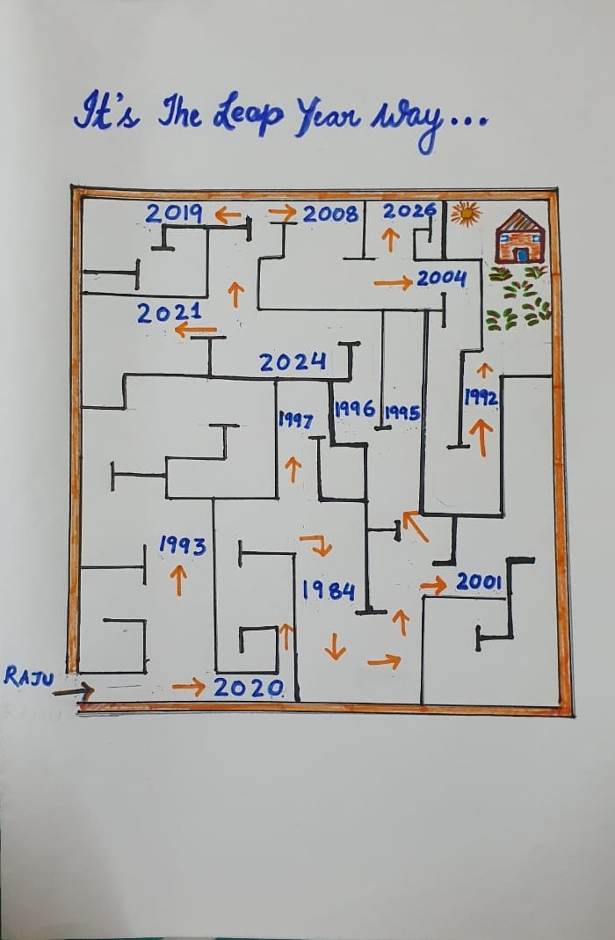
ACTIVITY ON LEAP YEAR
Teacher’s Explanation:
https://www.youtube.com/watch?v=0bX5AmKfyA0&feature=youtu.be
(Video Link)

Slide 17

Time in Minutes and Seconds
The second hand of the clock is the fastest moving hand.
Second is the smallest unit of time.
1 minute = 60 seconds
Observe the relations
365 days = 1 year Leap year = 366 days
52 weeks = 1 year 10 years = 1 decade
100 years = 1 century

Slide 18
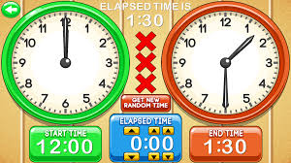
Addition of Time

Slide 19

Time (after the given time)
TO FIND THE FUTURE TIME
Example: What will be time 3 hours ahead of 5:40 am?
+1 hr
+1 hr
+1 hr
5:40 AM
6:40 AM
7:40 AM
8:40 AM

Slide 20
Addition with regrouping
Step1 : Arrange hrs under hrs and mins under mins
Step 2 : Add hrs to hrs and mins to mins
Step 3: (If min>or = 60) convert it into hr add 1
under hrs column
For example: 3hrs 45mins and 2hrs 55mins
hrs mins
3 45
+2 55
5 100
+1 -60 ( 1 hour = 60 mins)
6 40
So, Sum = 6 hrs 40 mins
OH!!!!
IT’S MORE THAN 60 !!!!!

Slide 21
EXAMPLE WITH MARKING SCHEME
Example: What time will be 2 hours 25 minutes after 6:35 a.m.?
Solution:
(2 marks)
HOUR | MINUTES
6 | 35
2 | 25
8 | 60
1
9
A R R A N G E M E N T
(½)
(½)
(½)
Time will be 9 a.m ( ½)

Slide 22
Subtraction in hours and minutes
( without regrouping)
Find the difference between-
4 hrs 50 min and 2 hrs 30 min
Step 1:
Arrange the numbers in hrs min
hours and minutes column 4 50
Step 2: -2 30
subtract hours and minutes 2 20
separately. (Ans: 2 hrs 20 min)

Slide 23
Subtraction in hours and minutes
( with regrouping)
Eg. Find the difference between :
3 hrs 50 min and 5 hrs 15 min
Step 1:
Arrange the numbers in hours hrs min
and minutes column. 5 15
- 3 50
Think : 50 >15 , hence cannot be subtracted

Slide 24

Step 2:
Borrow I hour (60 min) from 5 hours:
hrs min
4 75 (60 + 15)
Step 3: 5 15
- 3 50
Now subtract 1 25
Ans: 1 hour 25 minutes

Slide 25
EXAMPLE WITH MARKING SCHEME
Example: Mr. Sharma starts his morning exercises daily at 5:40 am. He completes it at 7:25 am. How many minutes does he spend in the morning daily?
Solution: Starting time of morning exercise = 5:40 am
Exercise completes at = 7:25 am
Time spend for exercise = 7:25 am – 5:40 am
= 1 hr 45 mins
(3 marks)
(1)
HOUR | MINUTES
6 | 85(60+25)
7 | 25
-5 | 40
1 | 45
(½)
(A R R A N G E M E N T)
(½)
(A R R A N G E M E N T)
1
45
(1)

Slide 26

Time ( before the given time)
Elapsed time
In this case also we subtract
2 hrs before 5:50 p.m.
go back
3:50 p.m. 4: 50 p.m. 5: 50 p.m.
so, 2 hrs before 5: 50 pm is 3 : 50 pm
-1 hr
-1 hr

Slide 27
Application of time in daily life
Example: 1 Rohan’s school starts at 7:15 am and closes at 12: 30 pm. For how many hours does the school work?
Solution: Starting time of the school = 7 : 15 am
Closing time of the school = 12:30 pm
Time duration = hrs min
12 30
- 7 15
05 15
The school works for 5 hours 15 minutes.

Slide 28

Example 2 :
Mohit travels for 4 hrs 15 min by train and 2 hrs 10 min by bus to reach his town. How much time does he take to reach his town ?
Solution :
Time taken to travel by train = 4 hrs 15 min
Time taken to travel by bus = 2 hrs 10 min
Total time taken = 4 hrs 15 min + 2 hrs 10 min

Slide 29
Total time taken = hrs min
4 15
+ 2 10
6 25
Mohit takes 6 hrs 25 min to reach his town

Slide 30
Example 3 :
Rahul watched a movie with his friends for 2 hrs 35 mins. If the movie ended at 9 : 45 p.m. , at what time did it start?
Solution:
Ending time of the movie = 9: 45 p.m.
Duration of the movie = 2 hrs 35 min
Starting time of the movie=
9 hrs 45 min- 2 hrs 35 min

Slide 31
Starting time = hrs min
8 95 (60 + 35)
9 35
- 2 45
6 50
The movie started at 6 : 50 pm

Slide 32
ONLINE QUIZ TIME
https://drive.google.com/open?id=1QaayLwb2NGzbpOE5j9uRrcSEb12px-mTJmpbbaQY6Is

Slide 33


Art Integration
( Project)
Let’s Do

Slide 34

Preparation of Puzzle
Teacher’s Explanation
https://www.youtube.com/watch?v=fiPzzN1vTdU&feature=youtu.be
(Video Link)

Slide 35
CHAPTER-8 (TIME AND CALENDAR)
WORSHEET(BASIC)
Fill in the blanks
Minute hand takes ________ minutes move from 12 to 5.
Quarter to 12 at night is written as _________ (am/pm)
No. of days in the month when we can celebrate children’s day _______
In a year, _______ months have 31 days.
Reema has breakfast at 9.10 _________(am/pm)
8 days = ___________hours
12 hours= _______________ minutes
7:00 pm= ____________________ ( 24 hour clock time)
1500 hours = ___________ ( 12-hour clock time)
3 centuries= ____________ years

Slide 36
11) 4 years = _____________ months
2 hours after 6:05 am= ______________
I get up from bed at 5.00____________( a.m/ p.m)
1:05 after mid night is _______ (a.m / p.m)
Quarter to 7 = _____________ minutes past _________
ANSWER THE FOLLOWING QUESTION
Q16. Which of the following are leap years?
a) 1994 b)2004 c) 1900 d)2000
Q17. How many days are there from 19th June to 19th July ?
Q18. Name the months having 30 days.
Q19. Convert 4 hours 35 minutes into minutes
Q20. What time is it 2 hours before 1:20 pm?

Slide 37
Q21. What is the time 3 hours after 10 am?
Q22. Convert 7 minutes 5 seconds into seconds
Q23. Convert 12 minutes 40 seconds into seconds
Q24. If January 26,2013 is Saturday then January 26, 2014 will falls on ?
Q25. Sameer joined a 3-week computer course that got over on 4th August. When did it begin?
Q26. Find the total number of days in the months of July and August ?
Q27. What is the time interval in between 7:15pm and 10:10 pm?
Q28. How many seconds are there in one hour?
Q29. How many hours are there in 7 days and 7 hours?
Q30. How many minutes are there in 8 hours 50 minutes.
**********************

Slide 38
CHAPTER-8 (TIME AND CALENDAR)
WORSHEET(STANDARD)
Q1. Arrange in column and add
  8 hours 45 minutes and 6 hours 35 minutes.
  5 hours 25 minutes and 5 hours 55 minutes.
  9 hours 25 minutes 10 secs; 8 hours 16 mins 20 secs; and 2 hours 20 mins 35 secs.
  5 hours 40 mins, 7 hours 22 minutes; and 8 hours 45 minutes
  9 hours 25 minutes 10 seconds; 8 hours 16 minutes 20 seconds; 2 hours 20 minutes 35 seconds

Slide 39
Q2. Arrange in column and subtract
i. 8 hours 10 minutes from 10 hours
ii. 12 hours 56 minutes from 15 hours 40 minutes
iii. 7 hours 12 minutes 20 seconds from 10 hours 25 minutes 40 seconds
16 hours 25 minutes from 19 hours 35 minutes
12 hours 25 minutes 40 seconds from 20 hours.
Q3. WHAT TIME WILL IT BE,
4 hours 20 minutes after 2:25 am?
2 hours 10 minutes after 3:50 pm?
3 hours before 7:10 am?
2 hours before 6:20 pm?
5 hours before 9:35 pm?

Slide 40
Q4. FIND THE TIME DURATION BETWEEN
12 noon and 9:38 pm
5:16 am and 10:48 am
3:40 am and 6:20 pm
10:30 am and 2:30 pm
11:10 am and 6:10 pm
**************

Slide 41
CHAPTER-8 (TIME AND CALENDAR)
WORSHEET(ADVANCED)
ANSWER THE FOLLOWING QUESTIONS
Q1. Madhu goes to school at 8:20 am and returns at 3:30 pm. How long is she away from home?
Q2. Gurmeet jogs for 40 minutes everyday. If he leaves at 6:40 am when will he return?
Q3. Mrs Singh left home at 10:45 am and returned after 1 hour and 20 minutes. At what time did she return?
Q4. Rita went swimming at 4:10 pm and returned at 6:05 pm. How long was she away?
Q5. A vendor starts his rounds at 10:20 am and returns at 2:40pm. How long is he away on round?

Slide 42
Q6. A film show has to last for 3 hours 10 minutes. If the show had started at 3:10 pm, when will it get over?
Q7. Pritam joined a factory on 10th January 2011. He worked for 35 days. On what date did he leave the factory?
Q8. Nisha’s school was closed for summer vacation from May6,2012 onwards for 64 days. On what date the school reopen?
Q9. Kamla’s father left for Kolkota on January 7,2011 and returned home on March 8 2011. For how many days did he remain out of the home?
Q10. Maninder’s 21 days camp finished on 30 May. On what date did it begin?

Slide 43
LEARNING OUTCOMES:
Students will be able to:
1. understand the concept of leap year.
2. identify the difference between leap year and non leap year.
3. find the relation between different units (day, hour, minute, second)
4. perform addition and subtraction of time in hours and minutes.
5. tell the time before and after.
6. apply the knowledge of time in real life situation.

Slide 44
CONCEPT MAP
CALENDER
WRITING TIME
SECONDS
MINUTES
HOURS
READING TIME
DAYS
WEEK
MONTH
YEAR
TIME
ELAPSED TIME (SUBTRACTING TIME)
DECADES
CENTURIES
FUTURE TIME (ADDING TIME)

Slide 45
THANK
YOU

