Slide 1
SUBJECT – MATHEMATICS CLASS – V TOPIC - AVERAGE
Work is Worship

Slide 2
CLICK OR SCAN TO GET THE BOOK
PRIMARY MATHEMATICS
STD-5
Work is Worship

Slide 3
LEARNING OBJECTIVES
Students will able to
Define the meaning of Average.
Find average of different numbers.
Identify average related problems in their daily life.
Solve problems related to average.
Work is Worship

Slide 4
Real life examples
The term average is used frequently in everyday life to express an amount that is typical for a group of people or things. For example, you may read in a newspaper that on average people watch 3 hours of television per day. We understand from the use of the term average that not everybody watches 3 hours of television each day, but that some watch more and some less.
Work is Worship

Slide 5
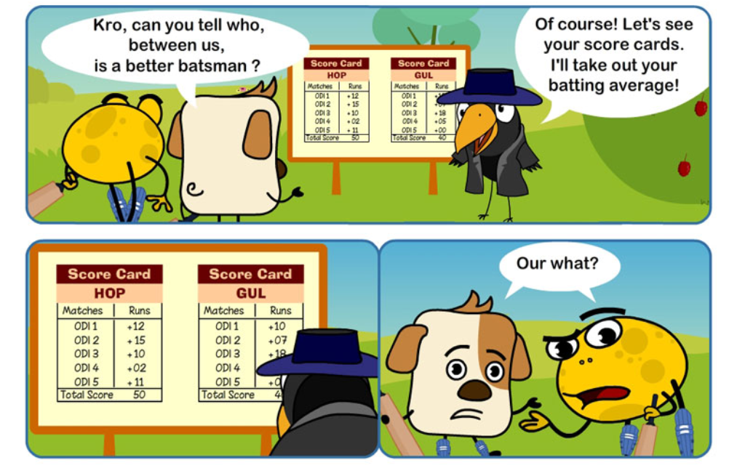
INTRODUCTION
Work is Worship

Slide 6
Defination of Average
Average of numbers is the sum of all numbers divided by the number of addends.
Work is Worship

Slide 7
VIDEO
A VIDEO IS HYPERLINKED
FOLLOW THE FOLLOWING STEPS TO WATCH THE VIDEO
RIGHT CLICK ON THE TITLE VIDEO
CLICK ON THE OPTION OPEN HYPERLINK
YOU WILL BE ABLE TO SEE THE VIDEO
ENJOY AND LEARN
(NOTE: IT REQUIRES CELLULAR DATA TO WATCH THE VIDEO)

Slide 8
FORMULA OF AVERAGE
https://youtu.be/fh-9AARg9Mk
Work is Worship

Slide 9
EXAMPLES
Work is Worship

Slide 10
Properties of Average
Average of the given data is less than the greatest numbers and greater than the smallest numbers of the given data
For example: Find the average of 4, 8, 10, 14
Average = 4+8+ 10+14 / 4 =9
If all the numbers of the given data are equal, then the average will also be the same as the numbers.
For example: Find the average of 2, 2, 2, 2, 2
Average = 2+2+2+2 / 4 =8/4 = 2
If zero is one of the numbers of the given set of data, then that zero should also be included while calculating the average.
For example: Find the average of 2, 7, 0
Average = 2+7+0/3 = 9 / 3 =3
Work is Worship

Slide 11
MORE PROPERTIES
If a number is added to all the numbers given in the data, then the average is increased by that particular number.
Ex – 8,5,6,9
Average = 8+5+6+9 / 4 = 28 / 4 = 7
Let add 5 to each number
Then new data – 13,10,11,14
Average = 13+10+11+14 /4 = 48 / 4 = 12 ( 7 + 5 )
The average is increased by 5.
Work is Worship

Slide 12
If a number is subtracted from all the numbers given in the data, then the average is decreased by that number.
Ex – 10,12,45,13
Average = 10 + 12 + 45 + 13/4 = 80/4 = 20
Subtract 5 from each number, then the new data – 5,7,40,8
Average = 5+7+40+8 / 4 = 60 /4 = 15 (20-5)
Average decreased by 5 .
Work is Worship

Slide 13
If a number is multiplied with all the numbers in the given data, then the Average is multiplied by that number of times.
Ex – 5,7,8,12
Average = 5+7+8+12/4 = 32/4 =8
multiply 3 to each number ,then the new data= 15,21,24,36
Average = 15+21+24+36/4=96/4 =24(8x3 )
Work is Worship

Slide 14
If a each number of a given data divided by the same number ,then the average will be reduced.
Ex- 20,24,28,32
Average = 20+24+28+32 /4 = 104/4=26
Divide 4 by each number,
New data = 5,6,7,8
Averages = 5+6+7+8/4 = 26/4 = 6.5,which is 26/4 = 6.5
Work is Worship

Slide 15
What’d be the average
A - If the numbers are counting numbers from 1
Ex- 1,2,3,4,5,6,7,8,9
Avearage = (1+2+3+4+5+6+7+8+9)/9 = 45/9 = 5
OR
Average = (9+1)/2 = 10 /2 =5
So we can write Average = (Last number +1)/2
*If the number starts from 1
Work is Worship

Slide 16
B – If the numbers are even numbers which starts from 2
Ex – 2,4,6,8,10,12
Average = (2+4+6+8+10+12)/6
= 42/6
= 7
OR
So it can be written as,
Average = 6+1 = 7
= Number of addends + 1
* If even nummbers start from 2
Work is Worship

Slide 17
C – If the numbers are odd which starts from 1
Ex -1:– 1,3,5,7,9,11,13
Average = (1+3+5+7+9+11+13)/7
= 49/7 = 7
Here observe the number of addends is 7.
Ex -2 : 1,3,5,7,9,11,13,15,17,19,21,23 (Number of addends is 12)
Average =(1+3+5+7+9+11+13+15+17+19+21+23)/12
= 144 /12 = 12
So the average of odd numbers which starts with one is the number of addends
Work is Worship

Slide 18
D – If the numbers are consecutive
Ex- 17,18,19,20,21
Average = (17+18+19+20+21)/5
= 95/5
= 19(17+21/2) = 38/2=19
Ex- 35,36,37,38,39,40
Average = (35+36+37+38+39+40)/6
= 225/6=37.5,which is 35+40/2 = 75/2=37.5
Average of consecutive numbers is (First No. + Last No.)/2
Work is Worship

Slide 19
LET’S PUT TOGETHER
Average of first "n" natural numbers | (N+1)/2
Average of first "n" even numbers | n+1
Average of first "n" odd numbers | n
Average of consecutive numbers | (First No. + Last No.)/2
Average of 1 to "n" odd numbers | (Last odd No. +1)/2
Average of 1 to "n" even numbers | (Last even Number +2 )/2
Work is Worship

Slide 20
LEARNING OUTCOME
Students will be able to
Find average of group of numbers.
Connect average to their daily life.
Define average.
Confident whie answering
Find patterns,relations,links among the numbers
Work is Worship

Slide 21
Work is Worship

Slide 22
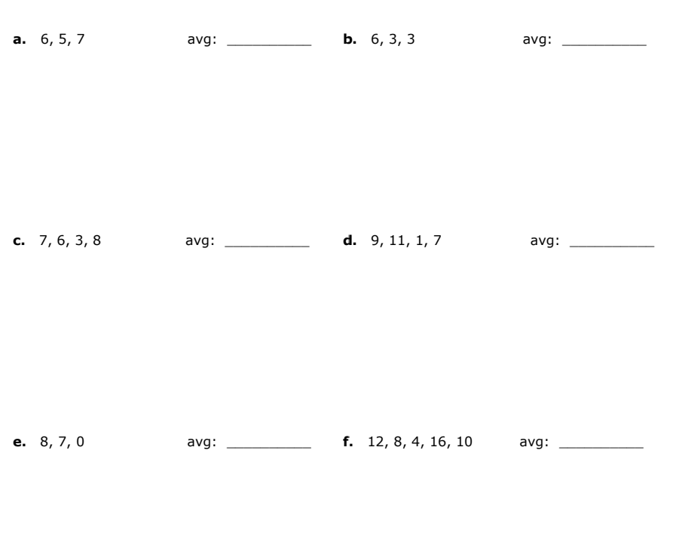
Work is Worship

Slide 23
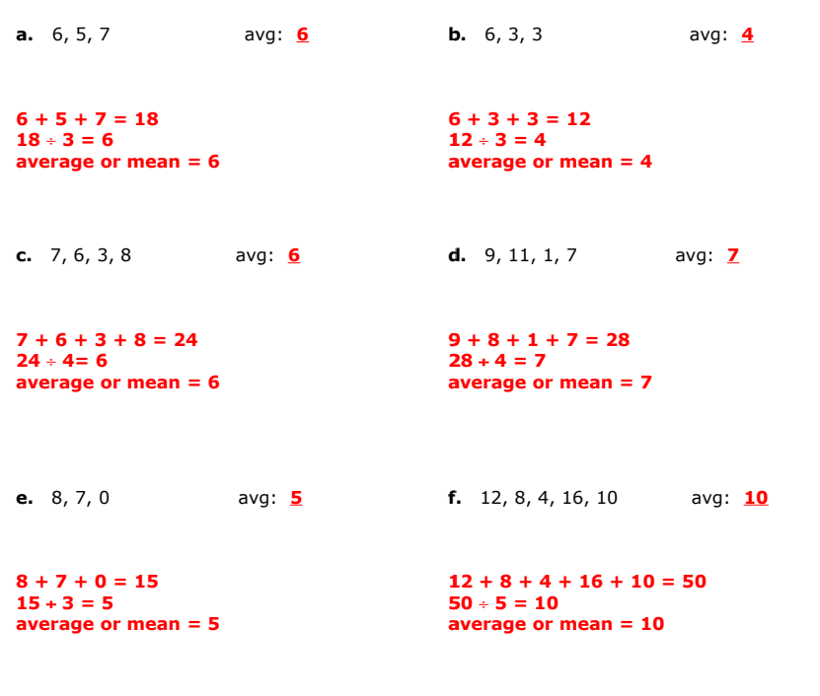
Work is Worship

Slide 24
Work is Worship

Slide 25
Work is Worship

Slide 26
SAMPLE QUESTIONS CUM ANSWERS
Fill in the blanks. 1mark
The average of 8 numbers is 90. sum of the 8 numbers is ______.
Ans: 720 ------------------------------------------------(1)
Answer the following questions. 2 marks
Find the average of first four prime numbers.
Ans: First four prime numbers = 2,3,5,7--------(0.5)
Average = (2+3+5+7) ÷ 4 --------------------------(0.5)
= 17 ÷ 4 ------------------------------------(0.5)
= 4.25 ---------------------------------------(0.5)

Slide 27
2. The average is of 50 numbers is 38.If two numbers 45 and 55 are discarded. Find the average of remaining numbers. 3marks
Ans. Average of first 50 numbers = 38 ------------------(0.5)
Sum of first 50 numbers = 38×50=1900 ----------(0.5)
Sum of two numbers discarded = 45+55=100 ---(0.5)
Sum of remaining numbers = 1900-100=1800 ----(0.5)
Average of remaining numbers = 1800 ÷ 48 ------(0.5)
= 37.5 -------------(0.5)
Therefore, the average of remaining numbers is 37.5

Slide 28
3. In a factory, 6 workers get weekly wages of Rs1250 each
and 9 other workers get weekly wages of Rs1500 each.
Find the average wage of each worker. 4marks
Ans. Total weekly wages of 6 workers =1250×6=7500---(1)
Total weekly wages of 9 workers =1500×9=13500--(1)
Total number of workers = 6+9=15
Total wages of 9 workers = 7500+13500=21000-(0.5)
Average wage of a worker = 21000 ÷ 15 ----------(0.5)
= 1400-------------------(0.5)
So, the average wage of a worker is 1400.

Slide 29
Work is Worship

Slide 30
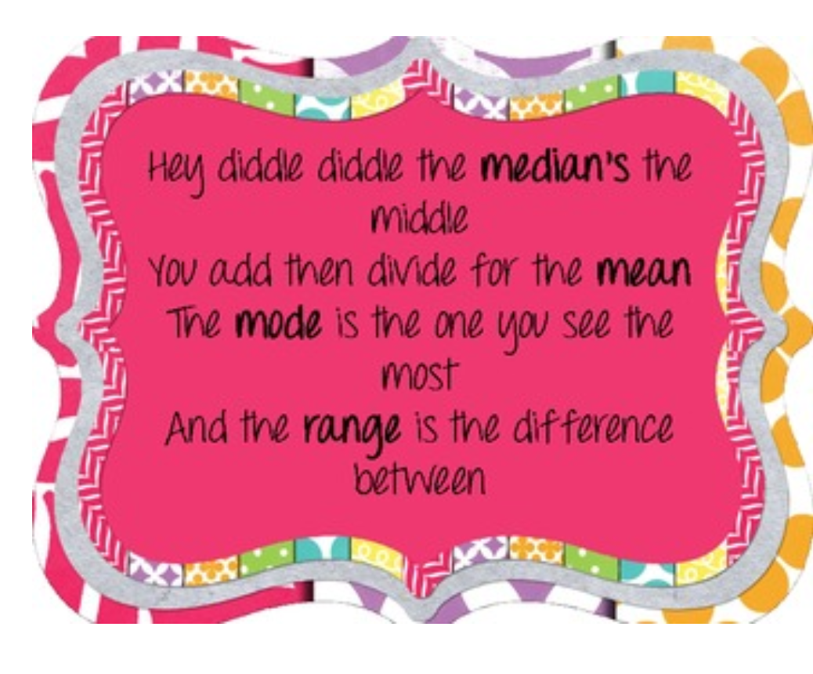
Work is Worship

Slide 31
Average
Sum of all the numbers is divided by the number of addends
If any number is added or subtracted from the number
If any number is multiplied or divided by the group of numbers
Sum of all the numbers/number of addends
If the group of number will be arrange in ascending order or descending order
CONCEPT MAP
Defination & Formula
Average will change
Average won’t change

Slide 32
Work is Worship

