Slide 1
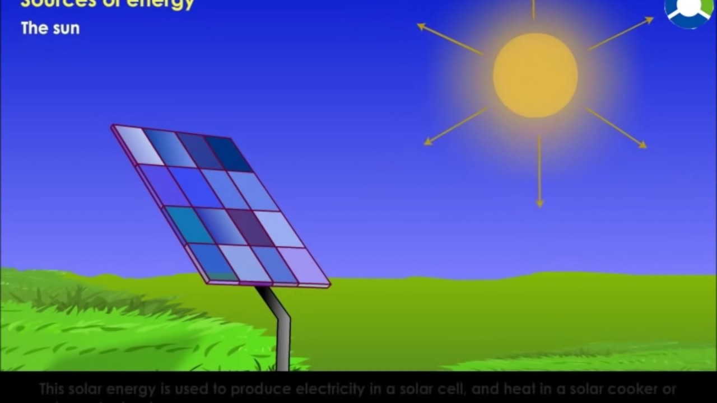
SOURCES OF ENERGY SESSION : 3
CLASS VIII
BY : VIJIT KUMAR

Slide 2
FORMATION OF COAL :
https://www.youtube.com/watch?v=QEa36qNo86E
Coal and Petroleum :
https://www.youtube.com/watch?v=S352O39Rc0Y

Slide 3
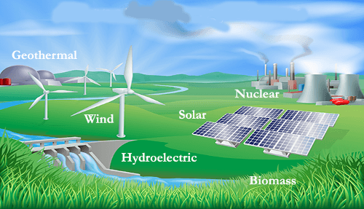
ENERGY : The capacity of a body to do work.
Forms of Energy :
Mechanical Energy
Heat Energy
Chemical Energy
Light Energy
Sound Energy
Nuclear Energy etc.
FUELS : The substances which produce energy (heat) on burning in air are called fuels.

Slide 4
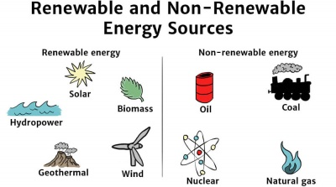
CLASSIFICATION OF SOURCES OF ENERGY :
Sources of energy can be classified on the basis of –
Occurrence
Natural Sources : available in nature
Ex. : Solar energy, wind energy, hydal energy (Hydro-electricity) etc.
Synthetic Sources : man made materials used as sources of energy
Physical State
Solid : Coal, wood, charcoal, coke etc.
Liquid : Kerosene, diesel, petrol etc.
Gas : LPG, CNG, bio-gas, coal gas, PNG etc.
Availability
Renewable : A natural resource which can be replenish itself naturally over a short period of time. Ex. Wind, solar, biomass etc
Non-renewable : Energy sources, which once used up, cannot be replenished, in a short period of time. Ex. : Coal, Petroleum, Natural Gas etc.

Slide 6
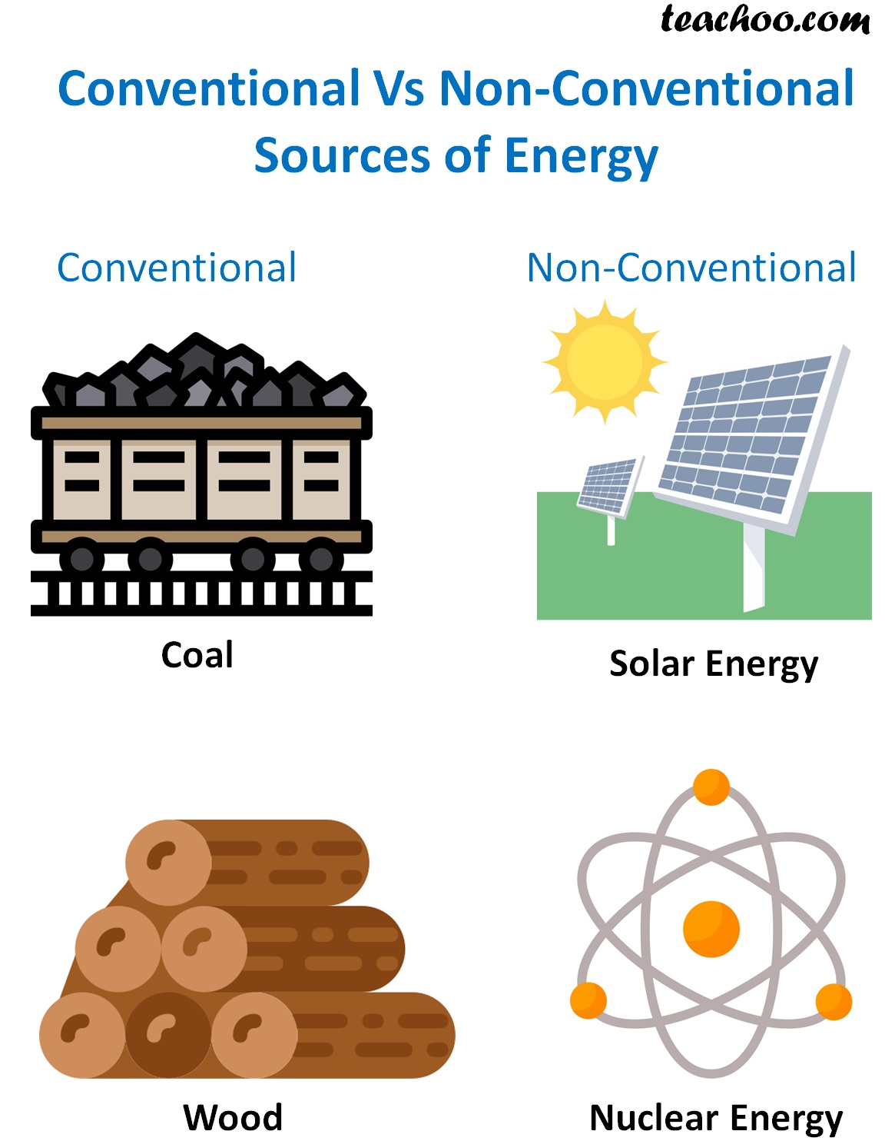
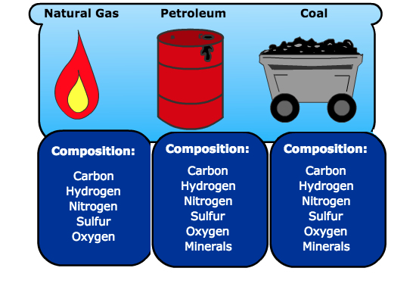
One another classification is –
1. Conventional sources of energy : Most important and most widely used as it can be used anytime and anywhere. We can not reuse after using it once.
2. Non-Conventional sources of energy : The natural resources that time and region bounding and can not be used anytime and anywhere. These are pollution free and can be used to generate electricity.
Fossil Fuels :
Fossil means the remains of living beings
The fuels which were formed, over a period of millions of years, by the action of heat and pressure on the remains of dead plants and animals.
Ex. : Coal, Petroleum and Natural Gas.

Slide 7
Wood as a Fuel :
Wood is major renewable natural resource. It is the largest source of energy. It is used for cooking and heating.
Combustion of wood produces heat along with some gases like carbon dioxide and carbon monoxide which are dangerous.

Slide 8
Assignment :
1. Define fuels
2. Explain the classification of sources of energy
3. Differentiate between renewable and non-renewable sources of energy.
Thanks
Have a Good Day

Slide 9
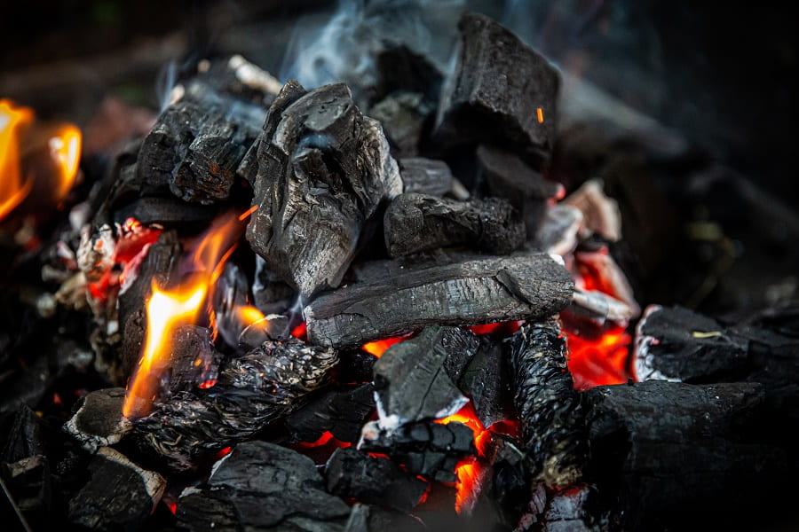
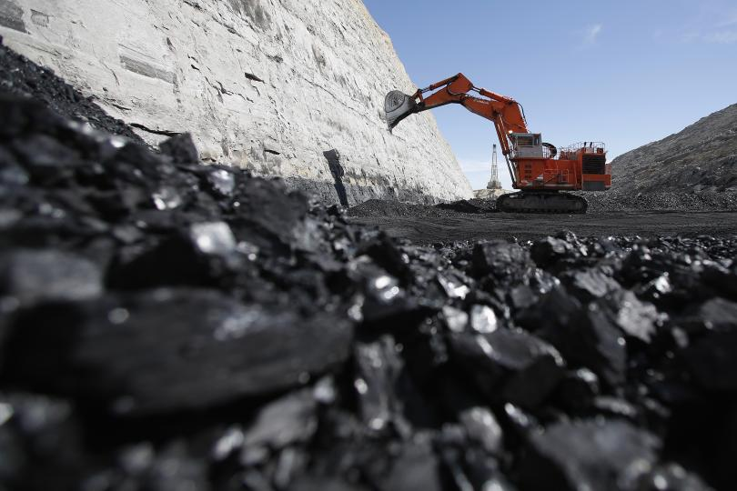
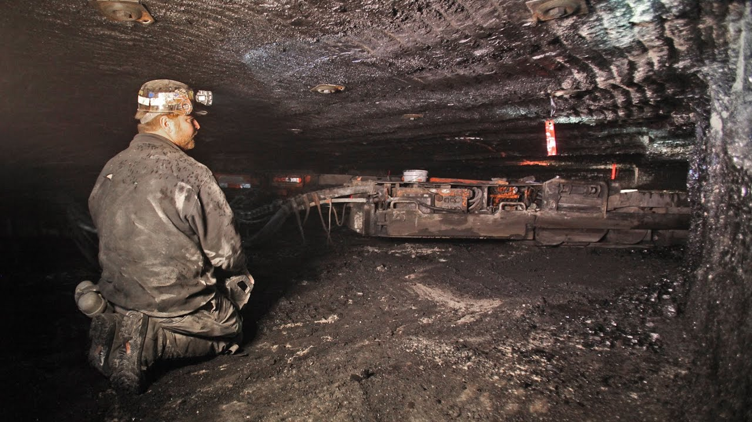
SESSION - 2
COAL :
Coal is a combustible black or a brownish black sedimentary rock.
USES OF COAL
Used as fuel for cooking
Used for generation of electricity (the largest source of energy for thermal power plant)
Occurrence of Coal :
It is found deep under the earth surface and derived out by mining the earth crust.
There are two types of Coal Mines
Open cast Mines
Underground Mines
Open Cast Mine
Underground Mine

Slide 10
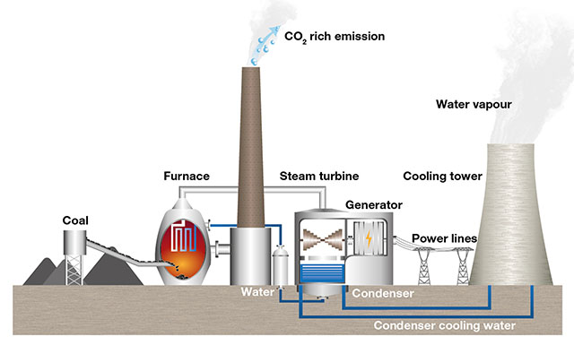
Thermal Power Plant

Slide 11
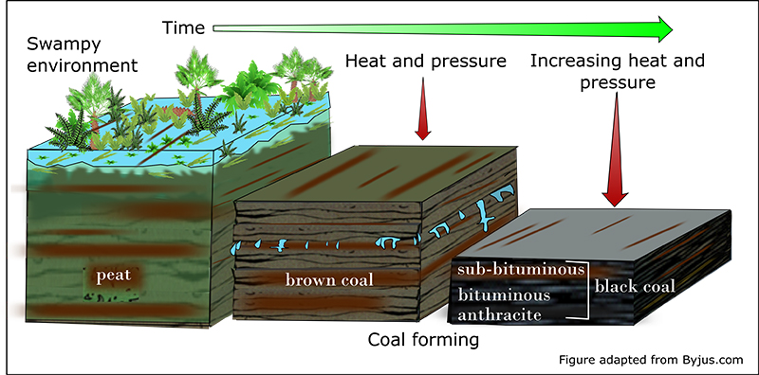
Formation of Coal :
Coal was formed from plant remains buried deep under the earth’s crust over a large period of time due to the geological actions of heat and pressure.
Carbonisation : The process of conversion of dead plant materials into coal is called carbonisation.

Slide 12
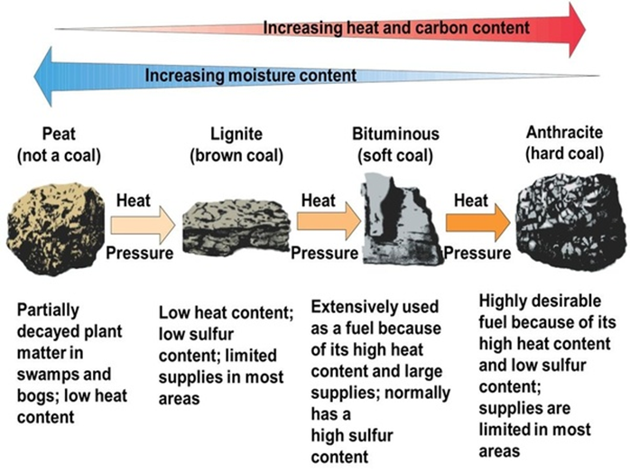
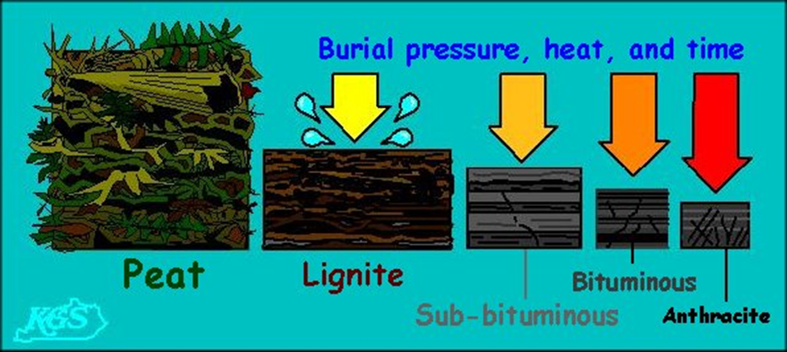
TYPES OF COAL
Peat : 30 % Carbon
Lignite : 38 % Carbon
Bituminous : 65 % Carbon
Anthracite : 90 % Carbon

Slide 13
Destructive Distillation of Coal :
The process of strong heating of coal in absence of air, is called destructive distillation of coal
On destructive distillation of coal many useful products are obtained. Three major products are :
Coke
Coal Tar
Coal Gas
Destructive Distillation of Coal

Slide 14
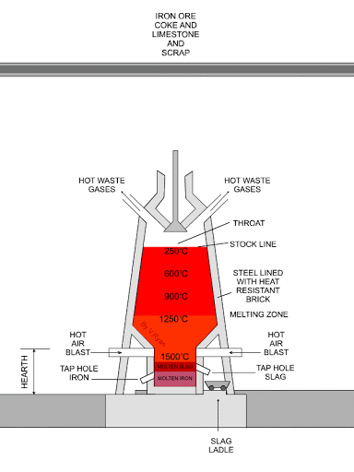
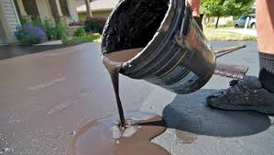
USES :
Coke : A hard porous substance which is mainly used
As a domestic as well as industrial fuel.
For extraction of metals
To make fuel gases like water gas
Water gas is a mixture of carbon monoxide and hydrogen gas which is used
as fuel.
Coal Tar : A black coloured viscous liquid which is used in
Synthetic dyes
Drugs
Explosives
Perfumes
Paints
Photographic materials
Roofing materials
Coal Gas : It is an inflammable gas which is used as
Domestic fuel and industrial fuel.
Limitation of coal gas:
It can be used for only those industries which are located near coal processing unit.

Slide 15
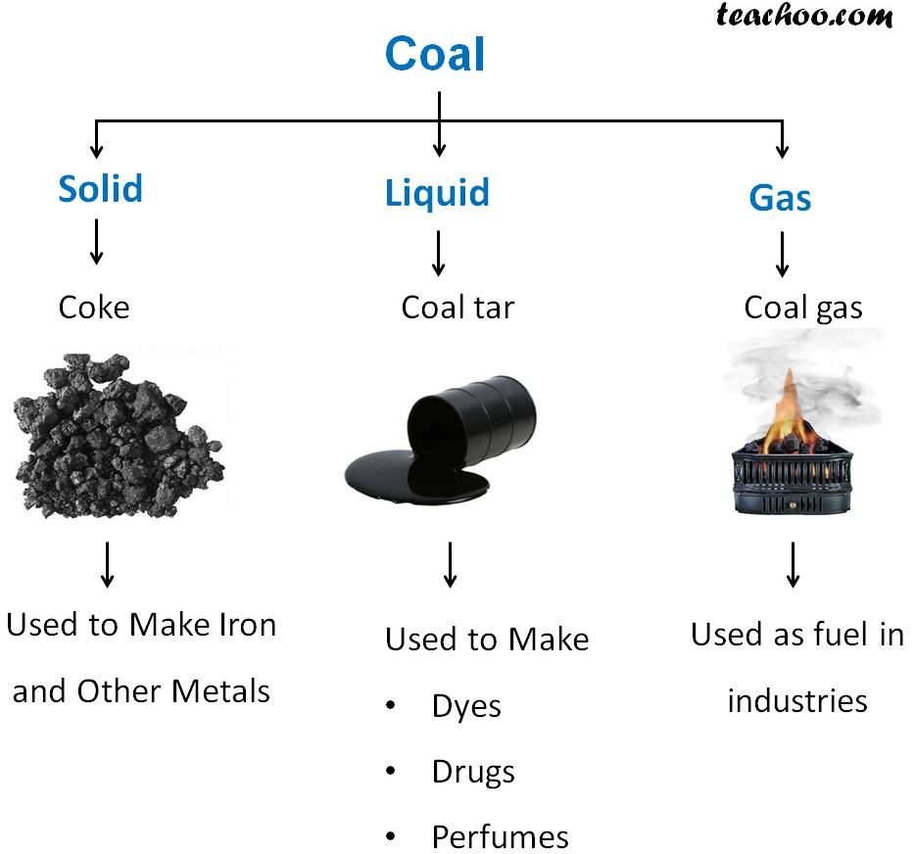

Slide 16
Assignment :
1. Define carbonization.
2. Explain the formation of coal
3. Differentiate between bituminous and anthracite type of coal.
4. What do you mean by destructive distillation of coal? What are the major products of destructive distillation of coal? Write two uses of each.
Thanks
Have a Good Day

Slide 17
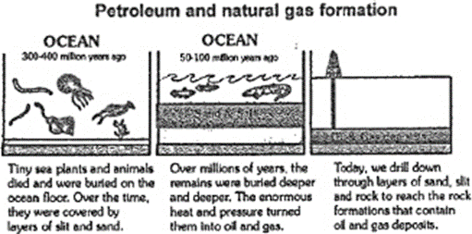
SESSION - 3
Petroleum :
It is dark brownish to green coloured viscous liquid fossil fuel. It has strong foul smell due to the presence of sulphur containing compounds in it. It is commonly called as crude oil. The economy of a nation depends to a great extent on petroleum wealth, that's why petroleum is called the black gold.
Its name is derived from Latin words Petra (meaning rock) and Oleum (meaning oil). Thus, petroleum literally means "rock oil".
Origin of petroleum :
Petroleum is a complex mixture of solid, liquid and serous hydrocarbons, mixed with salt water and earthy particles. It is always found trapped between two impervious rocks.
It is believed that petroleum is formed by the anaerobic decomposition of extremely small sea animals and plants which got buried in the sea bed millions of years ago. Let us see how this happened.

Slide 18
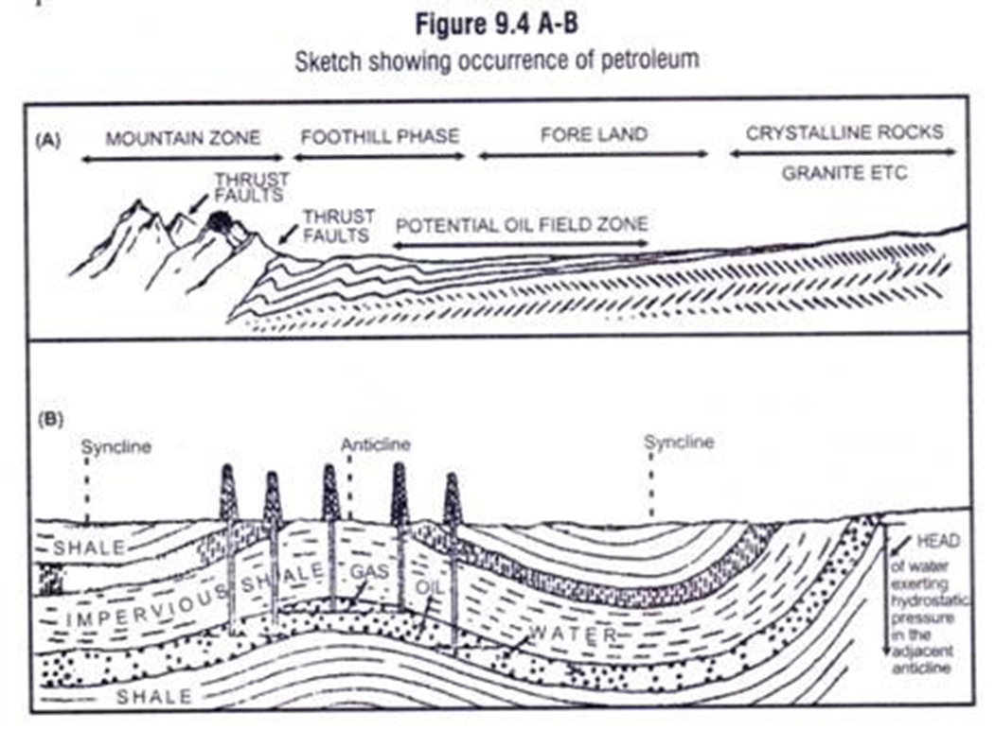
Occurrence of petroleum:
Petroleum occurs at a moderate depth (500 m to 2000 m) between the 2 layers of impervious rocks. The petroleum is lighter than It water & hence, floats over it. Natural gas is found above petroleum, trapped between the rock cap & petroleum layer.
Drilling of oil wells:
The hole is drilled in the Earth's crust & when it reached the rock cap, the natural gas comes out first with a great pressure. When the pressure of gas subsides, petroleum starts flowing out due to the pressure of natural gas. Later on it is being pumped out using electric pump.

Slide 19
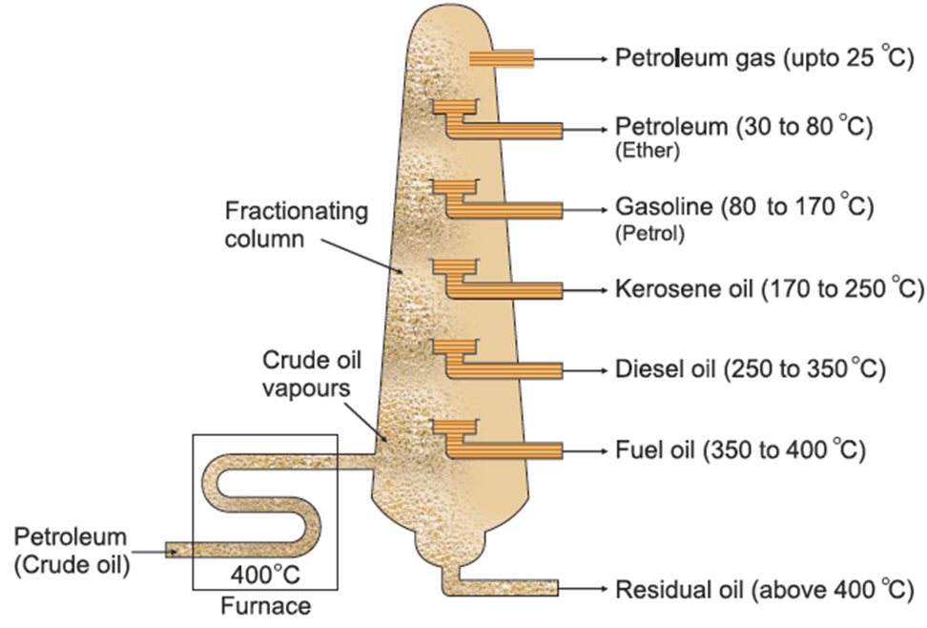
Refining of petroleum:
Petroleum is a mixture of several hydrocarbons. It also contains water, salt and rocky materials. It cannot be used in this made form either as a fuel or a basic material to produce other useful components. Before being put to use, it has to be purified or refined. The process of separating the various components of petroleum from one another is known as the refining of petroleum. This is done by a process called fractional distillation which is based on the fact that the different components of petroleum have distinctly different boiling points.
In fractional distillation, crude petroleum is heated to a temperature of, 400°C or slightly above in a furnace.
Fractional Distillation of Crude Oil
Uses of petroleum :
Petroleum products are used as fuels.
Lubricating oils, and vaseline are used as lubricants.
Paraffin wax, products of petroleum, is used for manufacturing candles, polishes, waxed paper, water proofing, etc.
4. Some of the by-products of petroleum
after purification are used in the preparation of medicines, ointments, face creams and cosmetics.

Slide 20
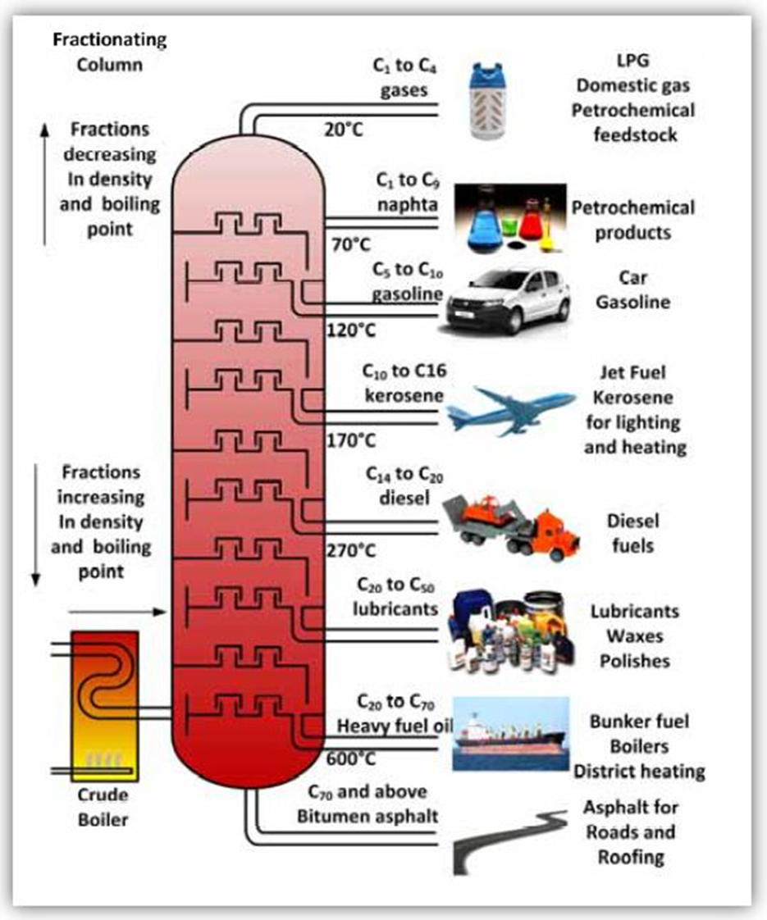
USES OF PETROLEUM PRODUCTS

Slide 21
Natural gas :
Natural gas was formed millions of years ago along with petroleum when microscopic sea plants & animals died & got buried under the sand & mud. These plants & animals under anaerobic conditions changed to gas.
Composition :
It consist mainly of methane (about 85%), ethane (about 10%) propane (about 3%) and butane when natural gas is compressed at high pressure then it is called CNG (compressed natural gas). CNG is used for power generation.
It is now being used as a fuel for transport vehicles because it is less polluting. The great advantage of CNG is that it can be used directly for burning in homes and factories where it can be supplied through pipes. Such network of pjpeline exists in Vadodara (Gujarat) and some parts of Delhi.
Occurrence :
It is generally found trapped between impervious rocks, sometimes along with petroleum & sometimes without petroleum.
In our country, natural gas has been found in Tripura, Rajasthan, Maharashtra and in the Krishna Godavari Delta.
Uses of natural gas :
(1) As a fuel - It has a very high calorific value of 55 ktJ/g
(2) As a source of hydrogen & carbon

Slide 22
Assignment :
1. Define refining of petroleum. Name the process used for refining of petroleum.
2. Explain the occurrence of petroleum
3. Write any five petroleum products and their uses.
4. What is natural gas? Write its composition and uses.

