Slide 1
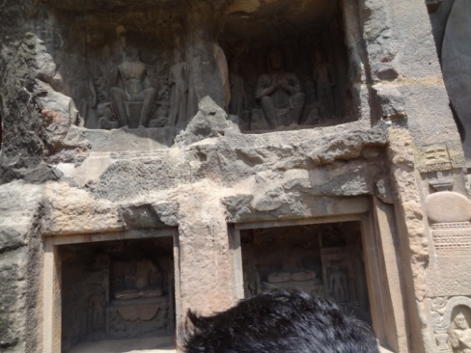
SHELTERS OF INDIA
CAVES
Primitive men and animals lived in caves.
Notes:
Primitive men and animals lived in caves. These are seen both on mountains and along side coast lines

Slide 2
OUR HOMES
CAVES ARE THE EARLIEST FORM OF SHELTER

Slide 3
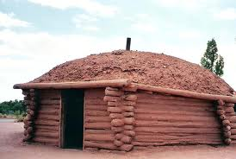
HUTS
HUTS
These are small crude shelters.Mostly made up of materials available locally like mud,log,grass,paddy etc
Notes:
These small crude shelters.Mostly made up materials available locally like mud,log ,grass,paddy etc

Slide 4
HUTS
HUTS ARE FOUND IN VILLAGES
IT IS MADE OF MUD

Slide 5
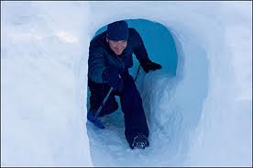
IGLOO
IGLOO
These are traditional shelters found in Artic regions not found in India
Notes:
These are traditional shelters found in arctic regions not in India

Slide 6
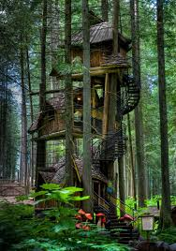
TREE HOUSE
TREE HOUSE
These are seen in forests built to protect its inhabitants from wild animals.They are generally made up of timber of forest trees. In India they are in Betla wild life sanctuary in Jharkhand.
Notes:
These are seen in forests built to protect its inhabitants from wild animals. They are generally made up of timber of forest trees. In India they are seen in Betla wild life sanctuary in Jharkhand

Slide 7
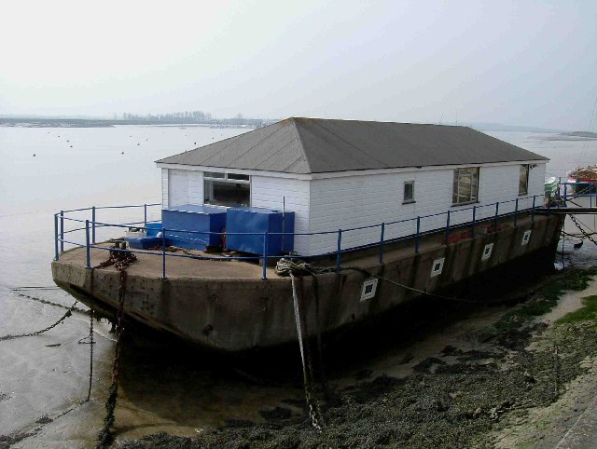
HOUSE BOATS
HOUSE BOATS
House Boats
These are boats which has a house built on top of it. In India,Kerala provides house boats used for pleasure trips and are locally called Kettuvalams.
Notes:
These are boats which has a house built on top of it. In India,kerala provides house boats used for pleasure trips and are locally called Kettuvalams.

Slide 8
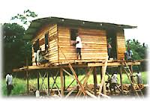
STILT HOUSES
STILT HOUSES
Stilt houses are also called pile dwellings. Generally seen on mountains. When constructed near lakes,they give protection from flooding.
Notes:
Stilt houses are also called pile dwellings.Generally seen on mountains.When constructed near lakes, they give protection from flooding.

Slide 9
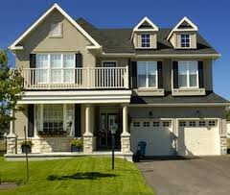
MANSIONS
Mansion are large independent houses with big garden areas.

Slide 10
WORKSHEET
PASTE PICTURES OF FURNITURES WE NEED IN A HOUSE IN THE PICTURE OF HOUSE GIVEN BELOW AND MAKE A COLLAGE

Slide 11
worksheet

