Slide 1
SOCIAL SCIENCE
CLASS – IV TOPIC – LET US TRAVEL

Slide 2
LET US TRAVEL …
DO YOU KNOW WHAT IS TRAVELLING ?
How did you come to school today ?
During the last summer vacation where did you go ? How did you go to that place ?
The act of going from one place to another is known as TRAVELLING or TRANSPORTATION.
BUS, CAR, BICYCLE, TRAIN, AEROPLANE, SHIP are various ways by which we travel.
These various ways by which we travel are known as
MEANS OF TRANSPORT
Some might have come to school by Bus or Car or Bicycle.
You might have gone to visit another state by train. You might have gone to another country by aeroplane or ship.

Slide 3
Mankind and travelling have been linked to each other since ancient times.
If you will go back to the period of early men, we will see people were travelling from one place to another for different reasons.
People always keep travelling.
You can travel short distances on foot, bicycle, rickshaw, tonga or a boat.
You can travel long distances on auto-rickshaw, car, bus or motorboat.
You can travel to different cities on a bus, train or in an aeroplane. You can also travel to far away places by ship.
These are some common means of transport.
The selection of the means of transport depends on the time and money that is spent on the travel.
Means of transport are also used to transport goods from one place to another.

Slide 4
RAILWAY STATION
BUS STOP
AIRPORT

Slide 5
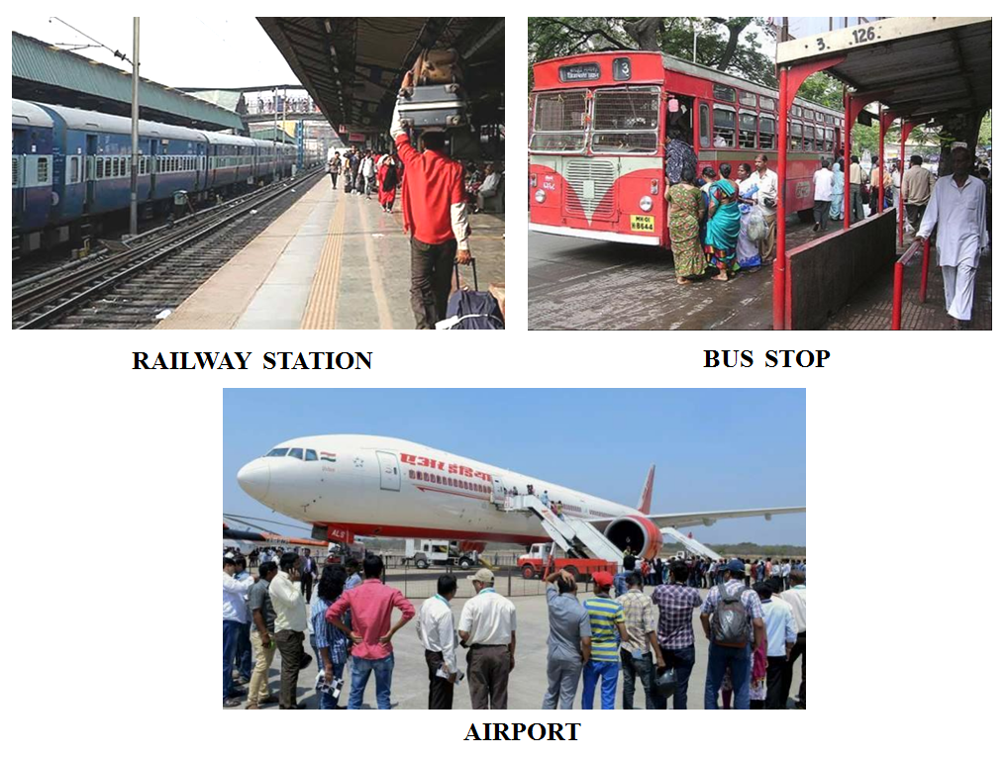
In the above pictures, we see people are crowded to move to different places. Similar condition is seen everywhere.

Slide 6
THINK !!!
Why do we travel ???
To go to school
To go to the office
To go to the market
To meet family members
For higher education
For better job
For business
To celebrate festivals
To attend family function
To visit places of interest

Slide 7
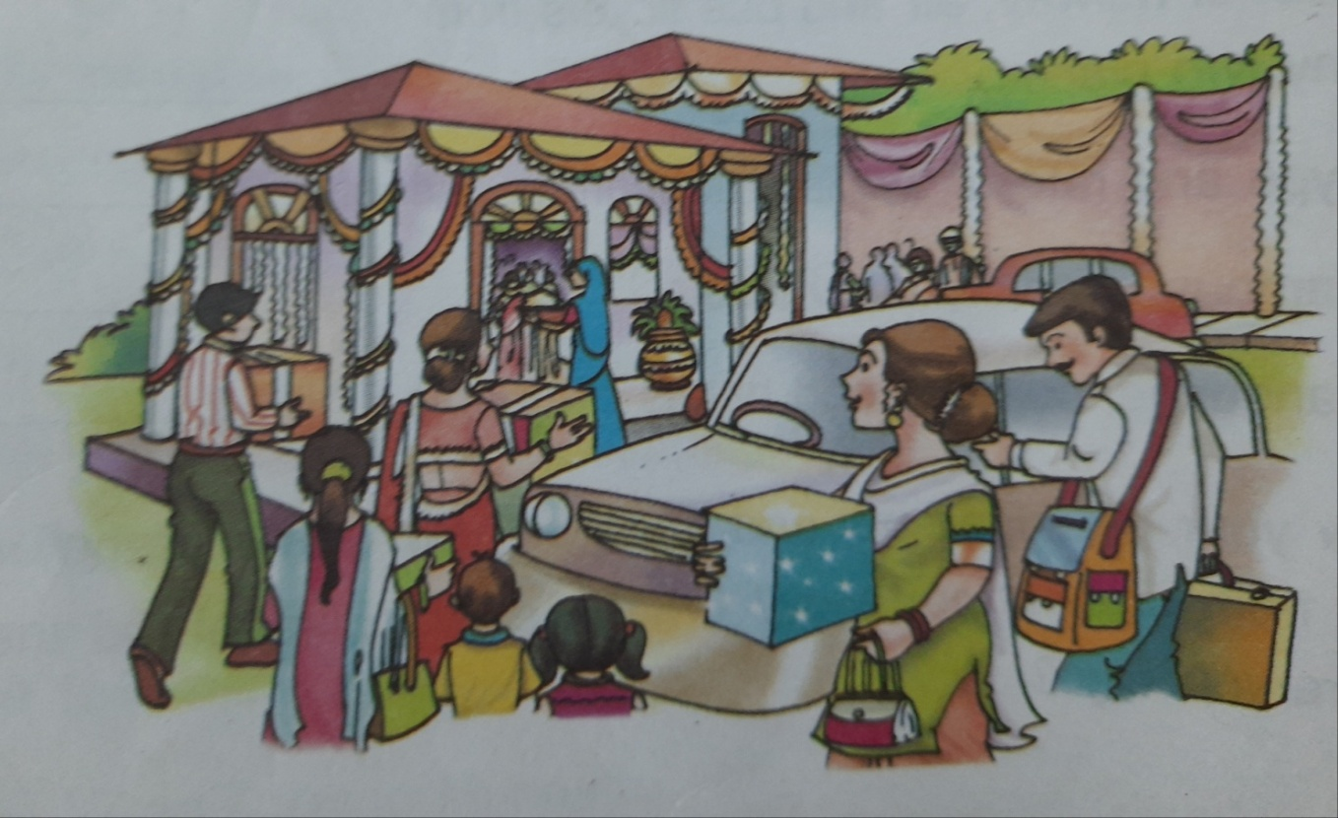
This is the picture of Sonali’s marriage function.
To attend the function, relatives have come from different places using different means of transport.
People use different means of transport for travelling over different distances.
Some means of transport used in rural areas differ from those used in urban areas.

Slide 8
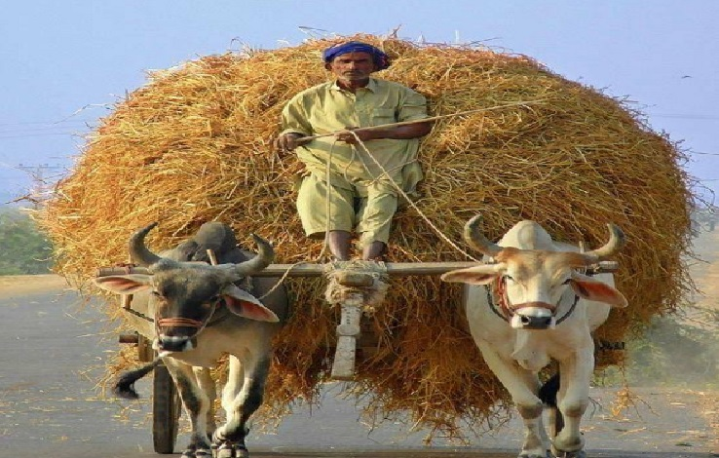
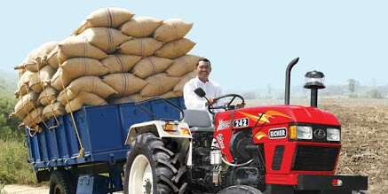
RURAL TRANSPORTATION
What comes to your mind when you hear the word ‘rural’ ?
In rural areas, farming is main occupation.
ON BULLOCK CARTS, TRACTOR TROLLEYS OR TRUCKS
VEGETABLES, FRUITS, & AGRICULTURAL GOODS
FROM RURAL AREAS
TRANSPORTED TO
NEARBY TOWNS OR CITIES
Vegetables and Fruits are perishable items. They get rotten very quickly. So they are transported almost daily
TRACTOR TROLLEYS
BULLOCK CARTS

Slide 9
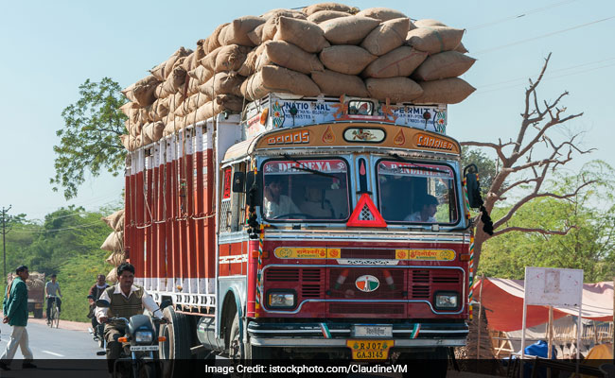
After harvesting of wheat and rice, trucks ladden with gunny bags of grains are sent to nearby towns and cities.

Slide 10
FACT
GOODS CARRIED BY MEANS OF TRANSPORT INDICATE CROPS GROWN IN THAT AREA.
IF YOU SEE MANY BULLOCK CARTS LOADED WITH SUGARCANE LINED ALONG A ROAD, YOU WILL KNOW THERE IS A SUGAR MILL AROUND.
When bullock carts, trucks and tractor-trolleys go back from cities to village they are laden with gas cylinders, light machinery (crushers, grinders), textiles, scooter etc.
So means of transport form a bridge between rural and urban areas.

Slide 11
TRANSPORTATION IN COASTAL AREAS
COASTAL AREA IS A PLACE WHERE LAND MEETS THE SEA.
In coastal areas, fishermen use boats to transport fish and other sea food items.
Steamers and ferries with cold storage are used to transport baskets containing fish.
BOATS CARRYING GOODS ACROSS RIVERS AND SEAS

Slide 12
FERRIES WITH COLD STORAGE TO CARRY FISH BASKETS
(COLD STORAGE IS USED TO AVOID FISH FROM GETTING ROTTEN)
So we see, fish are carried on boats by fishermen and also using steamers and ferries with cold storage.

Slide 13
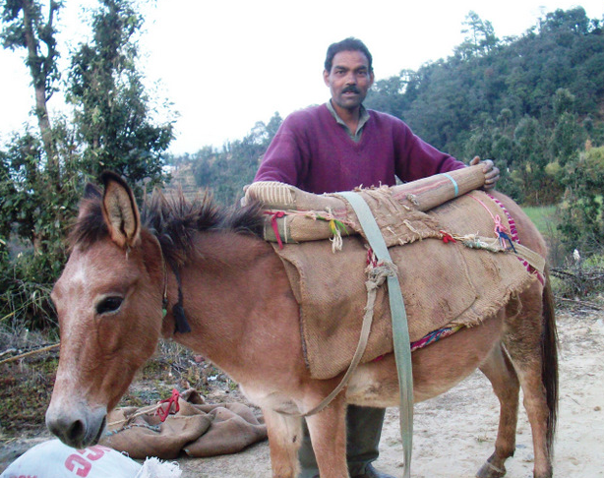
TRANSPORTATION IN HILLY AREAS
In hilly areas, Mules are used for transporting goods along with coolies (pithus)

Slide 14
ANIMALS IN TRANSPORT
Animals play an important role in rural transportation.
We have already seen horse carts and bullock carts. It is used to transport agricultural goods from rural areas to urban areas.
Similarly, Mules are used in hilly areas to transport goods.
Bullocks have been farmer’s friend since olden timeS. How are bullocks used by farmers ?
Bullock cart or horse cart can go up to the farm.
Farmer has used it to plough the field and pull water from well.
Helps the farmer to load vegetables & other goods easily for quick transportation to market.
Similarly, we will read about the camel carts :
Camel carts are found in roads of Bikaner and other places of Rajasthan.
Bikaner is a famous city in state of Rajasthan.
Can you locate Rajasthan in Political Map of India ?

Slide 15
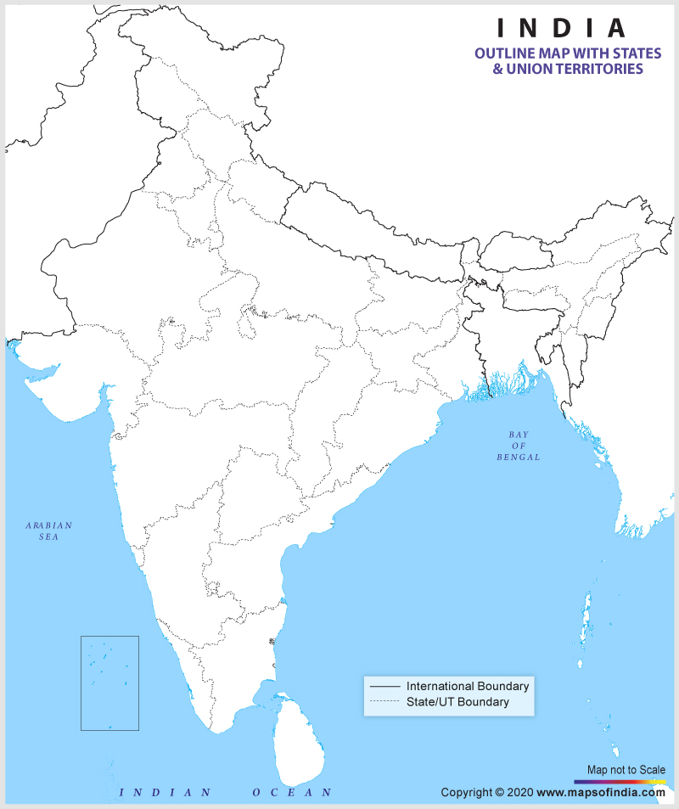

Slide 16
RAJASTHAN
.
RAJASTHAN
.

Slide 17
Cart
The camel is beautifully decorated with tassels and bells.
The owner addresses the camel as his son and pats him affectionately.
TASSELS AND BELLS

Slide 18
The camel carts are used to carry red chilies and other items

Slide 19
URBAN TRANSPORTATION
Means of transport in urban areas are different from that in rural areas.
Huge trucks and trailers transport many heavy machines from seaports and factories to different parts of our country.
ON HUGE TRUCKS AND TRAILERS
HEAVY MACHINES FROM SEAPORTS AND FACTORIES
DIFFERENT PARTS OF COUNTRY
TRANSPORTED TO

Slide 20
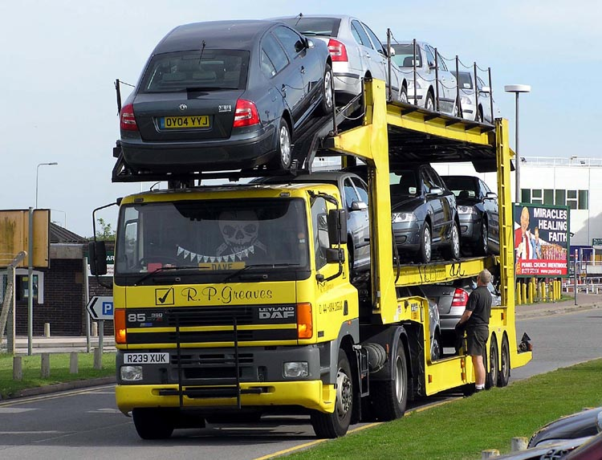
A TRAILER IS USED TO CARRY THE LATEST CARS TO THE TOWNS OR CITIES.
THIS REFLECTS PROGRESS OF CAR MANUFACTURING INDUSTRIES AND PROSPERITY OF PEOPLE WHO HAVE CREATED A LARGE DEMAND FOR CARS.

Slide 21
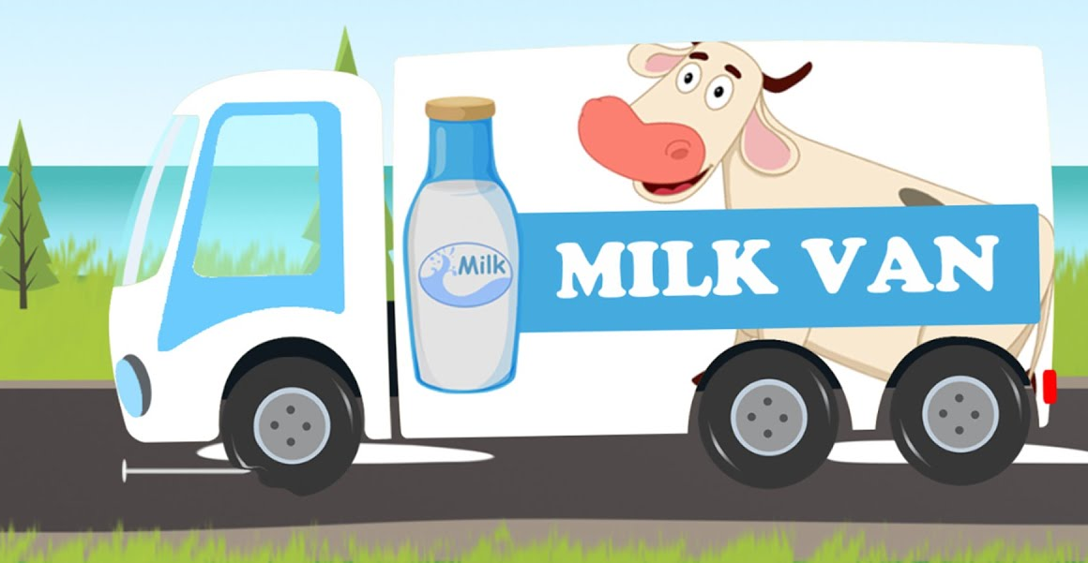
Modern means of transport have made it easy for goods to be transported from one area to another.
Earlier, cities faced huge shortage of milk in the summer times.
However now-a-days, situation has changed.
Special trucks collect milk from rural areas and transport it to cities in all seasons.

Slide 22
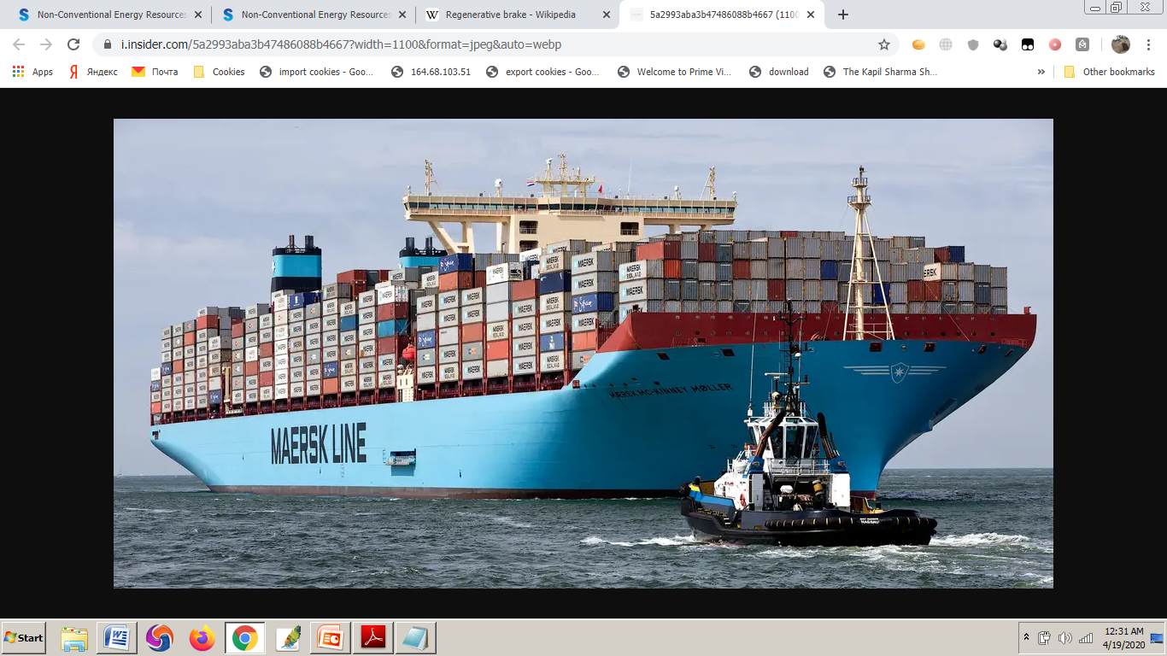
Ships are used for transporting very heavy items over sea from one country to another such as
Heavy items like oil drilling equipments,
Machinery for printing, textile and other manufacturing industries
Transportation by ships is cheaper than other modes of transport.

Slide 23
DISADVANTAGES
As we discussed, rural and urban means of transport have many advantages.
However, expanding role of transport in modern times has many negative effects.
Means of transport have increased the traffic on roads at very fast rate.
Everyday we find traffic jams, delay in delivery of goods, accidents, pollution etc.
To improve the present situation, efforts are being made to improve the quality of roads for smooth and quick movement of people and goods.

Slide 24
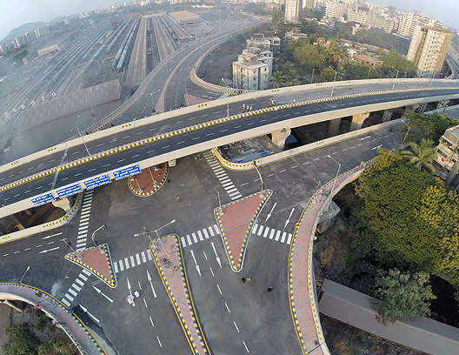
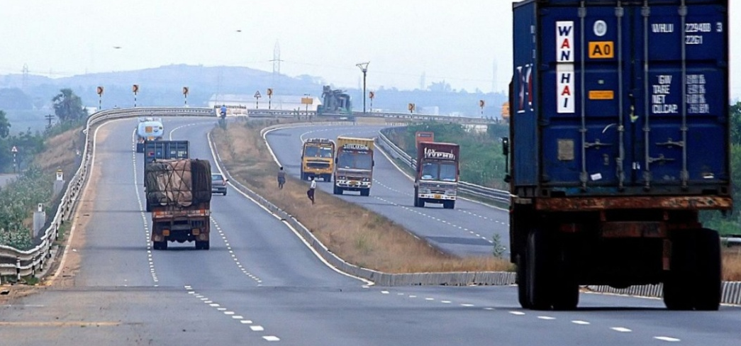
FLYOVERS
BRIDGES
Flyovers, bridges and city bypasses are made to remove traffic jam and unnecessary delays.
CITY BYPASS

Slide 25
FACT
PIPELINE TRANSPORTATION HAS BECOME POPULAR IN TRANSPORTING OIL AND GAS.
TILL NOW, IT WAS ONLY USED FOR TRANSPORTING WATER
BETTER QUALITY OF PETROL AND DIESEL
Vehicles are using CNG and better quality of petrol and diesel to reduce vehicular pollution.
CNG STANDS FOR
‘COMPRESSED NATURAL GAS’
CNG VEHICLES

Slide 26
POINTS TO REMEMBER LET US REVISE THE CHAPTER …
People use different means of transport for travelling over different distances.
The selection of means of transport depends on the time and money that can be spent.
Road transport provides door-to-door service.
Means of transport used in rural areas differ from those used in urban areas.
Farming is the main occupation in most rural areas.
Perishable items (vegetables, fruits) are transported on daily basis to nearby cities and towns in bullock carts, tractor trolleys or trucks.
After harvesting of wheat and rice, trucks loaded with gunny bags are sent to the nearby towns or cities.

Slide 27
Goods carried by different means of transport indicate about the crops grown in that area.
Means of transport form a bridge between rural and urban areas.
Boats, steamers and ferries are used in coastal areas to transport things.
Fish are carried on boats by fishermen and also using steamers and ferries with cold storage.
Mules are used for transporting goods in hilly areas along with coolies (pithus).
Animals play an important role in rural transportation like bullock cart, horse cart, camel cart.
Means of transport in urban areas are different from that in rural areas. Trucks and trailers carry various items across the country.

Slide 28
Modern means of transport have made it easy to transport goods in all seasons.
Ships are cheaper than other modes of transport and are used to transport very heavy items for industries.
Means of transport have various advantages as well as disadvantages.
Usage of vehicles has increased traffic jam, pollution and accidents.
Efforts are being made to reduce this by making flyovers, bridge and bypass and using CNG and better quality of petrol and diesel.

Slide 29
ASSIGNMENT - 1
Value Based Question
Our world is facing many problems due to Corona virus. During the lockdown period, children of DAV Public School Bhubaneswar prepared masks at their homes and sent to poor people of a nearby town that is located within 30 kms, through a representative. The representative took permission from the police and distributed the masks.
According to you, name the means of transport that was used by the representative to go to the town for this work.
Write any one value that you learn from the children of DAV School.
How can you help the poor during this time of crisis?

Slide 30
ASSIGNMENT - 2
HOTS Questions
Transportation by ship is cheaper than other modes of transport. Justify
If there is no means of transport for a day, our life will stand still. Explain
Activities to be conducted:
Draw the picture of your favourite means of transport and write five sentences to describe it.
Draw the pictures of one rural and one urban transport and write three differences between them.
Prepare a chronological album showing the stages of development of means of transport from early man to the modern man.

Slide 31
THANK YOU

