Slide 1
Our Sense Organs Class 1
Qurratul Ain Siddiqui

Slide 2
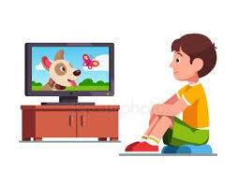
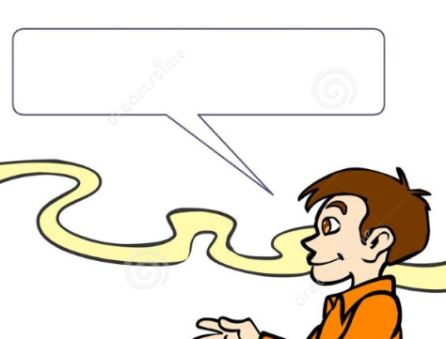
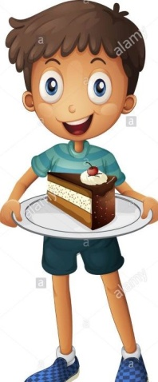
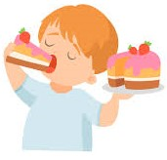
Story time
Nice smell
Ram was watching TV.
Nice smell came from the kitchen.
He went and saw a cake on a plate.
He took the plate . It was very hot.
It fell down. Mother shouted and came.
She gave a piece of cake to Ram. He ate .
It was very tasty. Ram
was happy.
Hot plate

Slide 3
Which body part helped Ram…
watch TV ? smell cake ?
feel hot ?
hear mother shout ? taste cake ?

Slide 4
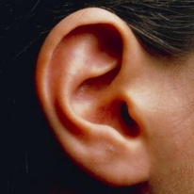
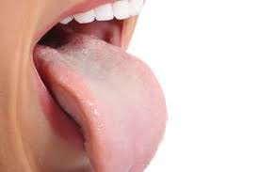
The body parts that helped Ram…
Watch TV– Eyes
Smell cake– Nose
Feel hot– Skin
Hear mother shout– Ears
Taste cake – Tongue
All these 5 body parts are called
as the SENSE ORGANS.

Slide 5
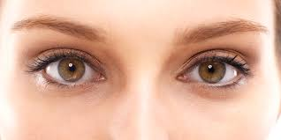
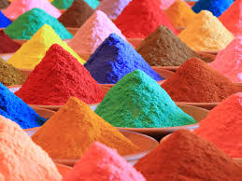
EYES
Eyes help us to see around us. We have 2 eyes.
Read books See colours
See trees

Slide 6
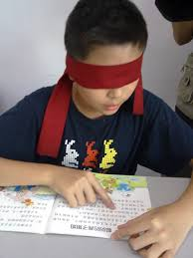
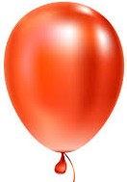
Activity time
Blindfold the learner . Give a picture/book/thing .
Ask to speak about thing/picture/read from book.
The learner cannot speak about the thing/ picture/read from book because EYES are not open . So, he/she will know that eyes help us SEE.

Slide 7
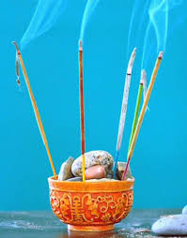
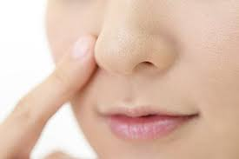
NOSE
Nose helps us to smell . We have 1 nose.
Breathe Good smell
Bad smell

Slide 8
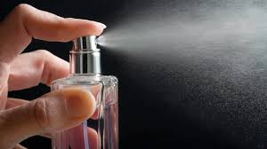
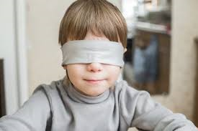
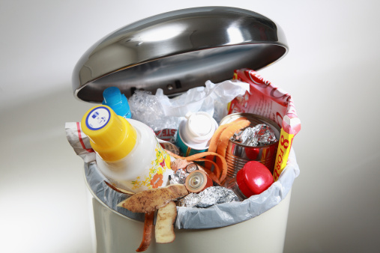
Activity time
Blindfold the learner. Spray some perfume around the learner. Ask if he/she finds any smell around . Whether it is a good smell or a bad smell.
Bring a trash bin with rotten vegetables ,curries ,left over food items etc. Ask if he/she finds any smell around. Whether it is a good smell or a bad smell.
The learner will identify good smell and bad smell . So, will know that NOSE helps us to SMELL.

Slide 9
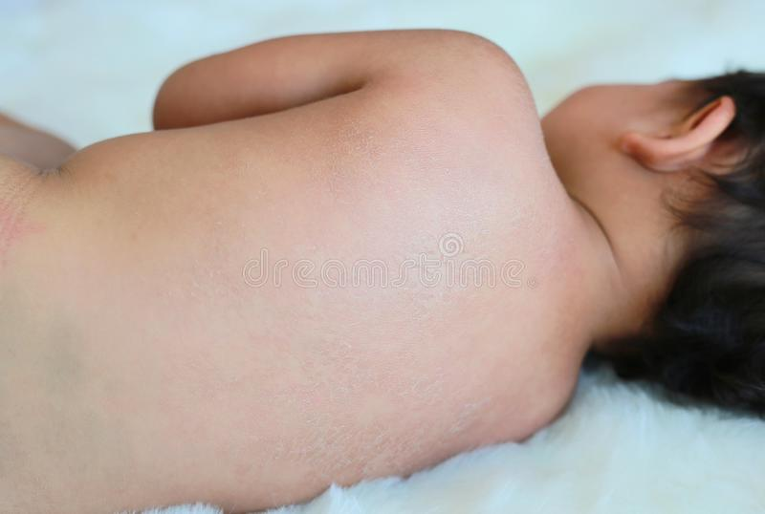
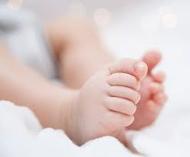
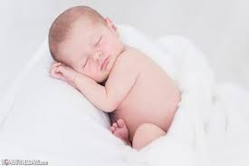
SKIN
The skin covers our body. We feel with our skin.
We feel hard or soft and hot or cold with our skin.

Slide 10
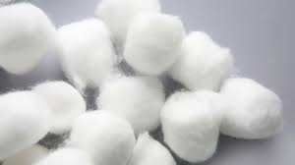
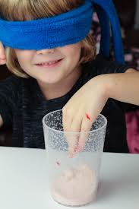
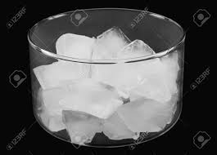
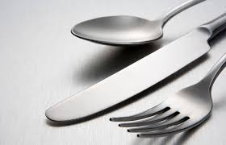
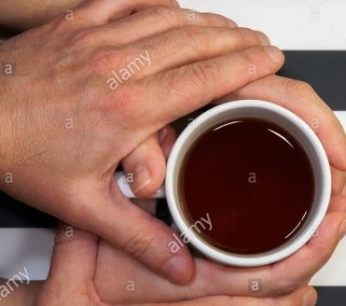
Activity time
Blindfold the learner. Give a cotton ball and a steel spoon to the learner and ask the feel. Make the learner touch ice cream and outside of a cup having hot tea and ask the feel.
The learner will learn that SKIN helps to know the FEEL of hard or soft and cold or hot.

Slide 11
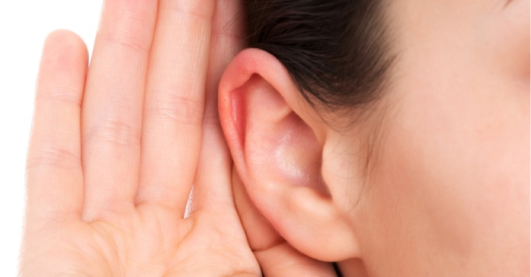
EARS
Ears help us to hear different sounds. We have 2 ears.
Listen music Sound of bell
Sound of thunder
Sound of animals

Slide 12
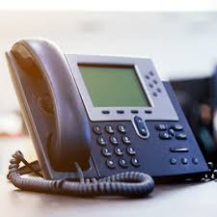
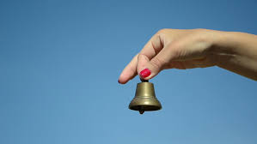
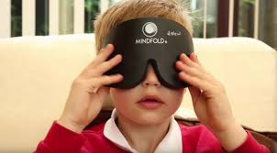
Activity time
Blindfold the learner. Ring a bell near him/her . Then ring the telephone or play a musical instrument.
The learner will know that the EARS help to hear different SOUNDS.

Slide 13
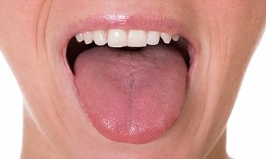
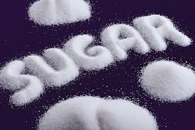
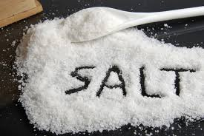
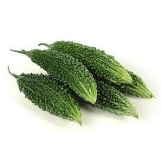
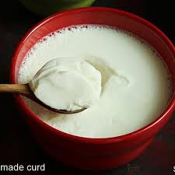
TONGUE
Tongue helps us to taste different things . We have 1 tongue.
It helps us taste
Sweet Salty
Sour Bitter

Slide 14
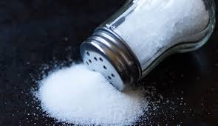
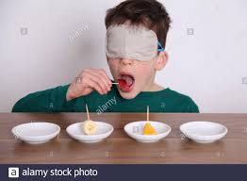
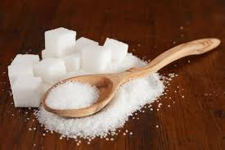
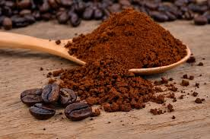
Activity time
Blindfold the learner. Give the learner different food items on the tongue. Then ask the taste.
The learner will know that TONGUE helps us to TASTE different tastes. He/she will also identify taste of salty, sweet, bitter and sour.

Slide 15
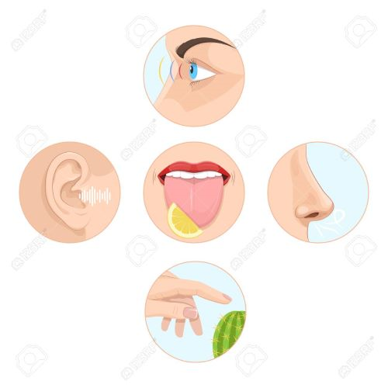
Our
Sense
Organs
We have 5 SENSE ORGANS which help sense and understand things around us.
We must take care of our sense organs .

