Slide 1
D.A.V. PUBLIC SCHOOL, SECTOR-14, GURUGRAM. STATISTICS AND PROBABILITY CLASS VIII
CONTENT – 9
28.04.20

Slide 2
In previous classes we have learnt about data collection, organising a given data, reading and preparing bar graphs. We have also learnt about the measures of central tendency – Mean, Median and Mode.
Now, we shall learn to arrange a given data into graphs and display the data as histogram, pie chart and probability.
STATISTICS
Statistics is science of collecting classifying, summarizing, analysing and interpreting numerical facts.
OBSERVATIONS
Information in the form of numerical figures is called observations.
RAW DATA
Collection of all observations is called data or raw data.

Slide 3
PRESENTATION OF DATA
Arranging the data in ascending or descending order is called presentation of data or organizing the data.
RANGE
The difference between the highest and the lowest values of the observations is called the range of the data.
Range = Highest observation – Lowest observation
FREQUENCY
The number of times a particular observation occurs in a data is called its frequency.
FREQUENCY DISTIBUTION TABLE
A table which shows the frequencies of various observations of a data is called frequency distribution table.

Slide 4
GROUPED FREQUENCY DISTIBUTION
In case of very large data, the raw data is divided into suitable number of groups (class intervals) to obtain a frequency distribution of the number of observations falling in each class interval.
A table showing the frequencies of various class intervals is called a frequency distribution table and the data in this form is called a grouped frequency data.
If the class interval is 10 -20 then in this class 10 is the lower limit and 20 is the upper limit.
CLASS SIZE OR CLASS WIDTH
The difference between the upper limit and the lower limit is called class size or class width.
Class Size = Upper Limit – Lower Limit
CLASS MARK
The average of upper and lower limits is called class mark.
Class Mark = $\frac{Upper Limit + Lower Limit}{2}$

Slide 5
GRAPHICAL METHOD OF REPRESENTING DATA
BAR GRAPH
A bar graph is a pictorial representation of the numerical data by a number of rectangles (bars) of uniform width erected vertically from the same base line with equal spacing between them.
histogram
A histogram is a graphical representation of a frequency distribution in the form of rectangles with class intervals as bases (equal) and heights proportional to corresponding frequencies such that there is no gap between any two successive rectangles (bars).

Slide 6
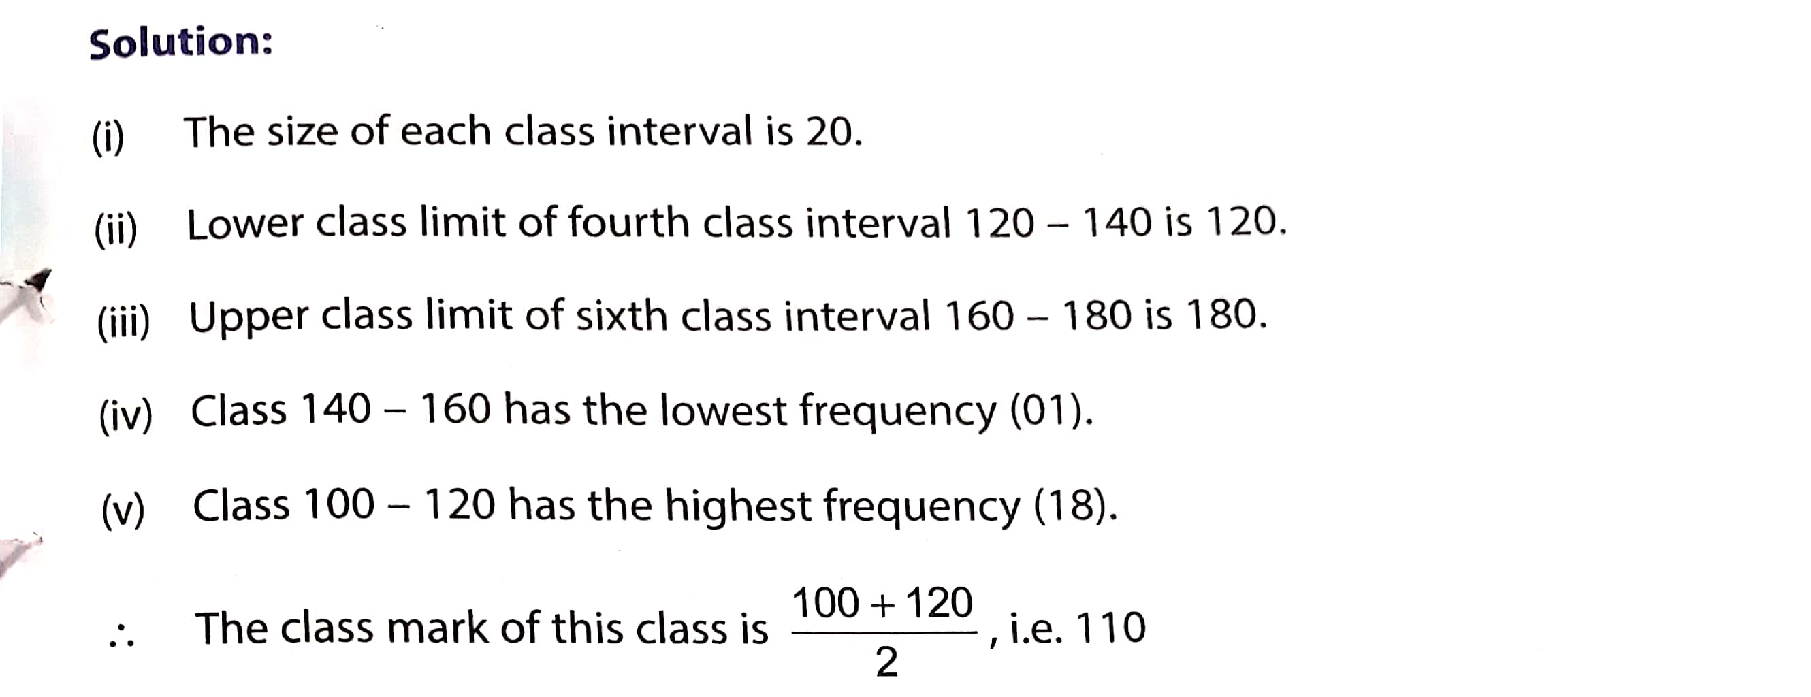

Slide 7
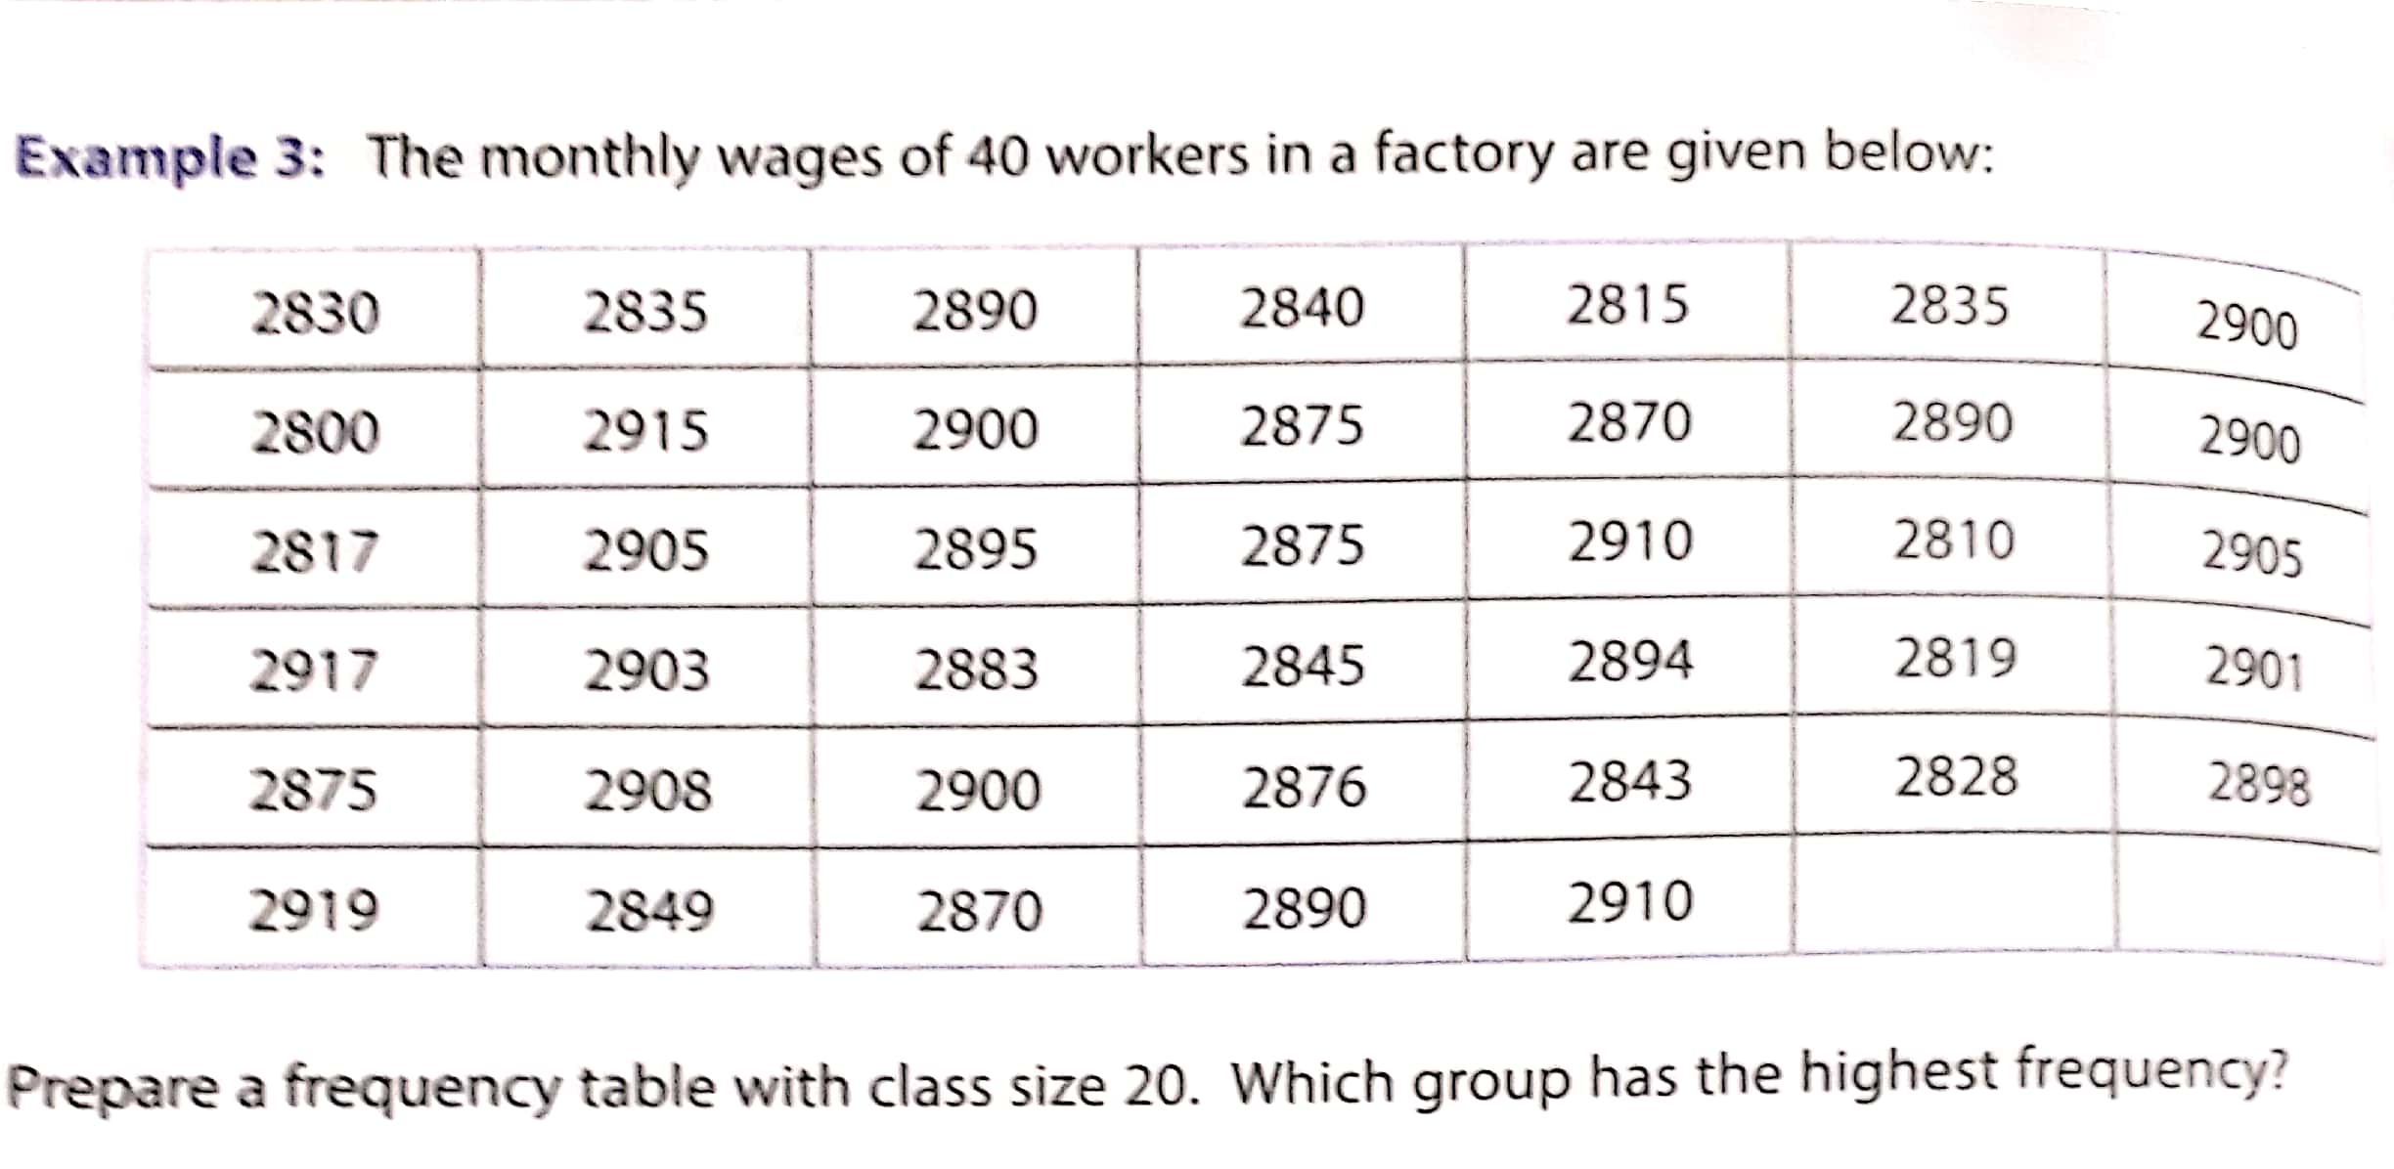
Solution:

Slide 8
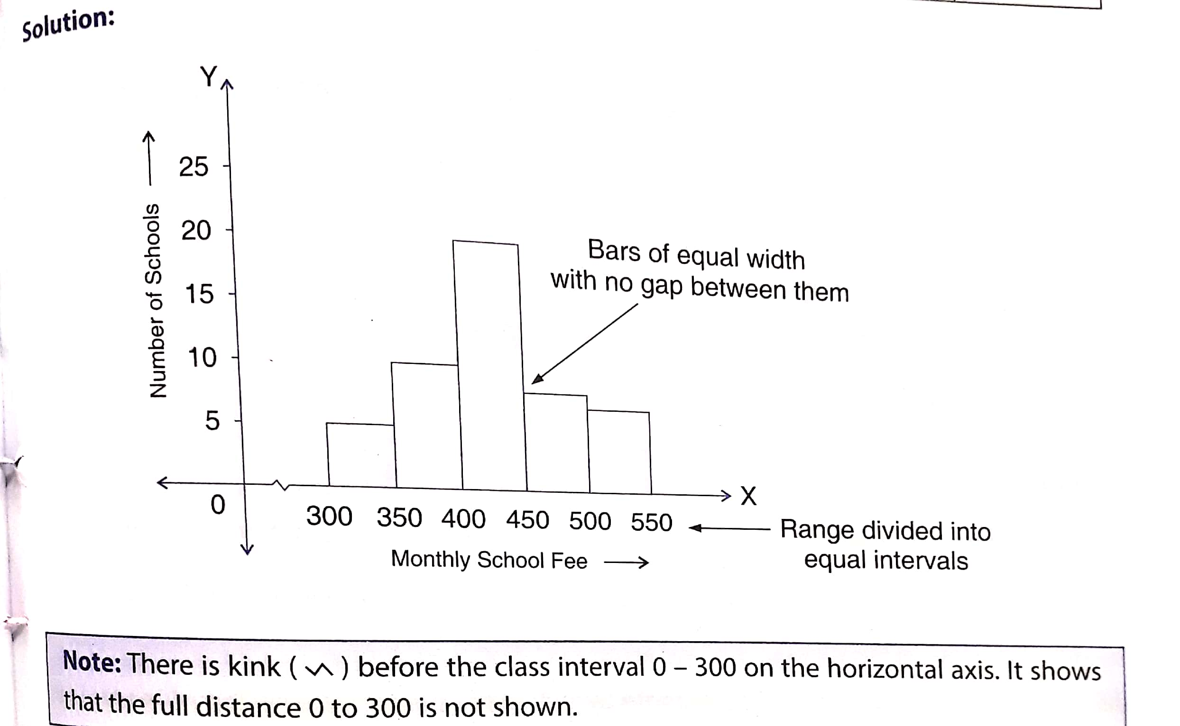

Slide 9
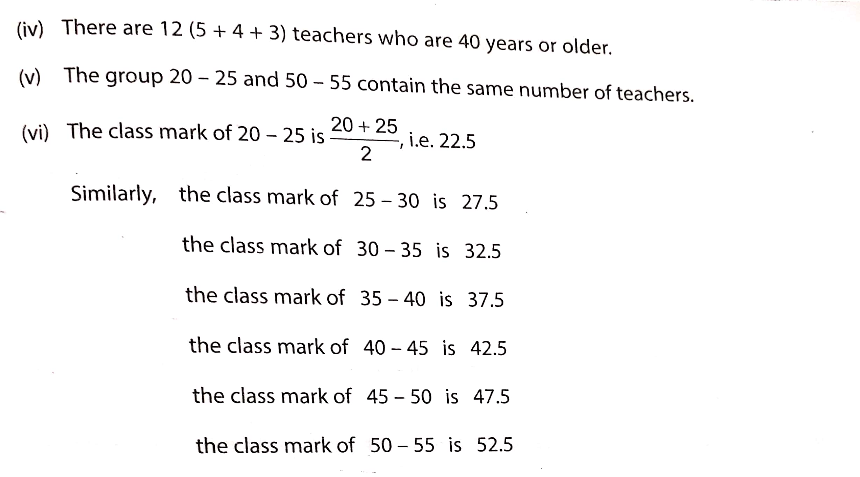

Slide 10
Worksheet 1
Q1.
Soln:
AGE (IN YEARS) | TALLY MARK | NUMBER OF STUDENTS
12 | IIII | 5
13 | IIII IIII | 9
14 | IIII IIII II | 12
15 | IIII | 4
TOTAL |  | 30

Slide 11
Q3.
Soln:
WAGES (IN `) | TALLY MARK | NUMBER OF STUDENTS
150 | III | 3
200 | IIII | 5
250 | IIII | 4
300 | II | 2
350 | I | 1
TOTAL |  | 15

Slide 12
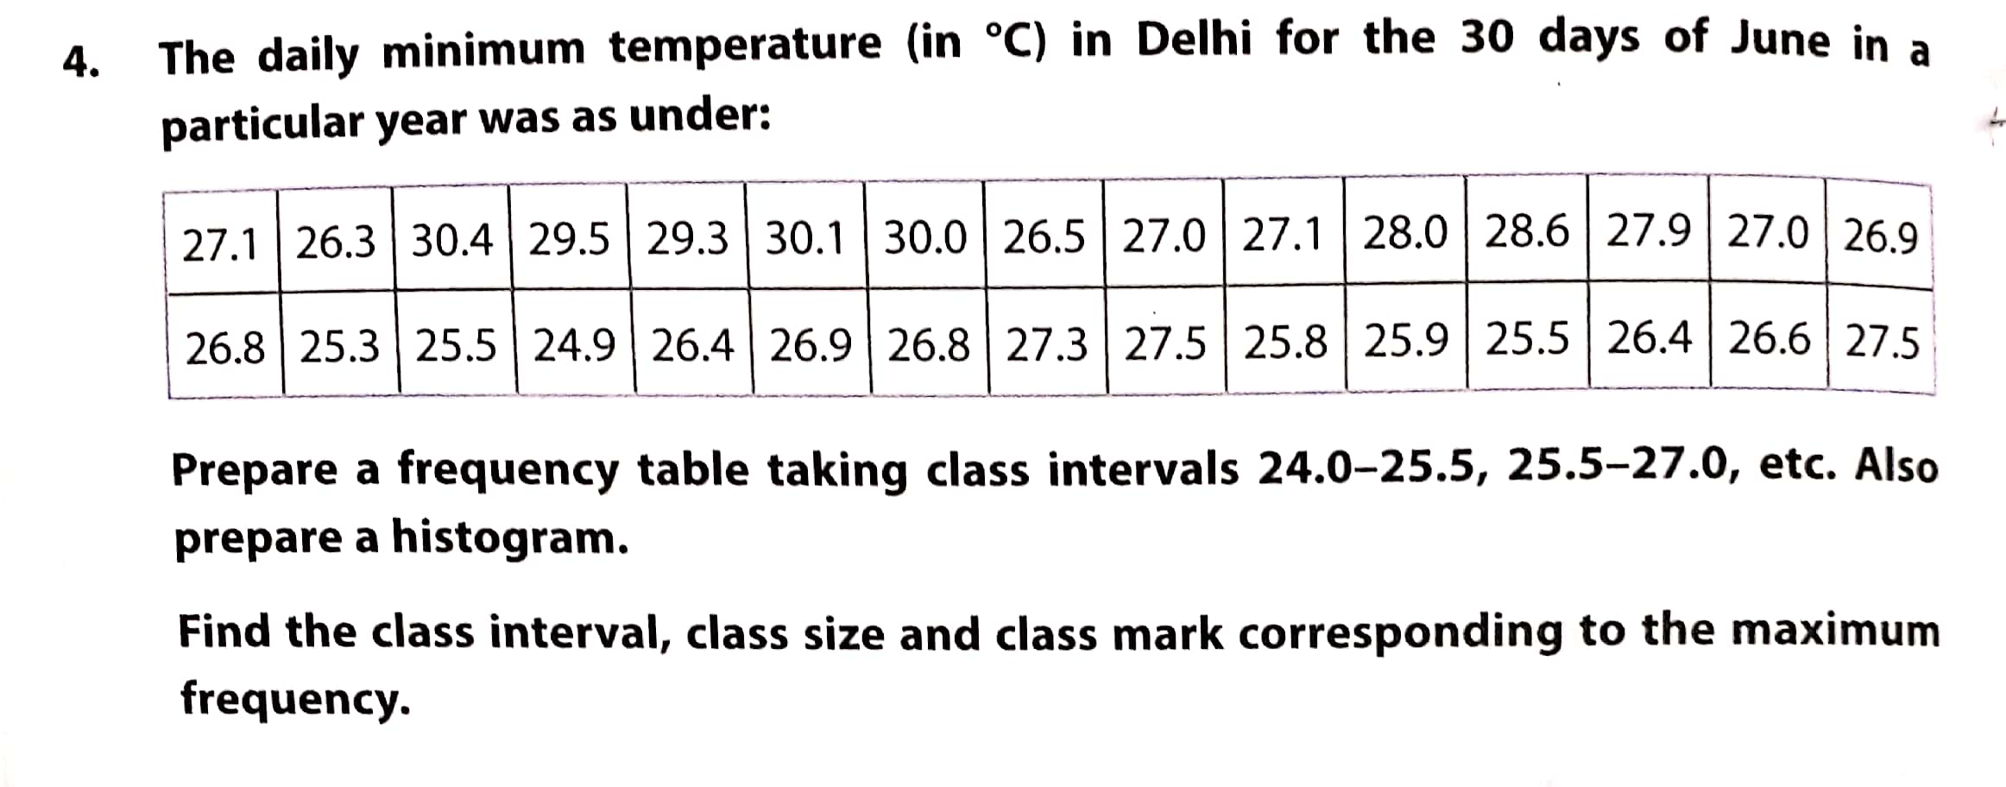
Range of wages = Highest wage – Lowest wage
= ` (350 – 150)
= `200
2 workers are getting `300.
1 workers is getting the maximum wage i.e. `350.
Q4.

Slide 13
Soln:
MIN. TEMPERATURE (IN °C) | TALLY MARK | NUMBER OF DAYS
24.0 – 25.5 | II | 2
25.5 – 27.0 | IIII IIII III | 13
27.0 – 28.5 | IIII IIII | 9
28.5 – 30.0 | III | 3
30.0 – 31.5 | III | 3
TOTAL |  | 30
Corresponding to Maximum Frequency (i.e 13)
(i) Class Interval : 25.5 – 27.0
(ii) Class Size = Upper Limit – Lower Limit
= 27.0 – 25.5
= 1.5 °C
(iii) Class Mark = $\frac{Upper Limit + Lower Limit}{2}$
= $\frac{25.5 + 27.0}{2}$
= 26.25

Slide 14
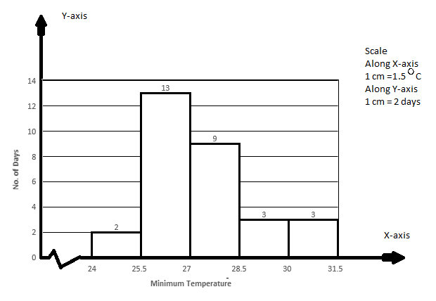
Video Link
https://www.youtube.com/watch?v=iXDtIz0maeg

Slide 15
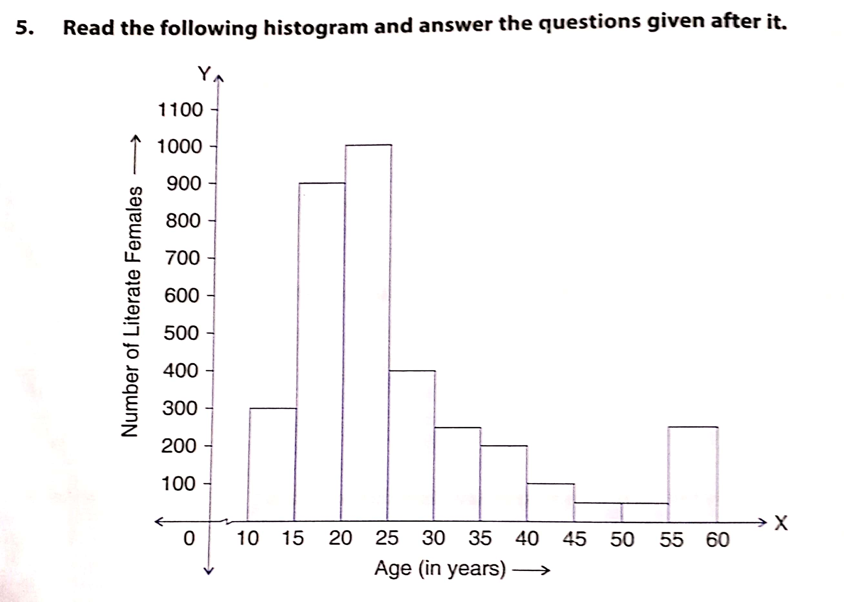
Q5.
What information is depicted by the above histogram?
Ans: The histogram shows the number of literate females in different age groups.

Slide 16
(ii) In which age group is the number of literate females maximum?
Ans: The number of literate female are maximum in the age group 25 – 30 years.
(iii) In which age group is the number of literate females minimum?
Ans: The number of literate female are minimum in the age group 45 – 55 years.
(iv) How many females below 35 years of age are literate?
Ans: Number of females below 35 years of age are literate = 300 + 900 + 1000 + 400 + 250
= 2850 females
Q8.

Slide 17
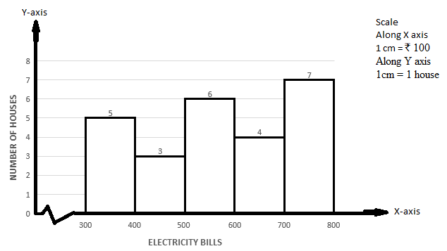
Soln:
ELECTRICITY BILLS(IN ` ) | TALLY MARK | NUMBER OF HOUSES
300 – 400 | IIII | 5
400 – 500 | III | 3
500 - 600 | IIII I | 6
600 - 700 | IIII | 4
700 - 800 | IIII II | 7
TOTAL |  | 25

Slide 18
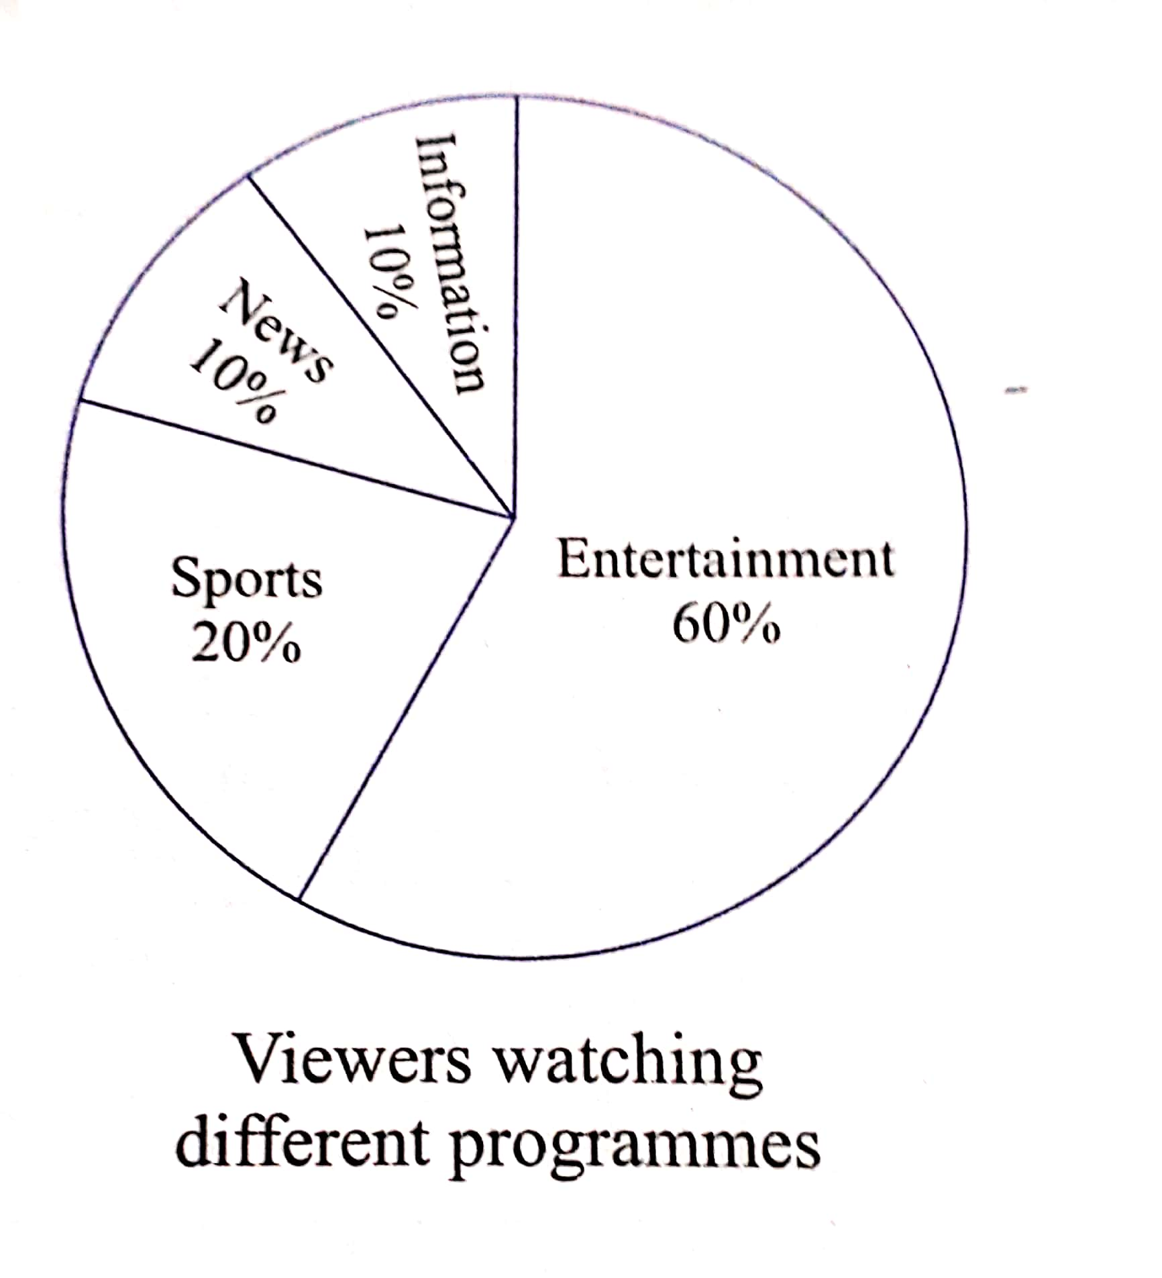
Circle graph or pie chart
A pie chart consists of a circle divided into as many sectors as there are classes in a frequency distribution. The size of the sector is proportional to the frequency of the class represented by the sector.
WORKSHEET-2
Find the fraction of the circle representing each of the information given below:
(i)
S.NO. | PROGRAMME | % OF VIEWERS | FRACTION OF CIRCLE
1 | ENTERTAINMENT | 60% | $\frac{60}{100}$ = $\frac{3}{5}$
2 | SPORTS | 20% | $\frac{20}{100}$ = $\frac{1}{5}$
3 | NEWS | 10% | $\frac{10}{100}$ = $\frac{1}{10}$
4 | INFORMATION | 10% | $\frac{10}{100}$ = $\frac{1}{10}$
 |  | TOTAL :100%

Slide 19
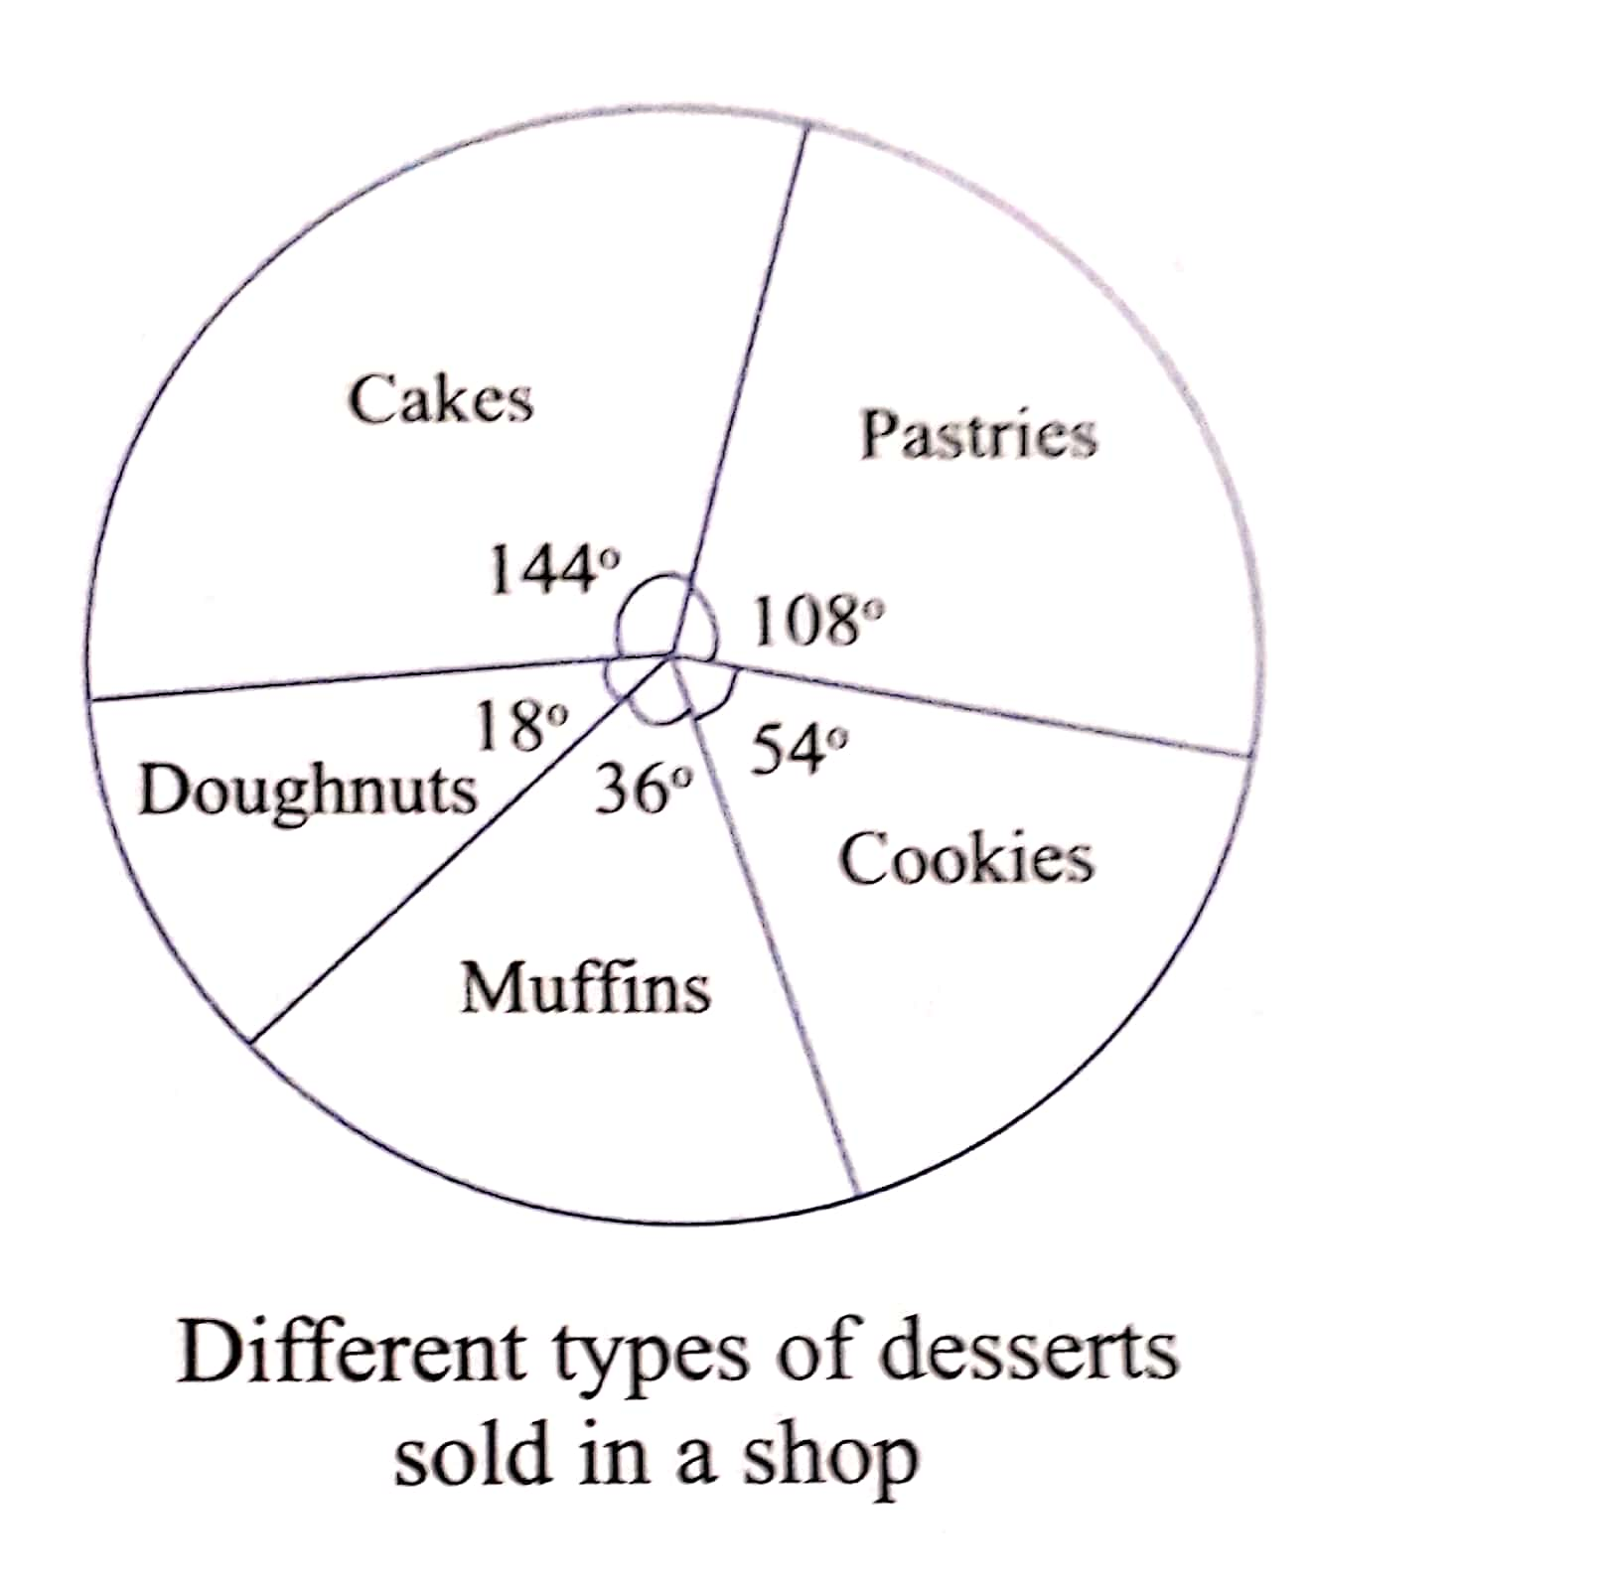
(iii)
S.NO. | DESSERTS | SECTORS | FRACTION OF CIRCLE
1 | CAKES | 144° | $\frac{144}{360}$ = $\frac{2}{5}$
2 | DOUGHNUTS | 18° | $\frac{18}{360}$ = $\frac{1}{20}$
3 | MUFFINS | 36° | $\frac{36}{360}$ = $\frac{1}{10}$
4 | COOKIES | 54° | $\frac{54}{360}$ = $\frac{3}{20}$
5 | PASTRIES | 108° | $\frac{108}{360}$ = $\frac{3}{10}$
 |  | TOTAL :360°

Slide 20
VALUE BASED QUESTION
Prepare a frequency distribution and draw a histogram for the above data
WEIGHTS | TALLY MARK | NUMBER OF STUDENTS
35 – 45 | IIII | 4
45 – 55 | IIII IIII I | 11
55 - 65 | IIII IIII III | 13
65 - 75 | II | 2
TOTAL |  | 30

Slide 21
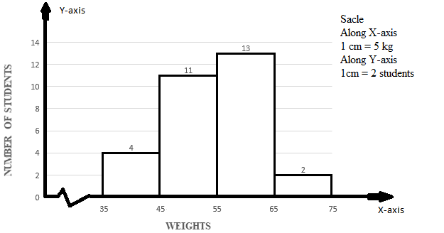
b) In what weight range do most students lie?
Ans: Most students lie in the weight range of 55 – 65 kg.
c) How many students got selected for the training?
Ans: 11 students are selected for the training.
d) What percentage of students weigh more than 55 kg?
Ans: Number of students having weight more than 55kg = 13 + 2 = 15
Percentage of students weighing more than 55 kg = $\frac{15}{30}$ x 100 = 50%

Slide 22
e) What factors are responsible for so many children being overweight and obese these days?
Ans: Lack of exercise and consumption of junk food are responsible for children being overweight.
f) How can healthy eating habits be developed amongst the students of this age group?
Ans: By spreading awareness of advantages of healthy living.
BRAIN TEASERS
Q1 B (b)
Soln: Range = Maximum Height – Minimum Height
= (128 – 72) cm
= 56 cm

Slide 23
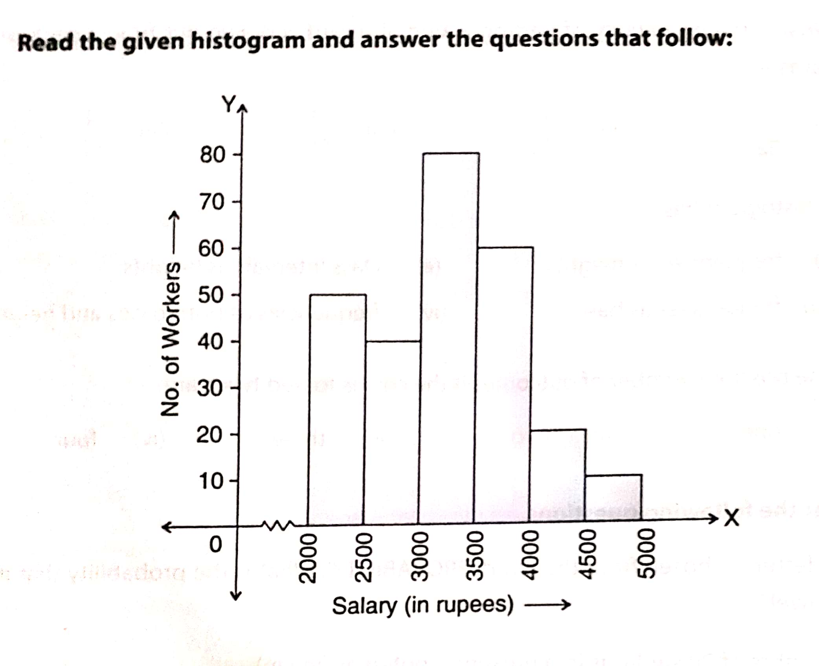
Q2.
i) What information is depicted by the above histogram?
Ans: The histogram depicts the salary obtained by workers.
ii) Prepare a grouped frequency table for the histogram.
Ans:
SALARY (`) | NUMBER OF WORKERS
2000 – 2500 | 50
2500 – 3000 | 40
3000 – 3500 | 80
3500 – 4000 | 60
4000 – 4500 | 20
4500 – 5000 | 10
TOTAL | 260
iii) Find the number of workers having salaries more than `3500.
Ans: Number of workers having salaries more than `3500 = 60 + 20 + 10 = 90
(iv) In which group is the number of workers maximum?
Ans: The number of workers are maximum in the group 3000 – 3500.

Slide 24
(v) In which group is the number of workers minimum?
Ans: The number of workers are minimum in the group 4500 – 5000.
(vi) What are the class marks of all the class intervals?
Ans: Class mark of interval 2000 – 2500 = $\frac{Upper Limit + Lower Limit}{2}$
= $\frac{2000 + 2500}{2}$ = 2250
Class mark of interval 2500 – 3000 = $\frac{2500 +3000}{2}$ = 2750
Similarly,
Class mark of interval 3000 – 3500 = 3250
Class mark of interval 3500 – 4000 = 3750
Class mark of interval 4000 – 4500 = 4250
Class mark of interval 4500 – 5000 = 4750

Slide 25
Q3.
Soln:
WATER BILL (IN `) | TALLY MARK | NUMBER OF HOUSES
0 – 15 | II | 2
15 – 30 | II | 2
30 – 45 | IIII II | 7
45 – 60 | II | 2
60 – 75 | IIII | 4
75 – 90 | IIII I | 6
90 – 105 | III | 3
105 – 120 | IIII | 4
TOTAL |  | 30

Slide 26
HOMEWORK
WORKSHEET -1
Q2, Q6, Q7, Q9, Q10
WORKSHEET – 2
(ii), (iv)
BRAIN TEASERS – Q4

