Slide 1
MY LIVING WORLD
CHAPTER – III
CLASS III

Slide 2
LEAF
Leaf is a green coloured part attached to the branches of the plant.

Slide 4
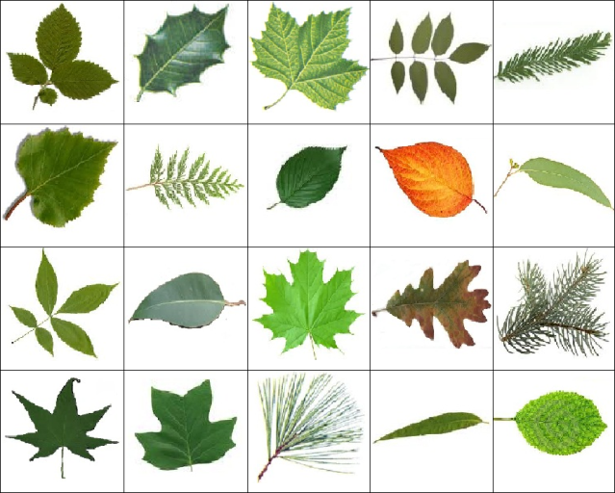
DIFFERENT TYPES OF LEAVES

Slide 6
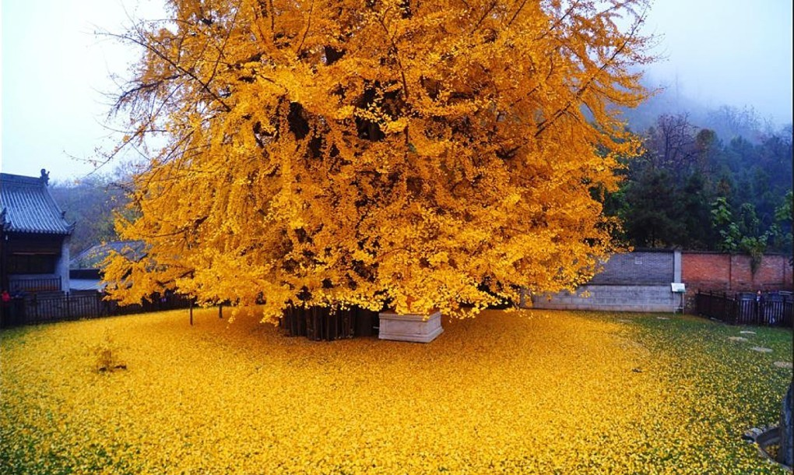
SHEDDING OF LEAVES

Slide 7
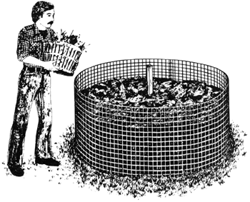
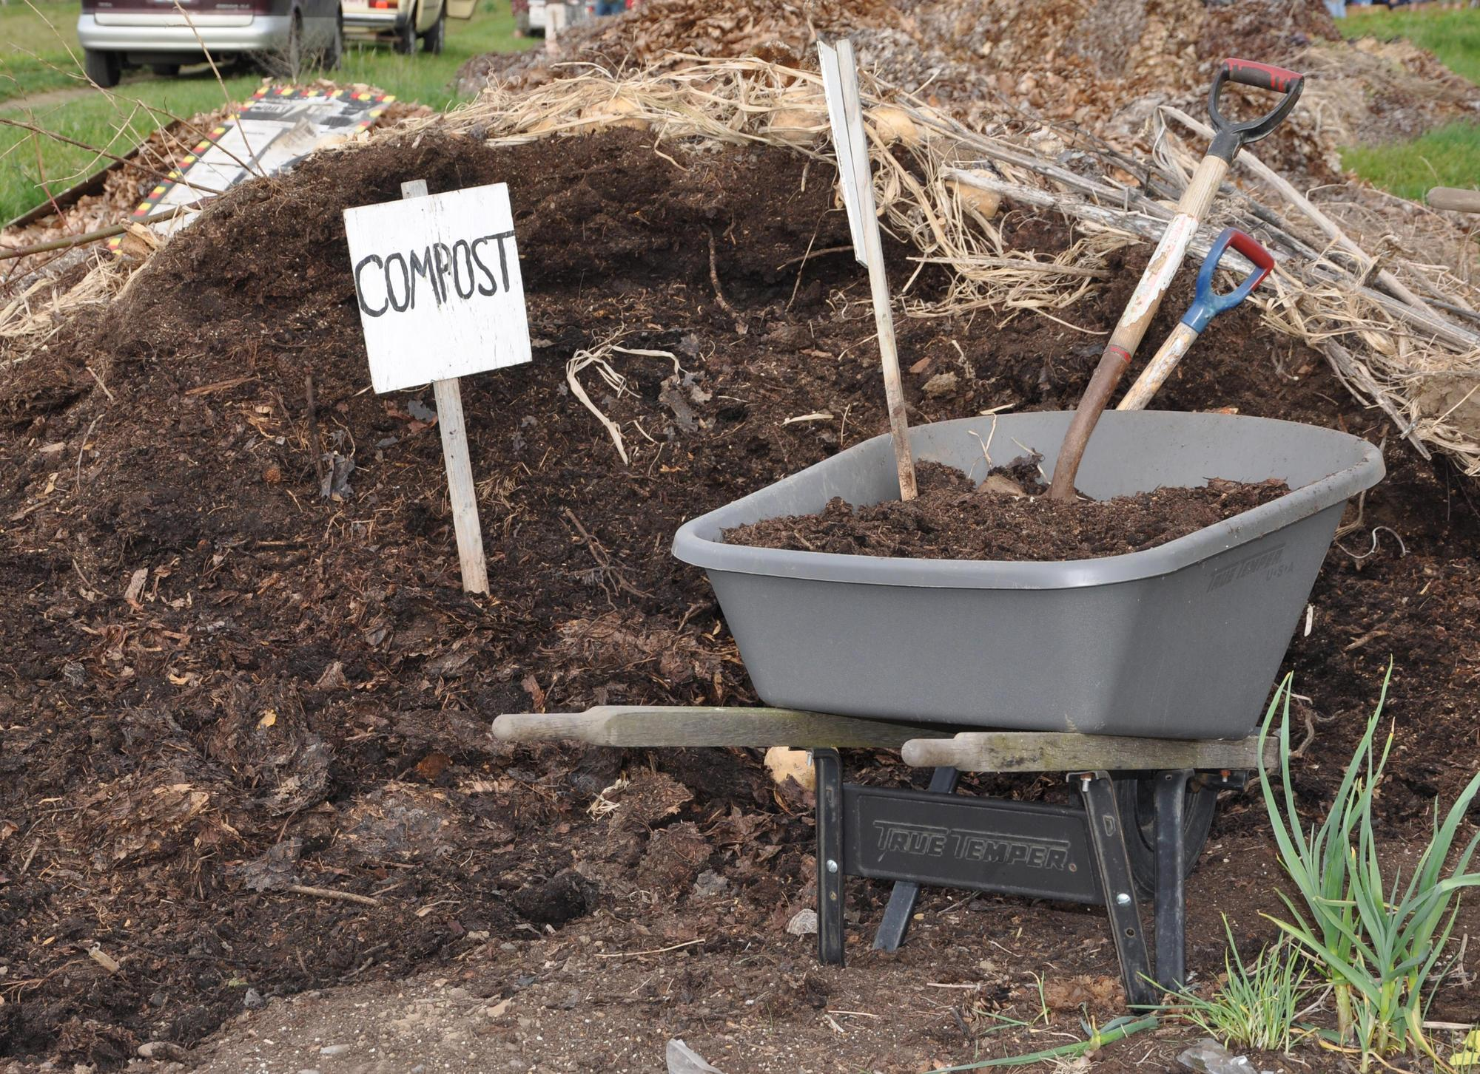
COMPOST OF THE LEAVES

Slide 8
ASSIGNMENT
Draw different types of leaves.

Slide 9
USES OF LEAVES:
For garnishing food & vegetable
For eating food in food plate
For wrapping materials
For tea
For curtain designs, saree borders, painting rangoli etc

Slide 10
ASSIGNMENT
Write the name of leaves used as
garnishing food – _______________ _______________
vegetable – _______________ _______________
medicine – _______________ _______________

Slide 11
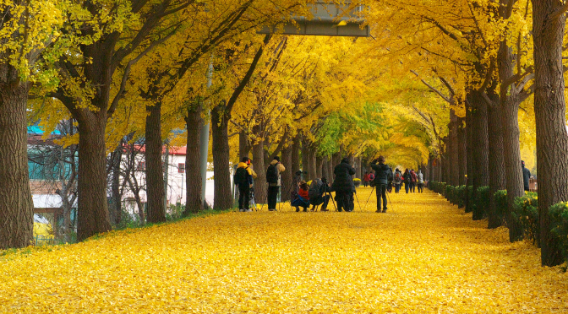
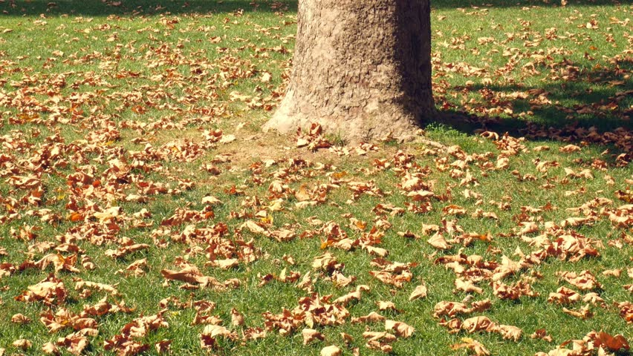
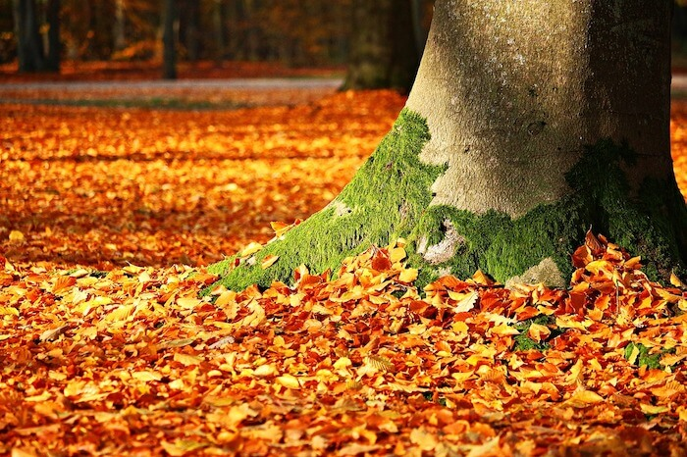
SHEDDING OF LEAVES:
When the leaves become old they don't perform their function well and plants shed them off. New leaves then grow up to take their place.

Slide 12
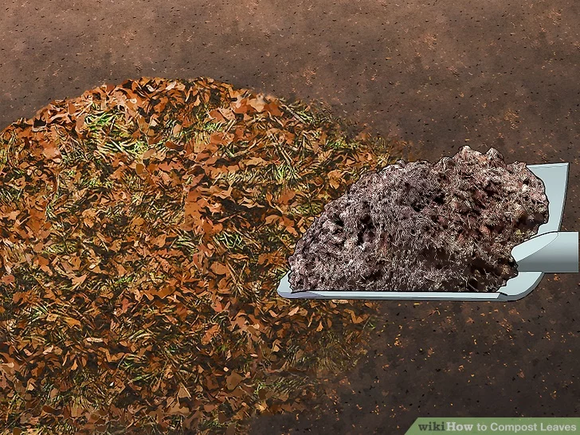
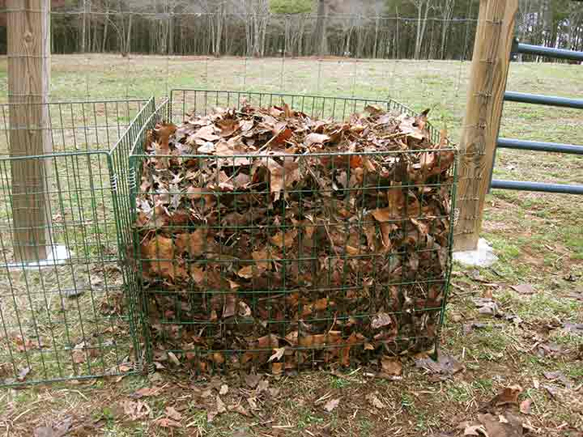
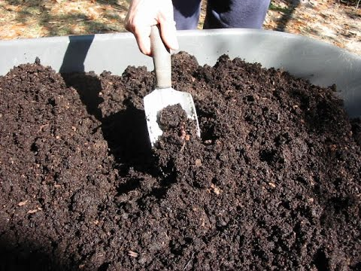
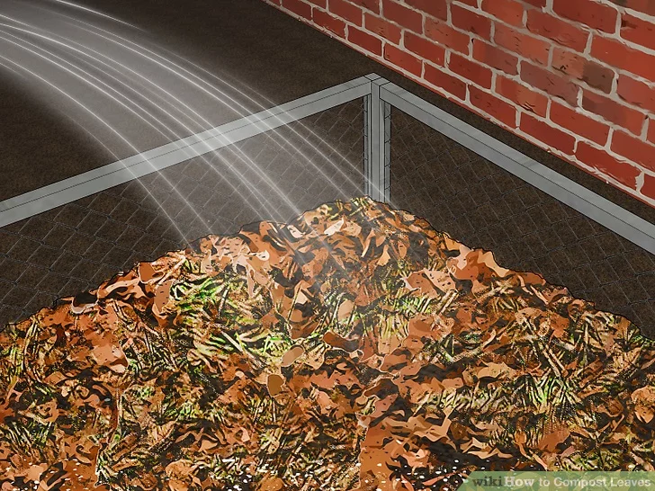
COMPOST THE LEAVES:
Compost can be made by collecting and dumping the fallen leaves along with our kitchen waste in a pit. The covered it with moist soil, after two or three month it become compost. It help the plants to grow better.

Slide 13
ASSIGNMENT
Draw different types of leaves.
Draw two medicinal leaves.
Draw two leafy vegetables.

