Slide 1
Std: IV
Subject: Social Science

Slide 2
Topic: Bricks and Bridges
Subtopic:

Slide 3
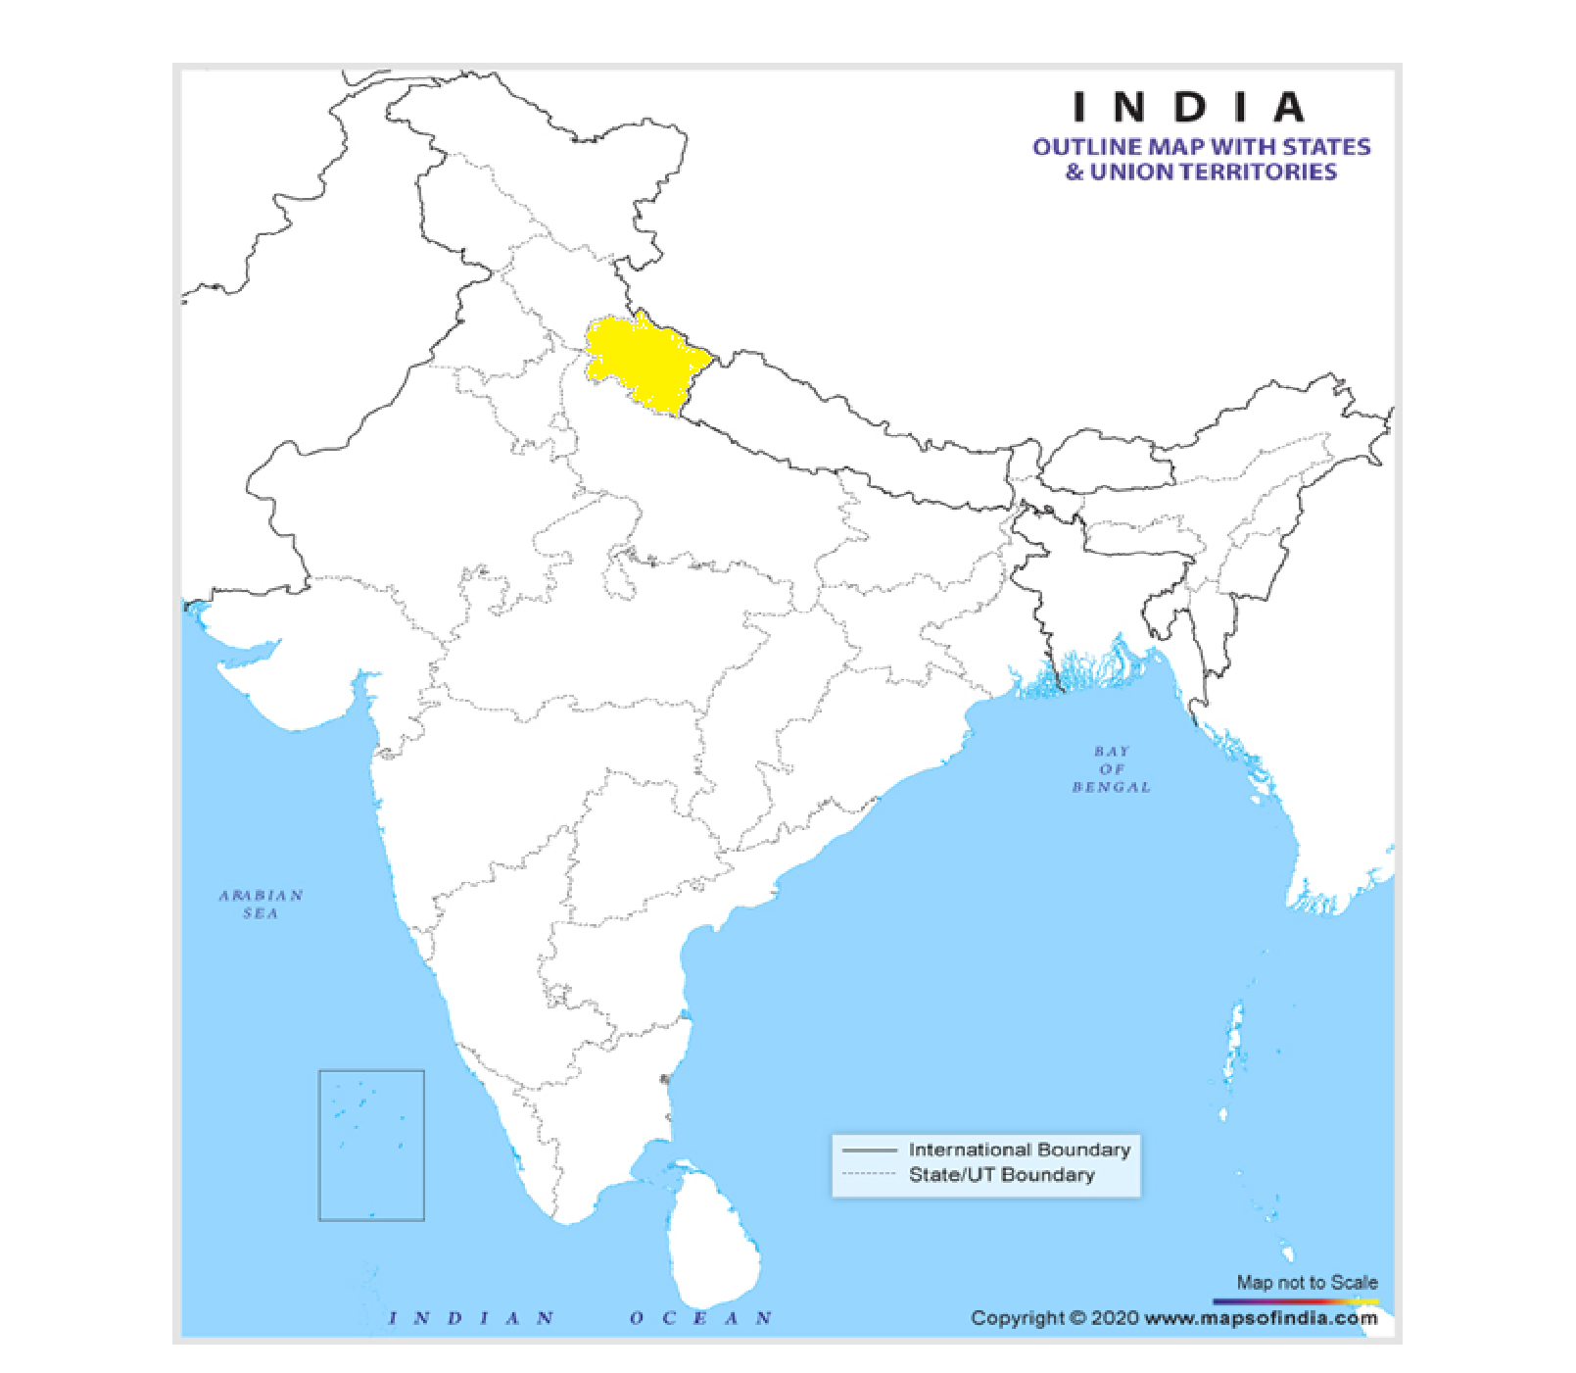
Type: Suspension Bridge
Name: Lakshman Jhula
State: Uttarakhand

Slide 4
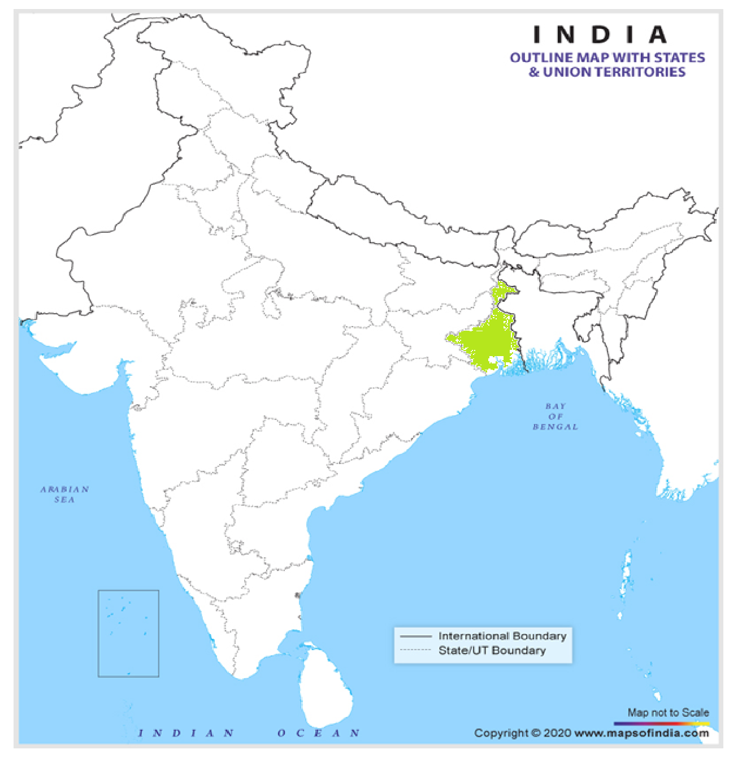
Type: Cantilever Bridge
Name: Howrah Bridge
State: West Bengal

Slide 5
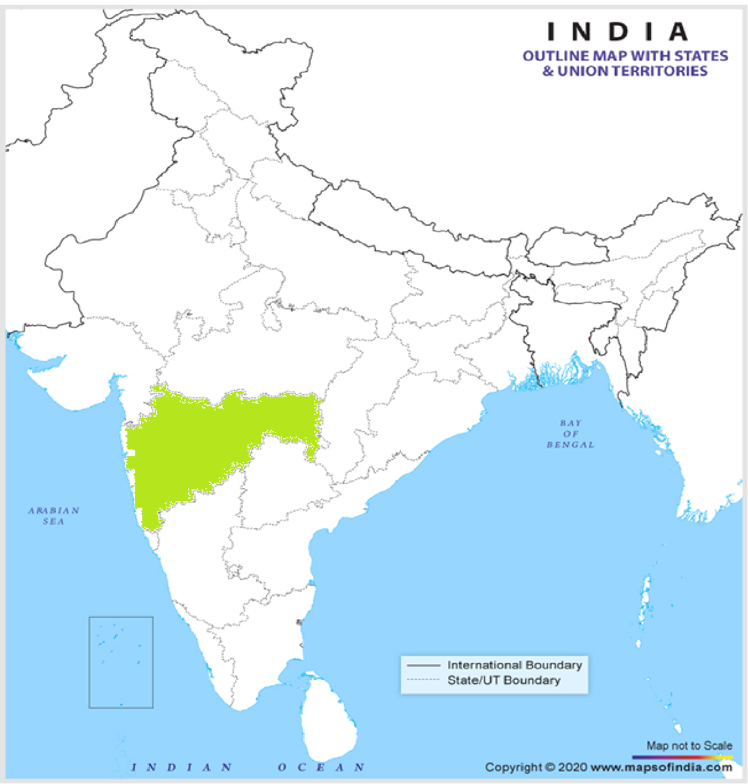
Type: Cable Stayed Bridge
Name: Bandra Sea Link Bridge
State: Maharashtra

Slide 6
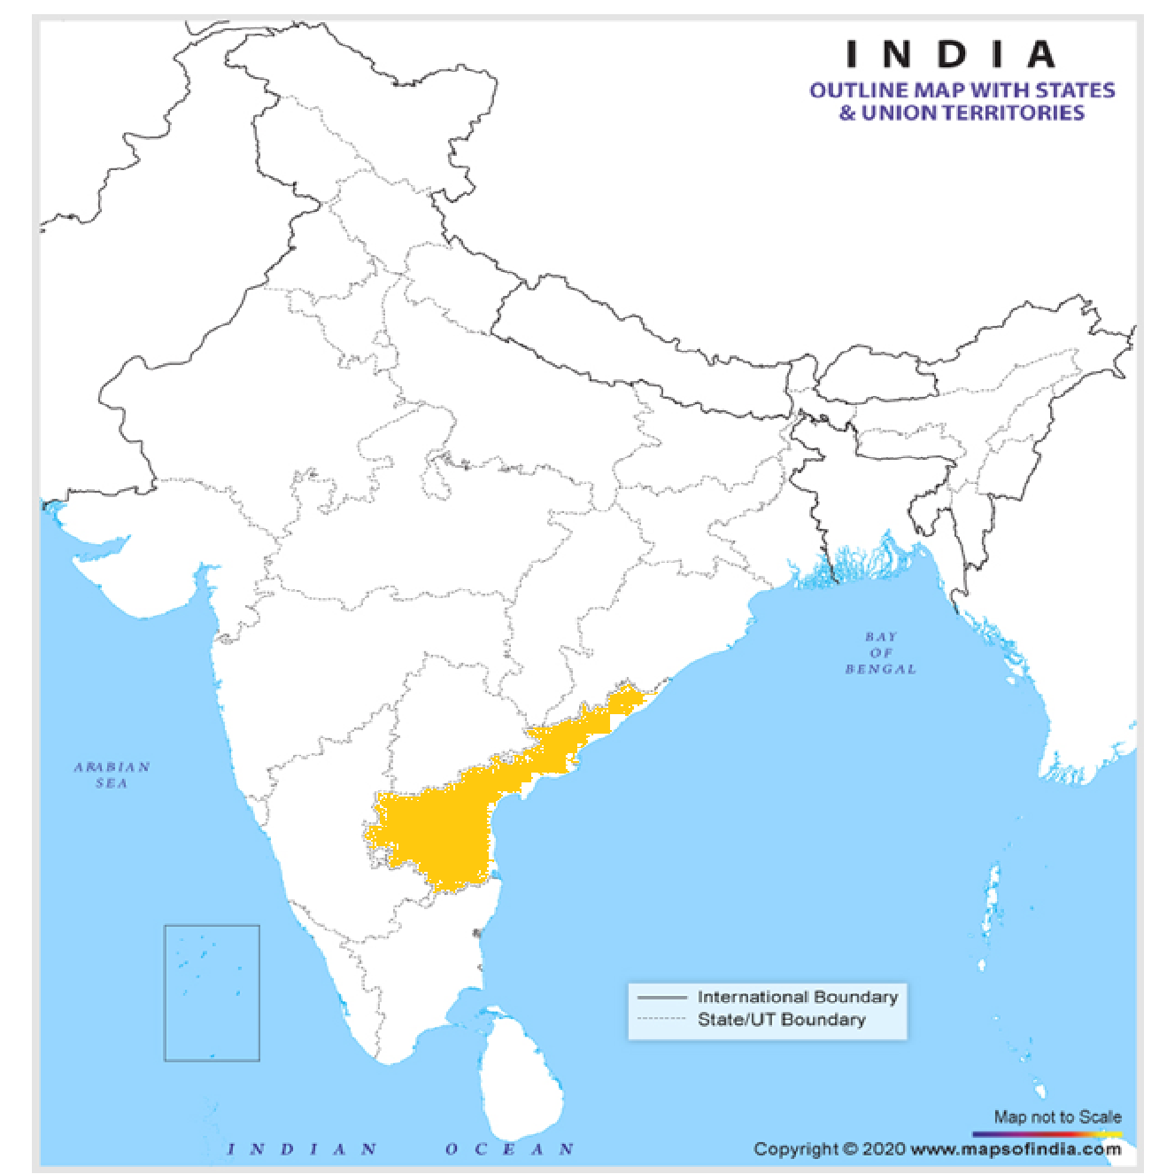
Type: Truss Bridge
Name: Rajamundry Railway Bridge
State: Andhra Pradesh

Slide 7
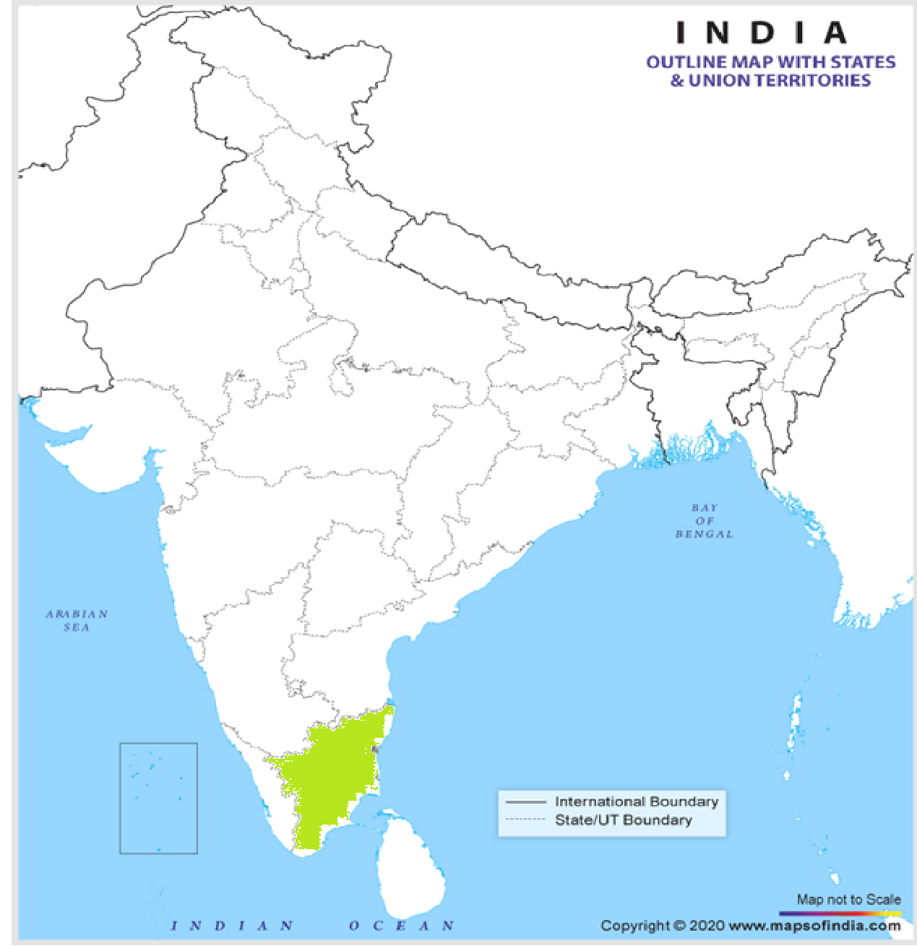
Type: Movable Bridge
Name: Golden Bridge
State: Tamil Nadu

Slide 8
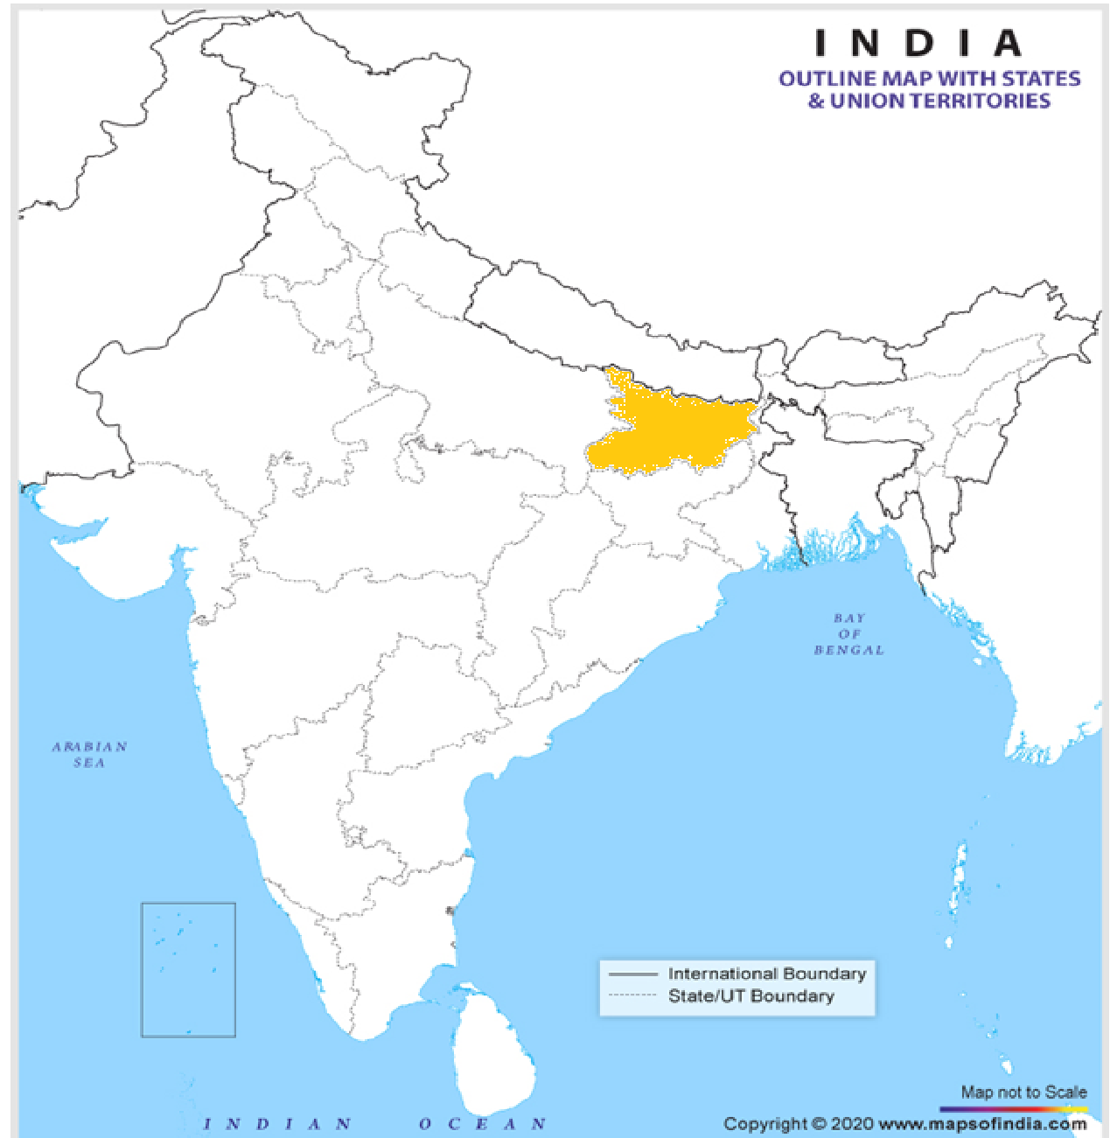
Type: Beam Bridge
Name: Gandhi Setu
State: Bihar

Slide 9
Type: Arch Bridge
Name: Godavari Arch Bridge
State: Andhra Pradesh

Slide 10
Type: Flyover
Name: J. J. Flyover
State: Maharashtra

Slide 11
Sr. No | Type of bridge | Name of Indian bridges | State
1. | Suspension | Lakshman Jhula | Uttarakhand
2. | Cantilever | Howrah Bridge | West Bengal
3. | Cable Stayed | Bandra Sea Link Bridge | Maharashtra
4. | Truss bridge | Rajahmundry Railway Bridge | Andhra Pradesh
5. | Movable bridge | Golden Bridge | Tamil Nadu
6. | Beam bridge | Gandhi Setu | Bihar
7. | Arch bridge | Godavari Arch Bridge | Andhra Pradesh
8. | Flyover | J.J. Flyover | Maharashtra

