Slide 1
DAV INSTITUTIONS, ODISHA ZONE-1
CLASS-X
SUBJECT:MATHEMATICS
TOPIC : POLYNOMIALS

Slide 2
CHAPTER-2 (POLYNOMIALS)
CONTENTS
Introduction.
Geometrical Meaning of Zeroes of a Polynomial.
Relationship Between Zeroes and coefficients of a Polynomial.
Division Algorithm for Polynomials.

Slide 3
LEARNING OBJECTIVES:
Students will be able to recall the concept of polynomials, degree of polynomials, value of a polynomials and zeroes of the polynomials.
They will be able to present the zeroes of the polynomials geometrically and identify the zeroes from it.
They will be able to identify the number of zeroes and types of graph for different polynomials.
They will be able to apply the relationship between the zeroes and coefficients of a polynomial to find the zeroes and nature of the zeroes.
They will be able to find the factors of polynomial s when some factors are given by using Division Algorithm to it.
They will be able to factorize a polynomial to find the number of linear factors it has by applying Factor theorem , Remainder theorem and Division Algorithm.

Slide 4
SESSION-1
Introduction to Polynomials

Slide 5
Algebraic Expressions
An algebraic expression is an expression made up of variables and constants along with mathematical operators.
A term is a product of variables and constants. A term can be an algebraic expression in itself.
Examples of a term : 3 ,which is just a constant.
2x, which is the product of constant ‘2’ and the variable ‘x’
4xy, which is the product of the constant ‘4’ and the variables ‘x’ and ‘y’.
5x²y, which is the product of 5, x, x and y.
The constant in each term is referred to as the Numerical coefficient.
Example of an algebraic expression : 3x²y+4xy+5x+6 which is the sum of four terms 3x²y, 4xy, 5x and 6
An algebraic expression can have any number of terms. The coefficient in each term can be any real number. There can be any number of variables in an algebraic expression. The exponent on the variables, however, must be rational numbers.

Slide 6
Polynomial
An algebraic expression can have exponents as rational numbers. However, a polynomial is an algebraic expression in which the exponent on any variable is a whole number or we may say non negative integers.
5x³+3x+1 is an example of a polynomial. It is an algebraic expression as well.
2x+3√x is an algebraic expression, but not a polynomial. – since the exponent of x is 1/2 which is not a whole number.
STANDARD FORM: a_{n}x^{n}+a_{n-1}x^{n-1}+…………..+a₁x¹+a₀x⁰
Where n is a non negative integers.
a₀, a₁, ……a_{n} are constants (Real numbers)

Slide 7
Degree of a Polynomial
For a polynomial in one variable – the highest exponent on the variable in a polynomial is the degree of the polynomial.
Example: The degree of the polynomial x²+2x+3 is 2, as the highest power of x in the given expression is 2.
TYPES OF POLYNOMIALS
Polynomials can be classified based on
a) Number of terms
b) Degree of the polynomial.
Types of polynomials based on the number of terms
a) Monomial : A polynomial with just one term. Example – 2x, 6x², 9xy
b) Binomial : A polynomial with two terms.
Example : 4x²+x, 5x+4
a) Trinomial : A polynomial with three terms.
Example : x²+3x+4

Slide 8
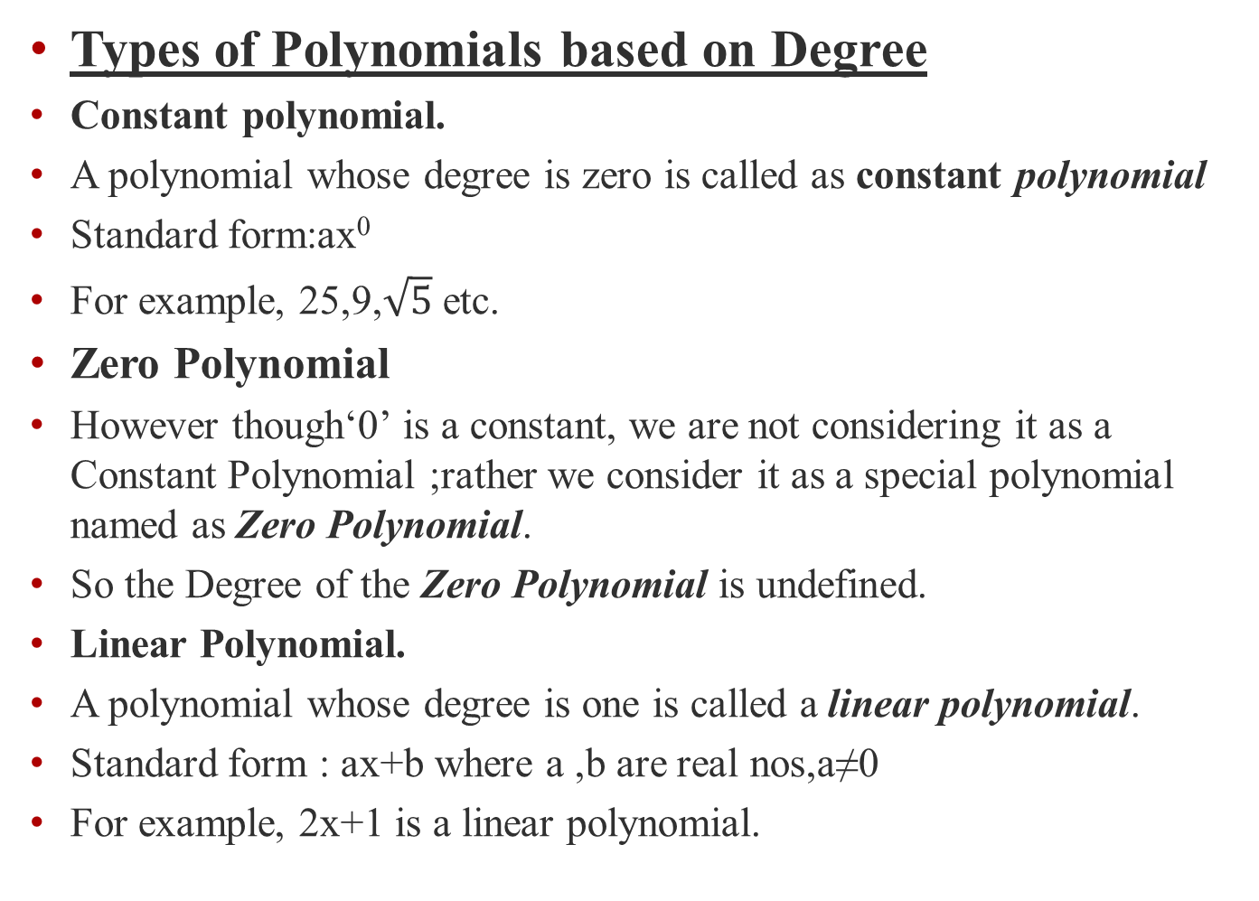
Types of Polynomials based on Degree
Constant polynomial.
A polynomial whose degree is zero is called as constant polynomial
Standard form:ax⁰
For example, 25,9,$\sqrt{5}$ etc.
Zero Polynomial
However though‘0’ is a constant, we are not considering it as a Constant Polynomial ;rather we consider it as a special polynomial named as Zero Polynomial.
So the Degree of the Zero Polynomial is undefined.
Linear Polynomial.
A polynomial whose degree is one is called a linear polynomial.
Standard form : ax+bwhere a ,b are real nos,a≠0
For example, 2x+1 is a linear polynomial.

Slide 9
Quadratic Polynomial.
A polynomial of degree two is called as quadratic polynomial.
Standard form:ax²+bx+c where a ,b ,c are real numbers,a≠0
For example, 3x²+8x+5 is a quadratic polynomial.
Cubic Polynomial.
A polynomial of degree three is called a cubic polynomial.
Standard form:ax³+bx²+cx+d where a,b,c,d are real numbers, a≠0
For example, 2x³+5x²+9x+15 is a cubic polynomial.

Slide 10

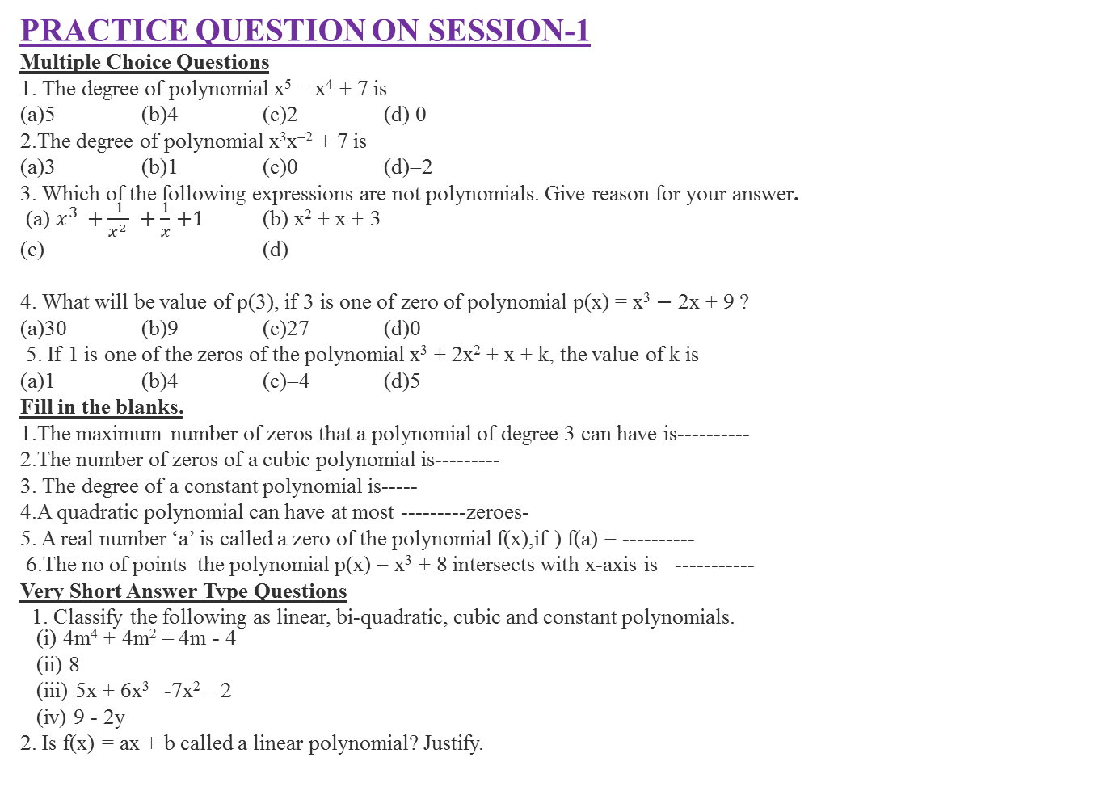
PRACTICE QUESTION ON SESSION-1
Multiple Choice Questions
1. The degree of polynomial x⁵− x⁴ + 7 is
(a)5(b)4(c)2(d) 0
2.The degree of polynomial x³x⁻² + 7 is
(a)3(b)1(c)0(d)−2
3.Which of the following expressions are not polynomials. Give reason for your answer.
(a) $x^{3 }+\frac{1}{x^{2 }} +\frac{1}{x}$ $+1$ (b) x² + x + 3
(c) (d)
4. What will be value of p(3), if 3 is one of zero of polynomial p(x) = x³$−$ 2x + 9 ?
(a)30(b)9(c)27(d)0
5. If 1 is one of the zeros of the polynomial x³ + 2x² + x + k, the value of k is
(a)1(b)4(c)−4(d)5
Fill in the blanks.
1.The maximum number of zeros that a polynomial of degree 3 can have is----------
2.The number of zeros of a cubic polynomial is---------
3. The degree of a constant polynomial is-----
4.A quadratic polynomial can have at most ---------zeroes-
5. A real number ‘a’ is called a zero of the polynomial f(x),if ) f(a) = ----------
6.The no of points the polynomial p(x) = x³ + 8 intersects with x-axis is -----------
Very Short Answer Type Questions
1. Classify the following as linear, bi-quadratic, cubic and constant polynomials.
(i) 4m⁴ + 4m² – 4m - 4
(ii) 8
(iii) 5x + 6x³ -7x² – 2
(iv) 9 - 2y
2. Is f(x) = ax + b called a linear polynomial? Justify.

Slide 11
SESSION-2
Graphical Presentation of polynomials

Slide 12
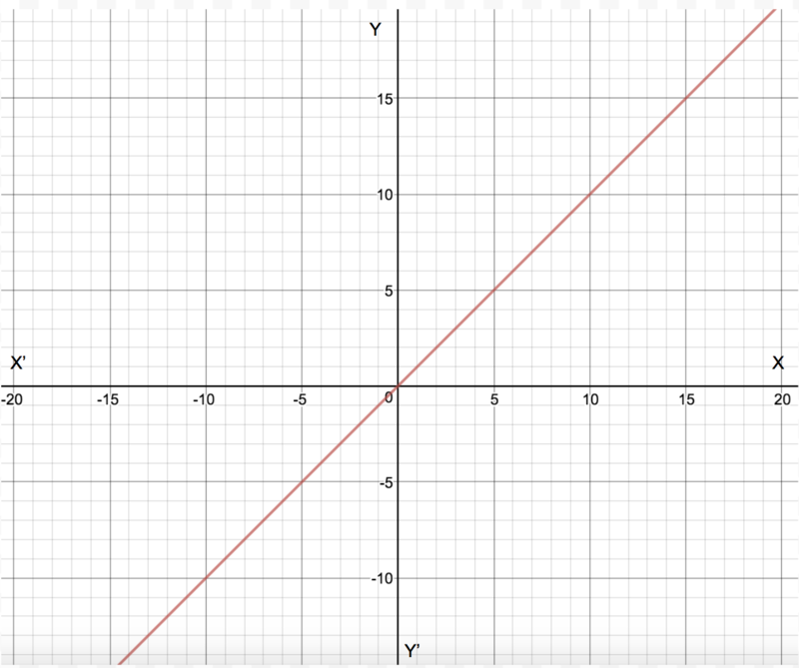
Graphical Representations
Any Polynomial p(x) can be represented geometrically,where p(x) represents the value of the polynomial for different values of x we take.
Each point on the graph represents the x and y coordinates of the point that satisfies x as value of the variable and y as the value of the polynomial.
For example, the polynomial p(x)= x, on a graph, will be a straight line that joins all the points which have their x coordinate equal to their y coordinate. Example :(1,1), (2,2) and so on.

Slide 13
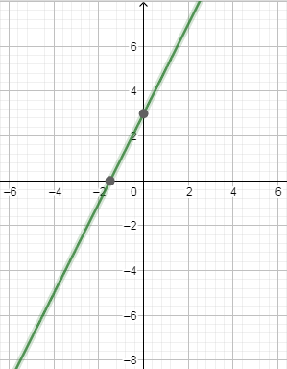
Visualization of a Polynomial
Geometrical Representation of a
Linear Polynomial
The graph of a linear polynomial
is a straight line. It cuts the
x-axis at exactly one point.
Linear graph

Slide 14
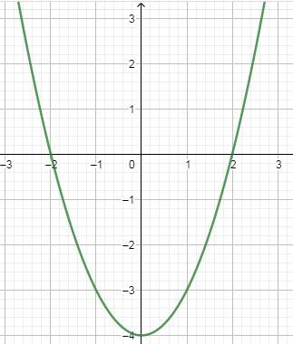
Geometrical Representation of a Quadratic Polynomial
  The graph of a quadratic
  polynomial is a parabola.
  It looks like a U which either opens
  upwards or opens downwards,
  depending on the value of
  a in ax²+bx+c.
  If a is positive then parabola opens
  upwards and if a is negative then it opens downwards.
  It can cut the x-axis at no point, one point or two points.

Slide 15
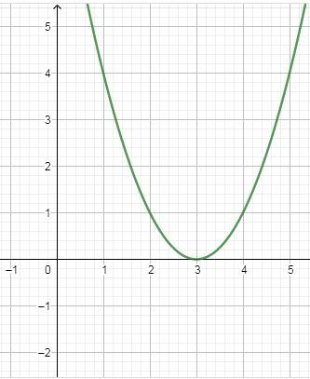
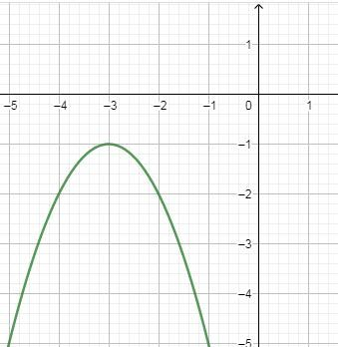
Graph of a polynomial which
cuts the x-axis in two distinct
points (a>0)
Graph of a Quadratic polynomial
which touches the x-axis at one
point (a>0)
Graph of a Quadratic polynomial
that doesn’t touch the x-axis (a<0)

Slide 16
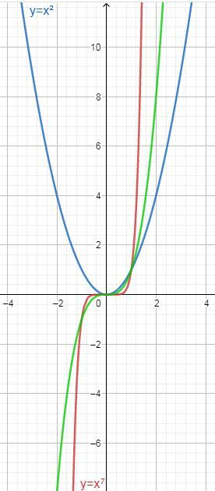
Graph of the polynomial x^{n}
For a polynomial of the form p(x)=x^{n}
where n is a whole number:
as n increases, the graph becomes
steeper or draws closer to the y-axis.
If n is odd, the graph lies in the first
and third quadrants
If n is even, the graph lies in the first
and second quadrants.
Graph of polynomials with different degrees.

Slide 17
PRACTICE QUESTIONS FOR SESSION-2.
1-Which of the following is not the graph
of a quadratic polynomial?
2.What is the geometrical meaning of the zeroes of a polynomial?
3. Explain, what you understand by the expression of the form
P (x) = a₀ + a₁x + a₂ x² + a₃ x³ +………….a_{n} x^{n}
4 Name the point at which the graph represented by y = ax+ b crosses the x axis.

Slide 18
SESSION-3
Zeroes of a Polynomial and it’s Geometrical Meaning

Slide 19
Zeroes of a Polynomial
A zero of a polynomial p(x) is the value of x for which the value of p(x) is 0. If k is a zero of p(x), then p(k)=0.
For example, consider a polynomial p(x)= x²−3x+2.
When x=1, the value of p(x) will be equal to
p(1)=1²−3×1+2
=1−3+2
=0
Since p(x)=0 at x=1, we say that 1 is a zero of the polynomial x²−3x+2 .

Slide 20
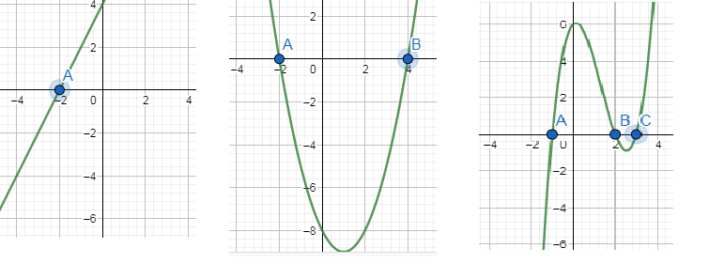
Geometrical Meaning of Zeros of a Polynomial
Geometrically, zeros of a polynomial are the points where its graph cuts the x-axis.
(i) One zero (ii) Two zeros (iii) Three zeros
Here A, B and C correspond to the zeros of the polynomial represented by the graphs

Slide 21
Number of Zeroes
In a general polynomial of degree n has at most n zeroes.
A linear polynomial has one zero,
A quadratic polynomial has at most two zeros.
A cubic polynomial has at most 3 zeros.

Slide 22
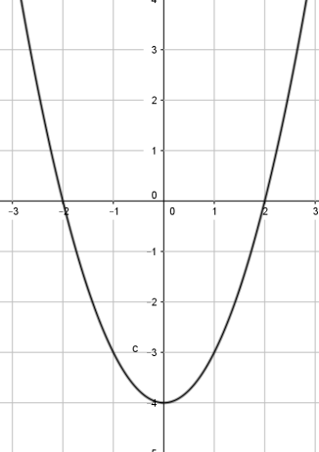
GEOMETRICAL REPRESENTATION OF THE ZEROES OF A QUADRATIC POLYNOMIAL
1.Represent y=x² - 4 (a greater than 0)
x | 2 | 0 | -2 | 1 | -3 | -1
y | 0 | -4 | 0 | -3 | 5 | -3

Slide 23
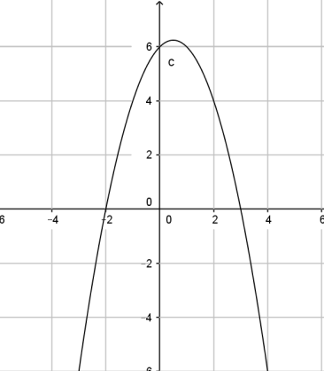
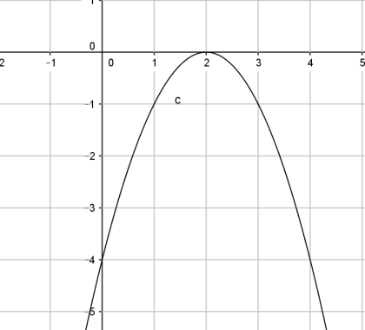
2. Represent y=-x²+x+6(a smaller than 0)
3. Represent y=-x²+4x-4(a smaller than 0)

Slide 24
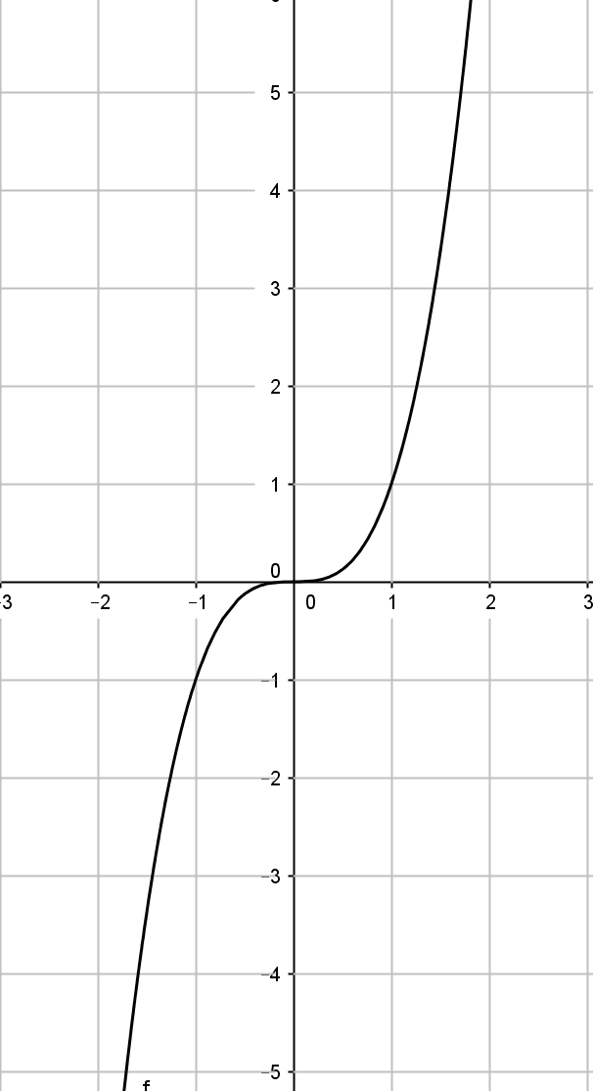
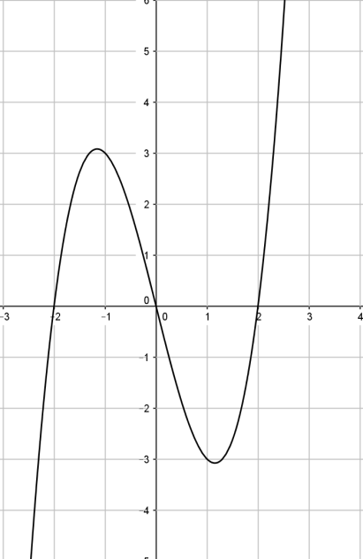
REPRESENTATION OF THE ZEROES OF A CUBIC POLYNOMIAL
1.y = x³ 2.y=x³- 4x

Slide 25
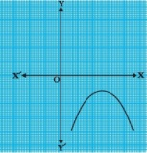
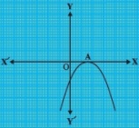
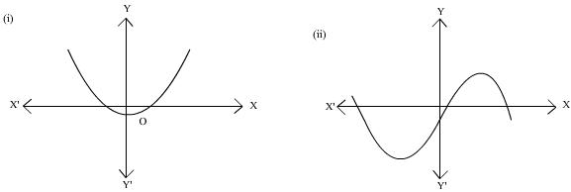
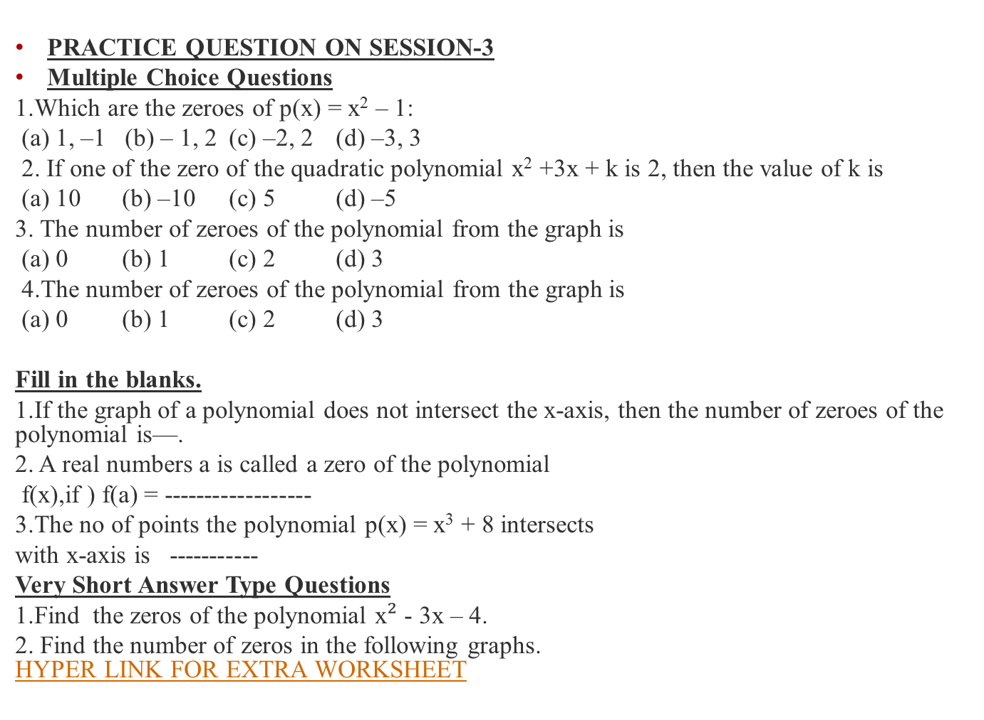
PRACTICE QUESTION ON SESSION-3
Multiple Choice Questions
1.Which are the zeroes of p(x) = x² – 1:
(a) 1, –1 (b) – 1, 2 (c) –2, 2 (d) –3, 3
2. If one of the zero of the quadratic polynomial x² +3x + k is 2, then the value of k is
(a) 10 (b) –10 (c) 5 (d) –5
3. The number of zeroes of the polynomial from the graph is
(a) 0 (b) 1 (c) 2 (d) 3
4.The number of zeroes of the polynomial from the graph is
(a) 0 (b) 1 (c) 2 (d) 3
Fill in the blanks.
1.If the graph of a polynomial does not intersect the x-axis, then the number of zeroes of the polynomial is—.
2. A real numbers a is called a zero of the polynomial
f(x),if ) f(a) = ------------------
3.The no of points the polynomial p(x) = x³ + 8 intersects
with x-axis is -----------
Very Short Answer Type Questions
1.Find the zeros of the polynomial x$²$ - 3x – 4.
2. Find the number of zeros in the following graphs.
HYPER LINK FOR EXTRA WORKSHEET

Slide 26
SESSION-4
Relationship Between Zeroes and Coefficients of a Polynomial

Slide 27
Factorization of Polynomials
The factorisation of Quadratic Polynomials
Quadratic polynomials can be factorized by splitting the middle term.
For example, consider the polynomial 2x²−5x+3
Splitting the middle term.
The middle term in the polynomial 2x²−5x+3 is -5.
This must be expressed as a sum of two terms such that the product of their coefficients is equal to the product of 2 and 3 (coefficient of x² and the constant term)
−5 can be expressed as (−2)+(−3), as (−2)×(−3)=6 =2×3
Thus, 2x²−5x+3=2x²−2x−3x+3
=2x(x−1)−3(x−1)
=(x−1)(2x−3)

Slide 28
Relationship between Zeroes and Coefficients of a Polynomial
In a Linear Polynomial like p(x)= ax+b, a≠0 the value of x for which the polynomial reduces to zero is -b/a
If α and β are the zeroes of a Quadratic polynomial , p(x)= ax²+bx+c, a≠0 then, α + β = -b/a
Sum of zeroes = -coefficient of x /coefficient of x²
αβ = c/a product of zeroes = constant term / coefficient of x²
Similarly in a Cubic polynomial like p(x) = ax³+bx²+cx+d, a≠0 , α ,β and γ are the zeroes then
α + β+ γ = -b/a
αβ+ βγ + αγ =c/a
αβγ = -d/a

Slide 29
FORMATION OF QUADRATIC POLYNOMIAL and CUBIC POLYNOMIALWITH GIVEN ZEROES
If α and β are the two zeroes of a quadratic polynomial, then the formula to construct the quadratic polynomial is
P(x)= x² - (α + β)x + αβ
That is, x² - (sum of zeroes)x + product of zeroes
If a quadratic polynomial is given in standard form, we can find the sum and product of the roots using coefficient of x², x and constant term as we discussed earlier .
Similarly, if α,β and γ are the three zeroes of a cubic polynomial, then the formula to construct the cubic polynomial is P(x)= x³ - (α+β+ γ ) x² + (αβ+βγ+αγ) x- αβγ
That is, x³ - (sum of zeroes) x² + (sum of the product of any two zeroes taken together)x – product of zeroes .

Slide 30
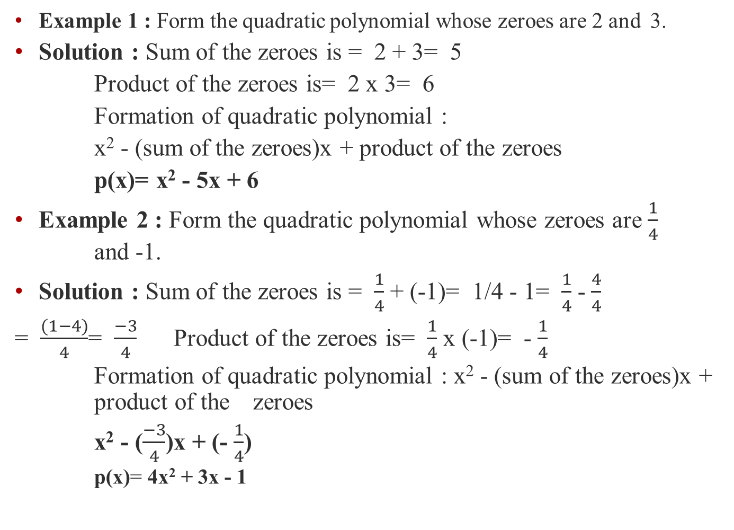
Example 1 : Form the quadratic polynomial whose zeroes are 2 and 3.
Solution : Sum of the zeroes is = 2 + 3= 5
Product of the zeroesis= 2 x 3= 6
Formation of quadratic polynomial:
x² - (sum of the zeroes)x + product of the zeroes
p(x)= x² - 5x + 6
Example 2 : Form the quadratic polynomialwhose zeroesare $\frac{1}{4}$ and -1.
Solution : Sum of the zeroesis = $\frac{1}{4}$+ (-1)= 1/4 - 1= $\frac{1}{4}$ - $\frac{4}{4}$
= $\frac{(1−4)}{4}$= $\frac{−3}{4}$ Product of the zeroes is= $\frac{1}{4}$ x (-1)= -$\frac{1}{4}$
Formation of quadratic polynomial: x² - (sum of the zeroes)x + product of the zeroes
x² - ($\frac{−3}{4}$)x + (-$\frac{1}{4}$)
    p(x)= 4x² + 3x - 1

Slide 31
Notes :
Irrational zeroes of a quadratic polynomial occur in conjugate pairs.
That is, if (m + √n) is a zero, then (m - √n) is the other zero of the same quadratic polynomial.
Example 3 :
If one zero of a quadratic polynomial is (2 + √3), then form the polynomial given that the zeroes are irrational.
Solution :
(2 + √3) is an irrational number.
We already know the fact that irrational zeroes of a quadratic polynomial will occur in conjugate pairs.
That is, if (2 + √3) is one zero of a quadratic polynomial, then (2 - √3) will be the other zero of the same polynomial.
So, (2 + √3) and (2 - √3) are the zeroes of the required quadratic polynomial
Sum of the zeroes is = (2 + √3) + (2 - √3)= 4
Product of the zeroes is= (2 + √3)(2 - √3)= 2² - √3²= 4 - 3= 1
Formation of quadratic polynomial : x² - (sum of the zeroes)x + product of the zeroes
p(x)=x² - 4x + 1

Slide 32
Example 4 :
If α and β be the zeroes of p(x)=x² + 7x + 12 , find the quadratic polynomial f(x),whose zeroes are (α + β)² and (α - β)²
Solution :
Given : α and β be the zeroes of x² + 7x + 12
Then, sum of zeroes = -coefficient of x / coefficient of x²
α + β = -7 / 1 α + β = -7
product of zeroes = constant term / coefficient of x²
αβ = 12/1 αβ = 12
quadratic polynomial with zeroes (α + β)² and (α - β)² is
x² - [(α + β)² + (α - β)²]x + (α + β)²(α - β)² = 0 -----(1)
Find the values of (α + β)² and (α - β)².
(α + β)² = (-7)^{2 ,} (α + β)² = 49
(α - β)² = (α + β)² - 4αβ
(α - β)² = (-7)² - 4(12)
(α - β)² = 49 – 48=1
So, the required quadratic polynomial is:
f(x)= x² - [49 + 1]x + 49 ⋅1= x² - 50x + 49

Slide 33
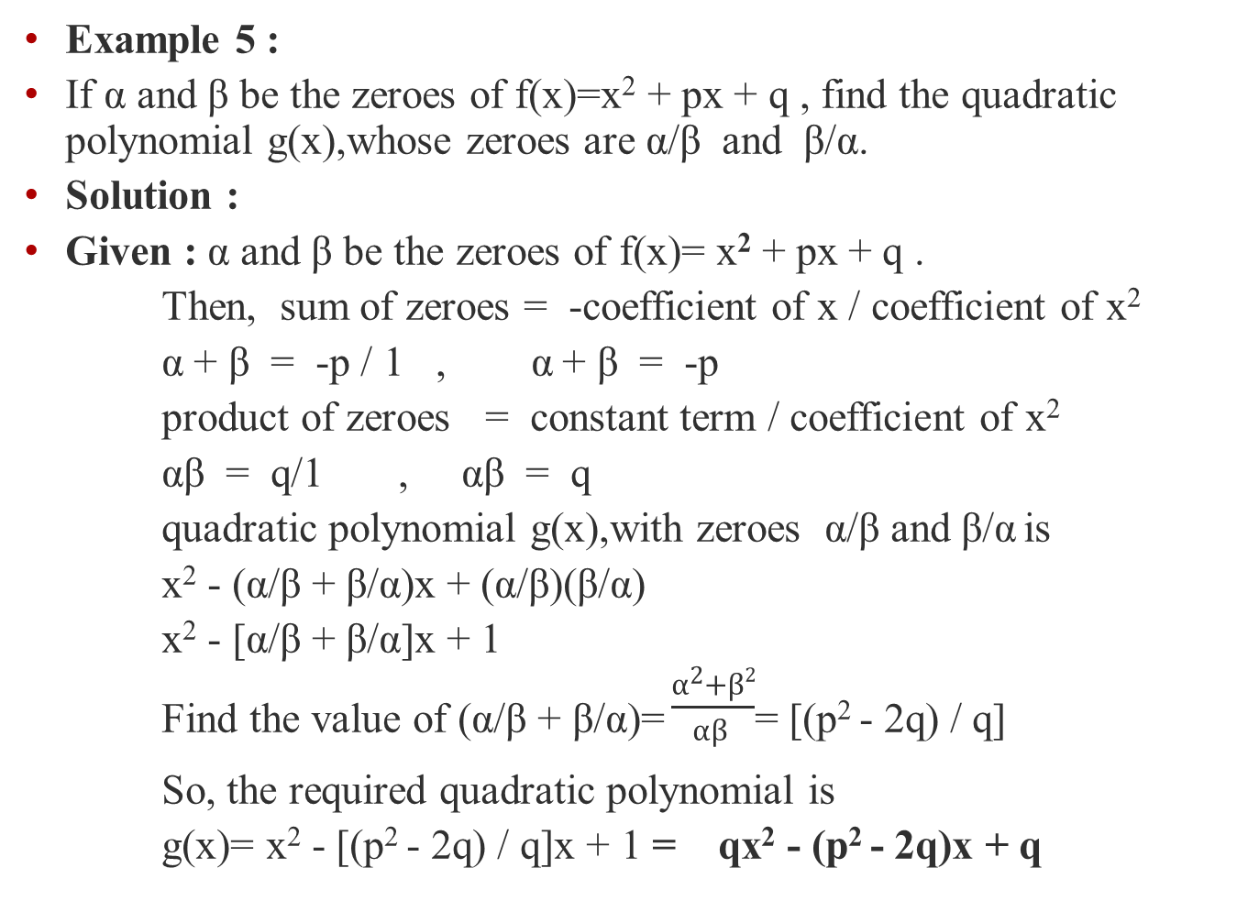
Example 5 :
If α and β be the zeroes of f(x)=x² + px + q , find the quadratic polynomial g(x),whose zeroesare α/β and β/α.
Solution :
Given : α and β be the zeroesof f(x)= x² + px + q .
Then, sum of zeroes= -coefficient of x / coefficient of x²
α + β = -p / 1 , α + β = -p
product of zeroes = constant term / coefficient of x²
αβ = q/1 , αβ = q
quadratic polynomial g(x),with zeroes α/β and β/α is
x² - (α/β + β/α)x + (α/β)(β/α)
x² - [α/β + β/α]x + 1
Find the value of (α/β + β/α)=$\frac{α^{2}+β2}{αβ }$= [(p² - 2q) / q]
So, the required quadratic polynomial is
g(x)= x² - [(p² - 2q) / q]x + 1 = qx² - (p² - 2q)x + q

Slide 34
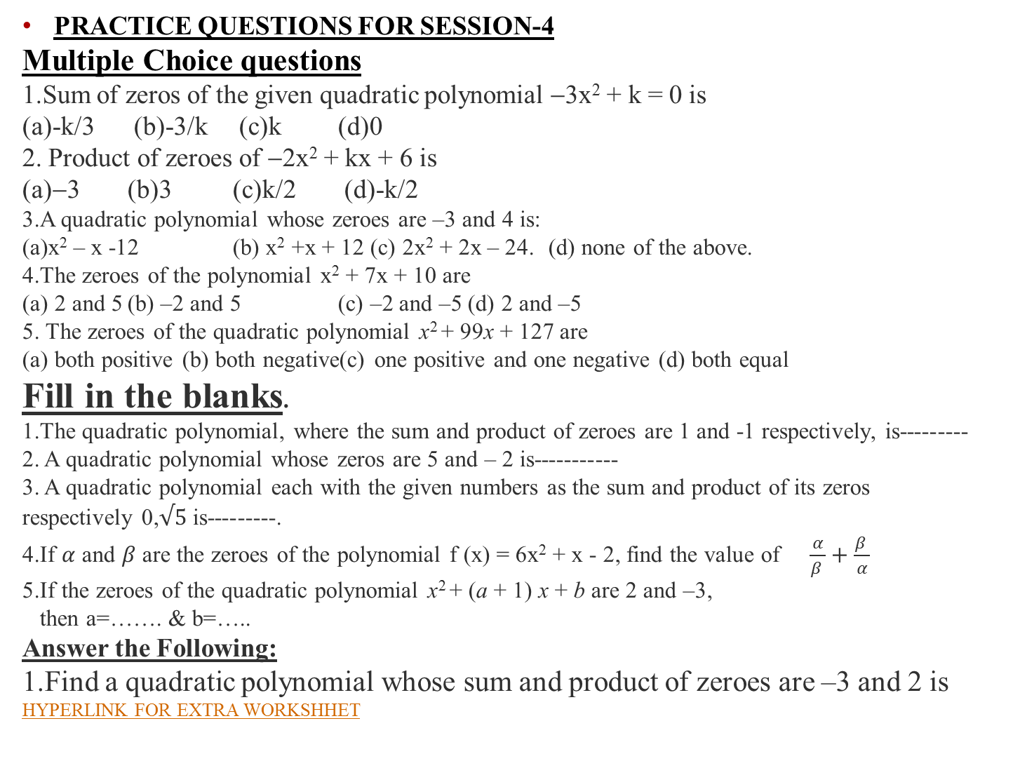
PRACTICE QUESTIONS FOR SESSION-4
Multiple Choice questions
1.Sum of zeros of the given quadratic polynomial −3x² + k = 0 is
(a)-k/3 (b)-3/k (c)k (d)0
2. Product of zeroes of −2x² + kx + 6 is
(a)−3 (b)3 (c)k/2 (d)-k/2
3.A quadratic polynomial whose zeroes are –3 and 4 is:
(a)x²– x -12 (b) x² +x + 12 (c) 2x² + 2x – 24. (d) none of the above.
4.The zeroes of the polynomial x² + 7x + 10 are
(a) 2 and 5 (b) –2 and 5 (c) –2 and –5 (d) 2 and –5
5. The zeroes of the quadratic polynomial x² + 99x + 127 are
(a) both positive (b) both negative(c) one positive and one negative (d) both equal
Fill in the blanks.
1.The quadratic polynomial, where the sum and product of zeroes are 1 and -1 respectively, is---------
2. A quadratic polynomial whose zeros are 5 and – 2 is-----------
3. A quadratic polynomial each with the given numbers as the sum and product of its zeros
respectively 0,$√5$is---------.
4.If $α$ and $β$ are the zeroes of the polynomial f (x) = 6x² + x - 2, find the value of$\frac{α}{β }+\frac{β }{α}$
5.If the zeroes of the quadratic polynomial x² + (a + 1) x + b are 2 and –3,
then a=……. & b=…..
Answer the Following:
1.Find a quadratic polynomial whose sum and product of zeroes are –3 and 2 is
HYPERLINK FOR EXTRA WORKSHHET

Slide 35
SESSION-5
Division Algorithm for Polynomials

Slide 36
Division Algorithm For Polynomials
Division algorithm for polynomials states that, suppose f(x) and g(x) are the two polynomials, where g(x)≠0, we can write:
f(x) = q(x) g(x) + r(x)
which is same as the Dividend = Divisor * Quotient + Remainder and where r(x) is the remainder polynomial and degree r(x) < degree g(x).

Slide 37
Steps of Division Algorithm for a Polynomial
To divide one polynomial by another, follow the steps given below.
Step 1: arrange the terms of the dividend and the divisor in the decreasing order of their degrees.
Step 2: To obtain the first term of the quotient, divide the highest degree term of the dividend by the highest degree term of the divisor . Then carry out the division process.
Repeat this process until the degree of the remainder becomes less than the degree of the divisor.

Slide 38
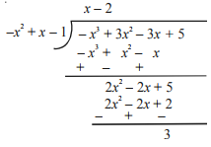
Verification of Division Algorithm
Take the above example and verify it.
Divisor = -x²+x-1
Dividend = -x³+3x²-3x+5
Quotient = x-2
Remainder = 03
Applying the Algorithm:
Dividend = Divisor × Quotient + Remainder
=(-x²+x-1)(x-2)+3 = -x³+3x²-3x+5 (Hence verified.)

Slide 39
Finding Factors of Polynomials with Division Algorithm
Long division algorithm is used to find out factors of polynomials of degree greater than equal to two. We’ll be describing the steps to find out the factors along with an example.
Example: Find zeroes of cubic polynomial P(x)=3x³ – 5x² – 11x – 3

Slide 40
Solution
Step 1: Use the factor theorem to find a factor of the polynomial.
Step 2: First divide the whole equation by the coefficient of the highest degree term of the dividend.
P(x)=3x³ – 5x² – 11x – 3, On dividing the whole equation by 3,
P(x) =x³ – (5/3)x² – (11/3)x – 1
Step 3: Find out factors of the constant term so obtained. In the present case, factors of the constant term are 1 and -1.
Step 4: Put the value of x in P(x) = 3x³ – 5x² – 11x – 3 equal to 1 and find the remainder. Again put the value of remainder equal to -1 in and find the remainder using remainder theorem. Find the value of x for which remainder is zero for the cubic polynomial.
P (1) = 3(1)³ – 5(1)² – 11(1) – 3 = -16
P(-1) = 3( -1 )³ – 5( -1 )² – 11( -1 ) – 3 =0
Step 5: Remainder is zero for x = -1. So, (x + 1) is a root of the polynomial.
Step 6: By Division Algorithm, find out the quotient. It comes out: 3x² – 8x – 3
Step 7: Now, Quotient = 3x² – 8x – 3
Dividend = (Divisor) * (Quotient) + Remainder
In present case,
3x³ – 5x² – 11x – 3 = (x + 1) (3x² – 8x – 3) + 0
By factorizing the quadratic polynomial we shall be able to find out remaining factors of the cubic polynomial.
Step 8: Break middle term in terms of a pair of numbers such that its product is equal to -9 and summation equal to -8.
Step 9: On factorizing, possible pair of number satisfying both conditions is (-9, 1). Breaking the middle term,
f(x) = 3x² – 8x – 3
= 3x² – 9x + x – 3
Step 10: Form pairs of terms and factor out GCD of the two pairs separately. Then again factor out GCD of the remaining two products.
Step 11:
f(x) = 3x² – 8x – 3 = 3x² – 9x + x – 3
= 3x(x – 3) + 1(x – 3) = (x – 3)(3x + 1)
Now,
3x³ – 5x² – 11x – 3 = (x + 1) (3x² – 8x – 3) + 0
= (x + 1) ( x – 3)(3x + 1)
Factors of cubic polynomial are -1, 3 and -1/3.

Slide 41
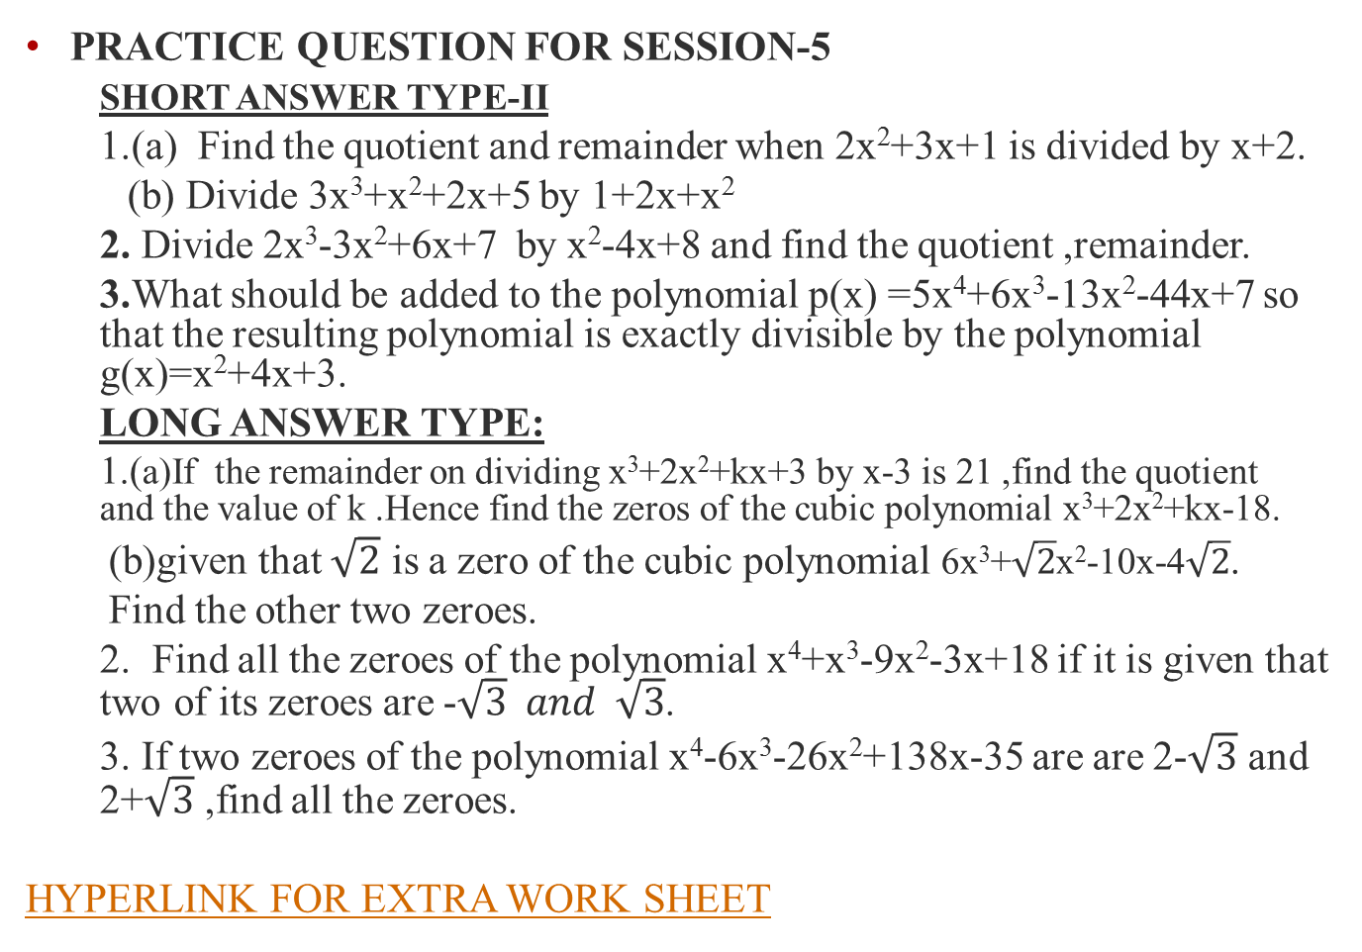
PRACTICE QUESTION FOR SESSION-5
SHORT ANSWER TYPE-II
1.(a) Find the quotient and remainder when 2x²+3x+1 is divided by x+2.
(b) Divide 3x³+x²+2x+5 by 1+2x+x²
2.Divide 2x³-3x²+6x+7 by x²-4x+8 and find the quotient ,remainder.
3.What should be added to the polynomial p(x) =5x⁴+6x³-13x²-44x+7 so that the resulting polynomial is exactly divisible by the polynomial g(x)=x²+4x+3.
LONG ANSWER TYPE:
  1.(a)If the remainder on dividing x³+2x²+kx+3 by x-3 is 21 ,find the quotient and the value of k .Hence find the zeros of the cubic polynomial x³+2x²+kx-18.
(b)given that $\sqrt{2}$ is a zero of the cubic polynomial 6x³+$\sqrt{2}$x²-10x-4$\sqrt{2}$.
Find the other two zeroes.
2. Find all the zeroes of the polynomial x⁴+x³-9x²-3x+18 if it is given that two of its zeroes are -$\sqrt{3} and \sqrt{3}$.
3.If two zeroes of the polynomial x⁴-6x³-26x²+138x-35 are are 2-$\sqrt{3}$ and 2+$\sqrt{3}$ ,find all the zeroes.
HYPERLINK FOR EXTRA WORK SHEET

Slide 42
A Brief Summary on the Chapter.
An algebraic expression is an expression made up of variables and constants along with mathematical operators.
An algebraic expression can have exponents that are rational numbers. However, a polynomial is an algebraic expression in which the exponent on any variable is a whole number or we may say non negative integers.
The degree of the polynomial is the highest exponent of the variable among all the terms in a polynomial.
According to the degree of the polynomial the polynomials are classified as constant polynomial, linear polynomial, quadratic polynomial, cubic polynomial etc.
Any Polynomial p(x) can be represented geometrically on the Cartesian plane, where p(x) represents the value of the polynomial for different values of x we take.
The geometrical presentation of a linear polynomial is a straight line, and the geometrical presentation of a quadratic polynomial is a parabola .
A zero of a polynomial p(x) is the value of x for which the value of p(x) is 0. If k is a zero of p(x), then p(k)=0.
A linear polynomial has one zero, a quadratic polynomial has at most two zeroes and cubic polynomial has at most three zeroes and so on.
In a Linear Polynomial like p(x)= ax+b , a≠0 the value of x for which the polynomial reduces to zero is -b/a
Ina quadratic polynomial of x, Sum of zeroes = -coefficient of x /coefficient of x²
,product of zeroes = constant term / coefficient of x²
If α and β are the two zeroes of a quadratic polynomial, then the formula to construct the quadratic polynomial is
P(x)= x² - (α + β)x + αβ ,that is: x² - (sum of zeroes)x + product of zeroes
Division algorithm for polynomials states that, suppose f(x) and g(x) are the two polynomials, where g(x)≠0, we can write:
f(x) = q(x) g(x) + r(x)
which is same as the Dividend = Divisor * Quotient + Remainder and where r(x) is the remainder polynomial and degree r(x) < degree g(x).

Slide 43
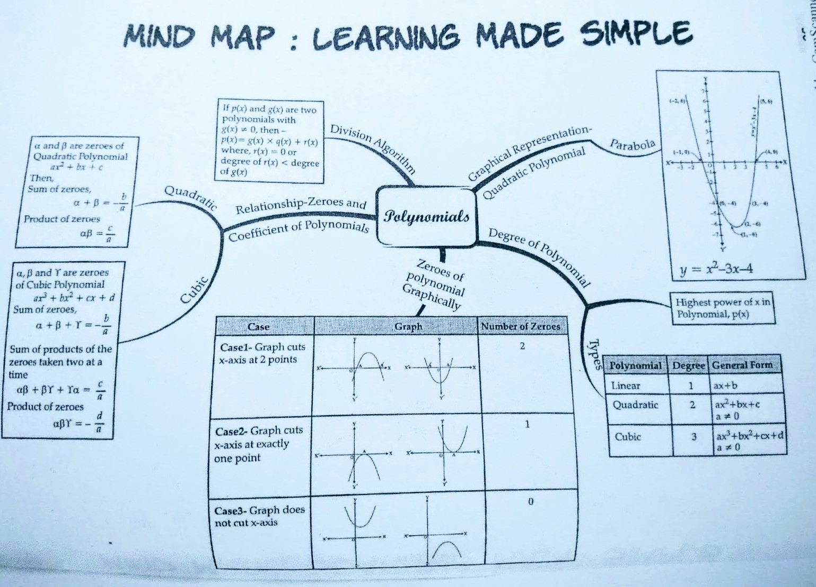
MIND MAP FOR POLYNOMIALS

Slide 44

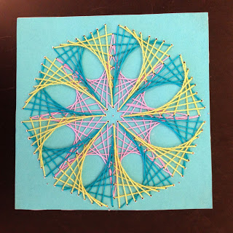
ACTTIVITY PERFORMED LINKING ART INTEGRATION:
MAKING CURVE STICHING DESIGNS BY THREAD.
Which helps the children to create interest for learning the polynomial and its curves

Slide 45
TEST WORKSHEETS ON THE CHAPTER POLYNOMIALS
BASIC
STANDARD
ADVANCE
HOTS

Slide 46
THANK YOU

