Slide 1
MATHEMATICS
STD-IX
TOPIC: VOLUME

Slide 2
PDF CHAPTER LINK
NCERT TEXT BOOK (CHAPTER- VOLUME)

Slide 3
Learning Objectives
Students will be able to
understand the importance of volume in our daily life.
find volume of solid objects (cuboid, cube, cylinder, cone, sphere and hemisphere)by using formula.
solve problem related to volume of solid objects.
apply the concept of volume of solid objects in day to day life.

Slide 4
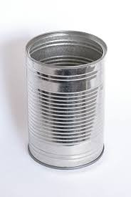
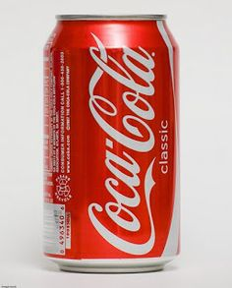
Why will you study volume?
To find capacity of aquarium.
To find how much water does the cylindrical container hold?
To know how much coca cola the cylindrical container hold?

Slide 5
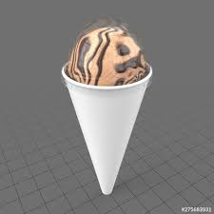
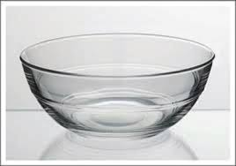
Cont …
To find quantity of ice cream inside the cone.
To know amount of air football holds.
To know capacity of a hemi spherical bowl.

Slide 6
Introduction
If an object is solid, then the space occupied by such an object is measured, and is termed the Volume of the object.
On the other hand, if the object is hollow, then interior is empty, and can be filled with air, or some liquid that will take the shape of its container. In this case, the volume of the substance that can fill the interior is called the capacity of the container.

Slide 7
Definition of Volume
The space occupied by an object is called Volume of the object.
The capacity of an object is the volume of substance its interior can accommodate.
The unit of measurement of either volume/capacity is cubic unit.

Slide 8
Volume of a Cuboid
Let the area of each rectangle is A.
The height up to which the rectangles are stacked is h and the volume of the cuboid is V.
The area of plane regions by each rectangle × height= Volume of the cuboid
A × h = V
So ,Volume = Base area $×$ Height

Slide 9
Cont..
Volume of a Cuboid = base area × height
= $l×b×h$
Volume of cuboid =$l×b×h$
Where ,
$l$=length
$b$=breadth
$h$=height
Cuboid

Slide 10
Volume of a cube
Here length=breadth=height=$a$
Volume of a Cube = base area × height
=$a×a×a$
= $a^{3}$
Volume of cuboid =$a^{3}$
Where,
$a$ = edge of the cube

Slide 11
Example 1
Question : A wall of length 10 m was to be built across an open ground. The height of the wall is 4 m and thickness of the wall is 24 cm. If this wall is to be built up with bricks whose dimensions are 24 cm × 12 cm × 8 cm, how many bricks would be required? (3 Marks)

Slide 12
Solution:
Given : Length = 10 m = 1000 cm
Thickness = 24 cm
Height = 4 m = 400 cm
Volume of the wall = length × thickness × height
= 1000 × 24 × 400 $cm^{3}$ 1mark
Now, each brick is a cuboid with length = 24 cm, breadth = 12 cm and height = 8 cm
So, volume of each brick = length × breadth × height
= 24 × 12 × 8 $cm^{3}$ 1mark

Slide 13
cont..
So, number of bricks required =$\frac{Volume of the wall}{Volume of the brick}$
$=\frac{100×24×400}{24×12×8}$
$=4166.6$
$=\text{4167}$ 1mark
So, the wall requires 4167 bricks.

Slide 14
Example 2
Question : A village, having a population of 4000, requires 150 litres of water per head per day. It has a tank measuring 20 m × 15 m × 6 m. For how many days will the water of this tank last?
Solution: 1 Litre =0.001 $m^{3}$
150 Litre= 150$×0.001=0.15 m^{3}$
Amount of water require by 4000 people per day =$4000×0.15$
$=600m^{3}$
Given dimension of tank: $l=20m, b=15m , h=6m$
Volume of cuboidal tank =$l×b×h=20×15×6$
$=1800m^{3}$
No. of days water will last =$\frac{1800}{600}=3 days$

Slide 15
Example 3
Question : A solid cube of side 12 cm is cut into eight cubes of equal volume. What will be the side of the new cube? Also, find the ratio between their surface areas.
Solution: Given side of big cube =12cm
Volume of big cube =${12}^{3}=1728 cm^{3}$
It is cut in to 8 cubes of equal volume
Let side of small cube= $a$cm , So Volume of a small cube=$a^{3}$
So volume of 8 small cubes= $8×a^{3}$
According to question $8a^{3}=1728 ⟹a^{3}=216$
$a=6$cm
Now ratio of their surface areas= $\frac{6×{12}^{2}}{6×6^{2}}=4:1$

Slide 16
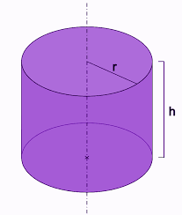
Volume of a right circular Cylinder
A right circular cylinder can be built up using circles of the same size.
So, Volume of right circular cylinder
= base area $×height$
= area of circular base × height
= $πr^{2}h$
Volume of a Cylinder = $πr^{2}h$

Slide 17
Example 4
Question :At a Ramzan Mela, a stall keeper in one of the food stalls has a large cylindrical vessel of base radius 15 cm filled up to a height of 32 cm with orange juice. The juice is filled in small cylindrical glasses (see Figure ) of radius 3 cm up to a height of 8 cm, and sold for Rs15 each. How much money does the stall keeper receive by selling the juice completely?
(4 Marks)

Slide 18
Solution:
The volume of juice in the vessel = volume of the cylindrical vessel = $πR^{2}H$
(where R and H are radius and height respectively of the vessel)
= $π$ × 15 × 15 × 32 $cm^{3}$ 1mark
Similarly, the volume of juice each glass can hold = $πr^{2}h$
(where r and h are radius and height respectively of each glass)
= $π$× 3 × 3 × 8 $cm^{3}$ 1mark

Slide 19
Cont…
So, number of glasses of juice that are sold
$= \frac{Volume of vessel}{volume of each glass}$
$=\frac{π×15×15×32}{π×3×3×8}$= 100 1mark
Therefore, amount received by the stall keeper
= Rs 15 × 100
= Rs1500 1mark

Slide 20
Activity 1: Volume of a Right Circular Cone
Objective : To find the volume of a right circular cone
Materials required : Chart paper , sand , scissor etc.
Procedure:
Try to make a hollow cylinder and a hollow cone like this with the same base radius and the same height.
Fill the cone up to the brim with sand once, and empty it into the cylinder. We find that it fills up only a part of the cylinder [see Fig. (a)].
When we fill up the cone again to the brim, and empty it into the cylinder, we see that the cylinder is still not full [see Fig. (b)].

Slide 21
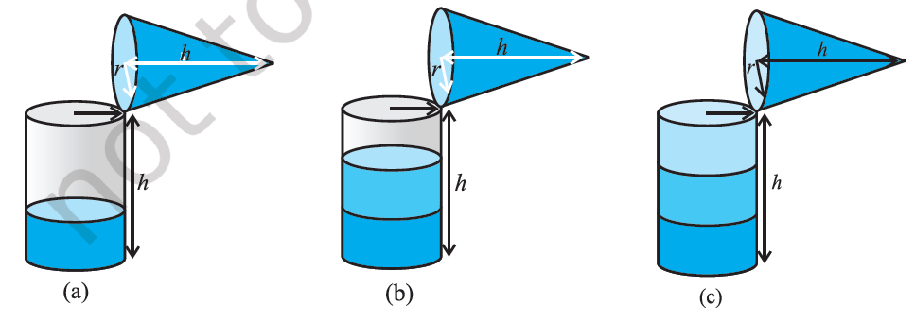
Activity 1 cont…
When the cone is filled up for the third time, and emptied into the cylinder, it can be seen that the cylinder is also full to the brim [see Fig. (c)].
Observation: We observed that when cone is filling three times the cylinder , the cylinder is completely filled.
Conclusion: So we conclude that volume of cone is one third of volume of the cylinder.
See This Video for proof of Volume of cone

Slide 22
Cont..
Volume of cone$=\frac{1}{3}πr^{2}h$
Let slant height =$l$
radius =$r ,$height=$h$
So we can write
$$l^{2}=h^{2}+r^{2}$$

Slide 23
Example 5
Question :The height and the slant height of a cone are 21 cm and 28 cm respectively. Find the volume of the cone.
(2 Marks)
Solution : we know $l^{2}=h^{2}+r^{2}$
$r=\sqrt{l^{2}−h^{2}}$
$=\sqrt{{28}^{2}−{21}^{2}}$
=7$\sqrt{7}$ cm 1mark
So, volume of the cone=$\frac{1}{3}πr^{2}h$
=$\frac{1}{3}×\frac{22}{7}×7\sqrt{7}×7\sqrt{7}×21$ =7546$cm^{3}$ 1mark

Slide 24
Example 6
Question: The surface area of a sphere of radius 5 cm is five times the area of the curved surface of a cone of radius 4 cm. Find the height and the volume of the cone.
Solution: Given radius of sphere =5cm
Surface area of the sphere = 4$π$× 5 × 5 $cm^{2}$.
Given radius of circular base of cone =4cm
Curved surface area of the cone = $π$× 4 × $l cm^{2}$
where $l$ is the slant height of the cone.

Slide 25
Cont..
According to the statement
4𝜋 × 5 × 5 = 5 × 𝜋× 4 × 𝑙
or 𝑙 = 5 cm.
Now $l^{2}=h^{2}+r^{2}$
$h^{2}=5^{2}−4^{2}$
$h^{2}=9, or h=3cm$
So Volume of cone =$\frac{1}{3}πr^{2}h=\frac{1}{3}×\frac{22}{7}×4×4×3$
$=50.29cm^{3} (approx.)$

Slide 26
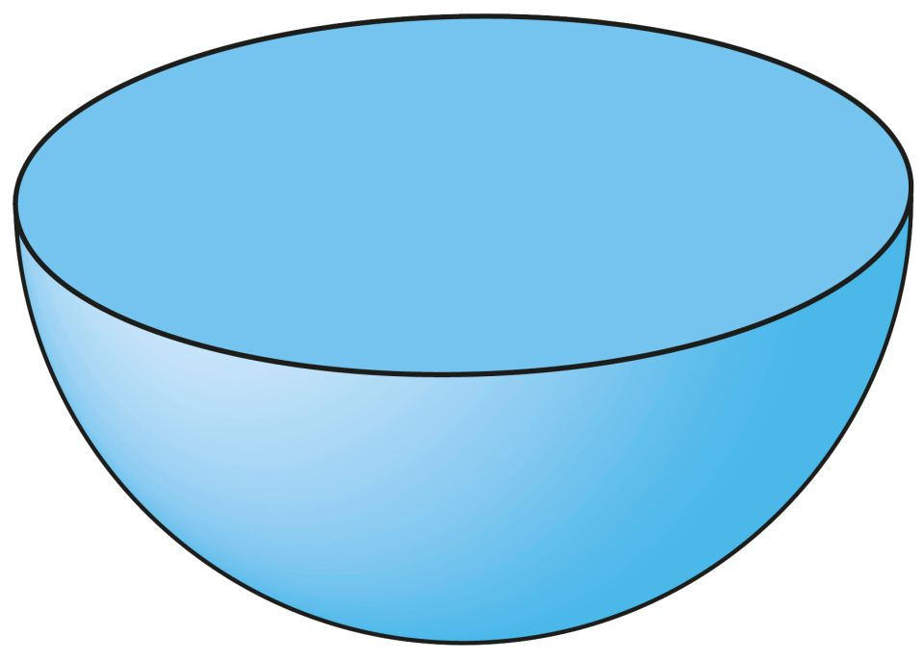
Volume of a Sphere
Volume of a sphere of radius r =$\frac{4}{3}πr^{3}$
Volume of hemisphere of radius r
= $\frac{2}{3}πr^{3}$

Slide 27
Example 7
Question : Find the volume of a sphere of radius 11.2 cm
(1 Mark)
Solution : Given radius , $r=11.2cm$
Volume of sphere $=\frac{4}{3}πr^{3}$ ½
$=\frac{4}{3}×\frac{22}{7}×11.2×11.2×11.2$
$=\text{5887.32 }$ $cm^{3}$ ½

Slide 28
Example 8
Question : A hemispherical bowl has a radius of 3.5 cm. What would be the volume of water it would contain?
Solution: Given radius of hemispherical bowl , $r$=3.5cm
The volume of water the bowl can contain
$=\frac{2}{3}πr^{3}$
=$\frac{2}{3}×\frac{22}{7}×3.5×3.5×3.5$
=89.8 $cm^{3}$

Slide 29
Example 9
Question : The radius of a sphere is increased by 10%. Prove that the volume will be increased by 33.1% approximately.
Solution: Volume of sphere $=\frac{4}{3}πr^{3}$
10% increase in radius = 10% r
Increased radius = $r+\frac{r}{10}=\frac{11}{10}r$
The volume of the sphere now becomes =$\frac{4}{3}π{\left(\frac{11}{10}r\right)}^{3}$
$=\frac{4}{3}π1.331r^{3} cm^{3}$

Slide 30
Cont…
Increase in volume =$\frac{4}{3}π1.331r^{3}−\frac{4}{3}πr^{3}$
$=\frac{4}{3}π×0.331r^{3}$
Percentage increase in volume =$\frac{\frac{4}{3}π×0.331r^{3}}{\frac{4}{3}πr^{3}}×100$
$=33.1\%$

Slide 31
Summary
In this chapter, you have studied the following points:
Volume of a cuboid = $l×b×h$
Volume of a cube = $a^{3}$
Volume of a cylinder = $πr^{2}h$
Volume of a cone =$\frac{1}{3}πr^{2}h$
Volume of a sphere of radius r = $\frac{4}{3}πr^{3}$
Volume of a hemisphere = $\frac{2}{3}πr^{3}$

Slide 32
Mind Map

Slide 33
Learning Outcomes
Students learn that the volume of a cuboid is $l×b×h$. Where $l,b \& h$ are length ,breadth and height respectively.
Students learn that the volume of a cube is $a^{3}$. Where a is edge of the cube.
Students learn that the volume of a cylinder is $πr^{2}h$where r is the radius of the base and h the height of the cylinder.
The volume of a cone is one-third the volume of the cylinder of the same height (h) and radius of base (r), i.e. equal to = $\frac{1}{3}πr^{2}h.$Because of the simplicity of the concrete activity and the ratio involved, students are likely to remember the result of the activity easily.

Slide 34
Cont…
5. The students arrive at the formula for the volume of a cone through a simple activity, which relates it to the volume of a cylinder.
6. Students learn that the volume of a sphere & hemisphere.
7. Students learn that how to use the volume of these solid objects in daily life situations.

Slide 35
.

