Slide 1
Sub:MATHEMATICS
CLASS- III
Topic: ADDITION

Slide 2
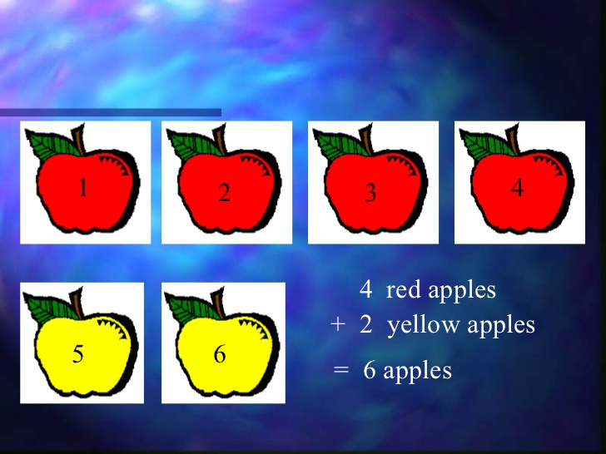
ADDITION
A FUNDAMENTAL OPERATION
OF MATHEMATICS

Slide 7
Addition (4- digit numbers)
ADD 4573 AND 2115
Putting the numbers in column format as shown below
 | TH | H | T | O
 | 4 | 5 | 7 | 3
+ | 2 | 1 | 1 | 5
 |  |  |  | 8
STEP-1
Addition of Ones place value
+ 5 = 8 Ones
Write 8 in Ones column

Slide 8
 | TH | H | T | O
 | 4 | 5 | 7 | 3
+ | 2 | 1 | 1 | 5
 |  |  | 8 | 8
STEP- 2
Addition of Tens place value
7 + 1 = 8 Tens
Write 8 in Tens column

Slide 9
 | TH | H | T | O
 | 4 | 5 | 7 | 3
+ | 2 | 1 | 1 | 5
 |  | 6 | 8 | 8
STEP- 3
Addition of Hundreds place value
5 + 1 = 6 Hundreds
Write 6 in Hundreds column

Slide 10
 | TH | H | T | O
 | 4 | 5 | 7 | 3
+ | 2 | 1 | 1 | 5
 | 6 | 6 | 8 | 8
STEP- 4
Addition of Thousands place value
4 + 2 = 6 Thousands
Write 6 in Thousands column
The sum of 4573 and 2115 is 6888.
Answer the following question.
Add 2634 and 5315
2) Add 6543 and 2312

Slide 11
Addition (with regrouping)
Find the sum of 4745 and 4387.
Putting the numbers in column format as shown below.
 | TH | H | T | 0
 | 4 | 7 | 4 | 5
+ | 4 | 3 | 8 | 7
 |  |  |  | 2
STEP- 1
Addition of Ones place value
5+ 7 = 12 Ones
= 1 Ten+ 2 Ones
Write 2 under ones column and
carry 1 ten to the tens place
column
1

Slide 12
 | TH | H | T | 0
 | 4 | 7 | 4 | 5
+ | 4 | 3 | 8 | 7
 |  |  | 3 | 2
STEP- 2
Addition of Tens place value
4 + 8 + 1 ( Carry over)
= 13 Tens
= 1 Hundred + 3 tens
Write 3 under tens column and carry 1 hundred to the hundreds column
1
1

Slide 13
 | TH | H | T | 0
 | 4 | 7 | 4 | 5
+ | 4 | 3 | 8 | 7
 |  | 1 | 3 | 2
STEP- 3
Addition of Hundreds place value
7 + 3 + 1( carry over)
= 11 Hundreds
= 1 Thousand + 1 hundred
Write 1 under hundreds column and carry 1 thousand to thousands column
1
1
1

Slide 14
 | TH | H | T | 0
 | 4 | 7 | 4 | 5
+ | 4 | 3 | 8 | 7
 | 9 | 1 | 3 | 2
STEP- 4
Addition of Thousands place value
4 + 4 + 1 (Carry over)
= 9 Thousands
Write 9 in Thousands column
1
1
1
So the sum is 9132.
Answer the following question.
Add 2634 and 5648
2) Add 6543 and 2759

Slide 15
PROPERTIES OF ADDITION
PROPERTY-1
12 + 18 = 30
+ 12= 30
12+ 18 = 18 +12
The sum remains the same even if we interchange the place of the numbers to be added.
PROPERTY-2
15 + 0 = 15
0 +178 = 178
The sum of a number and zero is the number itself.

Slide 16
ADDING THREE NUMBERS
Add 413 , 7821 and 51.
We first arrange the numbers in ones, tens, hundreds and thousands columns and then add.
 | TH | H | T | O
 |  | 4 | 1 | 3
 | 7 | 8 | 2 | 1
+ |  |  | 5 | 1
 |  |  |  | 5
STEP-1
Addition of Ones place value
+ 1 + 1 = 5 Ones
Write 5 in Ones column

Slide 17
 | TH | H | T | O
 |  | 4 | 1 | 3
 | 7 | 8 | 2 | 1
+ |  |  | 5 | 1
 |  |  | 8 | 5
STEP-2
Addition of Tens place value
1+ 2 + 5 = 8 Tens
Write 8 in Tens column

Slide 18
 | TH | H | T | O
 |  | 4 | 1 | 3
 | 7 | 8 | 2 | 1
+ |  |  | 5 | 1
 |  | 2 | 8 | 5
STEP-3
Addition of Hundreds place value
4+ 8 = 12 Hundreds
= 1 Thousand + 2 Hundreds
Write 2 under hundreds column and carry 1 thousand to thousands column
1

Slide 19
 | TH | H | T | O
 |  | 4 | 1 | 3
 | 7 | 8 | 2 | 1
+ |  |  | 5 | 1
 | 8 | 2 | 8 | 5
STEP-4
Addition of Thousands place value
7+ 1(carry over) = 8Thousands
Write 8 in Thousands column
1

Slide 20
WORD PROBLEMS
Q1) Raman sold 1022 pink kites, 989 red kites and 85 white kites in one day. Find the total number of kites sold.
Solution:
We will add all the kites of three colours to get the total number of kites sold.
Number of pink kites sold = 1022
Number of red kites sold = 989
Number of white kites sold = + 85
Total number of kites sold = 2096
Raman sold 2096 kites in total

Slide 21
Q2) Mr kapur bought a washing machine for Rs9000 and a chair for Rs950. How much money did he spent in all?
Solution:
We will add the money spent on the washing machine and chair to get the total money spent.
Money spent on a washing machine = Rs 9000
Money spent on a chair =+Rs 950
Total money spent = Rs 9950
Mr. Kapur spent Rs9950 in all.

Slide 22
Value based question
Vasanti didi comes to Rahul’s house everyday to help his mother in household work. Her six year old son Jagan got admission in Class-I. In order to help her , Rahul’s grandmother gave her Rs1500 for purchasing books. His parents gave Rs3460 for buying school uniform and bag. Rahul and his sister also contributed Rs170 from their piggy bank and bought a pencil box for Jagan. Now Jagan had everything required to study in the school.
Q1) How much money did Rahul’s parents and grandmother give to Vasanti?
Ans: Money given by Rahul’ parents = Rs 3460
Money given by Rahul’ grandmother = Rs 1500
Total money given by Rahul’s parents and grandmother = Rs 4960
Q2)How much money did Rahul’ family give to help Vasanti?
Ans: Total money given by Rahul’s family = Rs 3460
Rs 1500
+Rs 170
Rs 5130
Q3)Suggest any two ways in which you can help someone like Jagan.

Slide 23
THANK YOU

