Slide 1
CLASS-XII
SUB – MATHEMATICS
TOPIC – INCREASING & DECREASING

Slide 2
INCREASING

Slide 3
DECREASING

Slide 5
VIDEO

Slide 6
INCREASING
A continuous function is said to be increasing if x1<x2 => f(x1)≤f(x2) for all x1 and x2 belongs to domain of f
A continuous function is said to be increasing in an interval if x1<x2 => f(x1) ≤ f(x2) for all x1 and x2 belongs to that interval
For example f(x)=x

Slide 7
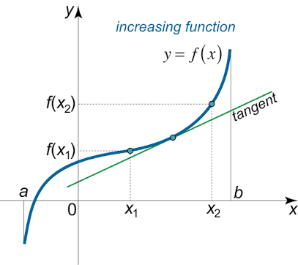

Slide 8
APPICATION OF TANGENT
Slope of Tangent of any curve f(x) at x0 is f’(x0)
If slope of tangent is positive then curve is increasing
If slope of tangent is negative then curve is decreasing

Slide 9
INCEARSING USING 1ST DERIVATIVE
f’(x)≥0 =>
h is small +ve
=>f(x+h)-f(x) ≥0
=>f(x+h) ≥ f(x)
x+h>x => f(x+h) ≥ f(x)
=> f is increasing
If f’(x)≥0 then f(x) increasing

Slide 10
DECREASING
A continuous function is said to be decreasing if x1<x2 => f(x1)≥f(x2) for all x1 and x2 belongs to domain of f.
A continuous function is said to be decreasing in an interval if x1<x2 => f(x1) ≥ f(x2) for all x1 and x2 belongs to that interval
F(x)= cosx

Slide 11
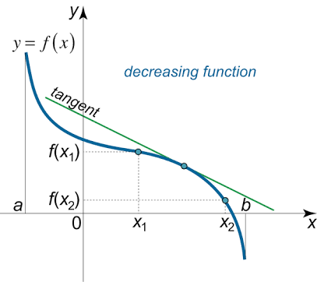

Slide 12
DECEARSING USING 1ST DERIVATIVE
f’(x)≤0 =>
h is small positive
=>f(x+h)-f(x) ≤0
=>f(x+h) ≤ f(x)
x+h>x => f(x+h) ≤ f(x)
=> f is decreasing
If f’(x) ≤ 0 then f(x) decreasing

Slide 13
MONOTONIC & CRITICAL POINTS
A function is said to be monotonic in an interval if it either increasing or decreasing in that interval
But some time a function both increase and decrease in an interval then there exist a point where it change its position increase to decrease or vice versa that points are called critical points
In differentiable function critical point is the points where f’(x)=0
But also the point of discontinuity and the points where it not differentiable are the critical points

Slide 16
STRICTLY INCREASING
A continuous function is said to be strictly increasing if x1<x2 => f(x1)< f(x2) for all x1 and x2 belongs to domain of f
A continuous function is said to be strictly increasing in an interval if x1<x2 => f(x1) < f(x2) for all x1 and x2 belongs to that interval

Slide 17
STRICTLY DECREASING
A continuous function is said to be strictly decreasing if x1<x2 => f(x1)>f(x2) for all x1 and x2 belongs to domain of f.
A continuous function is said to be strictly decreasing in an interval if x1<x2 => f(x1) > f(x2) for all x1 and x2 belongs to that interval

Slide 30
SUMMARY
A function is increasing if f’(x) ≥0
A function is strictly increasing if f’(x)>0
A function is decreasing if f’(x) ≤0
A function is strictly decreasing if f’(x)<0

Slide 31
A function is increasing in (a,b) if f’(x) ≥0 when xϵ(a,b)
A function is strictly increasing in (a,b) if f’(x)>0 when xϵ(a,b)
A function is decreasing in (a,b) if f’(x) ≤0 when xϵ(a,b)
A function is strictly decreasing in (a,b) if f’(x)<0 when xϵ(a,b)

Slide 32
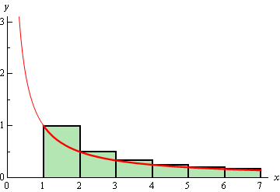

Slide 33
MIND MAPPING
INCREASING & DECREASING
Taking f’(x)=0 find the intervals
A function is increasing in (a,b) if f’(x) ≥0 when xϵ(a,b)
A function is decreasing in (a,b) if f’(x) ≤0 when xϵ(a,b)

Slide 34
QUESTIONS
BASIC
STANDARD
HOTS

Slide 35
THANK
YOU

