Slide 1


MATHEMATICS CLASS-XII
CH-DERIVATIVES

Slide 2
LEARNING OBJECTIVES
To learn differentiability of a function.
To find derivative of different functions.
To learn Mean Value Theorem and Rolle’s Theorem.

Slide 3
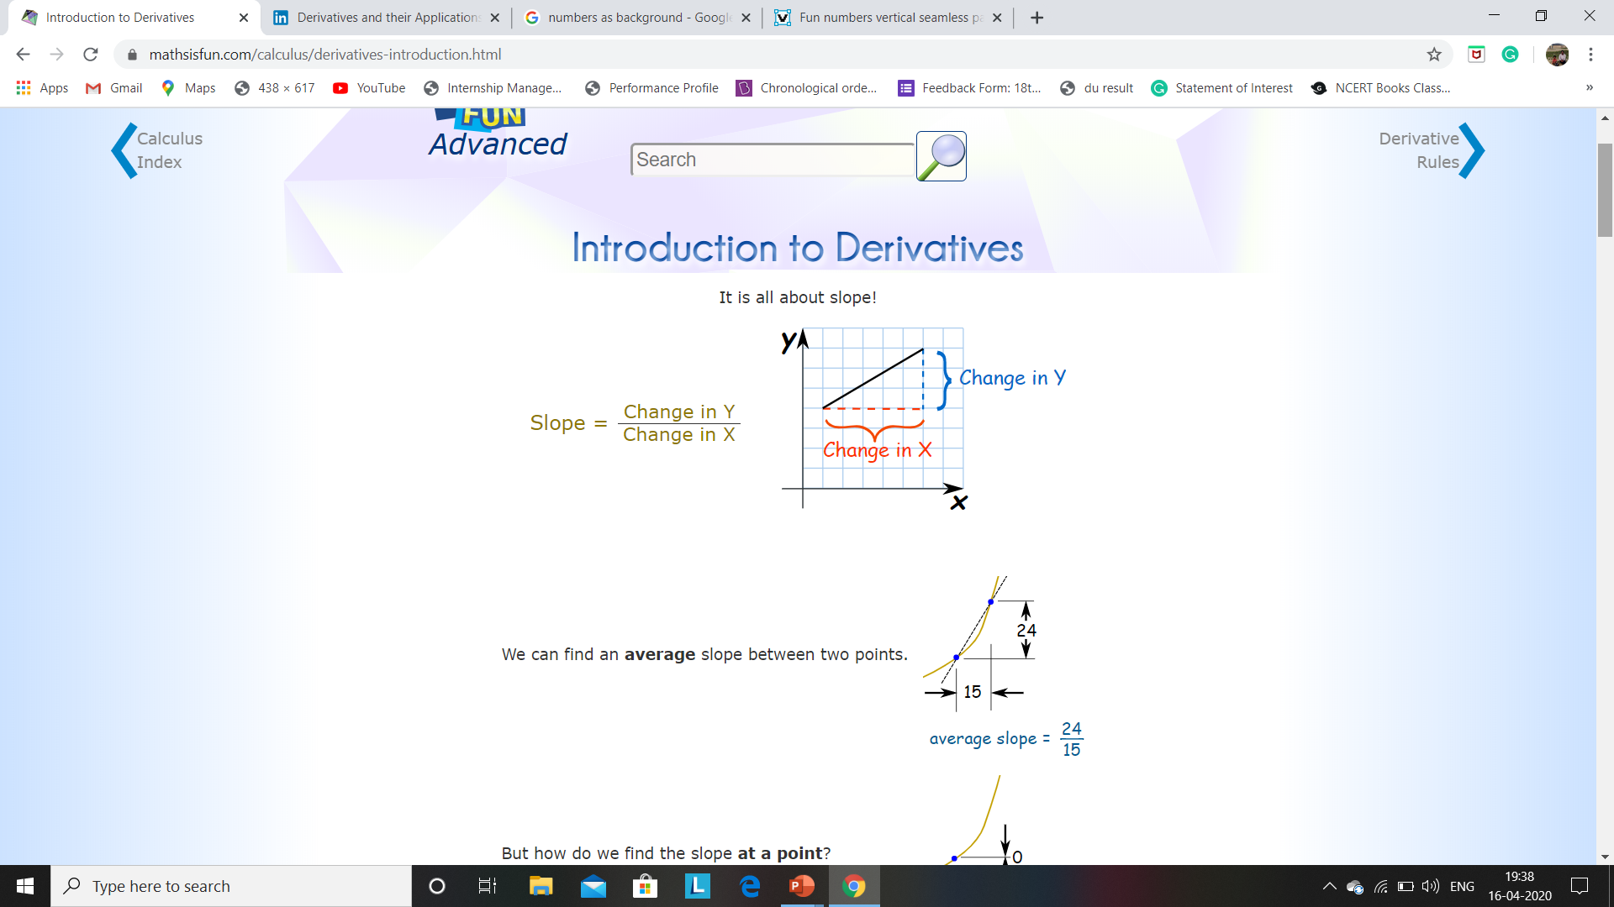

Slide 4


Slide 5
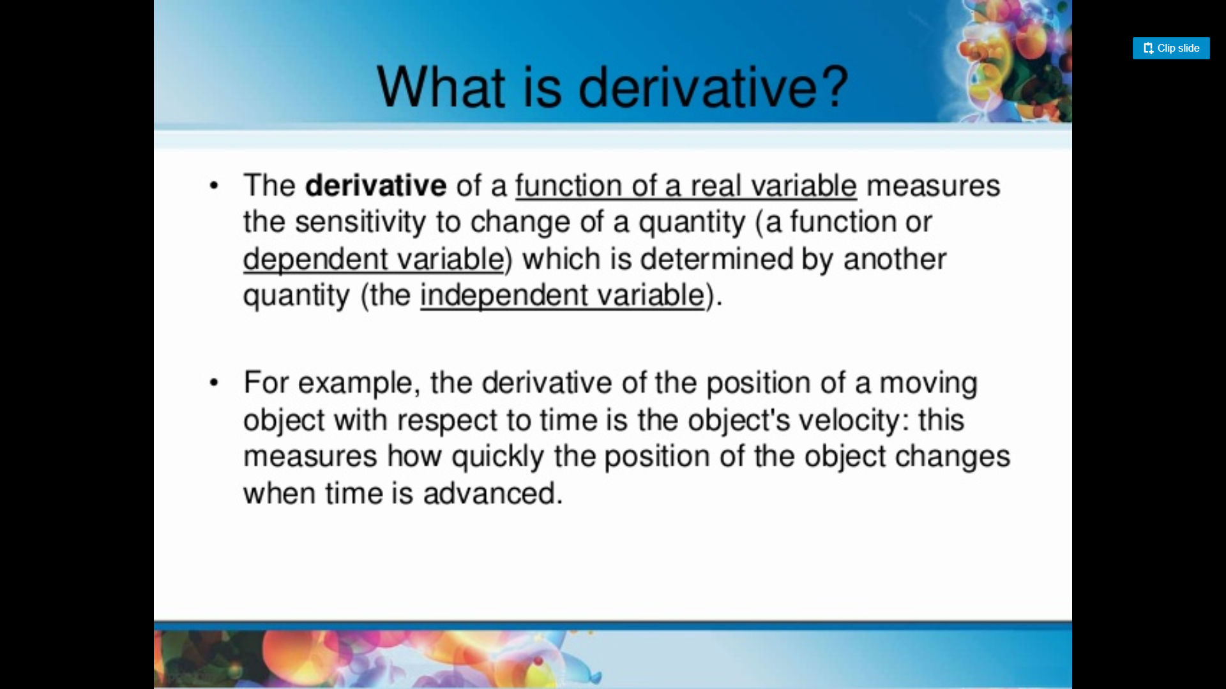

Slide 6
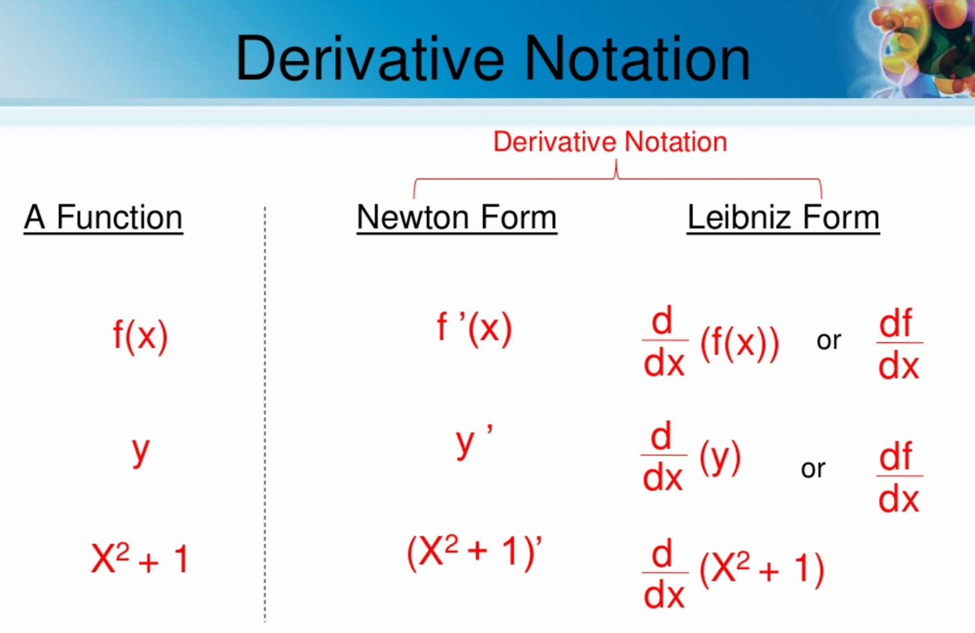

Slide 7
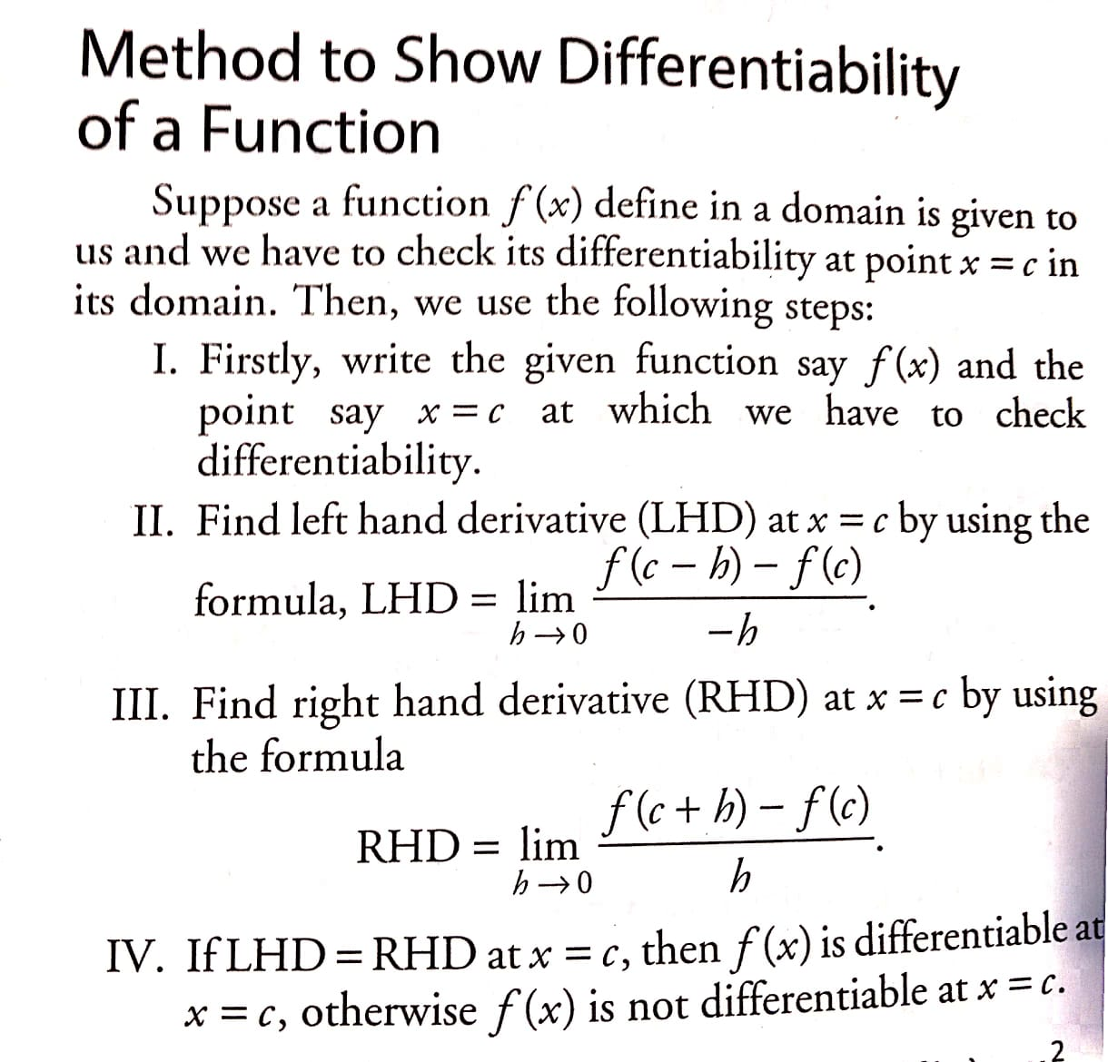

Slide 8
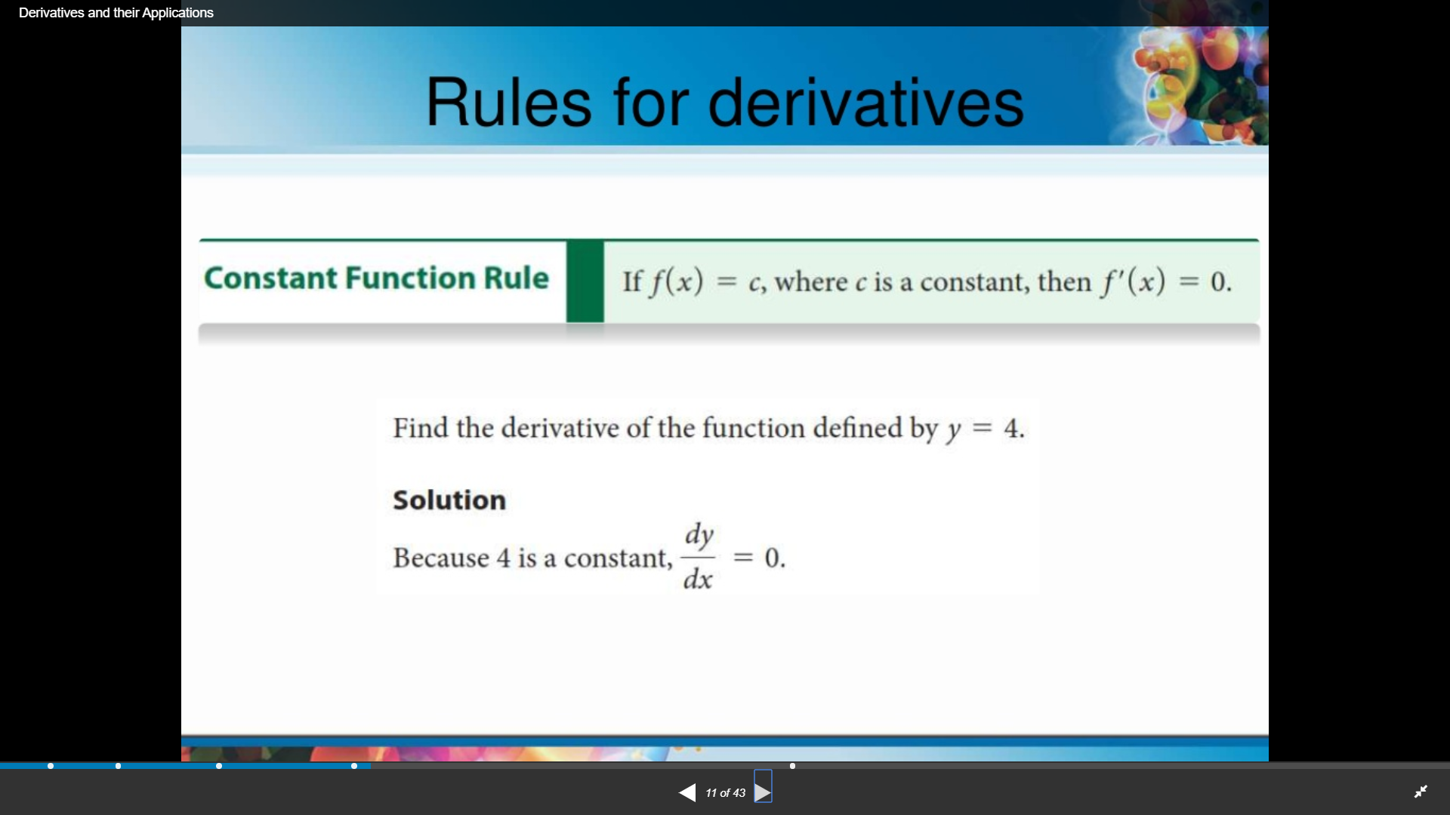

Slide 9
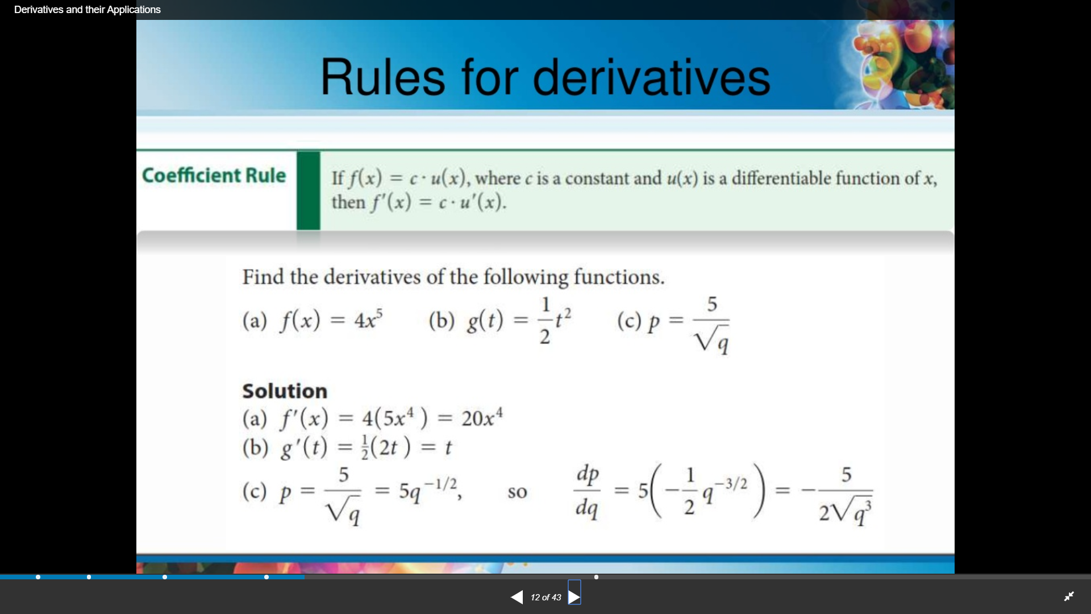

Slide 10
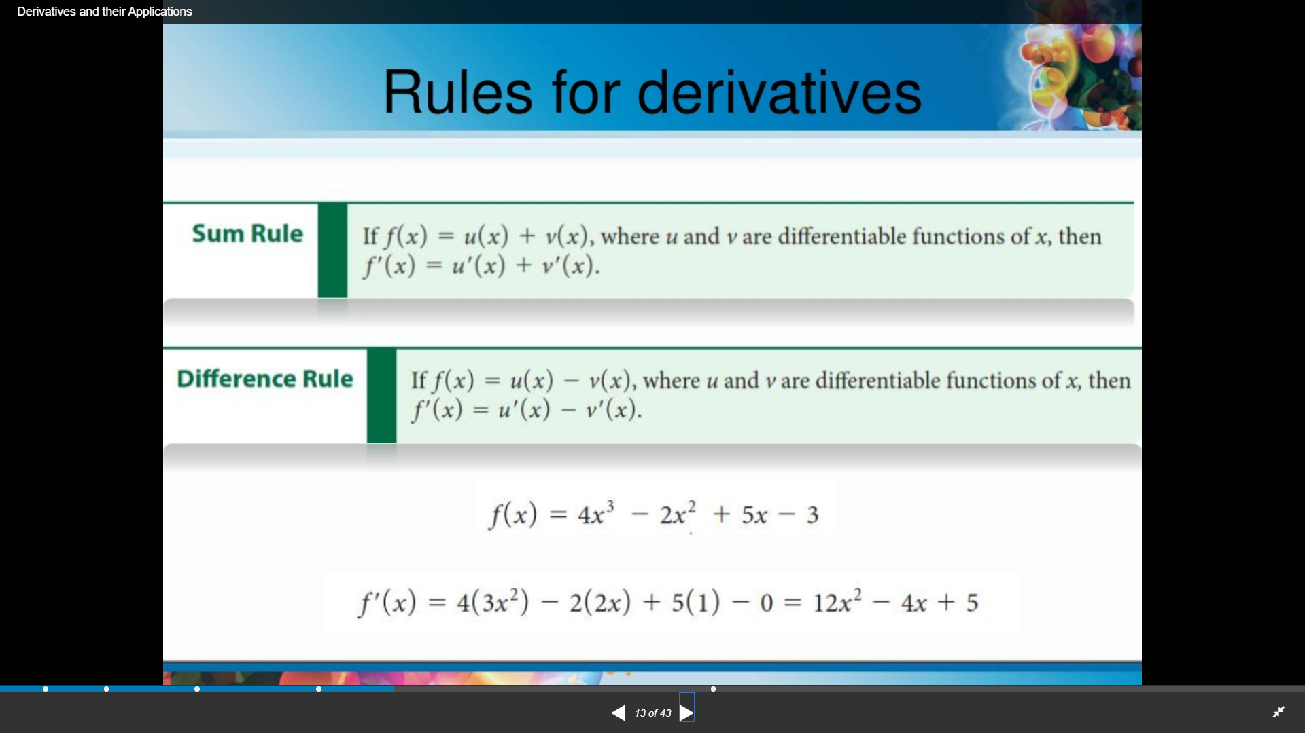

Slide 11
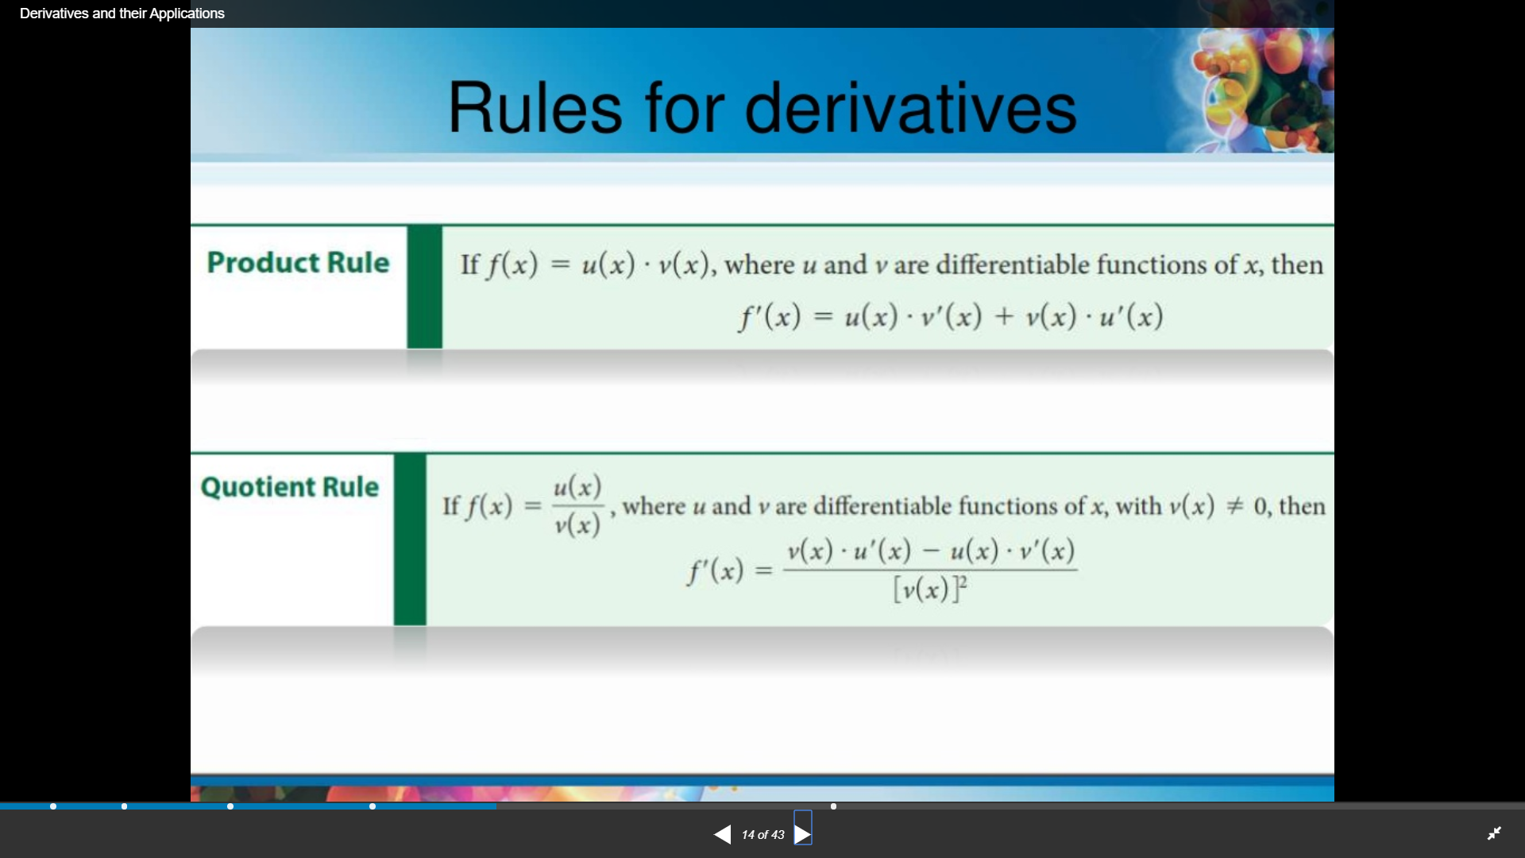
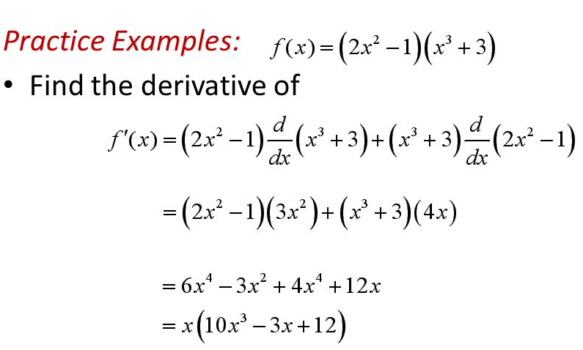

Slide 12
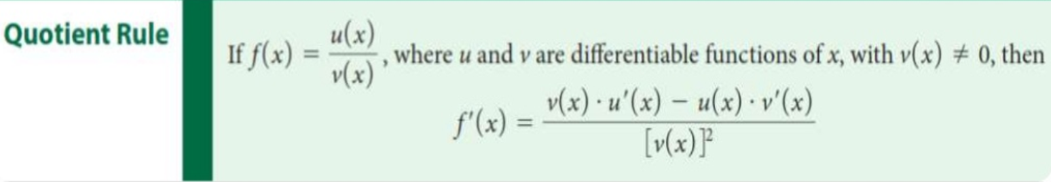
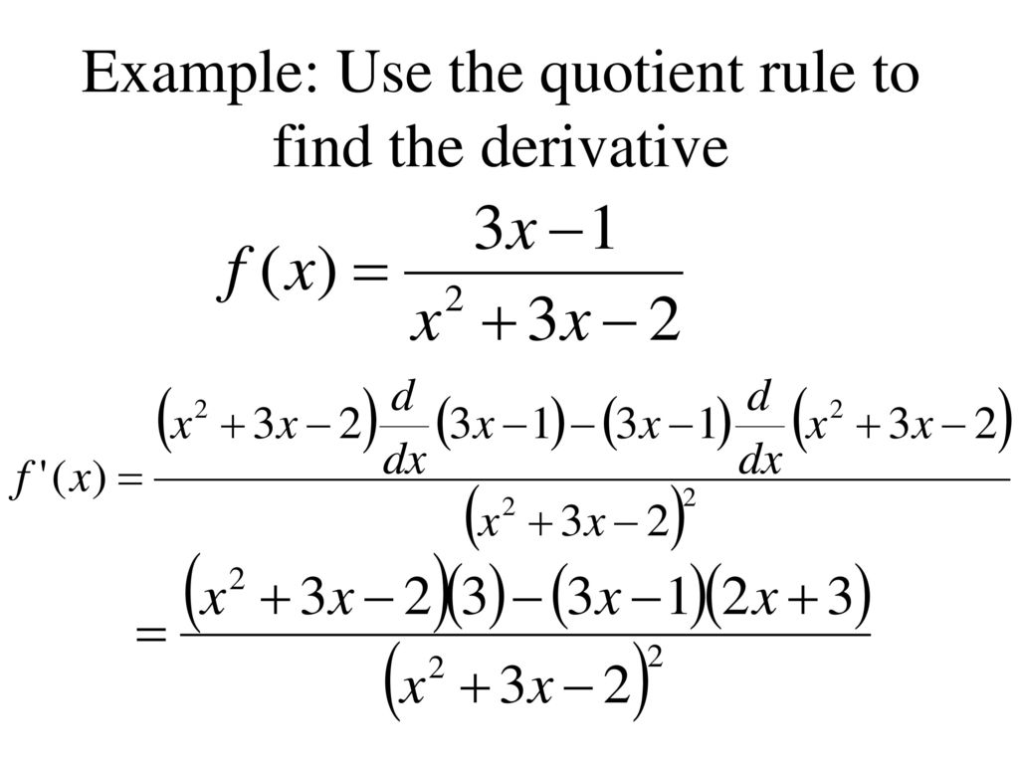

Slide 13
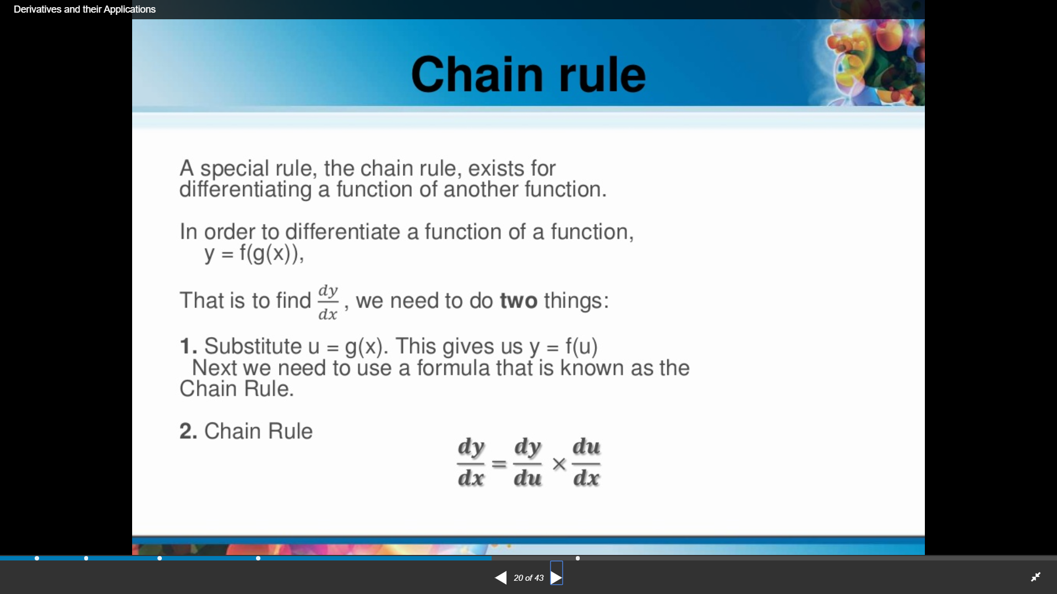

Slide 14
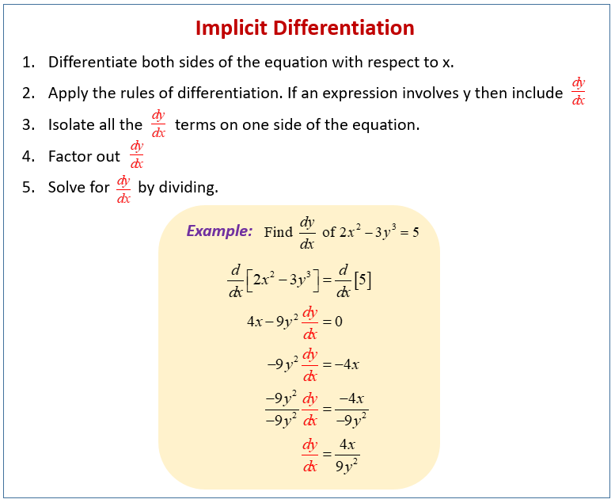

Slide 15
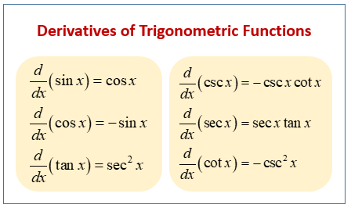

Slide 16
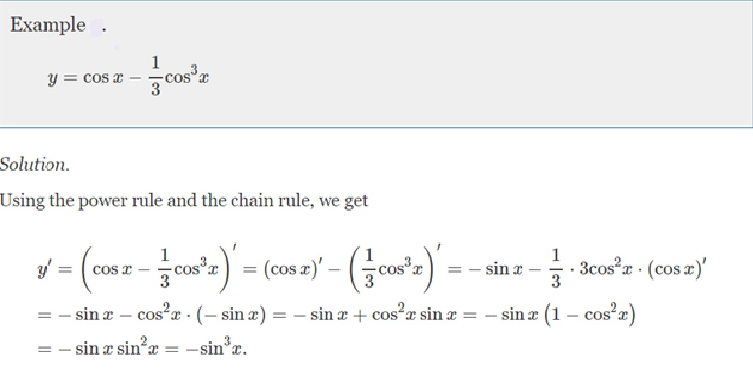

Slide 17
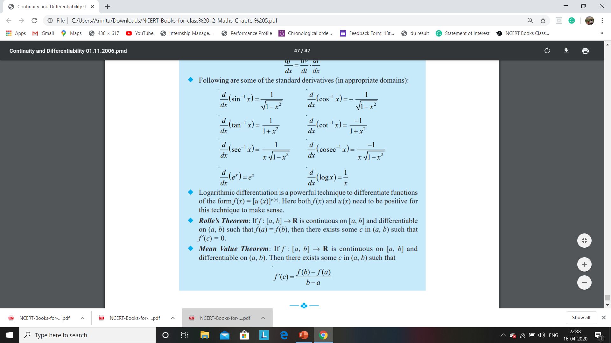
DERIVATIVES OF INVERSE TRIGONOMETRIC FUNCTIONS
LEARN THE TRICK TO MEMORIZE THESE WITH A VIDEO:- https://www.youtube.com/watch?v=NI9Avfc9K2M

Slide 18
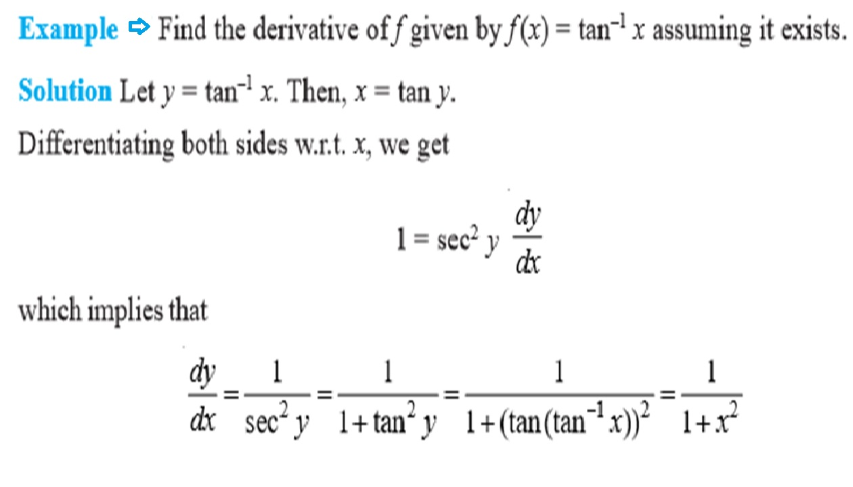

Slide 19
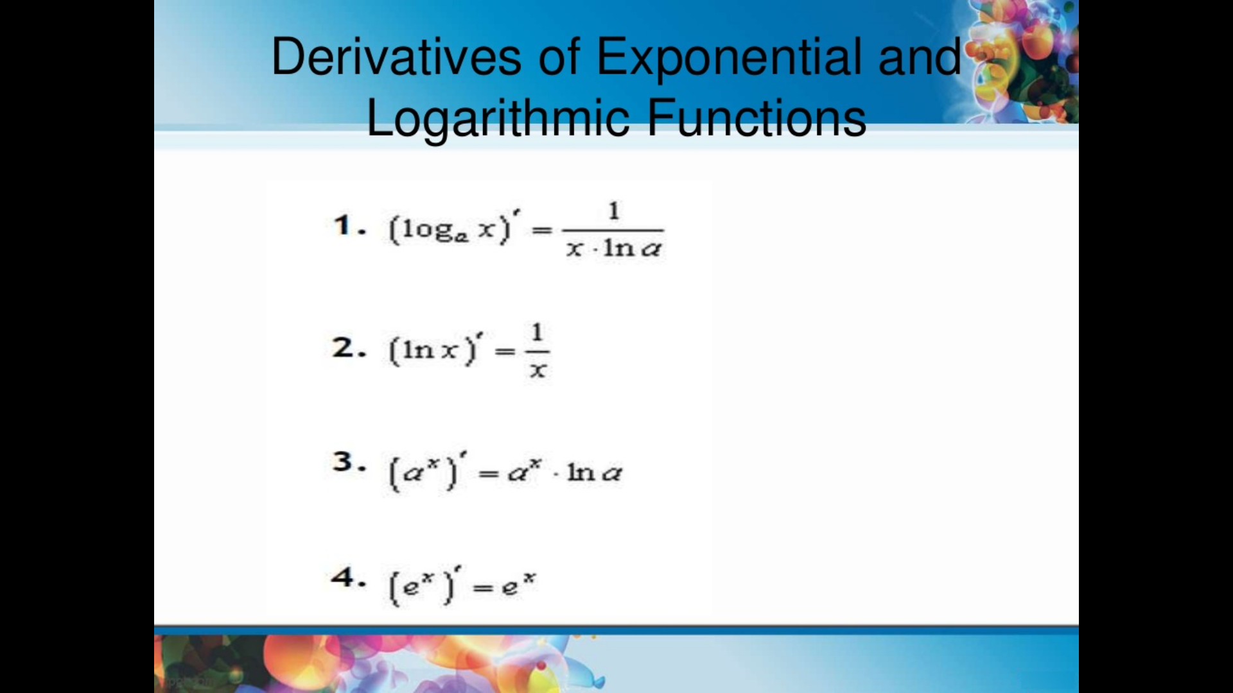
LEARN TO DIFFERENTIATE A NATURAL LOGARITHM WITH A VIDEO:- https://www.youtube.com/watch?v=ekwo6jhAneM&t=2s

Slide 20
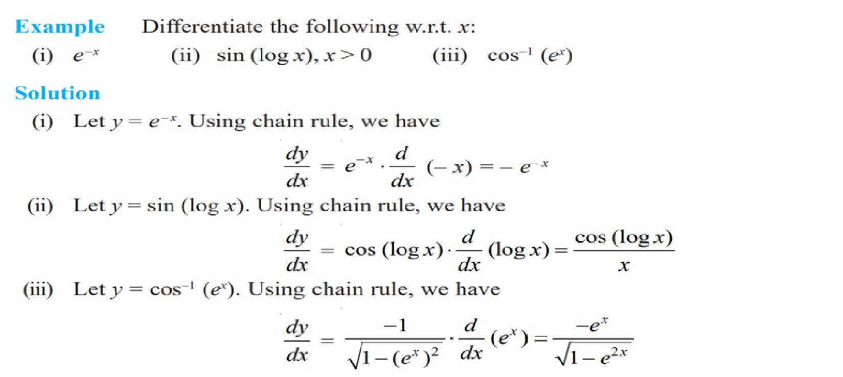

Slide 21
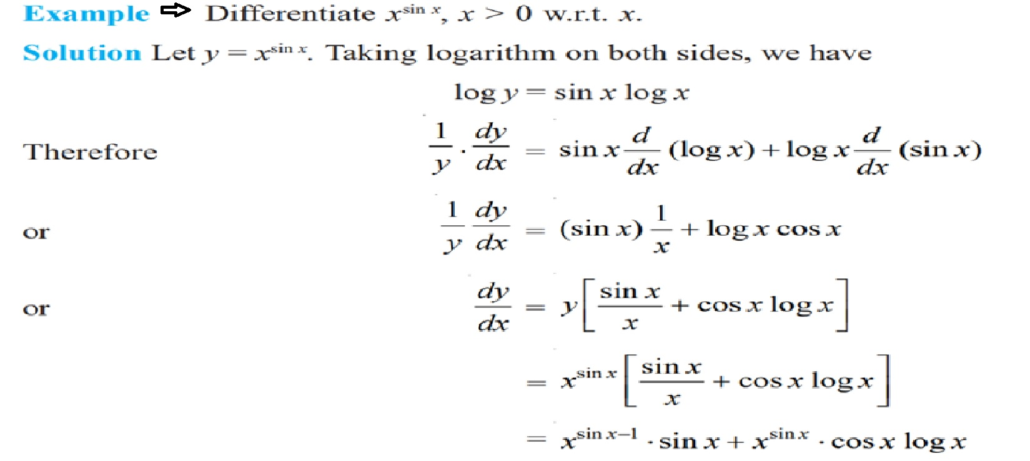
LOGARITHMIC DIFFERENTIATION

Slide 22
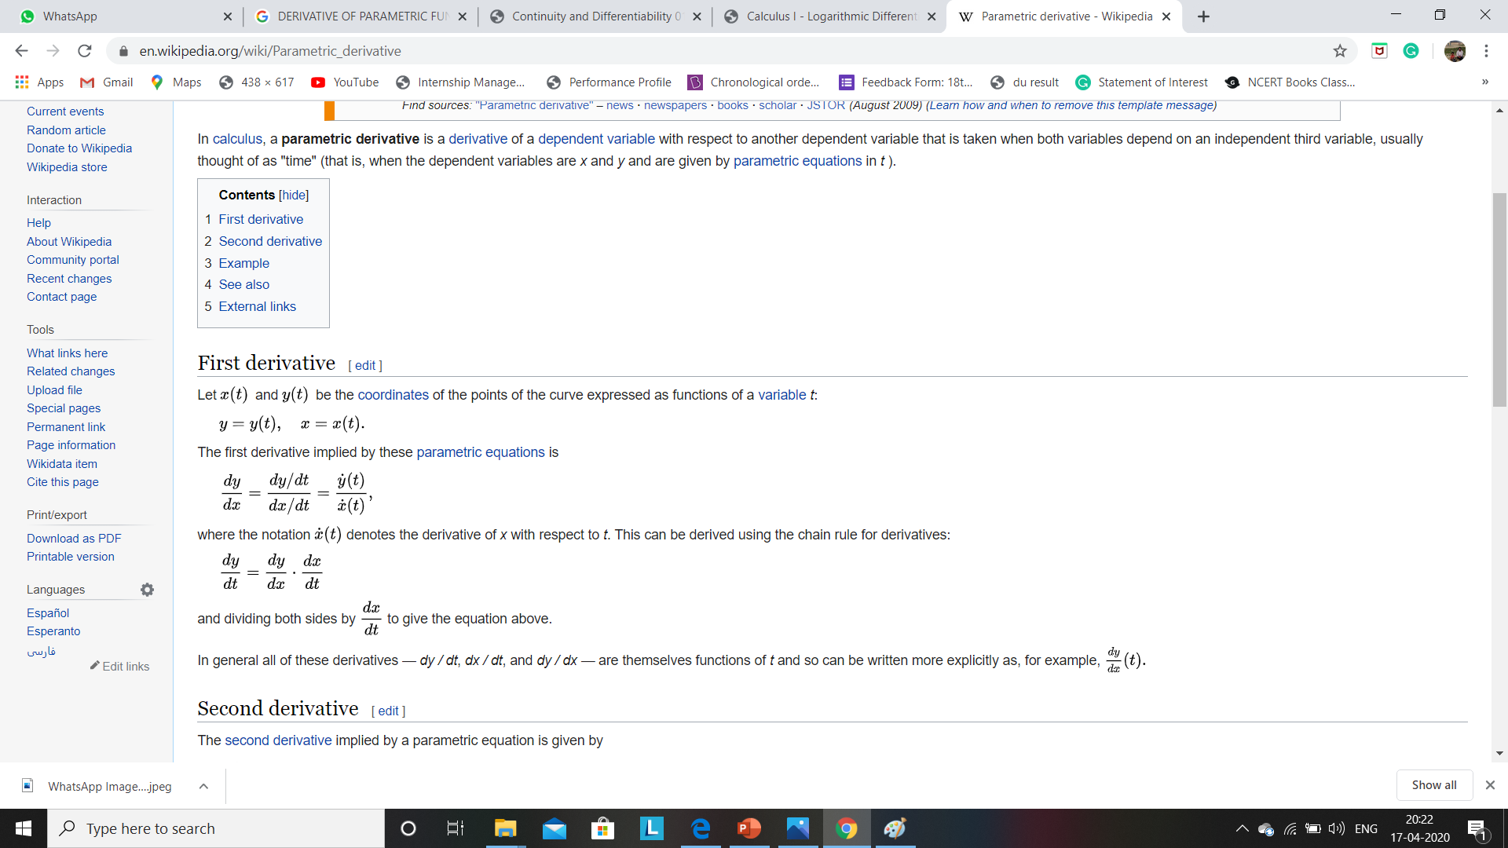
DERIVATIVES OF PARAMETRIC FUNCTIONS

Slide 23
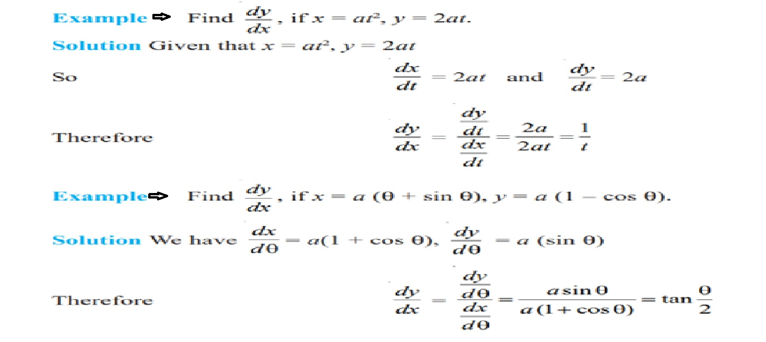

Slide 24
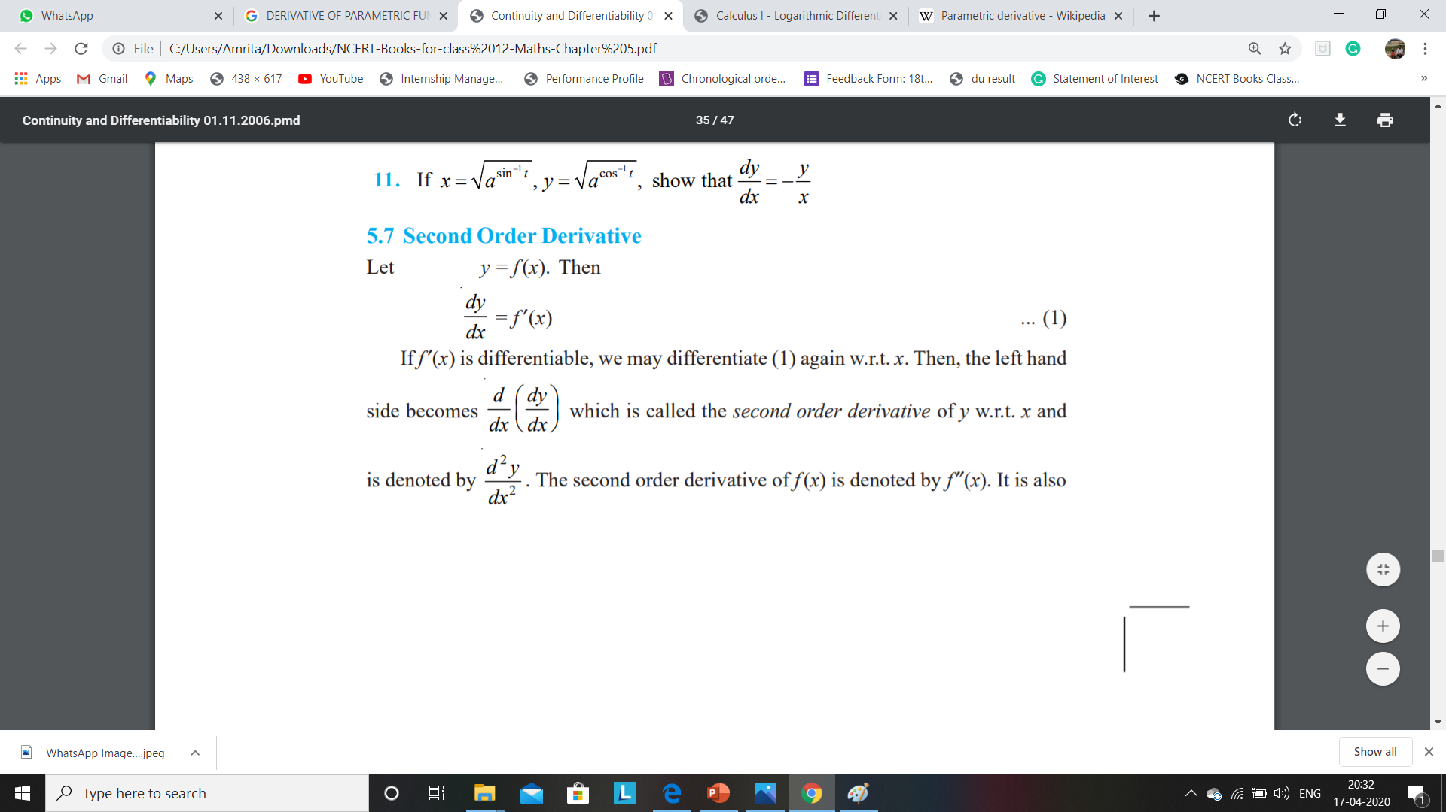
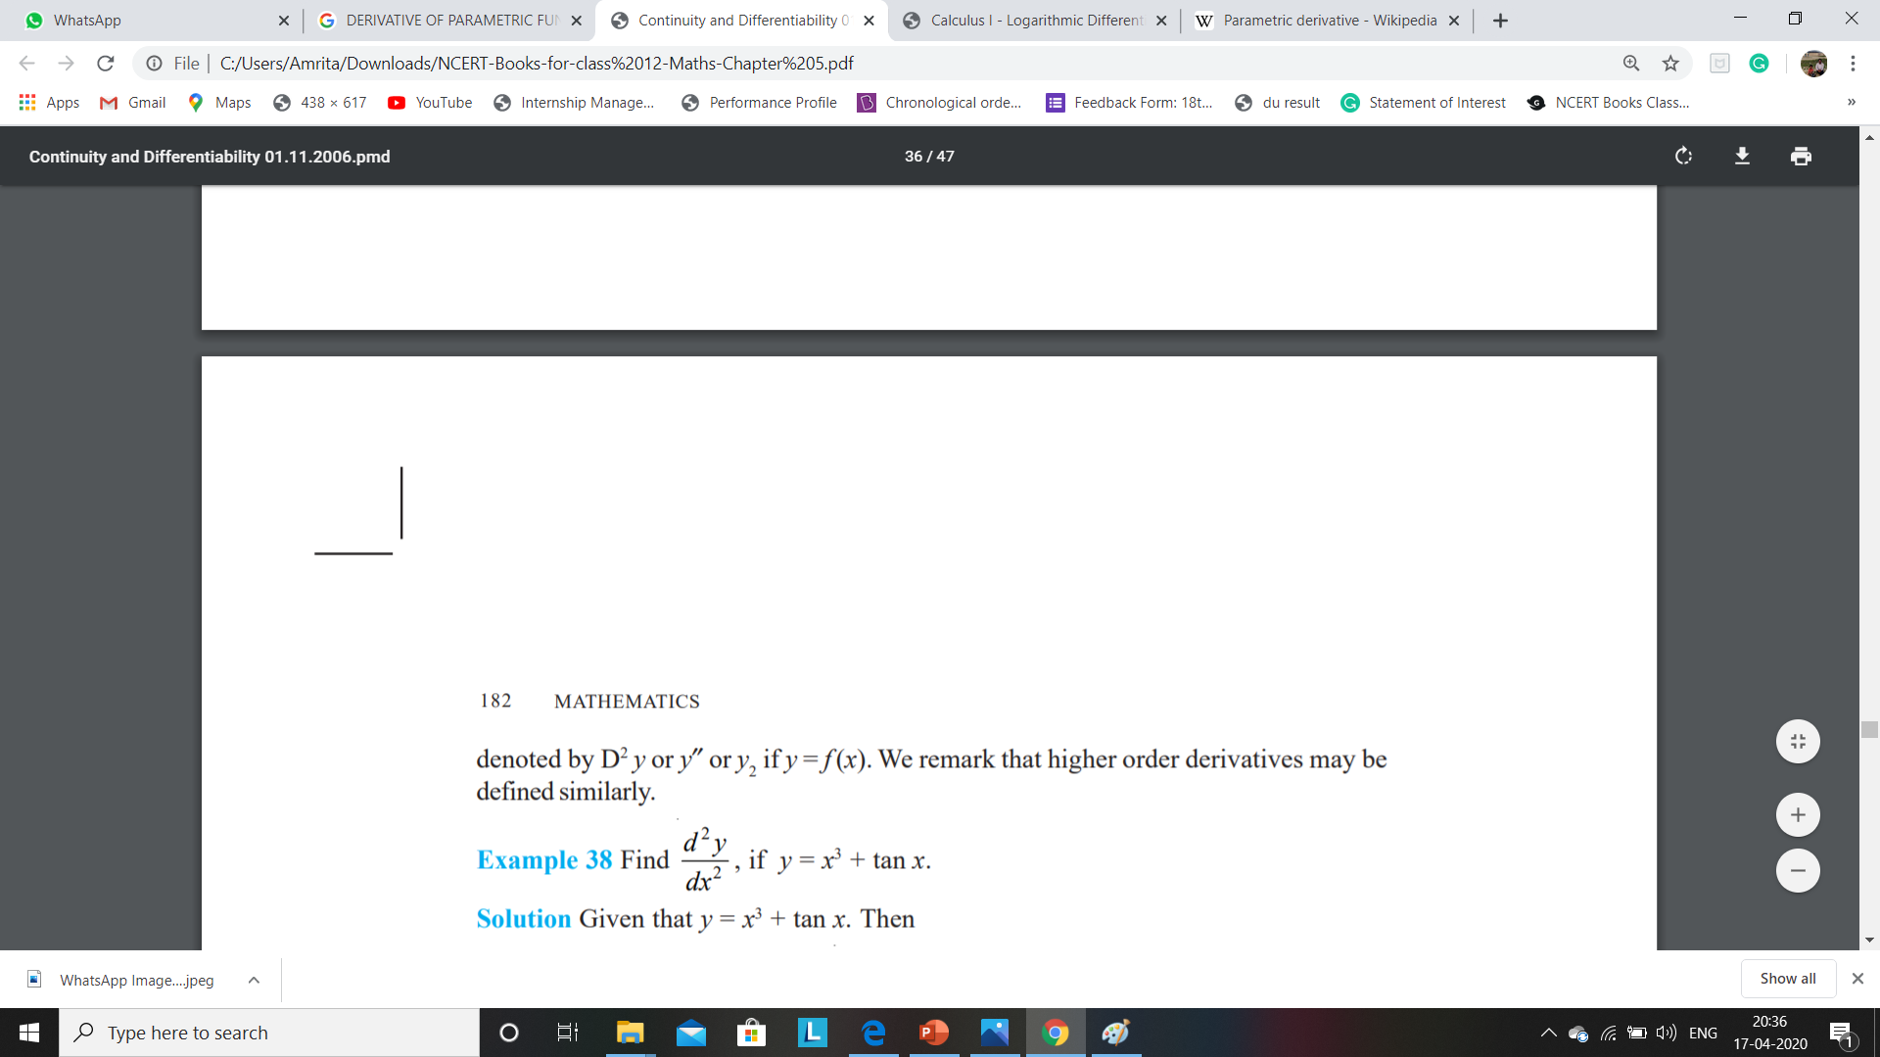
SECOND ORDER DERIVATIVE

Slide 25
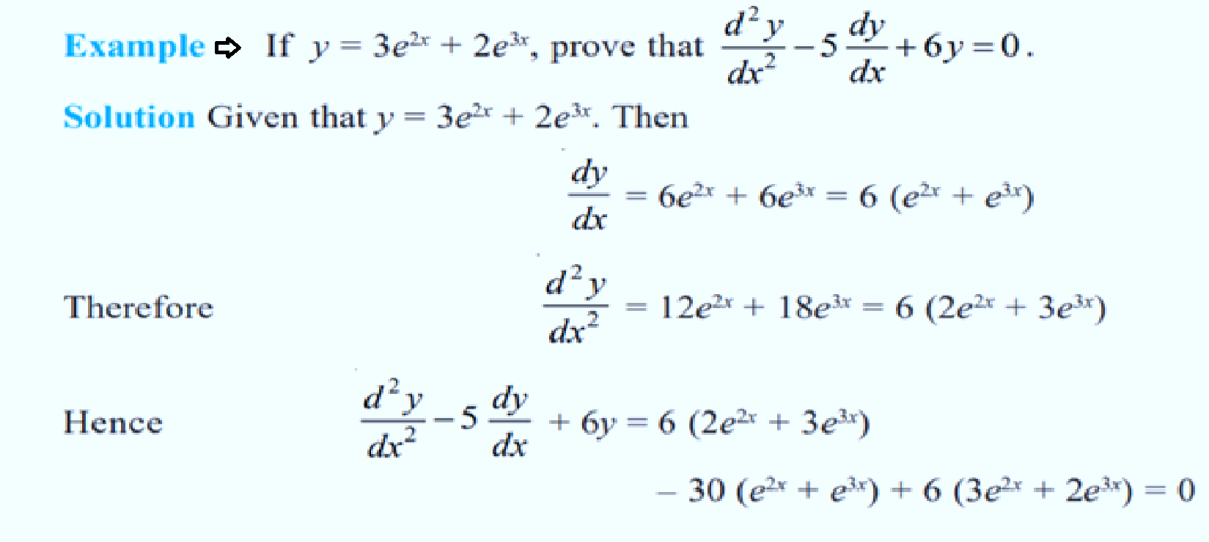

Slide 26
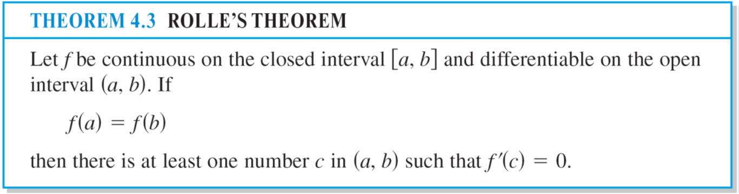
Rolle’s Theorem
The Extreme Value Theorem states that a continuous function on a closed interval [a, b] must have both a minimum and a maximum on the interval.
Both of these values, however, can occur at the endpoints. Rolle’s Theorem, named after the French mathematician Michel Rolle, gives conditions that guarantee the existence of an extreme value in the interior of a closed interval.

Slide 27
The Mean Value Theorem
Rolle’s Theorem can be used to prove another theorem—the Mean Value Theorem.
Although the Mean Value Theorem can be used directly in problem solving, it is used more often to prove other theorems.

Slide 28
The Mean Value Theorem
Geometrically, the theorem guarantees the existence of a tangent line that is parallel to the secant line through the points (a, f (a)) and (b, f (b)), as shown in Figure .
Rolle’s theorem is a special case of MVT.

Slide 29
MINDMAP
INTRODUCTION TO DERIVATIVE AND ITS DEFININTION
NOTATION & RULES OF DERIVATIVES
DERIVATIVES OF IMPLICIT FUNCTIONS
METHOD TO FIND DIFFERENTIABILTY
DERIVATIVE OF TRIGONOMETRIC FUNCTION
DERIVATIVE OF INVERSE TRIGONOMETRIC FUNCTION
DIFFERENTIATING LOGARITHM FUNCTION
DIFFERENTIATING PARAMETRIC FUNCTION
MVT AND ROLLE’S THEOREM

Slide 30
LEARNING OUTCOME
The above concepts of differential calculus helps the various disciplines like
ENGINEERING
BIOTECHNOLOGY
ECONOMICS
BANKING and so many fields of real life usage.

Slide 31
THANK YOU

