Slide 1
CLASS-XII
SUB- MATHEMATICS
TOPIC - INDEFINITE INTEGRALS

Slide 2
(INDEFINITE INTEGRALS) CLASS XII (NCERT)
CHAPTER TEXT BOOK LINK
http://ncert.nic.in/ncerts/l/lemh201.pdf

Slide 3
INTRODUCTION
In this lesson we will introduce the idea of the antiderivative of a function and formalize as “INDEFINITE INTEGRALS” we will derive a set of rules that will aid our computations as we solve problems.
The most of the mathematical operations have inverse operations. The invers operation of addition is subtractions, the inverse operation of multiplication is division, the inverse operation of differentiations is called integration

Slide 4
LEARNING OBJECTIVES
After studying this lesson student should be able to :
Understand indefinite integration as reverse process of differentiation.
Integrate simple functions like x⁴, $sin x$,e^{x}, log x and their sums, differences or constant multiples
Integrate the functions which can be converted into standard form using substitution.
Integrate the rational functions using partial fractions.
Integrate the product of function using by parts
Evaluate definite integral and use properties of definite integral in evaluate of integrals.
Understand the idea of the area under a curve as the limit of a sum.

Slide 5
If derivative of a function is given to us and we are asked to find its primitive (original function) then we have to adopt inverse process of finding differentiation. This process is called antidifferentiaton or integration.
$\frac{d}{dx}$ (x² ) = 2x or $\frac{d}{dx}$ (x² +c) =2x
Here 2x is the derivation of (x² +c)
So x² is the antiderivative /primitive/ integral of 2x
In general :
If $\frac{d}{dx}$ (f(x) + c ) = g(x), then
$$\int{g\left(x\right)dx=f\left(x\right)+c ;}$$
Where c ; constant
LET US UNDERSTAND IT BY AN EXAMPLE.

Slide 6
SOME STANDARD FORM OF INDEFINITE INTEGRALS
$$\int{x^{n}dx=\frac{x^{n+1}}{n+1}}+C,n≠1$$
$$\int{\frac{1}{x}dx=log\left|x\right|}+C$$
$$\int{e^{x}dx=e^{x}+C}$$
$$\int{a^{x}dx=\frac{a^{x}}{log a}}+C$$
$$\int{sin x dx=−cos x+C}$$
$$\int{cos x dx=sin x+C}$$
$$\int{\sec^{2} x dx=tan x+C}$$
$$\int{{cosec}^{2} x dx=−cot x+C}$$
$$\int{sec x tan x dx=sec x+C}$$
$$\int{cosec x cot x dx=−cosec x+C}$$
$$\int{\frac{1}{\sqrt{1−x^{2}}}dx=\sin^{−1}x+C}$$

Slide 7
SOME STANDARD FORM OF INDEFINITE INTEGRALS
$$\int{\frac{−1}{\sqrt{1−x^{2}}}dx=\cos^{−1}x+C}$$
$$\int{\frac{1}{1{+x}^{2}}dx=\tan^{−1}x+C}$$
$$\int{\frac{−1}{1+x^{2}}dx=\cot^{−1}x+C}$$
$$\int{\frac{1}{x\sqrt{x^{2}−1}}dx=\sec^{−1}x+C}$$
$$\int{\frac{−1}{x\sqrt{x^{2}−1}}dx={cosec}^{−1}x+C}$$
$$\int{\frac{1}{\sqrt{a^{2}−x^{2}}}dx=\sin^{−1}\left(\frac{x}{a}\right)+C}$$
$$\int{−\frac{1}{a^{2}+x^{2}}dx=\frac{1}{a}\cot^{−1}\left(\frac{x}{a}\right)+C}$$
$$\int{\frac{1}{a^{2}+x^{2}}dx=\frac{1}{a}\tan^{−1}\left(\frac{x}{a}\right)+C}$$
$$\int{−\frac{1}{\sqrt{a^{2}−x^{2}}}dx=\cos^{−1}\left(\frac{x}{a}\right)+C}$$
$$\int{\frac{1}{x\sqrt{x^{2}−}a^{2}}dx={\frac{1}{a}sec}^{−1}\left(\frac{x}{a}\right)+C}$$
$$\int{\frac{−1}{x\sqrt{x^{2}−}a^{2}}dx={\frac{1}{a}secec}^{−1}\left(\frac{x}{a}\right)+C}$$

Slide 8
SOME PROPERTY'S OF INDEFINITE INTEGERS
Two indefinite integrals with the same derivative lead to the same family curves.
Let f and g be any two functions such that
$\frac{d}{dx}\int{f\left(x\right)dx= }\frac{d}{dx}\int{g\left(x\right)dx }$
$\frac{d}{dx}\int{f\left(x\right)dx= }\frac{d}{dx}\int{g\left(x\right)dx=0 }$
$\frac{d}{dx}\left[\int{f\left(x\right)dx= }\frac{d}{dx}\int{g\left(x\right)dx }\right]$=0 c
$$\int{f\left(x\right)dx− }\int{g\left(x\right)dx=c }$$
$\int{f\left(x\right)dx= }\int{g\left(x\right)dx+c }$,
family $of$ curves $\left[\int{f\left(x\right)dx+C_{1},C_{1}∈R]} and\left[\int{g\left(x\right)dx+C_{2},C_{2}∈R]} \right]\right]are identical$
Hence, $\int{f\left(x\right)dx and }\int{g\left(x\right)dx are equivalent.}$
PROPERTY 1
PROOF :

Slide 9
PROPERTY II
For any real number K,$\int{K}f\left(x\right)dx=K\int{f\left(x\right)dx}$
PROOF :
$$\frac{d}{dx}\int{\left[Kf\left(x\right)dx\right]=Kf(x)}$$
Also, $\frac{d}{dx}\left[K\int{f\left(x\right)dx}\right]=K\frac{d}{dx}\int{f\left(x\right)dx=Kf(x)}$
Therefore by definition of integral,$\int{Kf\left(x\right)dx=K\int{f\left(x\right)dx.}}$
EXAMPLE
$$\int{({3x}^{4}+2^{x })dx }$$
$=3\int{x^{4}}$ $dx$+ $\int{2^{x}}$ $dx$
$=\frac{3}{5}x^{5}$ + $\frac{2^{x}}{\log_{2}}$ +c

Slide 10
PROPERTY III
Integral of any number of algebraic sum of functions is equal to the algebraic sum of the integrals of these functions taken individually I’e.
$$\int{\left\{f_{1 }\left(x\right)+ f_{2}\left(x\right)+f_{3}\left(x\right)+….\right\}dx=}∫f_{1 }\left(x\right)dx+\int{}f_{2}\left(x\right)dx+f_{3}\left(x\right)dx+….$$
PROOF: since, $\frac{d}{dx}\left[\left\{f_{1}\left(x\right)+f_{2}\left(x\right)+f_{3}\left(x\right)+….\right\}dx\right]=f_{1}\left(x\right)+f_{2}\left(x\right)+f_{3}\left(x\right)+…….(1)$
On the other hand, we find that
$$\frac{d}{dx}\left[\left\{f_{1}\left(x\right)+f_{2}\left(x\right)+f_{3}\left(x\right)+….\right\}dx\right]=\frac{d}{dx}{\{f}_{1}\left(x\right)dx\}+{\frac{d}{dx}\{f}_{2}\left(x\right)dx\}+\frac{d}{dx}{\{f}_{3}dx\}+…=f_{1}\left(x\right)+f_{2}\left(x\right)+f_{2}\left(x\right)+…….(2)$$
From (1) and (2), we find
$$\int{\left\{f_{1}\left(x\right)+f_{2}\left(x\right)+f_{3}\left(x\right)+…\right\}dx=\int{f_{1}\left(x\right)dx+\int{f_{2}\left(x\right)dx+\int{f_{3}\left(x\right)dx…}}}}$$
EXAMPLE
$\int{\left(2cosx − \frac{3}{x}+ x^{5}\right)}$dx
=2$\int{cosx dx −3\int{\frac{1}{x}}}$dx + $\int{x^{5 }dx}$
= 2 sinx – 3 $in x+\frac{x^{6}}{6}$ $+$ C

Slide 11
INTEGRATION BY SUBSTITUTION
$$If∅ \left(x\right)is a continuously differentiable function, then to evaluate integrals$$
$$of the$$
$form$ $\int{f\left(∅\left(x\right)\right)}$ $∅ \left(x\right)$dx, we substitute $∅ \left(x\right)$= t and $∅\left(x\right)$dx=dt.
This substitution reduces the above integral to $\int{f\left(t\right)}$dt. After evaluating this integral substitute back the value of t.
$\int{\frac{\sin\left(logx\right)}{x}\operatorname{dx}{}}$ =$\int{\sin{t dt=−cos{t+c=−\cos\left(logx\right)}}}$+ c
$\int{\frac{x}{x^{2}+1}}$dx = $\frac{1}{2}\int{\frac{2x}{x^{2}+1}}$dx =$\frac{1}{2}\log\left|x^{2}+1\right|$+ c
EXAMPLE

Slide 12
$If$ $\int{f\left(x\right)}$dx = $∅\left(x\right)$,then $\int{f\left(ax+b\right)}$dx=$\frac{1}{a}$ $∅\left(ax+b\right)$
Let I =$\int{\begin{aligned}f\left(ax+b\right)dx. \\ \end{aligned}}$
l$et ax+b=t.then,d \left(ax+b\right)=dt$ $⇒a dx ⇒dt ⇒dx= \frac{1}{a}$dt
Substituting ax +b =t and dx = $\frac{1}{a}dt$, we get
I = $\int{f\left(ax+b\right)}$dx = $\frac{1}{a}\int{f\left(t\right)}dt$ =$\frac{1}{a}∅\left(t\right)$=$\frac{1}{a}∅\left(ax+b\right)$+ c
$\int{\sec^{2}\left(7−4x\right)dx}$= - $\frac{1}{4}\tan\left(7−4x\right)+C$
$\int{\frac{\sin{4x}}{\cos{2x}}}$dx = $\int{\frac{2sin{2x}.\cos{2x}}{\cos{2x}}}$dx
$$−cos{2x+c}$$
INTEGRALS OF THE FORM $\int{f\left(ax+b\right)}dx$
PROOF :
EXAMPLE

Slide 13
EVALUATION OF INTEGRALS OF THE FORM
$\int{\sin^{m}}x dx,\int{\cos^{m }}$x dx, where m$≤4$
EXAMPLE
$\int{{\sin^{2}}}$3x dx = $\int{\frac{1−\cos{6x}}{2}}$ dx = $\frac{1}{2}\left[x−\frac{\sin{6x}}{6}\right]+C$
$\int{\sin^{2}}$x $\cos^{2}$xdx = $\frac{1}{4}\int{\sin^{2}}$2x = $\frac{1}{4}\int{\frac{1−\cos{4x}}{2}}$dx=$\frac{1}{8}\left[x−\frac{sin4x}{4}\right]$=C

Slide 14
EVALUATION OF INTEGRALS OF THE FORM
EXAMPLE
$$\int{\sin{6x\sin{2x dx} }}$$
$$=\frac{1}{2}\int{\left(\cos{4x−\cos{8x}}\right)dx} =\frac{1}{2}\left[\frac{\sin{4x}}{4}−\frac{sin8x}{8}\right]+C$$
Ex: $\int{\frac{sin4x}{sinx}dx=\int{\frac{4\sin{ ×\cos{ ×cos2x}}}{sinx}dx}}$
$=2\int{2\cos{2x\cos{x dx }}}$
$=2\int{\left(cos x+cos3x\right)dx}$
$=\left[sinx+\frac{sin3x}{3}\right]+C$

Slide 15
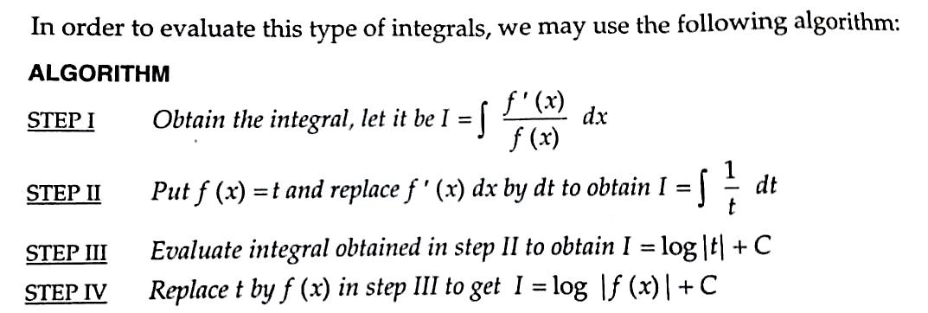
EVALUATION OF INTEGRALS BASED UPON $\int{\frac{f′(x)}{f(x)}}dx=log\left|f(x)\right|+C$
EXAMPLE
$$\int{\frac{e^{x}−e^{−x}}{e^{x}+e^{−x}}}dx=\int{\frac{d(e^{x}+e^{−x})}{e^{x}−e^{−x}}}dx$$
$$\int{e^{3logx}.{{(x}^{4}+1)}^{−1}dx=}\int{\frac{x^{3}}{\left(x^{4}+1\right)}}dx=\frac{1}{4}ln\left|x^{4}+1\right|+C$$

Slide 16
INTEGRALS OF THE FORM $\int{{\left\{f\left(x\right)\right\}}^{n}}$ $f′\left(x\right)$dx
EXAMPLE
$\int{\frac{4{\left(\tan^{−1}x\right)}^{3}}{{1+x}^{2}}}$dx $=\int{{4t}^{3}dt=t^{4}+C={\left(\tan^{−1}x\right)}^{4}+C}$
$\int{\frac{{\left(1+logx\right)}^{3}}{x}}$dx $=\int{t^{3}dt=\frac{1}{4}}t^{4}$+C=$\frac{1}{4}{\left(1+logx\right)}^{4}+C$

Slide 17
SOME SPECIAL INTEGRALS
In this section , we will introduce some important formulae and apply them to evaluate many integrals.
Following are some substitutions useful in evaluating integrals:
expression Substitution
$a^{2}+x^{2}$ $x=a\tan{θ or a\cot{θ}}$
$a^{2}−x^{2}$ $x=a\sin{θ or a\cos{θ}}$
$x^{2}−a^{2}$ $x=a\sec{θ or a cosec θ}$
$\sqrt{\frac{a=x}{a+x}}or, \sqrt{\frac{a+x}{a−x}}$ $x=\operatorname{acos}{2θ}$
$\sqrt{\frac{x−α}{β−x}}or,\sqrt{(x−α)(x−β)}$ $x=α \cos^{2}θ+β \sin^{2}θ$

Slide 18
SOME SPECIAL INTEGRALS
EXAMPLE
$$\int{\frac{1}{\sqrt{4x^{2}−9}}}dx=\frac{1}{2}\int{\frac{1}{\sqrt{x^{2}−{(\frac{3}{2})}^{2}}}dx}=\frac{1}{2}log\left|2x+\sqrt{{4x}^{2}−9}\right|+C$$
$$\int{\frac{1}{4+{9x}^{2}}dx=\frac{1}{9}\int{\frac{1}{{\left(\frac{2}{3}\right)}^{2}+x^{2}}dx=\frac{1}{6}\tan^{−1}\left(\frac{3x}{2}\right)+C}}$$

Slide 19
INTEGRALS OF THE FORM
$$\int{\frac{1}{{a sin}^{2} x+b \cos^{2 }x}dx},\int{\frac{1}{{a+b sin}^{2}x}dx,}$$
$$\int{\frac{1}{a+b \cos^{2}x}dx,\int{\frac{1}{{(a\sin{x+b\cos{x)}}}^{2}}dx,\int{\frac{1}{{a+sin}^{2}x+ {c cos}^{2}x}dx}}}$$
To evaluate this type of integrals we use the following algorithm.
ALGORITHM:
STEP I Divide numerator and denominator both by $\cos^{2}$x.
STEP II Replace $\sec^{2}$x, if any, in denominator by ${1+tan}^{2}$x.
STEP III Put tan x = t so that $\sec^{2}$x dx = dt. This substitution reduces the integral in the form $\int{\frac{1}{{at}^{2}+bt+c}}dt.$
STEP IV Evaluate the integral obtained in step III by using the methods discussed earlier.
EXAMPLE
$$\int{\frac{sinx}{sin3x}dx=}\int{\frac{sinx}{3sinx−4\sin^{2}x}dx}$$
$=\int{\frac{dx}{3−4\sin^{2}x}}$
$=\int{\frac{\sec^{2}x}{{3sec}^{2}x−4\tan^{2}x}}dx$
$=\frac{dt}{3(1+t^{2})−4t^{2}}$
$=\frac{1}{{(\sqrt{3)}}^{2}−t^{2}}dx$ $=\frac{1}{\sqrt[2]{3}}log\left|\frac{\sqrt{3}+tanx}{\sqrt{3}−tanx}\right|+C$

Slide 20
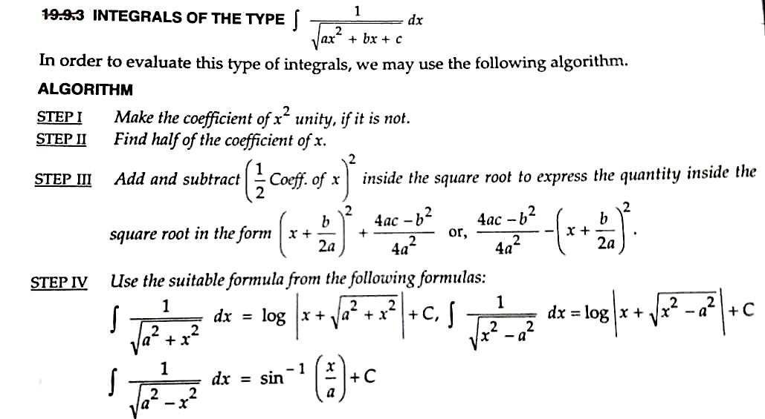
INTEGRALS OF THE FORM $\int{\frac{1}{\sqrt{{ax}^{2}+bx+c}}dx}$
EXAMPLE
$\int{\frac{2x}{\sqrt{1−x^{2}−x^{4}}}dx}$ $putx^{2}=t$
$$=\int{\frac{dt}{\sqrt{1−t−t^{2}}}}=\int{\frac{dt}{\sqrt{{\left(\frac{\sqrt{5}}{2}\right)}^{2}−{\left(t+\frac{1}{2}\right)}^{2}}}}=\sin^{−1}\left(\frac{2t+1}{\sqrt{5}}\right)+C$$
$$=\sin^{−1}\left(\frac{{2x}^{2}+1}{\sqrt{5}}\right)+C$$

Slide 21
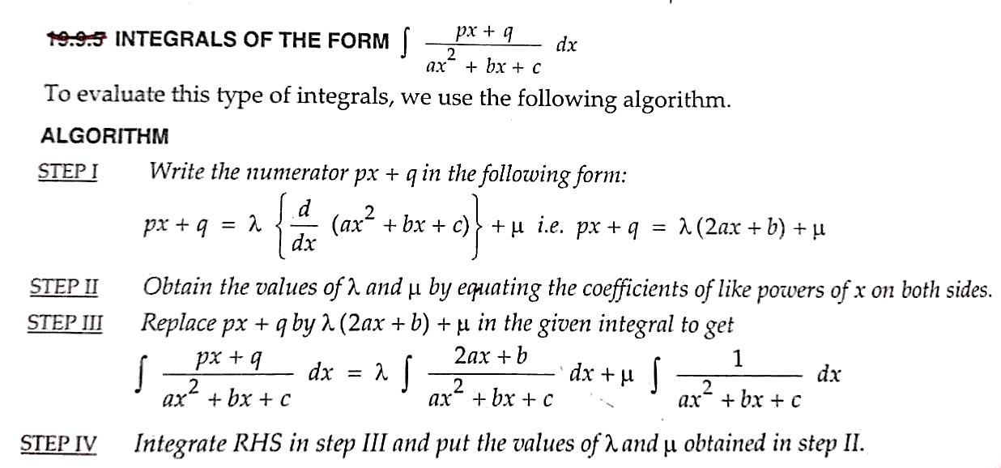
INTEGRALS OF THE FORM $\int{\frac{px+q}{{ax}^{2}+bx+c}dx}$
EXAMPLE
$$\int{\frac{2x−3}{x^{2}+6x+13}dx=\int{\frac{2x+6}{x^{2}+6x+13}dx −9\int{\frac{dx}{{(x+3)}^{2}2^{2}}}}}$$
$=ln\left|x^{2}+6x+13\right|−\frac{9}{2}\tan^{−1}\left(\frac{x+3}{2}\right)+C$

Slide 22
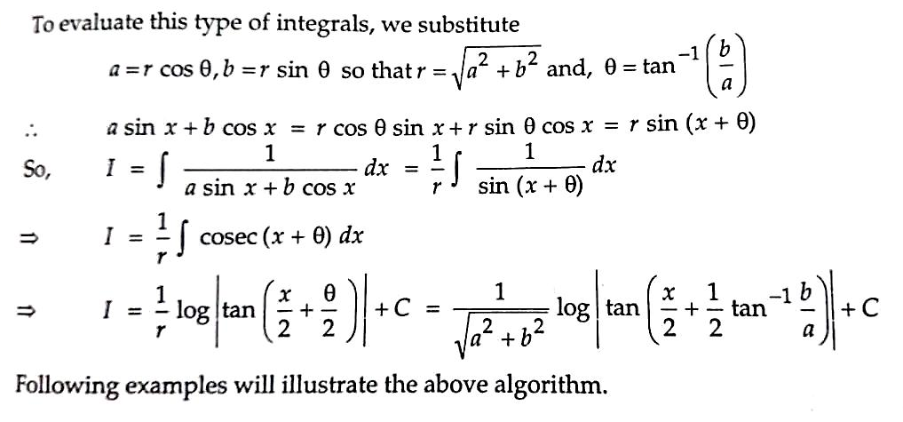
METHOD TO EVALUATE INTEGRALS OF THE FORM $\int{\frac{1}{a sin x+b cos x}dx}$
EXAMPLE
$$\int{\frac{1}{\sqrt{3}sinx+cosx}dx}$$
$$=\frac{1}{2}\int{\frac{1}{\frac{\sqrt{3}}{2}sinx+\frac{1}{2}cosx}dx}$$
$=\frac{1}{2}\int{\frac{1}{cos⁡(x−\frac{π}{3})}}dx$ $=\frac{1}{2}ln\left|\sec\left(x−\frac{π}{3}\right)+\tan\left(x−\frac{π}{3}\right)\right|+C$

Slide 23
INTEGRATION BY PARTS
THEOREM
$$if u and θ are two functions of x, then$$
$$\int{uθ dx=u\left(\int{θ dx}\right)−\int{\left\{\frac{du}{dx}\int{u dx}\right\}}}dx$$
The integral of the product of two functions =(First function) x (integral of
second function) – integral of
$$\left\{\left(Diff. of first function\right)x (integral of second function\right\}$$
EXAMPLE

Slide 24
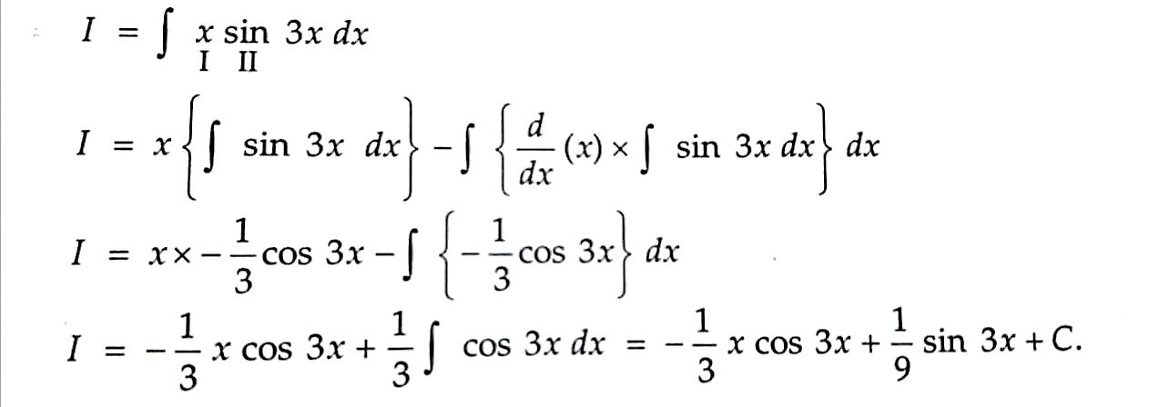
We can also choose the first function as the function which comes first in the word ILATE, where
I – stands for the inverse trigonometric function ($\sin^{−1}x,\cos^{−1}x,\tan^{−1}x etc.)$
L – stands for the logarithmic functions
A – stands for the algebraic functions
T- stands for the trigonometric functions
E – stands for the exponential functions
EXAMPLE

Slide 25
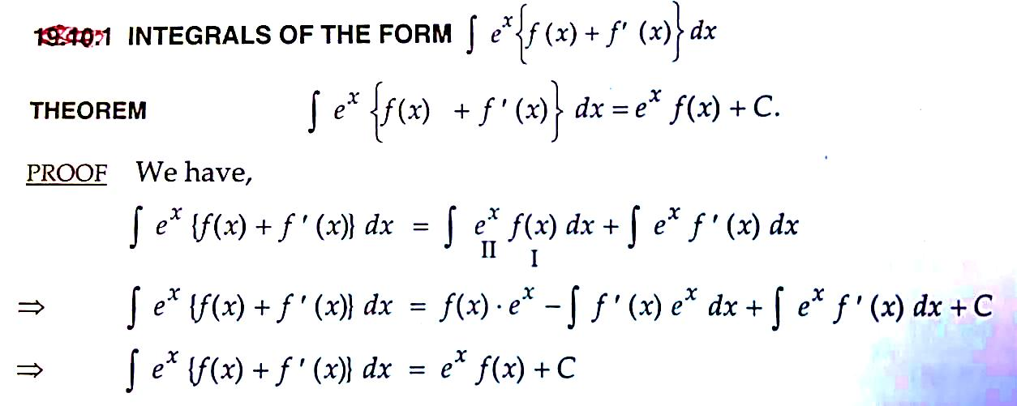
INTEGRATION OF THE FORM $\int{e^{x}\left\{f\left(x\right)+f^{′}(x)\right\}dx}$
THEOREM $\int{e^{x}\left\{f\left(x\right)+f^{′}(x)\right\}dx=e^{x}f\left(x\right)+C.}$
EXAMPLE
$$\int{\begin{aligned}e^{x}\left(\sin{x+\cos{x}}\right)dx \\ f f′\end{aligned}}$$
$$=e^{x}\sin{x+C}$$

Slide 26
INTEGRATION OF THE FORM $\int{e^{ax}\sin{bx dx}}$ and $\int{e^{ax}\cos{bx dx.}}$
In this sections, we will discuss problems based upon integrals of the form $\int{e^{ax}\sin{bx dx}}$ and $\int{e^{ax}\cos{bx dx.}}$in order to evaluate this type of integrals, we may use the following formulae:
THEOREM :
$\int{e^{ax}\sin{bx dx}=}\frac{e^{ax}}{a^{2}+b^{2}}\left(a\sin{bx −b\cos{bx}}\right)+C$
$\int{e^{ax}\cos{bx dx}=}\frac{e^{ax}}{a^{2}+b^{2}}\left(a\cos{bx −b\sin{bx}}\right)+C$
EXAMPLE
$$\int{e^{2x}\sin{3x dx}=}\frac{e^{2x}}{13}\left(2sin2x −3\cos{3x }\right)+C$$

Slide 27
SOME MORE SPECIAL INTEGRALS
$∫\sqrt{a^{2}−x^{2}}$ $dx=\frac{1}{2}x \sqrt{a^{2}−x^{2}}+\frac{1}{2}a^{2}\sin^{−1}\left(\frac{x}{a}\right)+C.$
$∫\sqrt{a^{2}+x^{2}}$ $dx=\frac{1}{2}x \sqrt{a^{2}+x^{2}}+\frac{1}{2}a^{2}log\left|x+ \sqrt{a^{2}+x^{2}}\right|+C.$
$∫\sqrt{x^{2}−a^{2}}$ $dx=\frac{1}{2}x \sqrt{x^{2}−a^{2}}−\frac{1}{2}a^{2} log\left|x+ \sqrt{x^{2}−a^{2}}\right|+C.$

Slide 28
“INTEGRATION BY USING PARTIAL FRACTIONS”

Slide 29
Integrate $\int{\frac{2x+3}{(x+2)(x−1)}}dx$
Let
$\frac{2x+3}{(x+2)(x−1)}\frac{A}{x+2}+\frac{B}{x−1}$
$⇒$ $2x+3=A\left(x−1\right)+B\left(x+2\right)$
$$∴A+B=2$$
$$−A+2B=3$$
$$B= \frac{5}{3},A=2−\frac{5}{3}=\frac{1}{3}$$
$$∴I= \int{\left(\frac{1/3}{x+2}+\frac{5/3}{x−1}\right)dx}=\frac{1}{3}ln\left|x+2\right|+\frac{5}{3}ln\left|n−1\right|+C$$

Slide 30
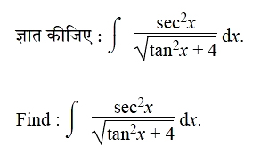
Marking scheme of board Questions 2019
Question :
2
Answer

Slide 31
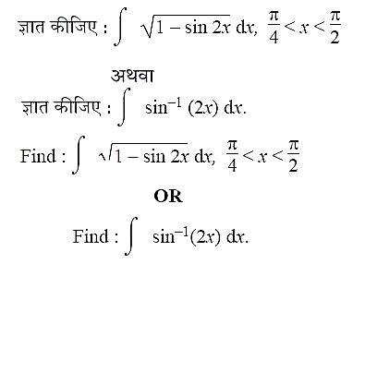
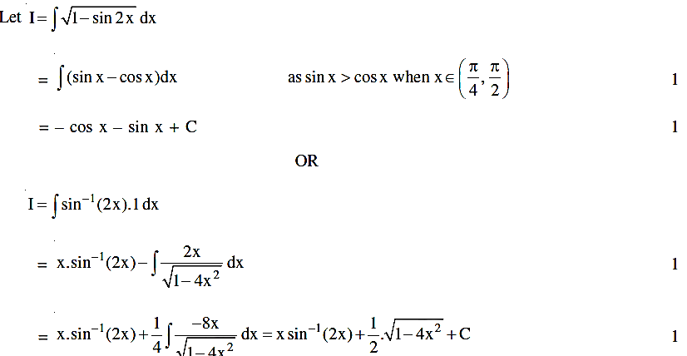
Question :
2
Answer

Slide 32
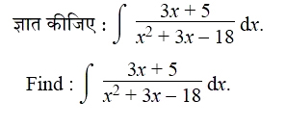
Question :
4
Answer

Slide 33
MIND MAP / CONCEPT MAP
Some standard integrals
Integration by parts
$$\int{u.v dx=u\int{v dx −\int{\left(u^{I}.\int{v dx}\right)dx}}}$$
Integration by substitution $∫f\left(g\left(x\right)\right).g^{I}\left(x\right)dx$
INDEFINITE INTEGRALS
Integration of some special functions
$\int{\frac{dx}{x^{2}−a^{2}}} ,$ $\int{\frac{dx}{x^{2}+a^{2}}} ,\int{\frac{dx}{\sqrt{x^{2}−a^{2}}}}$ , $\int{\frac{dx}{\sqrt{a^{2}−x^{2}}}}$ , $\int{\frac{dx}{\sqrt{x^{2}+a^{2}}}}$
Integration of Rational Expressions$\frac{p(x)}{Q(x)}$ using fractions partial
Some special types of integrals $\int{\sqrt{x^{2}}}−a^{2}dx, \int{\sqrt{x^{2}+a^{2} }}dx,\int{\sqrt{a^{2}−x^{2}}}dx$

Slide 34
LEARNING OUTCOMES
After completing all the above concepts, students will be able to.
Evaluate simple integrals by reversing the process of differentiation
Use a table of integrals
Explain the need for a constant of integration when finding indefinite integrals
Use the rules for finding integrals of sums of functions and constant multiples of functions

Slide 35
Video clip
https://youtu.be/x5WZv3IvF3I

