Slide 1
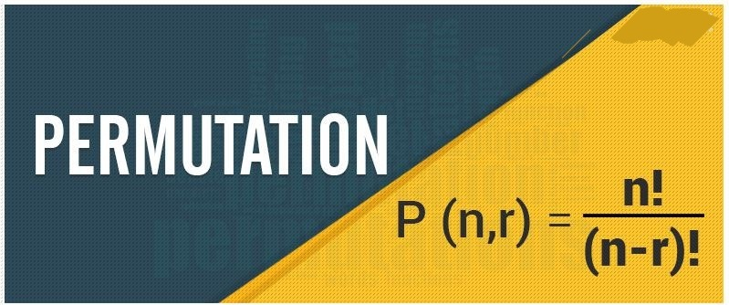
PERMUTATION
DEFINITION
A permutation is an arrangement in a definite order of a number of objects taken some or all at a time

Slide 2
EXAMPLE
Find the number of way of arranging
the letters abc taking all at a time
3 ways 2 ways 1way
abc , acb , bac , cab , cba

Slide 3
The number of permutations of
n distinct object taken all at a time is
n(n-1)(n-2)……..2.1
=n! ways

Slide 4
Number of permutation n different things taken r at a time .
0 ≤ r ≤ n
n n-1 n-2 . . n- r + 1
Total no of arrangements possible
=n(n-1)……(n-r+1)
= $\frac{n!}{\left(n−r\right)!}$
=^{n}P_{r}

Slide 5
POINTS TO REMBETR
^{n}P_{r}=$\frac{n!}{\left(n−r\right)!}$ 0, ≤ r ≤ n
In parti color ^{n}P_{r} =$\frac{n!}{\left(n−0\right)!}$ =$\frac{n!}{n!}$ = 1

Slide 6
EXAMPLE
How many different signals can be
made from 5 different flags
taken two at a time
Picture of flags of 5 different color
No of signals = ⁵P₂ =$\frac{n!}{3!}$= 5x4 = 20

Slide 7
Permutations when all the objects are not distinct
The number of permutations of n objects where
P₁ objects are of one kind , P₂ are of Second kind ,
…….P_{k} are of P^{th} kind and rest are
different kinds is
=$\frac{n!}{\text{p}\text{1}!\text{p}\text{2}! …\text{p}\text{k}!}$

Slide 8
EXAMPLE
Example:- How many words can be formed
arranging all the letters of the
word ‘ MATHEMATICS’.

Slide 9
The word MATHEMETICS
is a II letter word including
M- two times
T- two times
A- two times
No of arrangements possible
= $\frac{II!}{2!2!2!}$= 4989600

Slide 10
Permutations with certain Restrictions
How many 4 digit numbers are there
with no digit repeated.
EXAMPLE

Slide 11
4 digit numbers to be formed Repeating not allowed
Digits are 0,1,2,3…..9.
9 ways
Excluding zero
⁹P₃
Required 4 digit numbers
=9 x ⁹P₃
=9x 9 x 8 x 7
=4536

Slide 12
PROBLEM
How many words with or without dictionary meaning can be formed using letters of the word ‘EQUATION’ in which all vowels occur together

Slide 13
SOLUTION
A , E , I , O , U
Q , T , N
Vowels
Taking all vowels as one letter,
4 letters can be arranged in 4! ways,
5 vowels can be arranged in 5! Ways
Total no of words = 5! X 4!
= 120 X 24
= 2880

Slide 14
Permutations of n distinct objects
taken r at a time, When a particular
object is never taken in each
arrangement is ^{n-1}P_{r}.

Slide 15
The number of permutations of n objects taken r at a time
when a particular object is taken in each arrangement is ^{n-1}P_{r-1}

Slide 16
EXAMPLE
how many 5 digit telephone numbers
can be formed using all the digits if each
number starts with 97 and no digit is
repeated.

Slide 17
SOLUTION
Given digits are =10
digit telephone nos to be formed starting with 97
9 | 7
⁸P₃
Regd number = ⁸P₃ = 8 x 7 x 6 = 336

Slide 18
TO FIND RANK OF A WORD
PROBLEM
If all the letters of the word ‘INDIA’
One written in all possible orders and these words are written out as in a dictionary.
Find the rank of the word ‘INDIA’

Slide 19
SOLUTION
Alphabetical order of the letters of the
word INDIA is A , D , I , I , N
No of words starting with A = $\frac{4!}{2!}$ = 12
No of words starting with D= $\frac{4!}{2!}$ = 12
No of words starting with IA = 3!= 06
No of words starting with ID = 3!= 06
No of words starting with II = 3!= 06
No of words starting with INA = 2!= 02
No of words starting with INDAI - 1
No of words starting with INDIA – 1
Rank of the word = 12 + 12 + 6 + 6 + 6 + 2 + 1 + 1 = 46

Slide 20
Restricted permutation when all the
objects are distinct

Slide 21
EXAMPLE
Find the number of different word that can be formed from the letters of the word ‘TRIANGLE’ so that all vowels do not occur together

Slide 22
SOLUTION
No of words in which all vowels occur together
A E I
, T , R , N , G , L
No of words = 8! – 6! X 3! = 36000

Slide 23
IMPORTANT NOTES
^{n}P_{r} =$\frac{n!}{\left(n−r\right)!}$ 0, ≤ r ≤ n
^{n}P_{r}= 1 ^{n}P_{r}=n!

Slide 24
POINTS TO REMEMBER
Permutation is an arrangement order matters
N distinct things can be arranged taking all at a time = n!
n distinct things can be arranged taking r at a time ^{n}P_{r} =$\frac{n!}{\left(n−r\right)!}$
Number of permutations of n objects when all are not distinct =$\frac{n!}{\text{p}\text{1}!\text{p}\text{2}! …\text{p}\text{k}!}$

Slide 25
