Slide 1

MATHEMATICS
CLASS-X
TOPIC:STATISTICS

Slide 2
LINK FOR REFERENCE OF TEXTS
NCERT TEXT BOOK CHAPTER-14
NCERT EXEMPLAR BOOK CHAPTER-14

Slide 3
LEARNING OBJECTIVES:
To find mean for group data by direct method, assumed mean method and step deviation method.
To learn to find the mode for grouped data.
To learn to calculate cumulative frequency of a class.
To find median for grouped data using formula.
To represent cumulative frequency distribution graphically as cumulative frequency curve (ogive) of less than type and more than type.
To apply the knowledge of ogives to find median of grouped data graphically.

Slide 4
PREVIOUS KNOWLEDGE
Concept of Exclusive form of group(Continuous Form) and Inclusive form of group (Discontinuous Form);
Finding Class size ;
Finding mid value of a class or Class Mark;
Conversion of a Discontinuous Class to Continuous.
Measure of central tendency.
Calculating Mean of Raw data & Ungrouped Data.
Finding median of ungrouped Data;
Finding mode of Ungrouped data;
Graphical representation of Continuous and Discontinuous data.
(Such as Bar Graphs, Histograms of uniform width and of varying widths & Frequency polygons)

Slide 5
INTRODUCTION
In the previous year we learnt about the ungrouped data , its presentation and central tendencies ,now this year we will proceed to find the central tendencies of grouped data with various methods.
In this regard we will discuss about various methods of finding mean of a grouped data such as Direct method, Assumed Mean method , and Step Deviation method;
Various methods of finding median of a grouped data such as from formula and from cumulative frequency curves or Ogives.
Finding mode of a grouped frequency distribution;
Finding missing frequency of a class when the median or mean of that data is given.

Slide 6
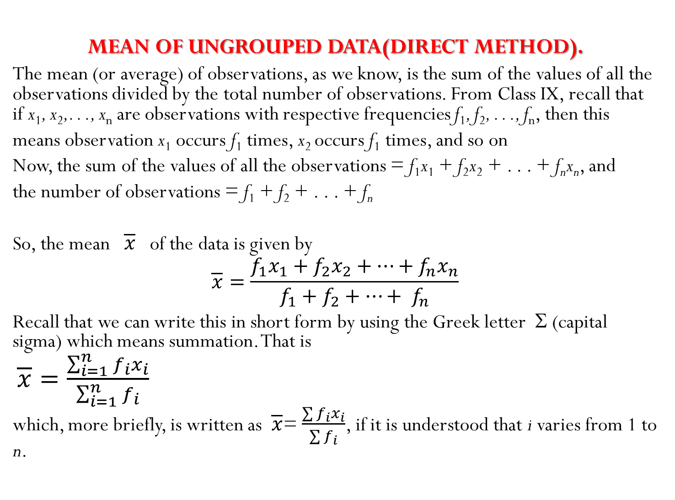

Slide 7
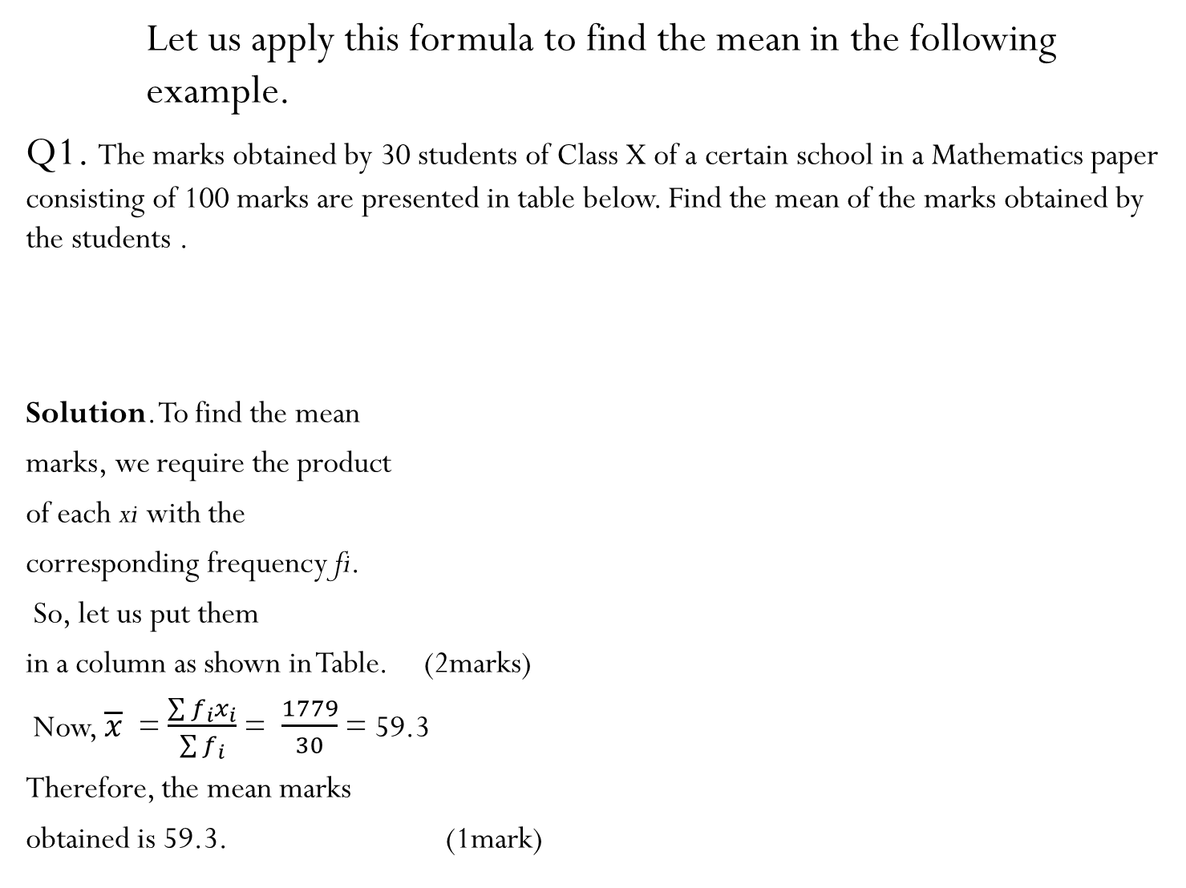
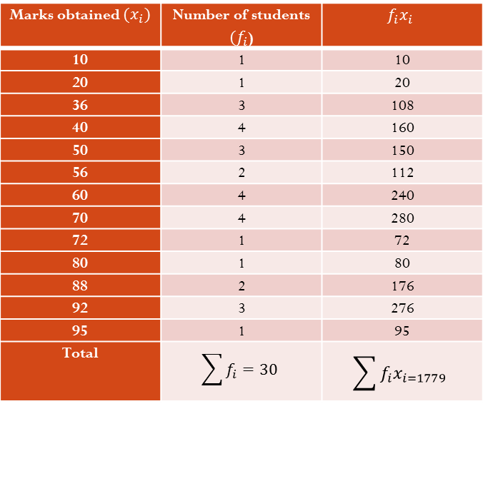
Marks obtained $(x_{i}$) | 10 | 20 | 36 | 40 | 50 | 56 | 60 | 70 | 72 | 80 | 88 | 92 | 95
Number of students ${(f}_{i}$) | 1 | 1 | 3 | 4 | 3 | 2 | 4 | 4 | 1 | 1 | 2 | 3 | 1
Marks obtained $(x_{i})$ | Number of students ${(f}_{i}$) | $$f_{i}x_{i}$$
10 | 1 | 10
20 | 1 | 20
36 | 3 | 108
40 | 4 | 160
50 | 3 | 150
56 | 2 | 112
60 | 4 | 240
70 | 4 | 280
72 | 1 | 72
80 | 1 | 80
88 | 2 | 176
92 | 3 | 276
95 | 1 | 95
Total | $$\sum{f_{i}=30}$$ | $$\sum{f_{i}x_{i=1779}}$$

Slide 8
MEAN OF GROUPED DATA (DIRECT METHOD)
In most of our real life situations, data is usually so large that to make a meaningful study it needs to be condensed as grouped data. So, we need to convert given ungrouped data into grouped data and devise some method to find its mean.
Let us convert the ungrouped data of Example 1 into grouped data by forming class-intervals of width, say 15. Remember that, while allocating frequencies to each class-interval, students falling in any upper class-limit would be considered in the next class, e.g., 4 students who have obtained 40 marks would be considered in the class interval 40-55 and not in 25-40. With this convention in our mind, let us form a grouped frequency distribution table.

Slide 9
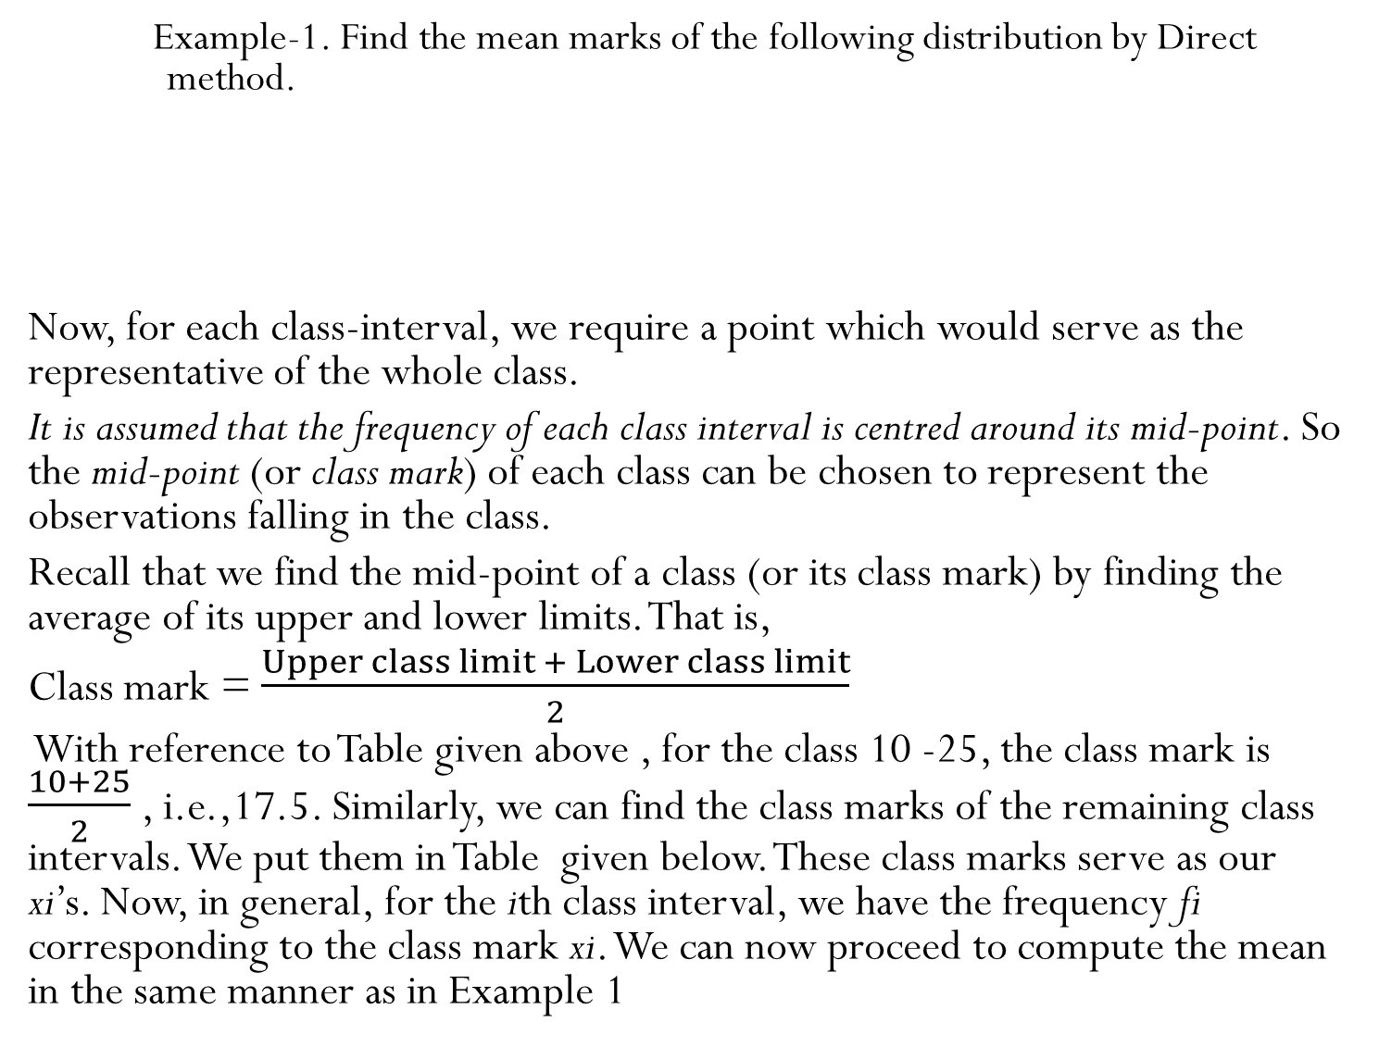
Example-1. Find the mean marks of the following distribution by Direct method.
Now, for each class-interval, we require a point which would serve as the representative of the whole class.
It is assumed that the frequency of each class interval is centred around its mid-point. So the mid-point (or class mark) of each class can be chosen to represent the observations falling in the class.
Recall that we find the mid-point of a class (or its class mark) by finding the average of its upper and lower limits. That is,
Class mark = $\frac{Upper class limit + Lower class limit}{2}$
With reference to Table given above , for the class 10 -25, the class mark is $\frac{10+25}{2}$ , i.e.,17.5. Similarly, we can find the class marks of the remaining class intervals. We put them in Table given below. These class marks serve as our xi’s. Now, in general, for the ith class interval, we have the frequency fi corresponding to the class mark xi. We can now proceed to compute the mean in the same manner as in Example 1
Class interval. | 10-25 | 25-40 | 40-55 | 55-70 | 70-85 | 85-100
Number of students | 2 | 3 | 7 | 6 | 6 | 6

Slide 10
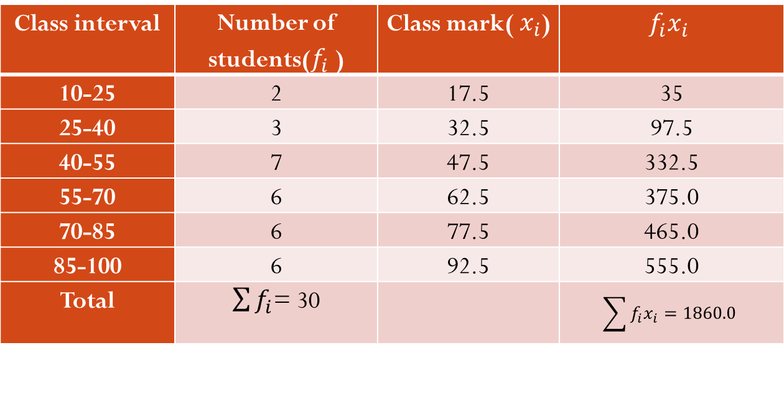

Table.
So, the mean $\overline{x}$ of the given data is given by
$\overline{x}$ = $\frac{\sum{f_{i}x_{i}}}{\sum{f_{i}}}$ = $\frac{1860}{30}$ = 62.
This new method of finding Mean is called as Direct Method for grouped data.
NOTE : The difference in the two values first mean and second is because of the mid-point assumption in second table,59.3 being the exact mean, while 62 an approximate mean.
Class interval | Number of students($f_{i}$ ) | Class mark( $x_{i}$) | $$f_{i}x_{i}$$
10-25 | 2 | 17.5 | 35
25-40 | 3 | 32.5 | 97.5
40-55 | 7 | 47.5 | 332.5
55-70 | 6 | 62.5 | 375.0
70-85 | 6 | 77.5 | 465.0
85-100 | 6 | 92.5 | 555.0
Total | $\sum{f_{i}}$= 30 |  | $$\sum{f_{i}x_{i}}=1860.0$$

Slide 11
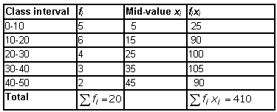

Example-2:Find the mean of the following data by Direct method :
Solution:
.
Table: (2 marks)
Mean =$\frac{\sum{f_{i}x_{i}}}{\sum{f_{i}}}$=$\frac{ 410}{20}$= 20.5 (1 mark )
Class Interval | 0-10 | 10-20 | 20-30 | 30-40 | 40-50
Frequency | 5 | 6 | 4 | 3 | 2

Slide 12
ACTIVITY BY STUDENTS TO FIND MEAN OF A GROUPED DATA BY USING DIRECT METHOD.

Slide 13
(SHORTCUT METHOD OR ASSUMED MEAN METHOD)
Sometimes when the numerical values of x_{i} and f_{i} are large, finding the product of x_{i} and f_{i} becomes tedious and time consuming. So, for such situations, let us think of a method of reducing these calculations.
We can do nothing with the f_{i}’s, but we can change each x_{i} to a smaller number so that our calculations become easy. How do we do this? What about subtracting a fixed number from each of these x_{i}’s? Let us try this method.
The first step is to choose one among the x_{i}’ s as the assumed mean, and denote it by ‘a’. Also, to further reduce our calculation work, we may take ‘a’ to be that x_{i} which lies in the centre of x₁, x₂ , . . ., x_{n}. So, we can choose
a = 47.5 or a = 62.5. Let us choose a = 47.5
The next step is to find the difference di between a and each of the x_{i}’s, that is, the deviation of ‘a’ from each of the x_{i}’s .
i.e., d_{i} = x_{i} – a = x_{i} – 47.5
The third step is to find the product of d_{i} with the corresponding f_{i}, and take the sum of all the f_{i} d_{i ‘}s. The calculations are shown in Table given below.

Slide 14
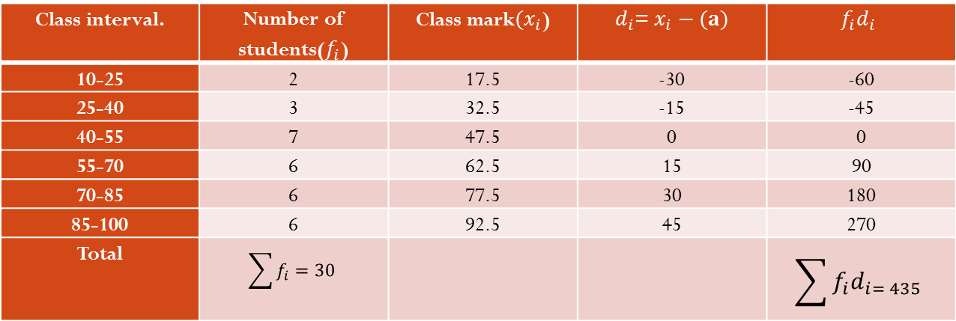

Example-3. Find the mean marks of the following distribution by shortcut method or assumed mean method.
Solution: From the table Let a = Assumed Mean= 47.5 ,$d_{i}$= $x_{i}−a$.
a = 47.5, $\sum{f_{i}=30}$ ,$\sum{f_{i}d_{i= 435}}$
So, mean ( $\overline{x}$) = a + $\frac{\sum{f_{i}d_{i}}}{\sum{f_{i}}}$
= 47.5 +$\frac{435}{30}$ = 47.5 + 14.5 = 62
Therefore, the mean marks obtained by the students is 62.
Class interval. | 10-25 | 25-40 | 40-55 | 55-70 | 70-85 | 85-100
Number of students | 2 | 3 | 7 | 6 | 6 | 6
Class interval. | Number of students($f_{i}$) | Class mark${(x}_{i}$) | $d_{i}$= $x_{i}−(a)$ | $$f_{i}d_{i}$$
10-25 | 2 | 17.5 | -30 | -60
25-40 | 3 | 32.5 | -15 | -45
40-55 | 7 | 47.5 | 0 | 0
55-70 | 6 | 62.5 | 15 | 90
70-85 | 6 | 77.5 | 30 | 180
85-100 | 6 | 92.5 | 45 | 270
Total | $$\sum{f_{i}=30}$$ |  |  | $$\sum{f_{i}d_{i= 435}}$$

Slide 15
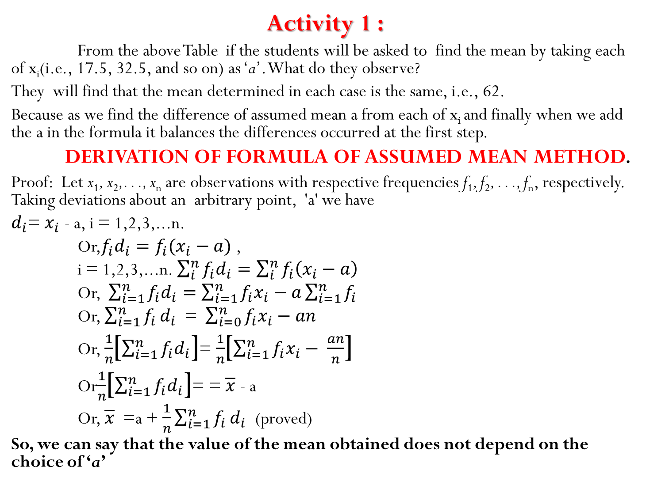
Activity 1 :
From the above Table if the students will be asked to find the mean by taking each of x_{i}(i.e., 17.5, 32.5, and so on) as ‘a’. What do they observe?
They will find that the mean determined in each case is the same, i.e., 62.
Because as we find the difference of assumed mean a from each of x_{i} and finally when we add the a in the formula it balances the differences occurred at the first step.
DERIVATION OF FORMULA OF ASSUMED MEAN METHOD.
Proof: Let x₁, x₂,. . ., x_{n} are observations with respective frequencies f₁, f₂, . . ., f_{n}, respectively. Taking deviations about an arbitrary point, 'a' we have
$d_{i}$= $x_{i}$ - a, i = 1,2,3,...n.
Or,$f_{i}d_{i}=f_{i}(x_{i}−a)$ ,
i = 1,2,3,...n.$\sum_{i}^{n}{f_{i}d_{i}=\sum_{i}^{n}{f_{i}\left(x_{i}−a\right)}}$
Or, $\sum_{i=1}^{n}{f_{i}d_{i}=\sum_{i=1}^{n}{f_{i}x_{i}−a\sum_{i=1}^{n}{f_{i}}}}$
Or, $\sum_{i=1}^{n}{f_{i}}d_{i}$ = $\sum_{i=0}^{n}{f_{i}x_{i}−an}$
Or, $\frac{1}{n}$[$\sum_{i=1}^{n}{f_{i}d_{i}}$]= $\frac{1}{n}$[$\sum_{i=1}^{n}{f_{i}x_{i}− \frac{an}{n}}$]
Or$\frac{1}{n}$[$\sum_{i=1}^{n}{f_{i}d_{i}}$]= = $\overline{x}$ - a
Or, $\overline{x}$ =a + $\frac{1}{n}\sum_{i=1}^{n}{f_{i}}d_{i}$ (proved)
So, we can say that the value of the mean obtained does not depend on the choice of ‘a’

Slide 16


Example-4. Find the average cost of the following data by assumed mean method.
Solution: Let, assumed mean (a) = 12
a = 12, (2 marks)
f_{i} = 130,
f_{i}d_{i} = 560
= 16.307
Therefore, average cost = 16.307 (1 mark)
Cost | 2 - 6 | 6 - 10 | 10 - 14 | 14 - 18 | 18 - 22 | Total
Frequency | 1 | 9 | 21 | 47 | 52 | 130
Cost | Frequency f_{i} | Midvalue x_{i} | d_{i} = x_{i} - a | f_{i}d_{i}
2-6 | 1 | 4 | - 8 | - 8
6-10 | 9 | 8 | - 4 | - 36
10-14 | 21 | 12 | 0 | 0
14-18 | 47 | 16 | 4 | 188
18-22 | 52 | 20 | 8 | 416
Total | f_{i} = 130 | 60 |  | f_{i}d_{i} = 560
( $\overline{x}$) = a + $\frac{\sum{f_{i}d_{i}}}{\sum{f_{i}}}$

Slide 17

Example:5-The data of 30 CORONA patients attending a hospital in a month are given below. Find the average number of patients attending the hospital in a day, using assumed mean method.
Solution: Let assumed mean (a) = 25
A = 25, $\sum{f_{i}=30}$ ,$\sum{f_{i}d_{i=110}}$ (table: 2marks)
So, mean ( $\overline{x}$) = a + $\frac{\sum{f_{i}d_{i}}}{\sum{f_{i}}}$
= 25 +$\frac{110}{30}$ =25 + $\frac{11}{3}$ = 28.666= 28.67. (1 mark)
Number of CORONA patients | 0-10 | 10-20 | 20-30 | 30-40 | 40-50 | 50-60
Number of days | 2 | 6 | 9 | 7 | 4 | 2
Class interval | Midvalue x_{i} | f_{i} | d_{i} = x_{i} - A | f_{i}d_{i}
0-10 | 5 | 2 | -20 | -40
10-20 | 15 | 6 | -10 | -60
20-30 | 25 | 9 | 0 | 0
30-40 | 35 | 7 | 10 | 70
40-50 | 45 | 4 | 20 | 80
50-60 | 55 | 2 | 30 | 60
Total

Slide 18
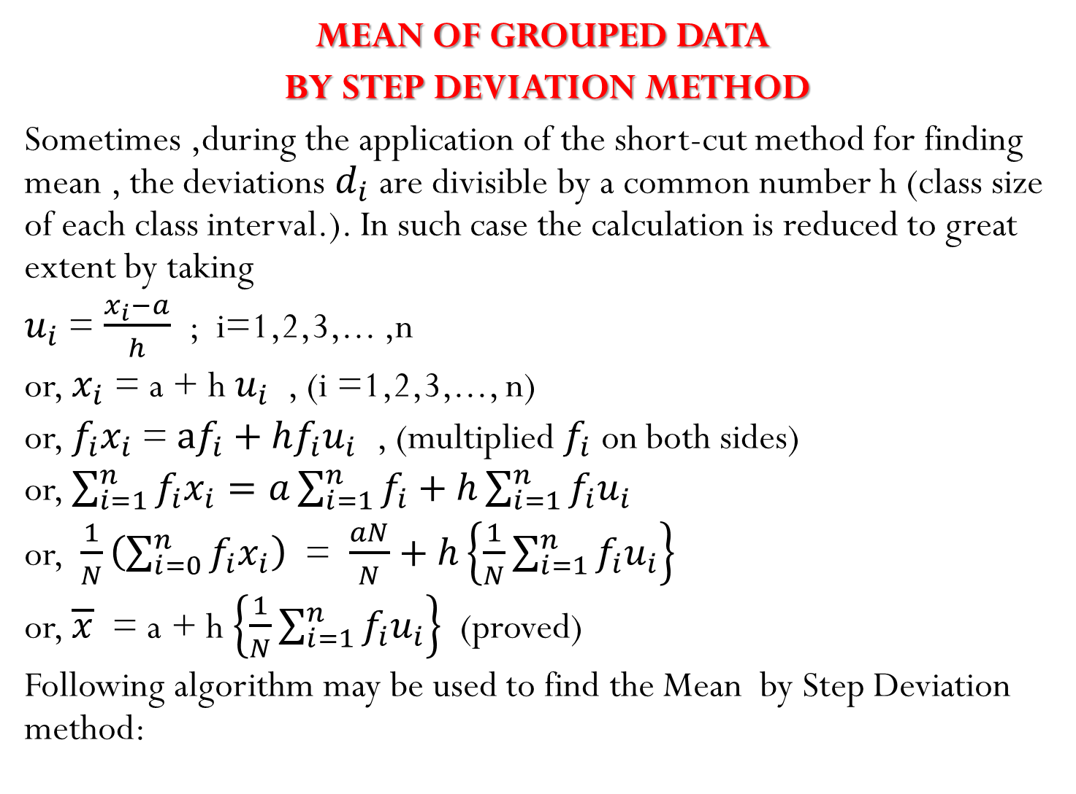
MEAN OF GROUPED DATA
BY STEP DEVIATION METHOD
Sometimes ,during the application of the short-cut method for finding mean , the deviations $d_{i}$ are divisible by a common number h (class size of each class interval.). In such case the calculation is reduced to great extent by taking
$u_{i}$ = $\frac{x_{i}−a}{h}$ ; i=1,2,3,... ,n
or, $x_{i}$ = a + h$u_{i}$ , (i =1,2,3,..., n)
or, $f_{i}x_{i}$ = $af_{i}+hf_{i}u_{i}$ , (multiplied $f_{i}$ on both sides)
or, $\sum_{i=1}^{n}{f_{i}x_{i}=a\sum_{i=1}^{n}{f_{i}+h\sum_{i=1}^{n}{f_{i}u_{i}}}}$
or, $\frac{1}{N}\left(\sum_{i=0}^{n}{f_{i}x_{i}}\right)$ = $\frac{aN}{N}+h\left\{\frac{1}{N}\sum_{i=1}^{n}{f_{i}u_{i}}\right\}$
or, $\overline{x}$ = a + h $\left\{\frac{1}{N}\sum_{i=1}^{n}{f_{i}u_{i}}\right\}$ (proved)
Following algorithm may be used to find the Mean by Step Deviation method:

Slide 19
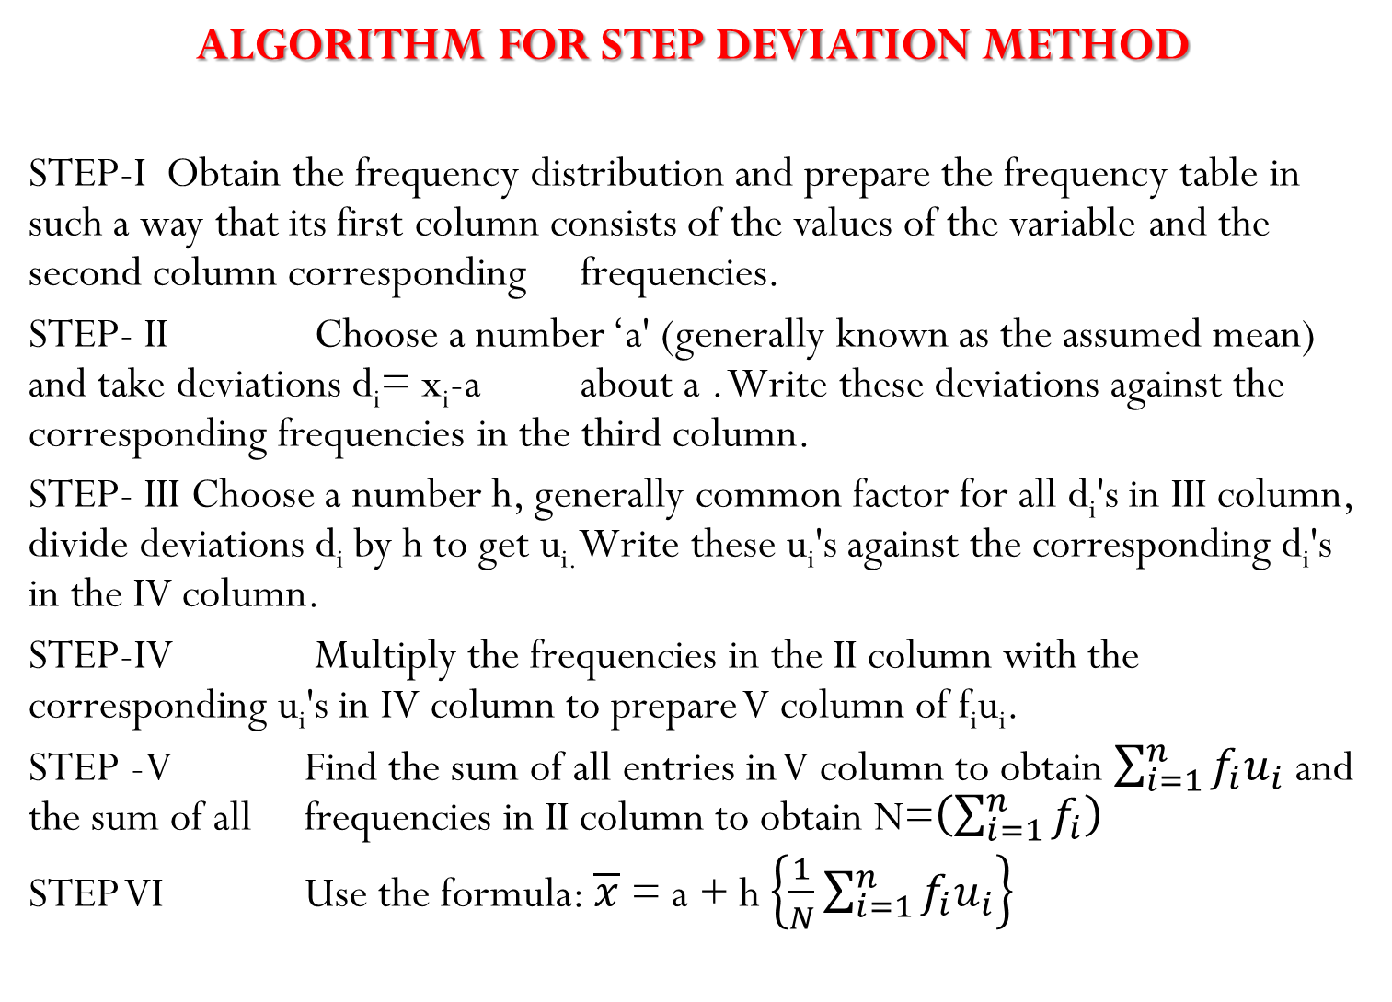
ALGORITHM FOR STEP DEVIATION METHOD
STEP-I Obtain the frequency distribution and prepare the frequency table in such a way that its first column consists of the values of the variable and the second column corresponding frequencies.
STEP- II Choose a number ‘a' (generally known as the assumed mean) and take deviations d_{i}= x_{i}-a about a . Write these deviations against the corresponding frequencies in the third column.
STEP- III Choose a number h, generally common factor for all d_{i}'s in III column, divide deviations d_{i} by h to get u_{i.} Write these u_{i}'s against the corresponding d_{i}'s in the IV column.
STEP-IV Multiply the frequencies in the II column with the corresponding u_{i}'s in IV column to prepare V column of f_{i}u_{i}.
STEP -V Find the sum of all entries in V column to obtain $\sum_{i=1}^{n}{f_{i}u_{i}}$ and the sum of all frequencies in II column to obtain N=$\left(\sum_{i=1}^{n}{f_{i}}\right)$
STEP VI Use the formula: $\overline{x}$ = a + h $\left\{\frac{1}{N}\sum_{i=1}^{n}{f_{i}u_{i}}\right\}$

Slide 20
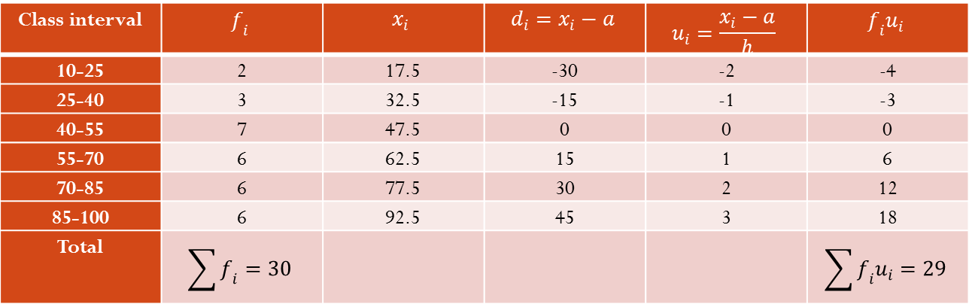

Following Example-6 will illustrate the above algorithm to find mean :
Solution: Let assumed mean $a$ = 47.5
Therefore using the formula:
$\overline{x}$ = $a$ + h $\left\{\frac{1}{N}\sum_{i=1}^{n}{f_{i}u_{i}}\right\}$
Now substituting the values of a, h, $\sum{f_{i}u_{i}}$and $\sum{f_{i}}$ from the Table we get
$\overline{x}$ = 47.5 + 15$×\left(\frac{29}{30}\right)$ =47.5+14.5 = 62 .
so, the mean marks obtained by a student is 62.
Class interval. | 10-25 | 25-40 | 40-55 | 55-70 | 70-85 | 85-100
Number of students | 2 | 3 | 7 | 6 | 6 | 6
Class interval | $$f_{i}$$ | $$x_{i}$$ | $$d_{i}=x_{i}−a$$ | $$u_{i}=\frac{x_{i}−a}{h}$$ | $$f_{i}u_{i}$$
10-25 | 2 | 17.5 | -30 | -2 | -4
25-40 | 3 | 32.5 | -15 | -1 | -3
40-55 | 7 | 47.5 | 0 | 0 | 0
55-70 | 6 | 62.5 | 15 | 1 | 6
70-85 | 6 | 77.5 | 30 | 2 | 12
85-100 | 6 | 92.5 | 45 | 3 | 18
Total | $$\sum{f_{i}}=30$$ |  |  |  | $$\sum{f_{i}u_{i}=29}$$

Slide 21
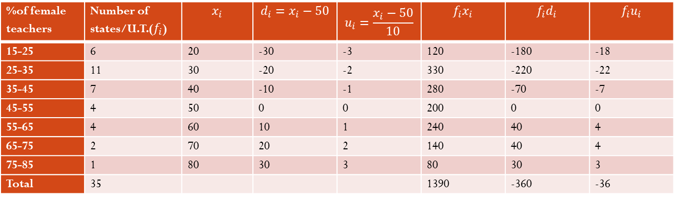

Example :7 The table below gives the percentage distribution of female teachers in the primary schools of rural areas of various states and union territories (U.T.) of India. Find the mean percentage of female teachers by all the three methods discussed in this section.
Solution: Let us solve this problem by using all the three methods.
From the table above, we obtain $\sum{f_{i}}=35$, $\sum{f_{i}x_{i=1390}}$ ,$\sum{f_{i}d_{i}=−360}$ ,$\sum{f_{i}u_{i}=−36}$.
Using the direct method $\overline{x}$ = $\frac{\sum{f_{i}x_{i}}}{\sum{f_{i}}}$ =$\frac{1390}{35}$ = 39.71
Assuming the mean from the class mark as a=50,
then using the assumed mean method $\overline{x}$ = $a+ \frac{\sum{f_{i}d_{i}}}{\sum{f_{i}}}$ = 50 + $\frac{−360}{35}$= 39.71
Using the step deviation method $\overline{x}$ = a + $\left\{\frac{\sum{f_{i}u_{i}}}{\sum{f_{i}}}\right\}×h$ = 50 + $\frac{−36}{35}×10$ = 39.71
Percentage of female teachers | 15-25 | 25-35 | 35-45 | 45-55 | 55-65 | 65-75 | 75-85
Number of states/U.T. | 6 | 11 | 7 | 4 | 4 | 2 | 1
%of female teachers | Number of states/U.T.($f_{i}$) | $$x_{i}$$ | $$d_{i}=x_{i}−50$$ | $$u_{i}=\frac{x_{i}−50}{10}$$ | $$f_{i}x_{i}$$ | $$f_{i}d_{i}$$ | $$f_{i}u_{i}$$
15-25 | 6 | 20 | -30 | -3 | 120 | -180 | -18
25-35 | 11 | 30 | -20 | -2 | 330 | -220 | -22
35-45 | 7 | 40 | -10 | -1 | 280 | -70 | -7
45-55 | 4 | 50 | 0 | 0 | 200 | 0 | 0
55-65 | 4 | 60 | 10 | 1 | 240 | 40 | 4
65-75 | 2 | 70 | 20 | 2 | 140 | 40 | 4
75-85 | 1 | 80 | 30 | 3 | 80 | 30 | 3
Total | 35 |  |  |  | 1390 | -360 | -36

Slide 22
REMARK
The result obtained by all the three methods is the same. So the choice of method to be used depends on the numerical values of xi and fi. If xi and fi are sufficiently small, then the direct method is an appropriate choice. If x_{i} and fi are numerically large numbers, then we can go for the assumed mean method or step-deviation method. If the class sizes are unequal, and x_{i} are large numerically, we can still apply the step-deviation method by taking h to be a suitable divisor of all the d_{i}’s.

Slide 23
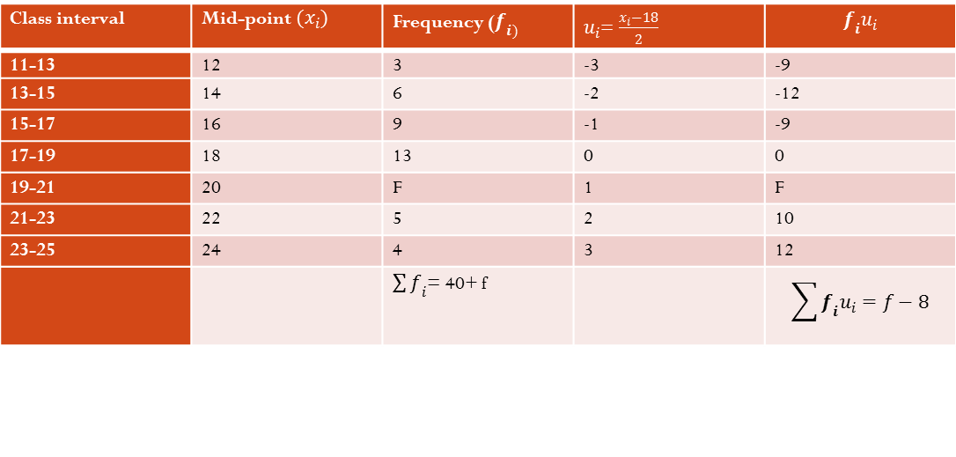

Example-8: The mean of the following distribution is 18. The frequency f in the class interval 19-21 is missing. Determine f (3 Marks)
Solution :
Let us take assumed mean (a) = 18. Here h = 2 (2 Marks)
Using the step deviation method $\overline{x}$ = a + $\left\{\frac{\sum{f_{i}u_{i}}}{\sum{f_{i}}}\right\}×h$ = 18 +2$\left(\frac{f−8}{40+f}\right)$
or, 18 = 18 +2$\left(\frac{f−8}{40+f}\right)$ ; $\overline{x}$ = 18(given)
f= 8 (1Mark)
Hence, the frequency of the class interval 19-21 is 8.
Class interval | 11-13 | 13-15 | 15-17 | 17-19 | 19-21 | 21-23 | 23-25
Frequency | 3 | 6 | 9 | 13 | f | 5 | 4
Class interval | Mid-point$(x_{i})$ | Frequency ($f_{i)}$ | $u_{i}$= $\frac{x_{i}−18}{2}$ | $$f_{i}u_{i}$$
11-13 | 12 | 3 | -3 | -9
13-15 | 14 | 6 | -2 | -12
15-17 | 16 | 9 | -1 | -9
17-19 | 18 | 13 | 0 | 0
19-21 | 20 | F | 1 | F
21-23 | 22 | 5 | 2 | 10
23-25 | 24 | 4 | 3 | 12
 |  | $\sum{f_{i}}$= 40+ f |  | $$\sum{f_{i}u_{i}=f−8}$$

Slide 24
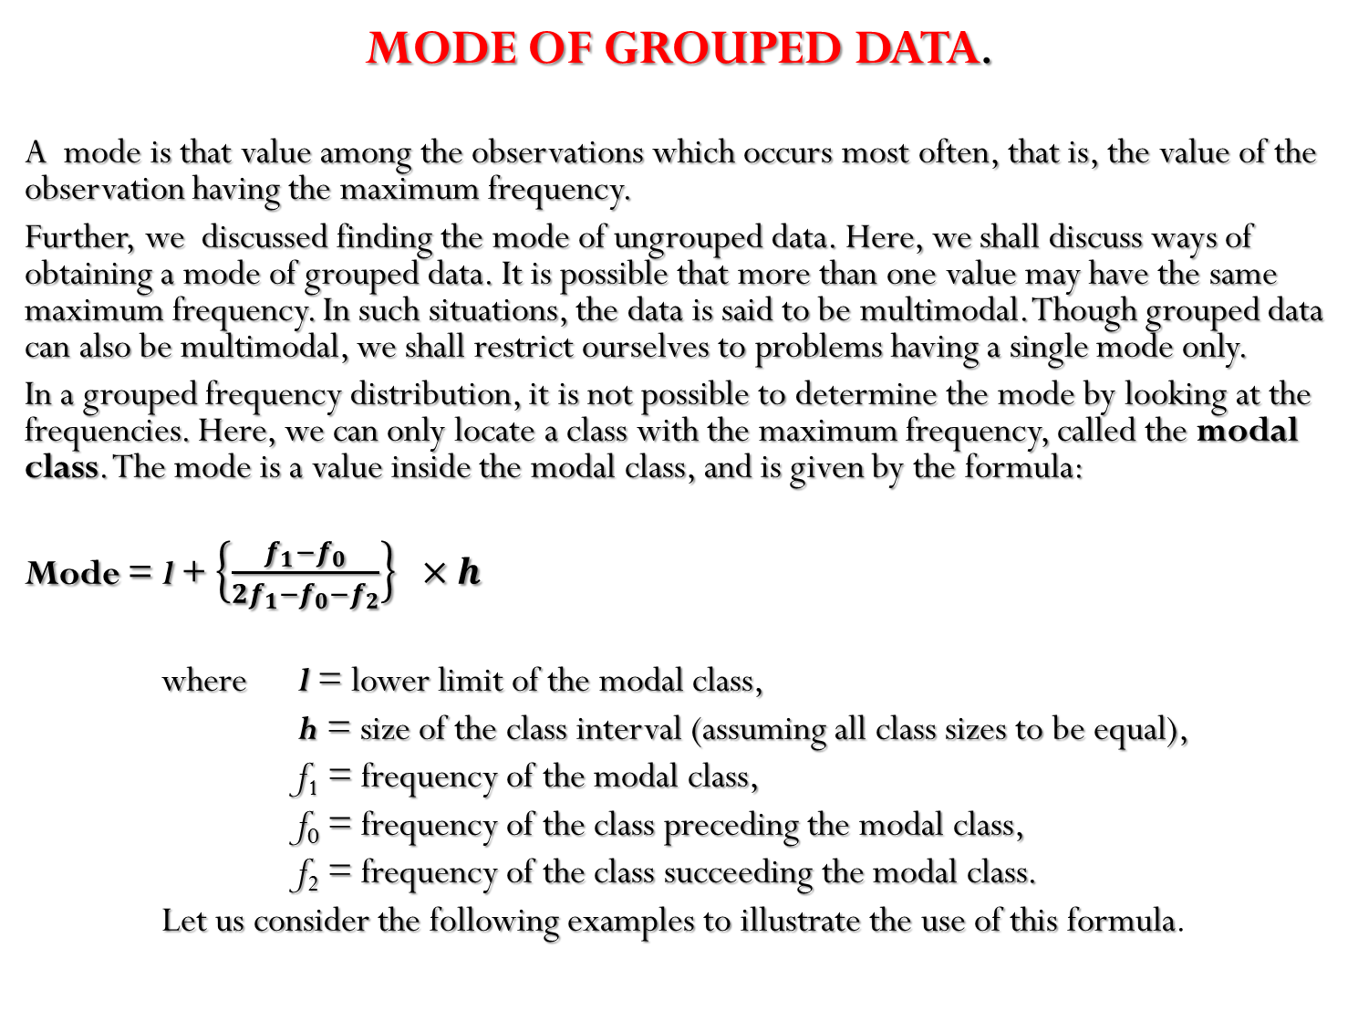
MODE OF GROUPED DATA.
A mode is that value among the observations which occurs most often, that is, the value of the observation having the maximum frequency.
Further, we discussed finding the mode of ungrouped data. Here, we shall discuss ways of obtaining a mode of grouped data. It is possible that more than one value may have the same maximum frequency. In such situations, the data is said to be multimodal. Though grouped data can also be multimodal, we shall restrict ourselves to problems having a single mode only.
In a grouped frequency distribution, it is not possible to determine the mode by looking at the frequencies. Here, we can only locate a class with the maximum frequency, called the modal class. The mode is a value inside the modal class, and is given by the formula:
Mode = l+ $\left\{\frac{f_{1}−f_{0}}{2f_{1}−f_{0}−f_{2}}\right\}×h$
where l= lower limit of the modal class,
h= size of the class interval (assuming all class sizes to be equal),
f₁= frequency of the modal class,
f₀= frequency of the class preceding the modal class,
f₂= frequency of the class succeeding the modal class.
Let us consider the following examples to illustrate the use of this formula.

Slide 25
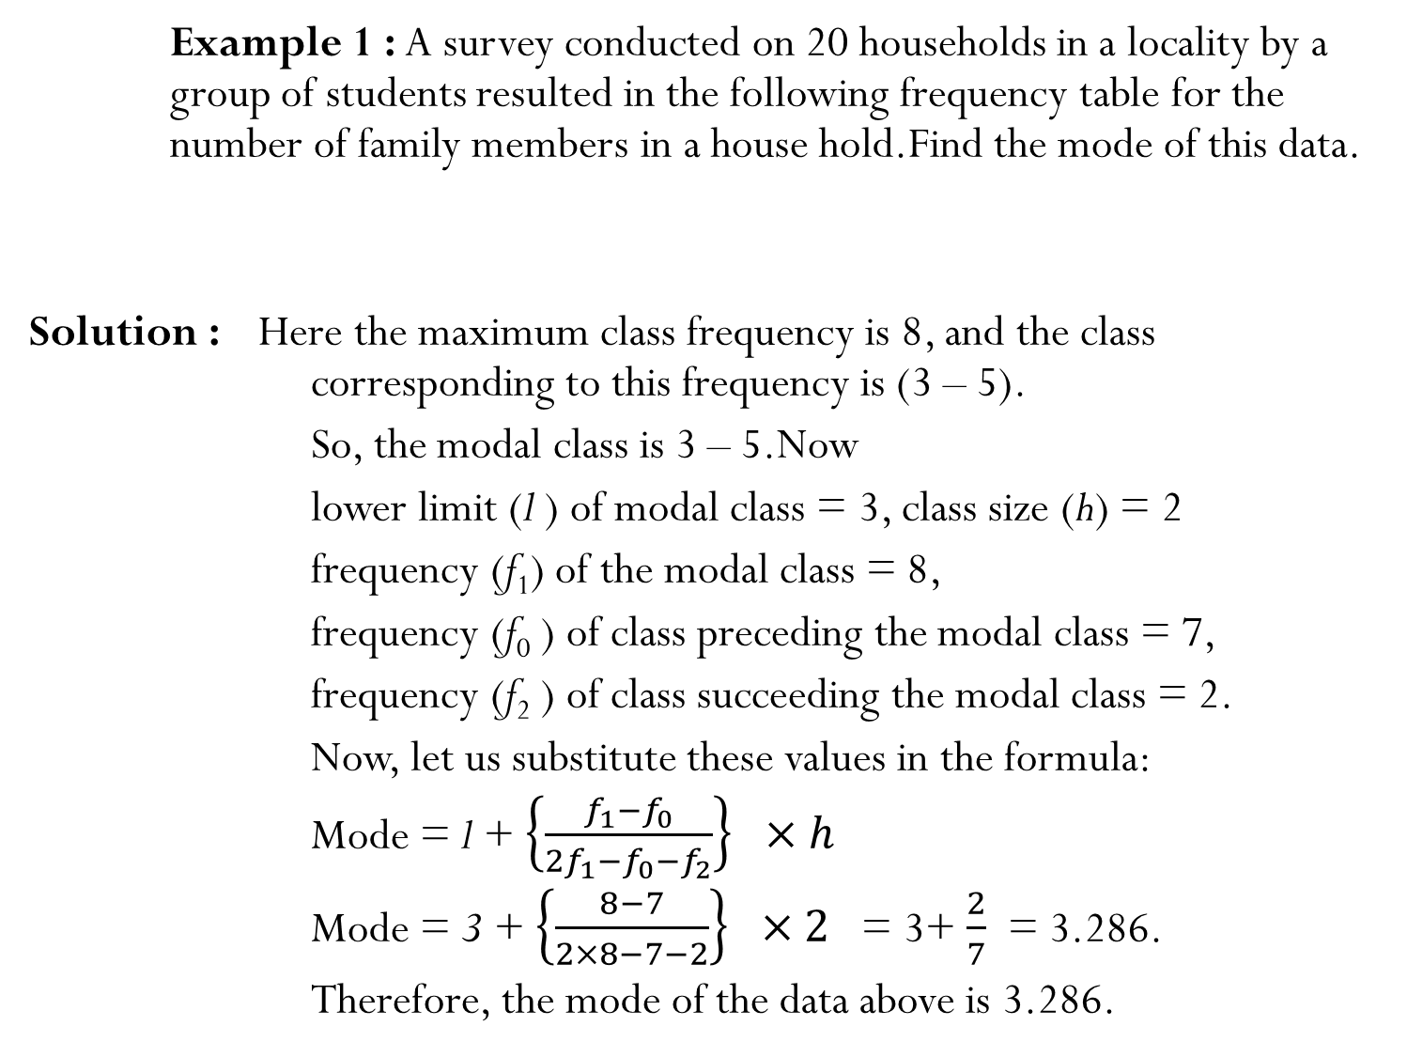
Example 1 : A survey conducted on 20 households in a locality by a group of students resulted in the following frequency table for the number of family members in a house hold.Findthe mode of this data.
Solution :Here the maximum class frequency is 8, and the class corresponding to this frequency is (3 – 5).
So, the modal class is 3 – 5.Now
lower limit (l ) of modal class = 3, class size (h) = 2
frequency (f₁) of the modal class = 8,
frequency (f₀ ) of class preceding the modal class = 7,
frequency (f₂ ) of class succeeding the modal class = 2.
Now, let us substitute these values in the formula:
Mode = l + $\left\{\frac{f_{1}−f_{0}}{2f_{1}−f_{0}−f_{2}}\right\}×h$
Mode = 3 + $\left\{\frac{8−7}{2×8−7−2}\right\}×2$ = 3+ $\frac{2}{7}$ = 3.286.
Therefore, the mode of the data above is 3.286.
Family size | 1-3 | 3-5 | 5-7 | 7- 9 | 9- 11
Number of families | 7 | 8 | 2 | 2 | 1

Slide 26
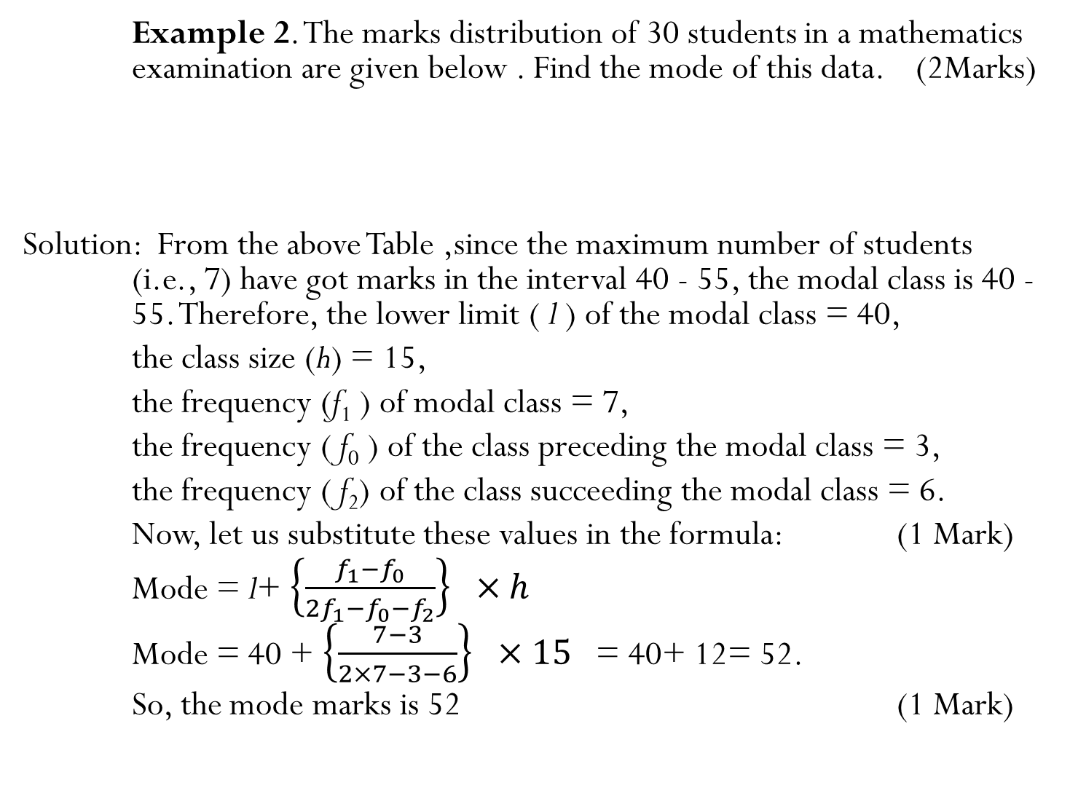
Example 2. The marks distribution of 30 students in a mathematics examination are given below . Find the mode of this data. (2Marks)
Solution: From the above Table ,since the maximum number of students (i.e., 7) have got marks in the interval 40 - 55, the modal class is 40 - 55. Therefore, the lower limit ( l ) of the modal class = 40,
the class size (h) = 15,
the frequency (f₁ ) of modal class = 7,
the frequency ( f₀ ) of the class preceding the modal class = 3,
the frequency ( f₂) of the class succeeding the modal class = 6.
Now, let us substitute these values in the formula: (1 Mark)
Mode = l+ $\left\{\frac{f_{1}−f_{0}}{2f_{1}−f_{0}−f_{2}}\right\}×h$
Mode = 40 + $\left\{\frac{7−3}{2×7−3−6}\right\}×15$ = 40+ 12= 52.
So, the mode marks is 52 (1 Mark)
Class interval. | 10-25 | 25-40 | 40-55 | 55-70 | 70-85 | 85-100
Number of students | 2 | 3 | 7 | 6 | 6 | 6

Slide 27
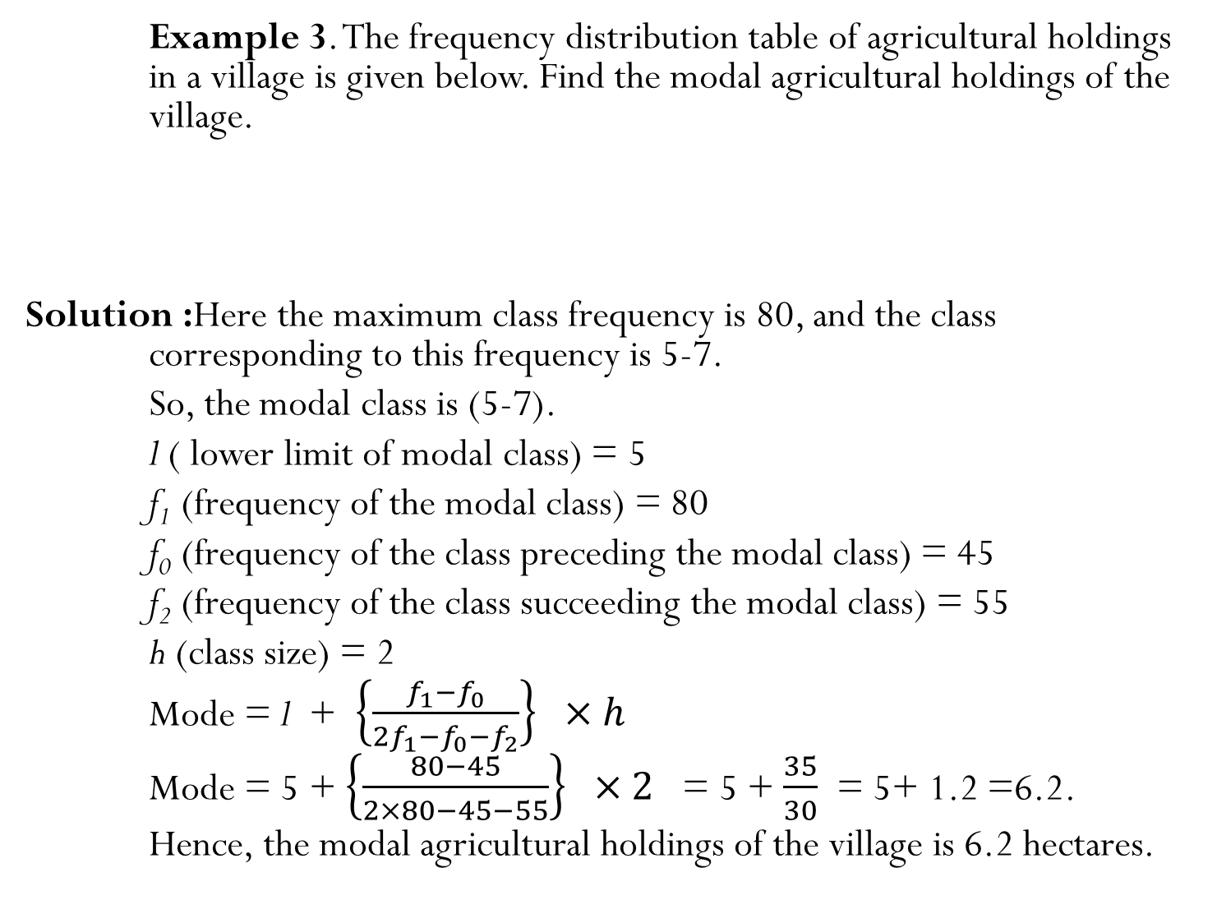
Example 3. The frequency distribution table of agricultural holdings in a village is given below. Find the modal agricultural holdings of the village.
Solution :Here the maximum class frequency is 80, and the class corresponding to this frequency is 5-7.
So, the modal class is (5-7).
l ( lower limit of modal class) = 5
f₁(frequency of the modal class) = 80
f₀(frequency of the class preceding the modal class) = 45
f₂(frequency of the class succeeding the modal class) = 55
h (class size) = 2
Mode = l + $\left\{\frac{f_{1}−f_{0}}{2f_{1}−f_{0}−f_{2}}\right\}×h$
Mode = 5 +$\left\{\frac{80−45}{2×80−45−55}\right\}×2$ = 5 + $\frac{35}{30}$ = 5+ 1.2 =6.2.
Hence, the modal agricultural holdings of the village is 6.2 hectares.
Area of land (in hectares) | 1-3 | 3-5 | 5-7 | 7-9 | 9-11 | 11-13
Number of families | 20 | 45 | 80 | 55 | 40 | 12

Slide 29
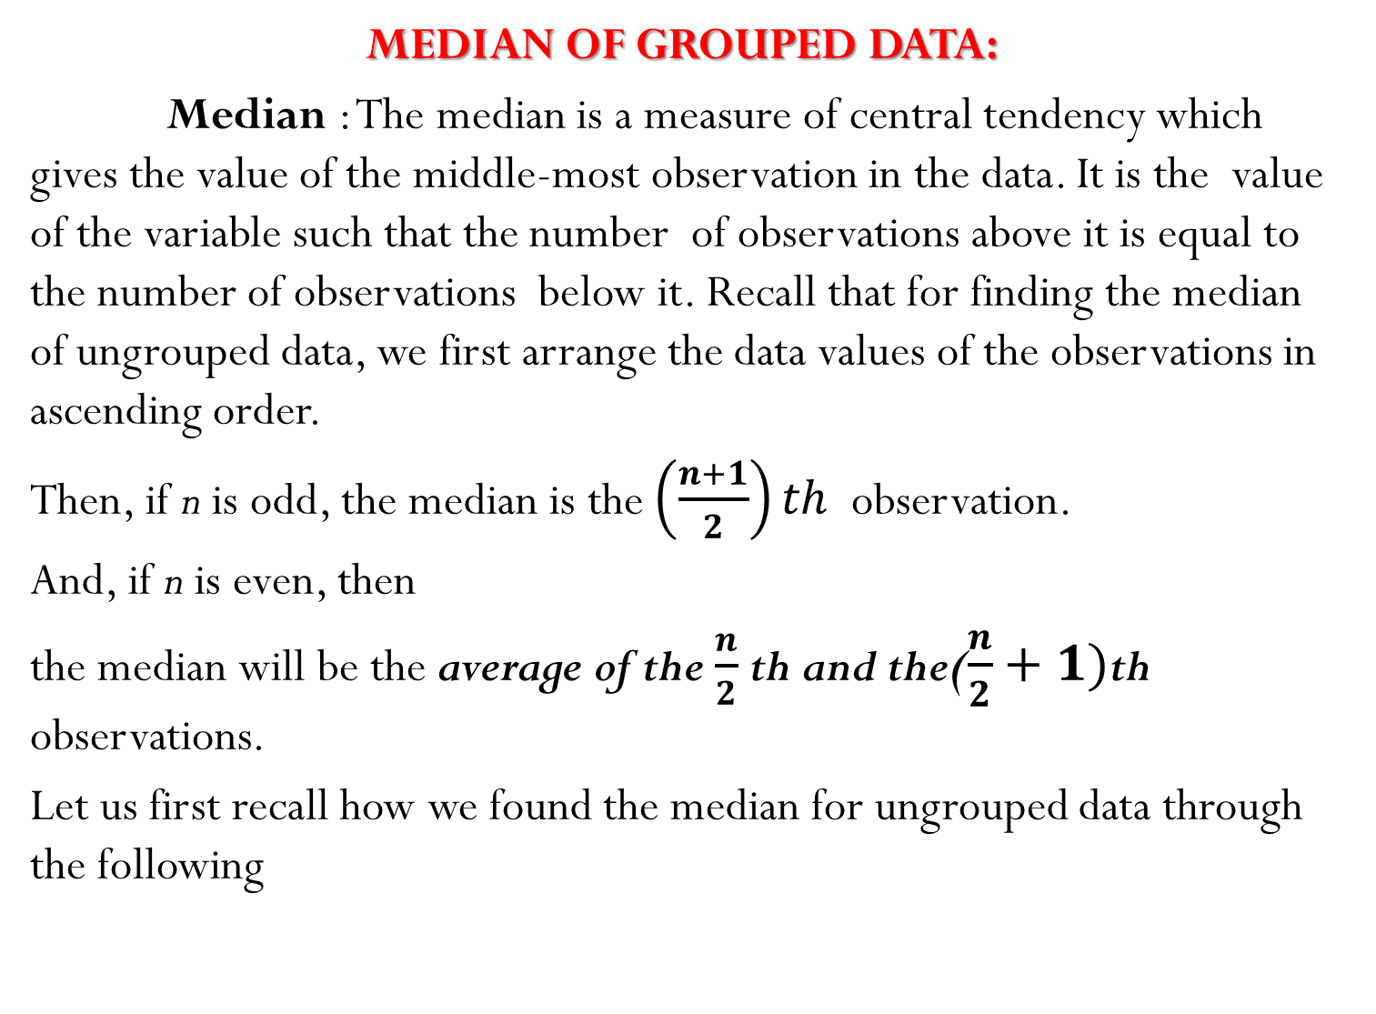
MEDIAN OF GROUPED DATA:
Median: The median is a measure of central tendency which gives the value of the middle-most observation in the data. It is the value of the variable such that the number of observations above it is equal to the number of observations below it. Recall that for finding the median of ungrouped data, we first arrange the data values of the observations in ascending order.
Then, if n is odd, the median is the $\left(\frac{n+1}{2}\right)th$ observation.
And, if n is even, then
the median will be the average of the $\frac{n}{2}$th and the($\frac{n}{2}+1)$thobservations.
Let us first recall how we found the median for ungrouped data through the following

Slide 30

Example 1: Suppose, we have to find the median of the following data, which gives the marks, out of 50, obtained by 100 students in a test :
First, we arrange the marks in ascending order and prepare a frequency table as follows :
Here n = 100, which is even. The median will be the average of the $\frac{n}{2}$th and the ($\frac{n}{2}+1)$th observations, i.e., the 50th and 51st observations. To find these observations, we proceed as follows:
Marks obtained | 20 | 29 | 28 | 33 | 42 | 38 | 43 | 25
Number of students | 6 | 28 | 24 | 15 | 2 | 4 | 1 | 20
Marks obtained | Number of studets(Frequency)
20 | 6
25 | 20
28 | 24
29 | 28
33 | 15
38 | 4
42 | 2
43 | 1
Total | 100

Slide 31
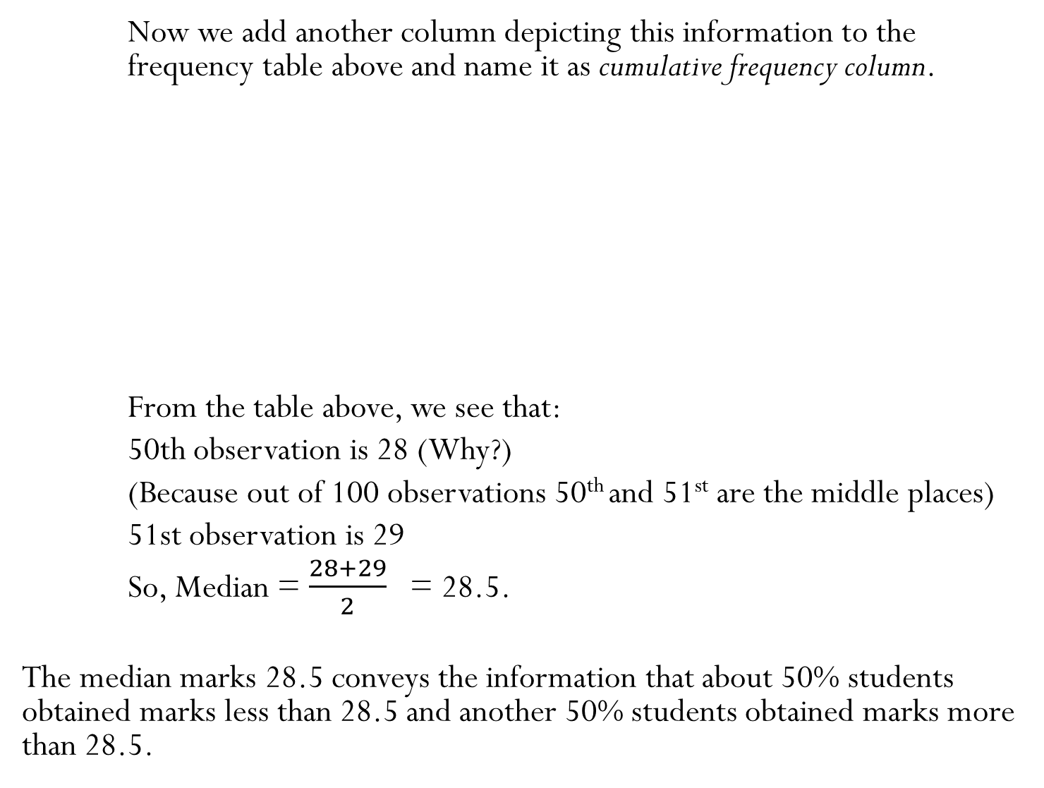
Now we add another column depicting this information to the frequency table above and name it as cumulative frequency column.
From the table above, we see that:
50th observation is 28 (Why?)
(Because out of 100 observations 50th and 51st are the middle places)
51st observation is 29
So, Median = $\frac{28+29}{2}$ = 28.5.
The median marks 28.5 conveys the information that about 50% students obtained marks less than 28.5 and another 50% students obtained marks more than 28.5.
Marks obtained | Number of students | Cumulative frequency (cf)
20 | 6 | 6
25 | 20 | 26
28 | 24 | 50
29 | 28 | 78
33 | 15 | 93
38 | 4 | 97
42 | 2 | 99
43 | 1 | 100

Slide 32
Now, let us see how to obtain the median of grouped data, through the following situation.
Example 2: Consider a grouped frequency distribution of marks obtained, out of 100, by 53 students, in a certain examination, as follows:
From the table above, try to answer the following questions:
How many students have scored marks less than 10? The answer is clearly 5.
How many students have scored less than 20 marks? Observe that the number
of students who have scored less than 20 include the number of students who have
scored marks from 0 - 10 as well as the number of students who have scored marks
from 10 - 20. So, the total number of students with marks less than 20 is 5 + 3, i.e., 8.
We say that the cumulative frequency of the class 10 -20 is 8.
Similarly, we can compute the cumulative frequencies of the other classes, i.e.,
the number of students with marks less than 30, less than 40, . . ., less than 100.
We give them in Table given below:
Marks | 0-10 | 10-20 | 20-30 | 30-40 | 40-50 | 50-60 | 60-70 | 70-80 | 80-90 | 90-100
Number of students | 5 | 3 | 4 | 3 | 3 | 4 | 7 | 9 | 7 | 8

Slide 33
Cumulative frequency distribution Table of less than type:
Marks obtained | Number of students (Cumulative freqency)
Less than 10 | 5
Less than 20 | 5+3=8
Less than 30 | 8+4=12
Less than 40 | 12+3= 15
Less than 50 | 15+3 =18
Less than 60 | 18+4 = 22
Less than 70 | 22+7=29
Less than 80 | 29+ 9= 38
Less than 90 | 38+7=45
Less than 100 | 45+8=53

Slide 34
We can similarly make the table for the number of students with scores, more than or equal to 0, more than or equal to 10, more than or equal to 20, and so on. From the Frequency Distribution Table , we observe that all 53 students have scored marks more than or equal to 0. Since there are 5 students scoring marks in the interval 0 - 10, this means that there are 53 – 5 = 48 students getting more than or equal to 10 marks. Continuing in the same manner, we get the number of students scoring 20 or above as 48 – 3 = 45, 30 or above as 45 – 4 = 41, and so on, as shown in Table.
Cumulative Frequency Distribution Table of the more than type.
Marks | Number of students (Cumulative freqency)
More than or equal to 0 | 53
More than or equal to 10 | 53-5= 48
More than or equal to 20 | 48-3=45
More than or equal to 30 | 45-4 =41
More than or equal to 40 | 41-3=38
More than or equal to 50 | 38-3=35
More than or equal to 60 | 35-4=31
More than or equal to 70 | 31-7=24
More than or equal to 80 | 24-9=15
More than or equal to 90 | 15-7=8

Slide 35
The table above is called a cumulative frequency distribution of the more than type. Here 0, 10, 20, . . ., 90 give the lower limits of the respective class intervals.
Now, to find the median of grouped data, we can make use of any of these cumulative frequency distributions.
By combining Question Table & Less than type Table we can get a Table given below.
Marks | Number of students(f) | Cumulative frequency(cf)
0-10 | 5 | 5
10-20 | 3 | 8
20-30 | 4 | 12
30-40 | 3 | 15
40-50 | 3 | 18
50-60 | 4 | 22
60-70 | 7 | 29
70-80 | 9 | 38
80-90 | 7 | 45
90-100 | 8 | 53

Slide 36
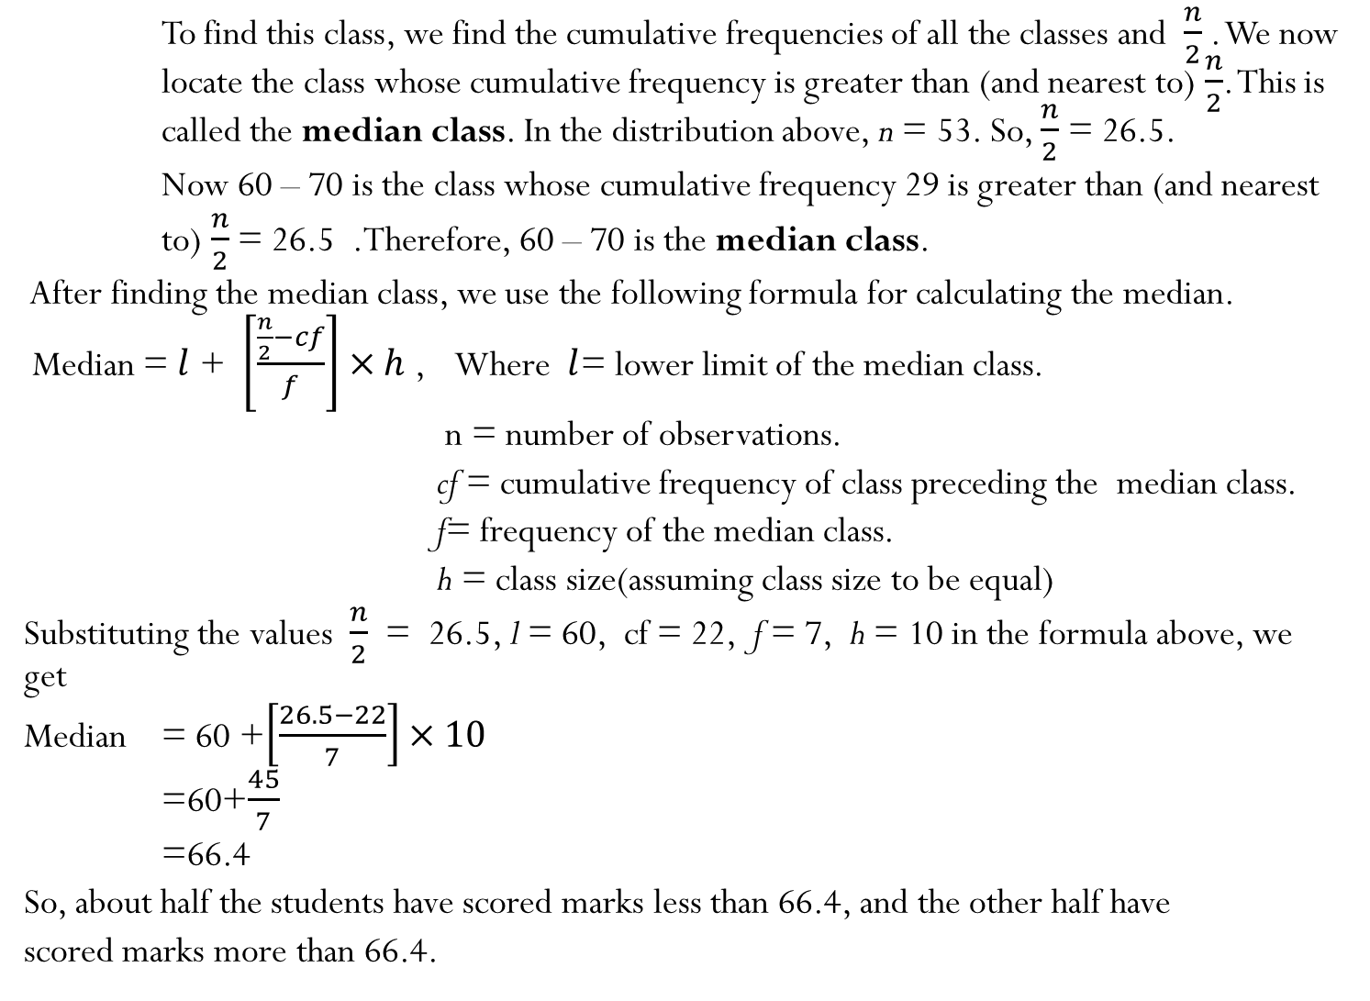
To find this class, we find the cumulative frequencies of all the classes and $\frac{n}{2}$ . We now locate the class whose cumulative frequency is greater than (and nearest to) $\frac{n}{2}$. This is called the median class. In the distribution above, n = 53. So, $\frac{n}{2}$ = 26.5.
Now 60 – 70 is the class whose cumulative frequency 29 is greater than (and nearest
to) $\frac{n}{2}$ = 26.5 .Therefore, 60 – 70 is the median class.
After finding the median class, we use the following formula for calculating the median.
Median =$l$ + $\left[\frac{\frac{n}{2}−cf}{f}\right]×h$ , Where $l$= lower limit of the median class.
n = number of observations.
cf= cumulative frequency of class preceding the median class.
f= frequency of the median class.
h= class size(assuming class size to be equal)
Substituting the values $\frac{n}{2}$ = 26.5, l = 60, cf = 22, f = 7, h = 10 in the formula above, we get
Median = 60 +$\left[\frac{26.5−22}{7}\right]×10$
=60+$\frac{45}{7}$
=66.4
So, about half the students have scored marks less than 66.4, and the other half have
scored marks more than 66.4.

Slide 40
GRAPHICAL REPRESENTATION OF CUMULATIVE FREQUENCY DISTRIBUTION
In previous class IX we have studied simple frequency curves which are drawn by plotting frequencies against class marks of the class intervals.
In this class we will learn the technique of drawing Cumulative Frequencies plotted against corresponding upper or lower limits of the classes depending upon the manner in which the series has been cumulated.
Such type of curves are called Ogives.
An Ogive is a graphical representation of cumulative frequency distribution, in the form of a smooth continuous, free hand curve, which is either ever rising upwards or ever falling downwards.
As per the data is cumulated there are two types of Ogives are possible according to it i.e less than type and more than type.
Less than type Ogive is drawn by taking upper limits with corresponding increasing cumulative frequencies ,while More than type Ogive is drawn by taking lower limits with corresponding decreasing cumulative frequencies .
Median can be found from these graphs by finding corresponding value of observation from class interval axis by joining middle place (n/2)from the cumulative frequency axis.
Lets learn through an ACTIVITY:

Slide 41
CUMULATIVE FREQUENCY DISTRIBUTION TABLE OF LESS THAN TYPE AND GRAPH:
Marks obtained | Number of students (Cumulative frequency)
Less than 10 | 5
Less than 20 | 5+3=8
Less than 30 | 8+4=12
Less than 40 | 12+3= 15
Less than 50 | 15+3 =18
Less than 60 | 18+4 = 22
Less than 70 | 22+7=29
Less than 80 | 29+ 9= 38
Less than 90 | 38+7=45
Less than 100 | 45+8=53

Slide 42
CUMULATIVE FREQUENCY DISTRIBUTION TABLE OF THE
MORE THAN TYPE AND GRAPH.
Marks | Number of students (Cumulative freqency)
More than or equal to 0 | 53
More than or equal to 10 | 53-5= 48
More than or equal to 20 | 48-3=45
More than or equal to 30 | 45-4 =41
More than or equal to 40 | 41-3=38
More than or equal to 50 | 38-3=35
More than or equal to 60 | 35-4=31
More than or equal to 70 | 31-7=24
More than or equal to 80 | 24-9=15
More than or equal to 90 | 15-7=8

Slide 45
Example-5:The table given below shows the frequency distribution of the scores obtained by 200candidates in a BBA entrance examination. Draw cumulative frequency curves by using
(i)'less than' series
(ii)'More than' series
(iii)Hence, find the median
Solution:
(i)Less than' series :Prepare the 'less than' series as under (1 mark)
(ii) 'More than' series:Prepare the 'more than' series as under: (1 mark)
Score | Number of candidates
200 - 250 | 30
250 - 300 | 15
300 - 350 | 45
350 - 400 | 20
400 - 450 | 25
450 - 500 | 40
500 - 550 | 10
550 - 600 | 15
Score | Number of Candidates
Less than 200 | 0
Less than 250 | 30
Less than 300 | 45
Less than 350 | 90
Less than 400 | 110
Less than 450 | 135
Less than 500 | 175
Less than 550 | 185
Less than 600 | 200
Score | Number of candidates
More than 200 | 200
More than 250 | 170
More than 300 | 155
More than 350 | 110
More than 400 | 90
More than 450 | 65
More than 500 | 25
More than 550 | 15
More than 600 | 0

Slide 46
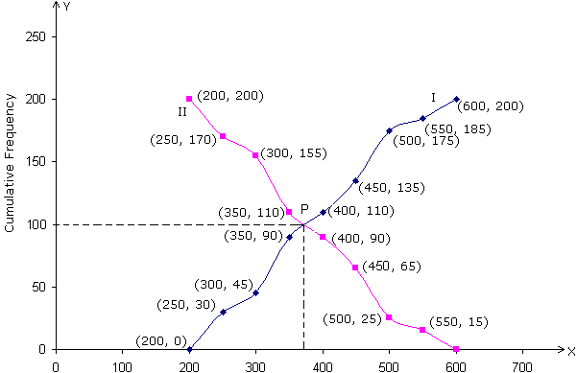
THE DOUBLE OGIVE FROM THE ABOVE TWO TABLES: (1.5 marks)
The two curves intersect at the point P(375, 100)
Hence, median = 375 (1/2 mark)

Slide 48
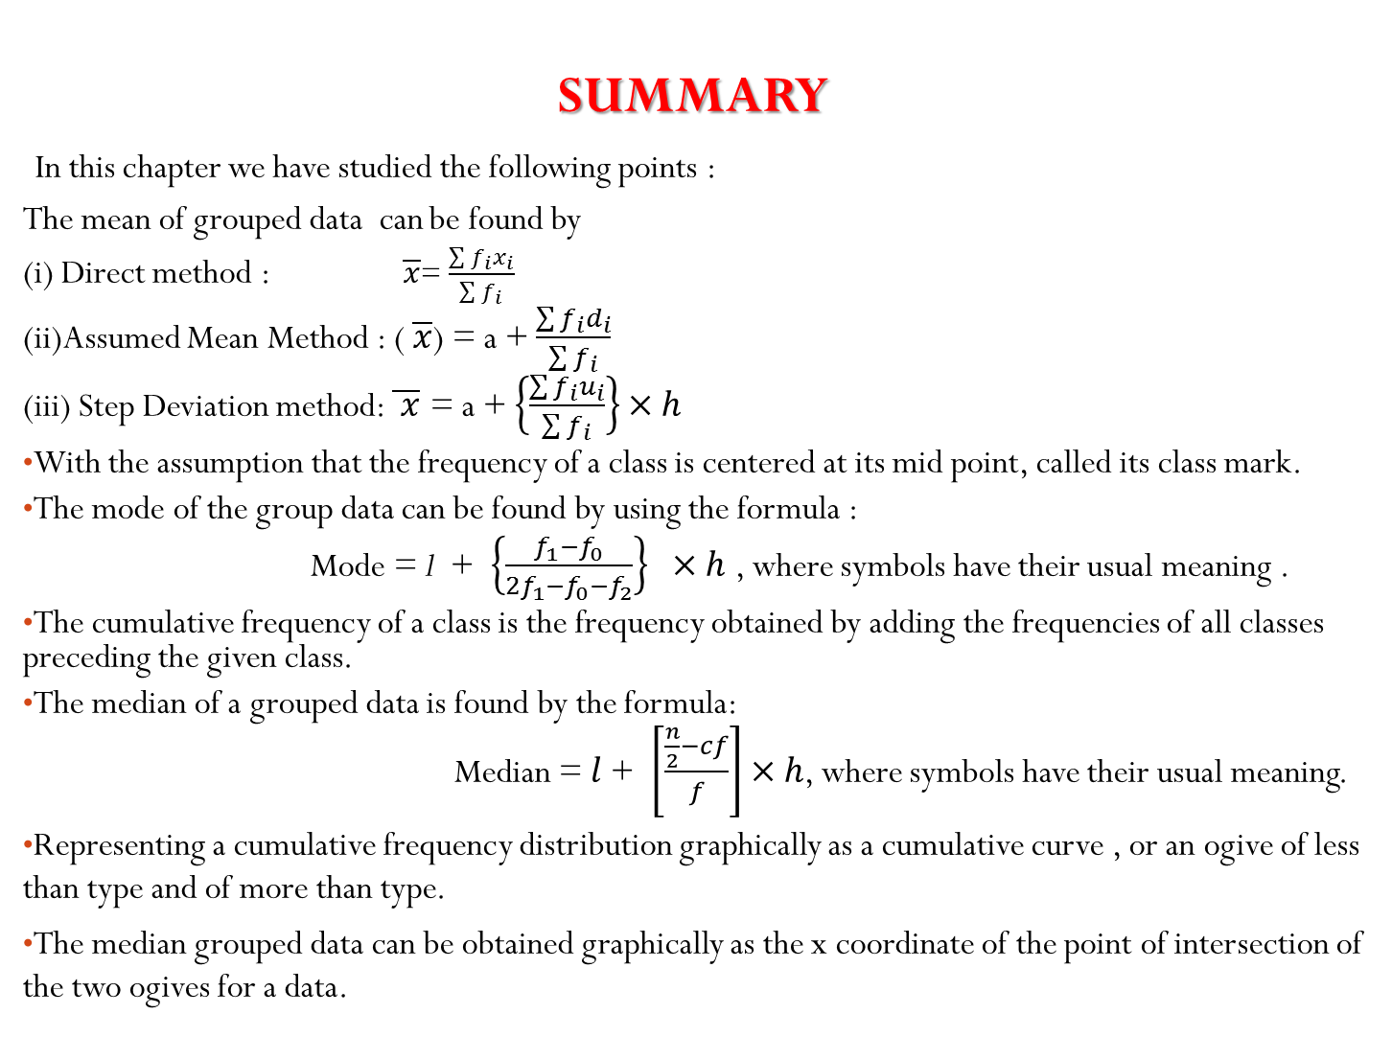
SUMMARY
In this chapter we have studied the following points :
The mean of grouped data can be found by
(i) Direct method : $\overline{x}$= $\frac{\sum{f_{i}x_{i}}}{\sum{f_{i}}}$
(ii)Assumed Mean Method : ( $\overline{x}$) = a + $\frac{\sum{f_{i}d_{i}}}{\sum{f_{i}}}$
(iii) Step Deviation method: $\overline{ x}$ = a + $\left\{\frac{\sum{f_{i}u_{i}}}{\sum{f_{i}}}\right\}×h$
With the assumption that the frequency of a class is centered at its mid point, called its class mark.
The mode of the group data can be found by using the formula :
Mode = l + $\left\{\frac{f_{1}−f_{0}}{2f_{1}−f_{0}−f_{2}}\right\}×h$ , where symbols have their usual meaning .
The cumulative frequency of a class is the frequency obtained by adding the frequencies of all classes preceding the given class.
The median of a grouped data is found by the formula:
Median =$l$ + $\left[\frac{\frac{n}{2}−cf}{f}\right]×h$, where symbols have their usual meaning.
Representing a cumulative frequency distribution graphically as a cumulative curve , or an ogive of less than type and of more than type.
The median grouped data can be obtained graphically as the x coordinate of the point of intersection of the two ogives for a data.

Slide 49
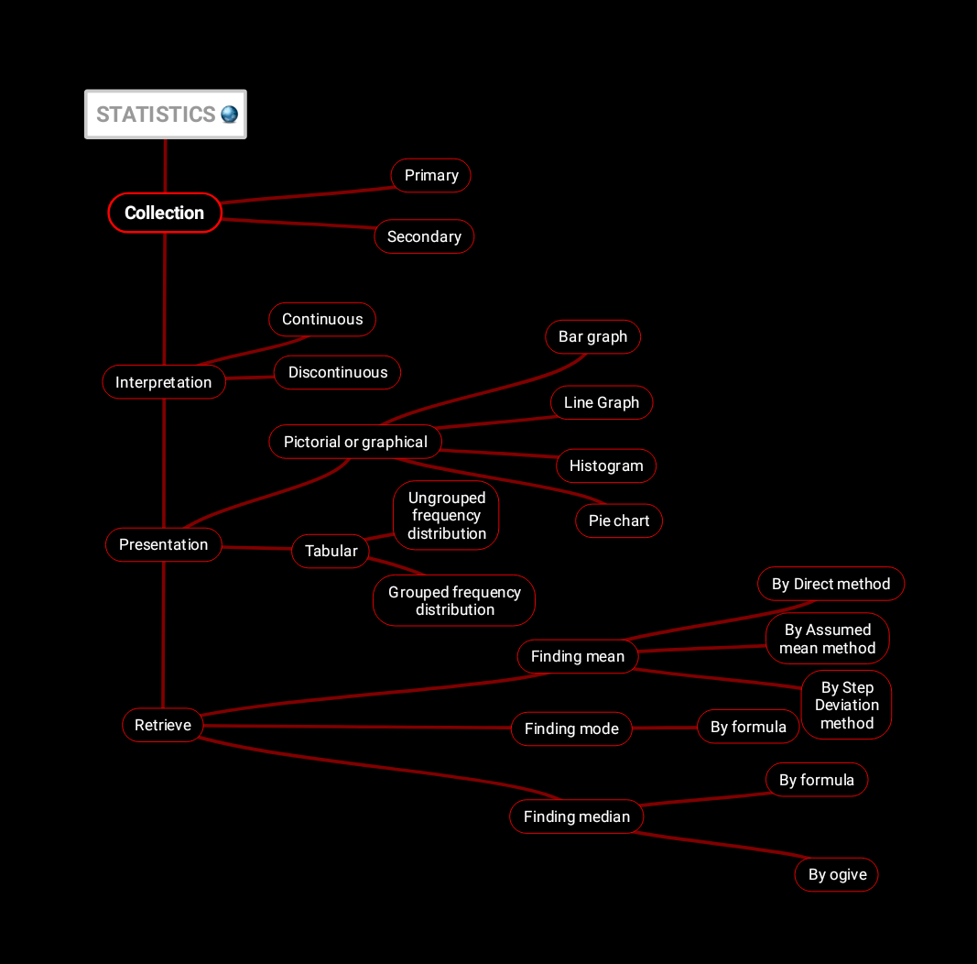
CONCEPT MAPPING OF THE TOPIC : STATISTICS

Slide 50
WORKSHEETS LINK FOR TEST OF DIFFERENT LEVEL
BASIC LEVEL
STANDARD LEVEL
ADVANCED LEVEL

Slide 51
THANK YOU

