Slide 1
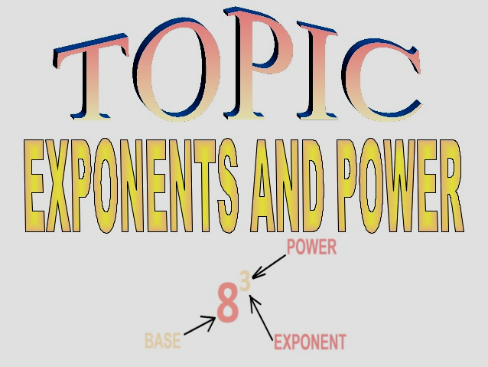

Slide 2
Evaluate exponential expressions.
Use the product rule for exponents.
Use the power rule for exponents.
Use the power rule for products and quotients.
Use the quotient rule for exponent, and define a number raised to the zero power.
Simplify an expression using rules.
LEARNING OBJECTIVES

Slide 3
INTRODUCTION
HOW DOES A SECRET SPREAD SO FAST?
The person with a secret tells a friend.
The friend promises never to tell anyone.
That same friend breaks the promise and tells two more friends.
The two new friends tell two new friends

Slide 4
The two new friends decide to tell two more friends .
This pattern occurs over and over until many people have been told.
By the end of the day it is no longer a secret .

Slide 5

IT’S TIME TO THINK
Tell me how will you express the pattern which was obtained in the Secret story.
How will you read the number 10000000000?
It’s nothing but expressing in an exponential form.

Slide 6
EXPONENTIAL NOTATION
A symbolic way of showing how many times a number or variable is used as a factor.
In the notation 5³ , the exponent 3 shows that 5 is a factor used 3 times; that is 5³ = 5×5×5= 125

Slide 7
EXPONENTS, POWERS AND BASES
The base number tells what number is being multiplied. The exponent, a small number written above and to the right of the base number, tells how many times the base number is being multiplied.
For example, “6 to the 5th power” may be written as 6⁵
Here, the base number is 6 and the exponent is 5. This means that 6 is being multiplied to itself 5 times.

Slide 8

SOLVE THE FOLLOWING QUESTIONS
Write the base and exponent of (-4/7 )⁶
Express 1.8 x 1.8 x 1.8 x 1.8 in exponential form
Express the rational number (-4/7 )⁶ in the form of p/q

Slide 9

SOLVE THE FOLLOWING QUESTIONS
Find the product of (2/5)⁶ and (2/5)¹⁰
Simplify (2/3)¹⁵ ÷ (2/3)⁶
Simplify and express [(-5/17)⁶]³
Find the value of (2/3)⁴ x (3/5)⁴
The above problems can easily be solved by laws of exponents

Slide 10
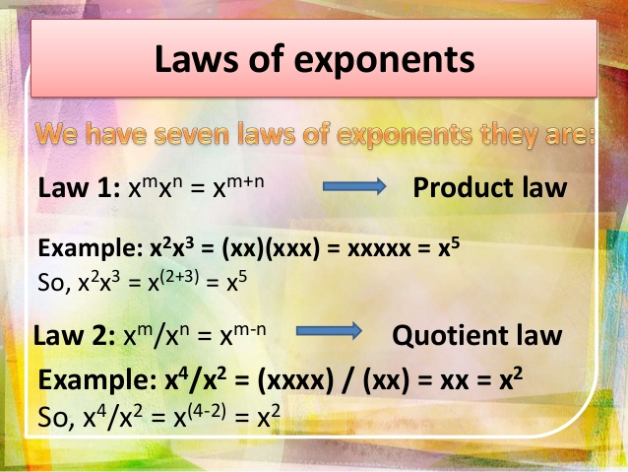
LAWS OF EXPONENTS
There are seven laws of exponents .
They are:
Ccc

Slide 11
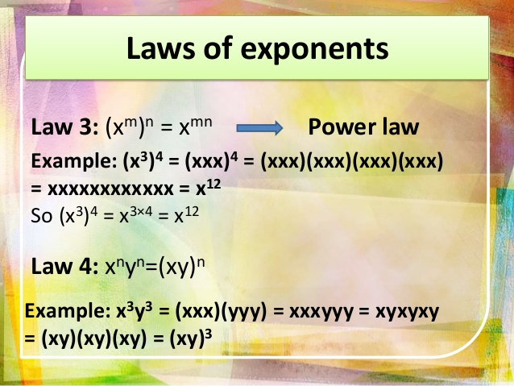
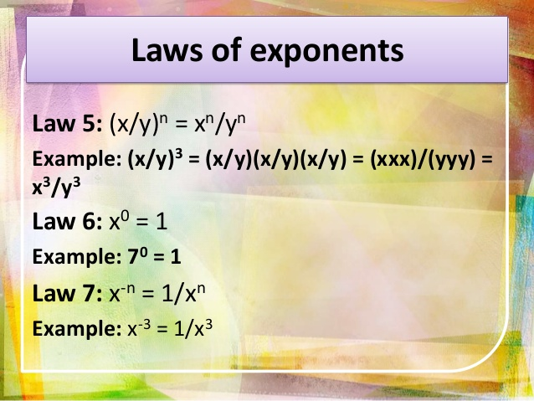

Slide 13
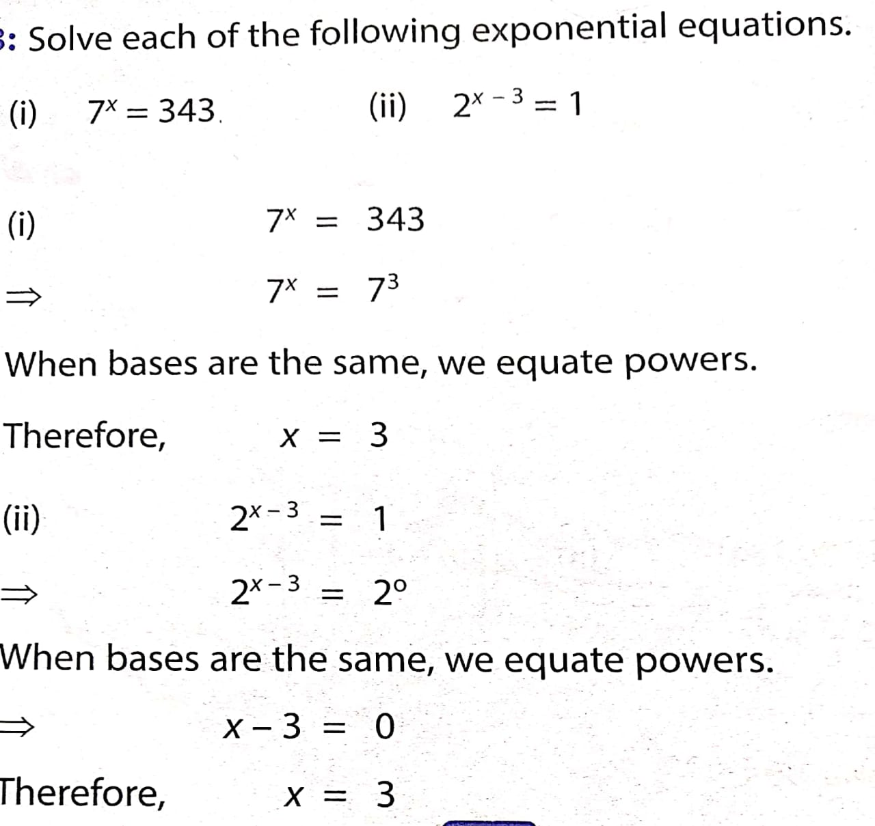

FEW EXAMPLES FOR BETTER UNDERSTANDING

Slide 14
How can you express the following number in order to make them easy to read and write ?
.
170,000,000
5,000,000,000
45920000000
0.000000000926
All these numbers are too large .In order to make them managable, we can write these in exponents.

Slide 15
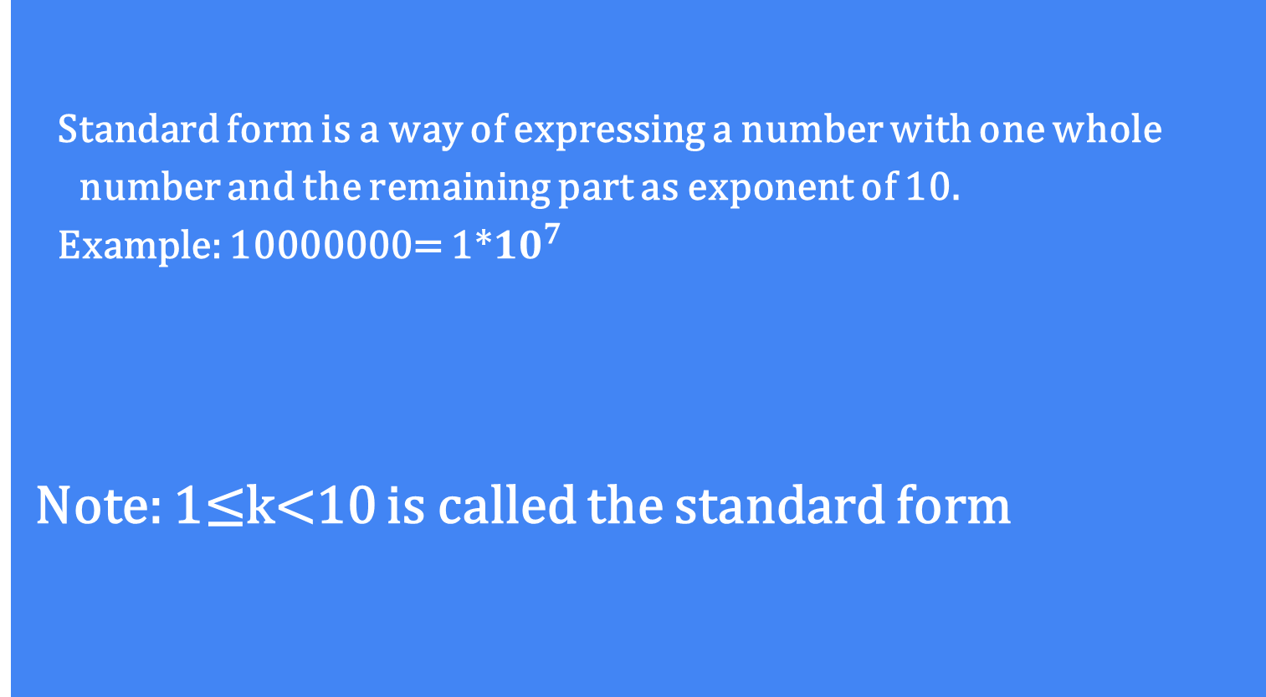
STANDARD FORM
Standard form is a way of expressing a number with one whole number and the remaining part as exponent of 10.
Example: 10000000= 1*${10}^{7}$
Note: 1≤k<10 is called the standard form

Slide 16
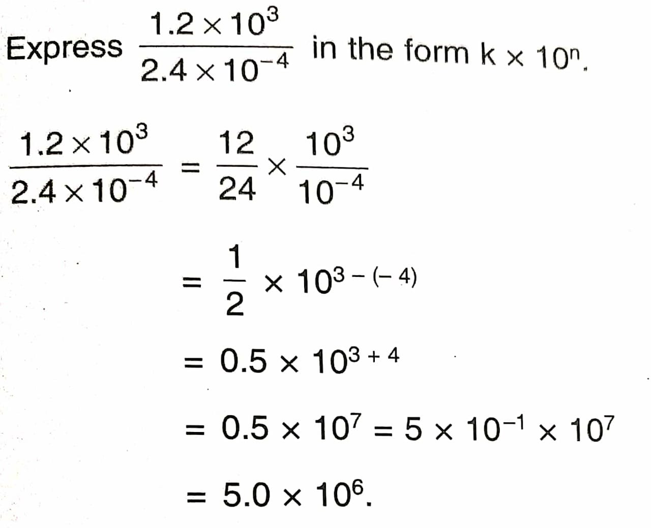
Let us solve few problems for better understanding
Express in the form k x 10^{n}

Slide 17
EXAMPLE :
Write the following numbers in the form
k x10^{n} where 1 ≤ k <10 and n is an integer
92340000
sol: 92340000 = 9.234 x 10⁷
[ Decimal point has to be moved 7 places from right to left When it moves from right to left, the exponent of 10 is positive]
(ii) 0.000255
Sol:0.000255=2.55 x 10⁻⁴
[Decimal point has to be moved 4 places from left to right.When it moves from left to right the exponent of 10 is negative]

Slide 18
RECAPTULATION
1. If x be any non zero rational number , and m ,n be any positive integers then ,
x^{m}x^{n} = x^{m+n}
^{Example :}
x²x³ = x²⁺³ = x⁵
^{2.} If x be any non zero rational number , and m ,n be any positive integers then ,
x^{m}/x^{n} = x^{m-n}
^{Example :}
x⁶/x² = x⁶⁻² = x⁴
3. If x be any non zero rational number , and m ,n be any positive integers then ,
(x^{m})^{n} = x^{mn}
^{Example :}
(x²)³ = x^{2×3} = x⁶
4. If x be any non zero rational number and n be any positive integers then ,
(xy)^{n} = x^{n}y^{n}
^{Example :}
(xy)³ = x³y³

Slide 19
5. If x be any non zero rational number and n be any positive integers then ,
(x/y)^{n} = x^{n}/y^{n}
^{Example :}
(x/y)² = x² / y²
6. If x be any non zero rational number and n be any positive integers then ,
x^{-n} = 1/x^{n}
^{Example :}
x⁻³ = 1/x³
7. If x be any non zero rational number then ,
x¹ = x example: 6¹ = 6
x⁰ = 1 example: 7⁰ = 1
x⁻¹ = 1/x example: 4⁻¹ = 1/4

Slide 20
FUN WITH EXPONENTS !!!!!!!!!!
This is a fun game for students to practise their skills with “Laws of exponents”. The students begin at the START and they have to move in the direction of correct answer and the process continues till they reach at the END.
This game helps the students to practise many concepts of EXPONENTS.

Slide 21
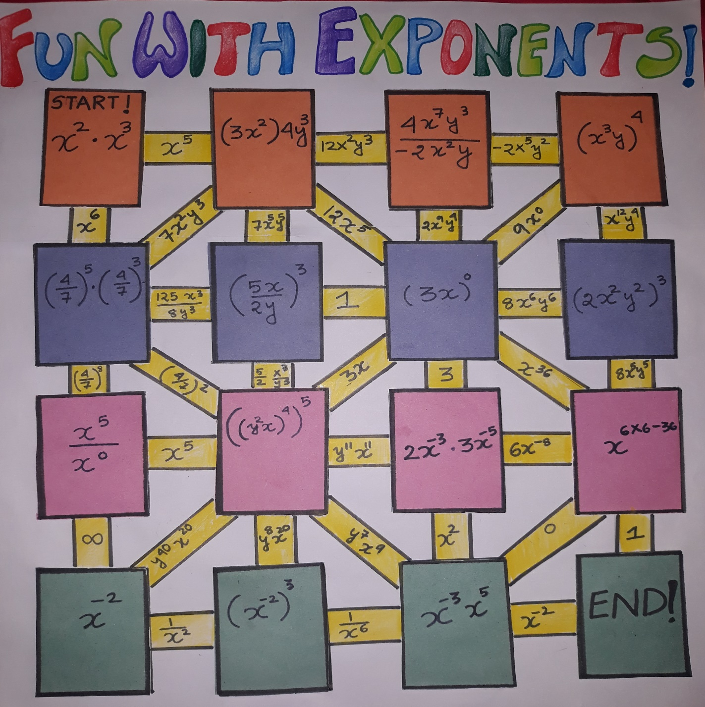

Slide 22
LEARNING OUTCOMES
The students will be able to understand :
Exponents and powers
Laws of exponents
To apply laws of exponents
To solve problems
The value of number raised to the power zero.
The standard form and will be able to write very large and small numbers using standard form .

Slide 23
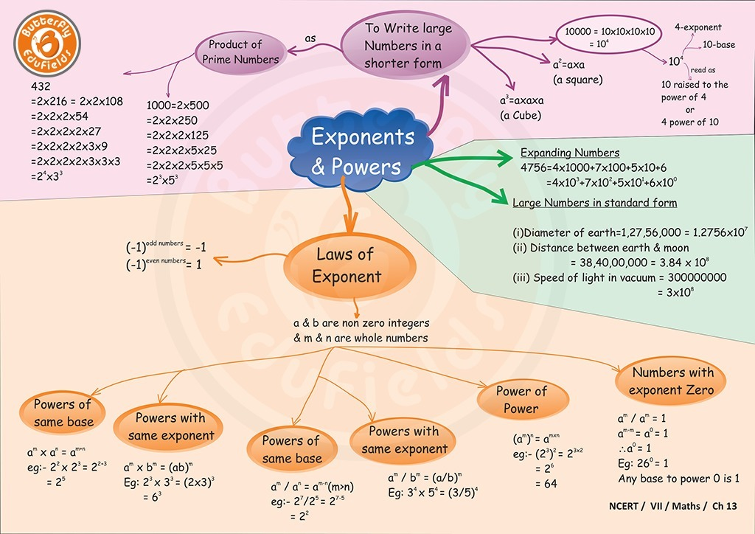
CONCEPT MAPPING

Slide 24
THANK YOU!!!!!

