Slide 1
SUBJECT-MATHEMATICS
CLASS – VII
TOPIC - PERIMETER

Slide 2
PDF link of the chapter…
PERIMETER

Slide 3
PERIMETER

Slide 4
LEARNING OBJECTIVES
Students will be able to :
Know about the perimeter of a triangle, rectangle, square, rhombus ,circles and polygons.
Understand how to find out the length of the boundary of different geometrical shapes.
Analyze the perimeter of different geometrical shapes.
Apply this knowledge in real life situation.

Slide 5
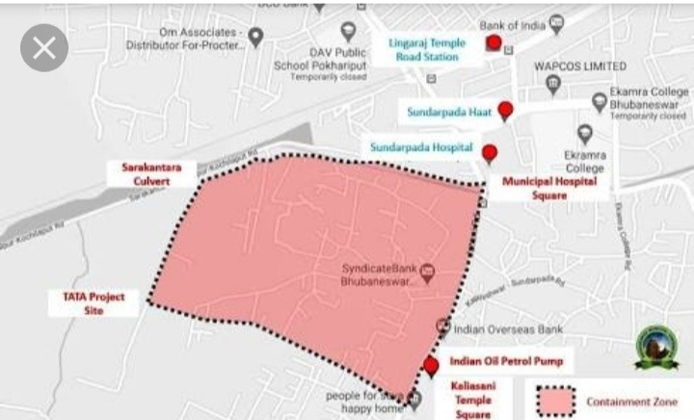
LIVE EXAMPLES.....
Dotted line shows the perimeter of the containment zone for COVID-19.

Slide 6
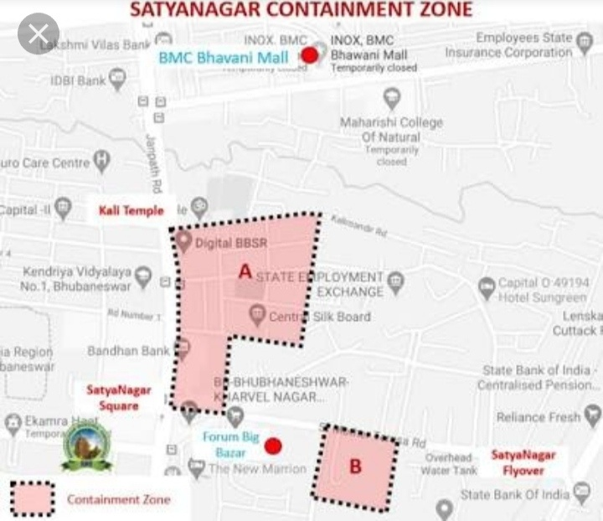
OTHER EXAMPLES...
Similarly, here also we can see the dotted line enclosure or the perimeter of the containment zone.

Slide 7
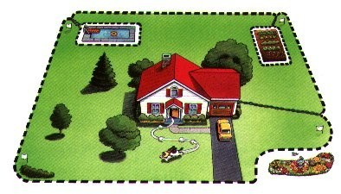
Your family wants to put up a new fence around your home. How will they know how much fencing they need?
INTRODUCTION
FROM THE ABOVE ACTIVITY WE CONCLUDE THAT PERIMETER IS THE LENGTH OF THE BOUNDARY OF A CLOSED FIGURE.

Slide 8
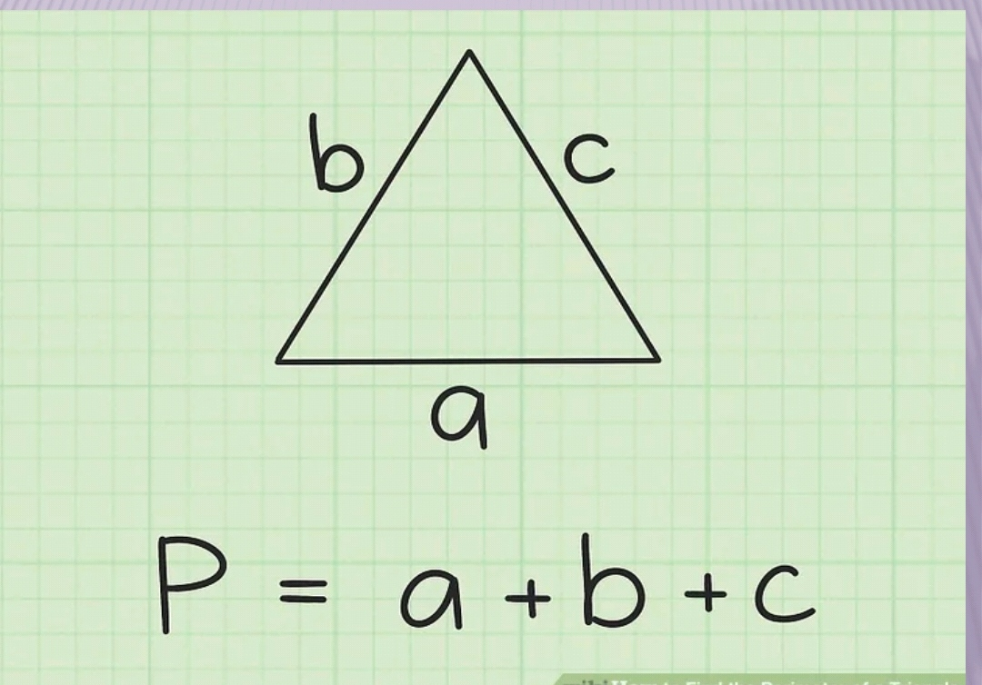
PERIMETER OF A TRIANGLE
Let us draw any triangle ABC.The perimeter can be found out by taking the sum of the length of all the three sides.
Perimeter(P) = AB+BC+CA
P = a + b + c

Slide 9
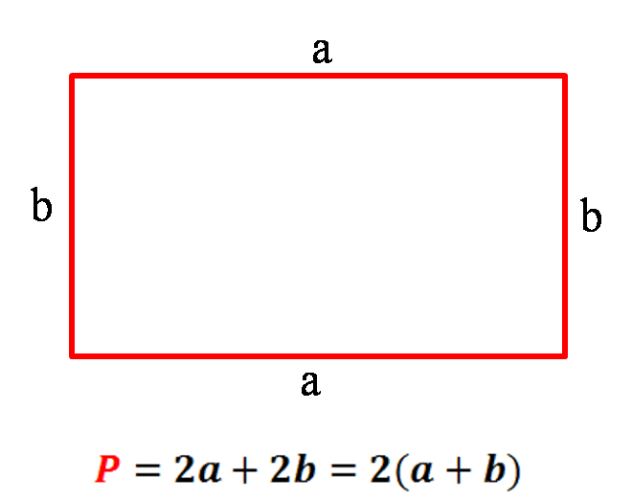
PERIMETER OF A RECTANGLE....
A RECTANGLE IS A CLOSED FIGURE HAVING FOUR SIDES WHOSE OPPOSITE SIDES ARE OF EQUAL LENGTH.
• A rectangle is a figure of 4 sides
whose opposite sides are equal.
• The perimeter can be found out by adding all the four sides together.
• It can also be found by adding twice
the width together with twice
the length...
• So, the formula for the perimeter of
a rectangle is P = 2a + 2b.
Perimeter of a rectangle

Slide 10
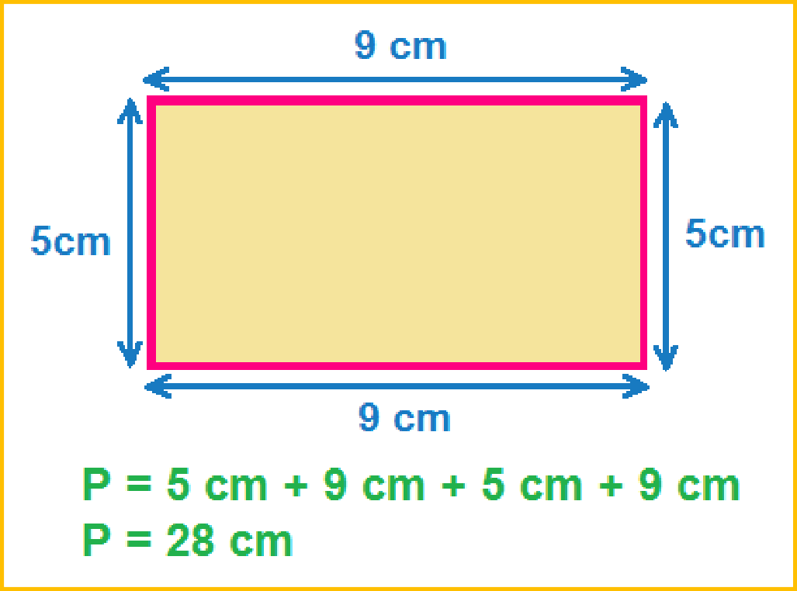
Worksheet-1(Assignment)
•
Find the perimeter of the given rectangle.

Slide 11
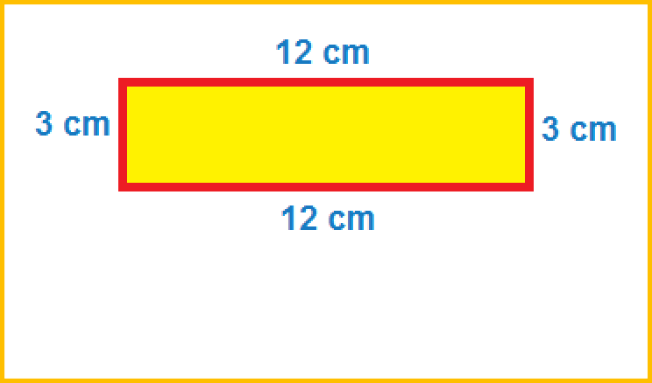
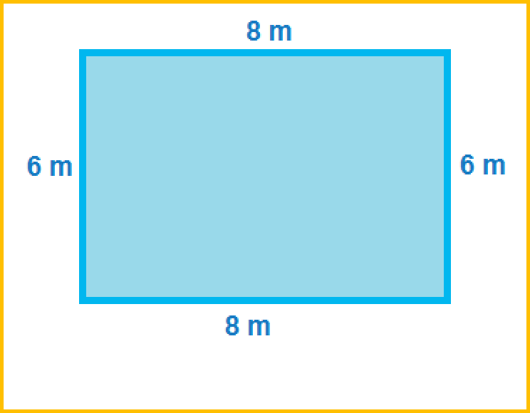
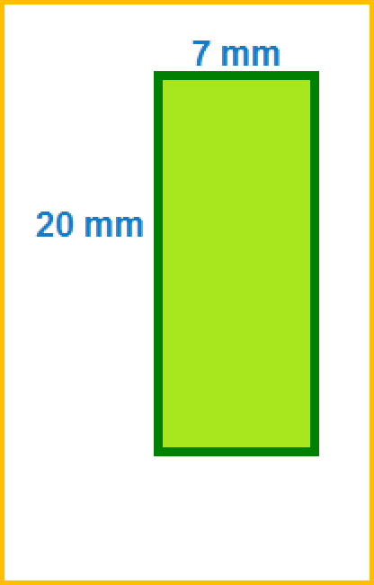
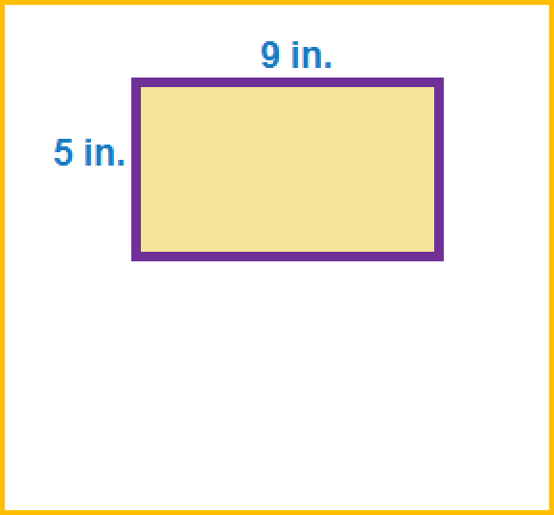
Worksheet - 2(Assignment)
.
.
Find the perimeter of the given adjoining figures using the formula
P = 2 ( L + B )
L= Length
B= breadth/width.
Work is worship

Slide 12
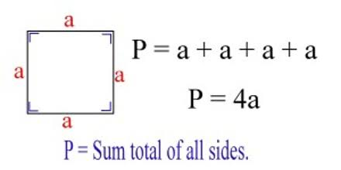
Perimeter of a square...
Let us consider a square of side ‘a’ unit.
We know all the sides of a square are of same length.
Hence, the perimeter can be found out by taking the sum of all the sides as given in the figure. Perimeter = 4 x side
Work is worship

Slide 13
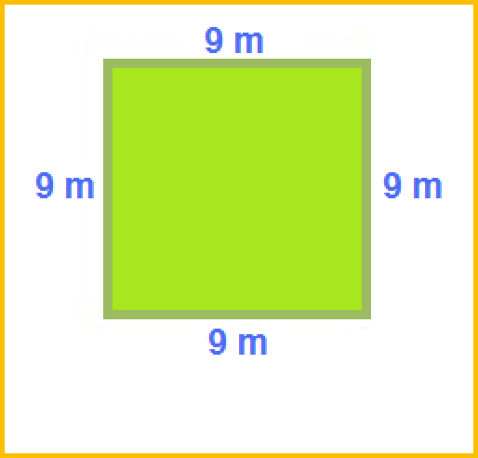
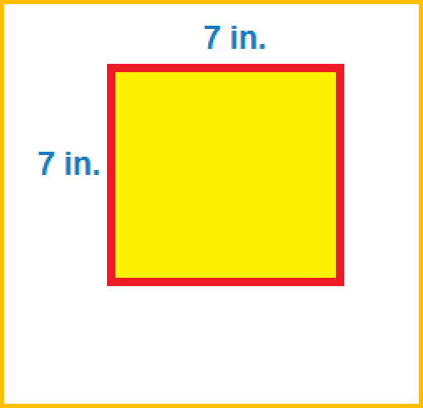
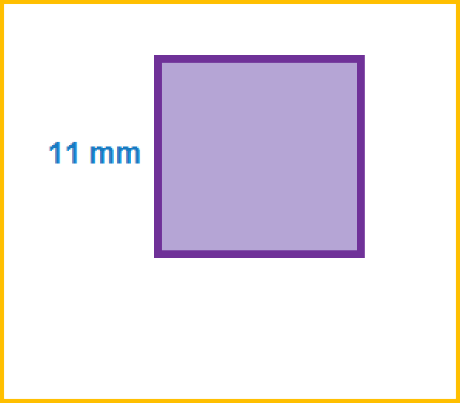
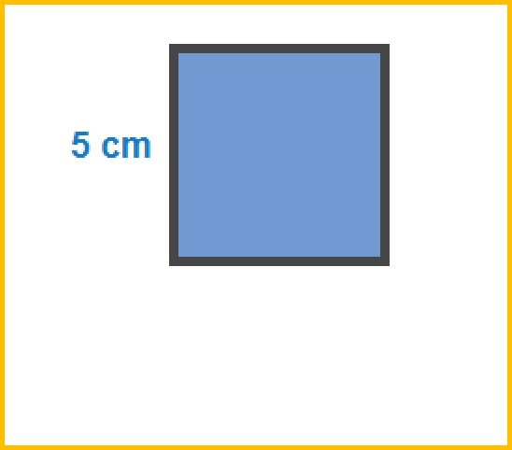
Worksheet -3(Assignment)
.
.
Find the perimeter of the given squares using the formula.
P = 4s
Perimeter = 4 x side
Work is worship

Slide 14
Perimeter of a Square…
• A square is a figure with 4 equal sides.
• The perimeter can be found by adding
all 4 sides together.
• It can also be found by multiplying the side
length by 4.
• So the formula for the perimeter of a
square is: P = 4 X Side = 4S

Slide 15
Relationship between circumference and diameter…
ACTIVITY
Let us do the following activity to obtain a relation between diameter and circumference:
Take three circular discs of different sizes.
Measure the diameter of each of the circle. To find the diameter, simply fold the disc over itself to form a semi-circle. The crease distance between the two ends of the semi-circle is the diameter.
Measure the circumference of each circle by using a piece of thread.
Find the ratio of the circumference to its diameter.
From the above activity, we arrived at a conclusion that the ratio of the circumference of the circle to its diameter is approximately equal to 3.14 for all the circles.
Activity for the above, is given in the next slide through the video link.

Slide 16
Relationship between circumference and diameter…
Activity for finding circumference and diameter ratio i,e “$π$”….
Let’s take a look at the VIDEO
YouTube Link : https://www.youtube.com/watch?v=XxVka4TKuPg&authuser=0

Slide 17
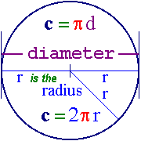
Formula of circumference of a circle

Slide 18
Find the Circumference of a circle whose radius is 3.5cm.
WORKSHEET- 4
Solution:
Radius = 3.5 cm
Circumference = 2πr [½]
= 2 x 22/7x 3.5
= 2x 22 x 0.5 [1]
= 22cm. [½]

Slide 19
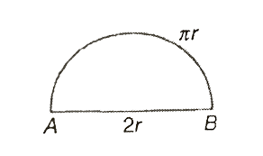
PERIMETER OF SEMI-CIRCLES
Perimeter of semi-circle = Length of the semi-circle(πr) + Diameter(2r)
= πr + AB
= πr +2r
= (πr + d)

Slide 20
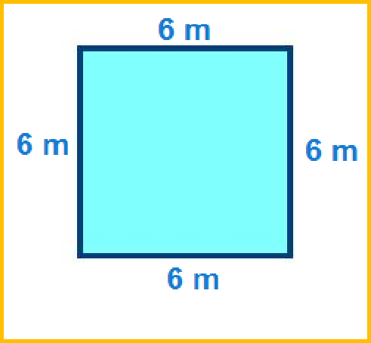
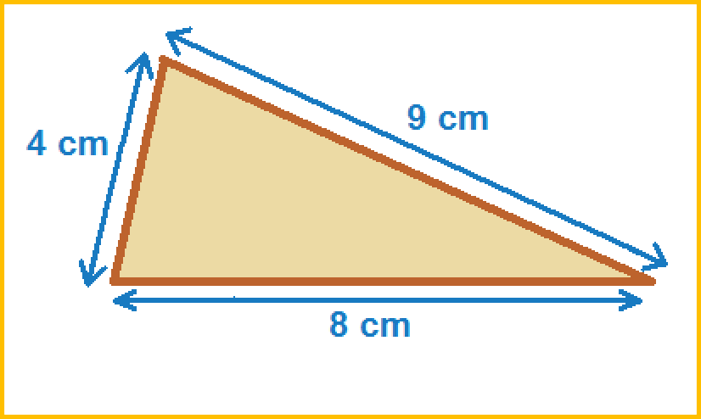
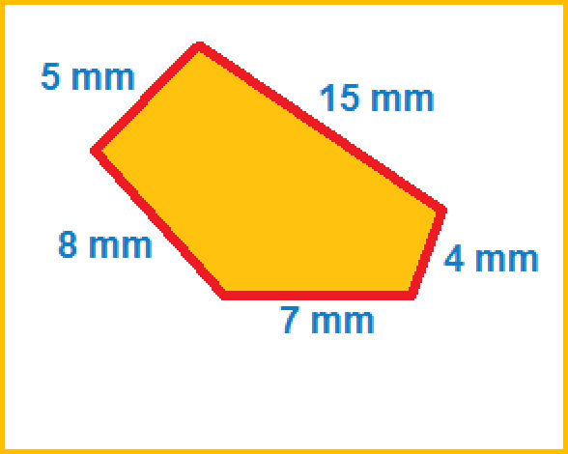
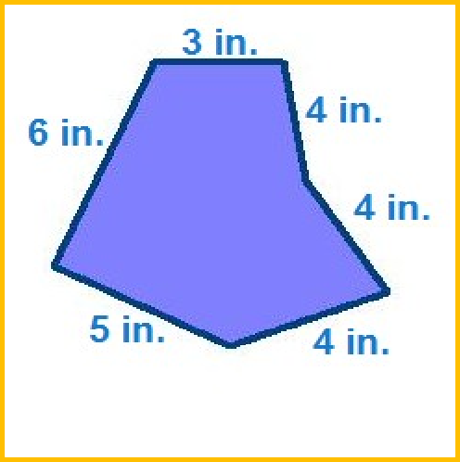
Worksheet- 5 (Assignment)
Find the perimeter of the given figures.
. .

Slide 21
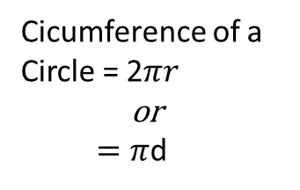
CONCEPT MAP
P E R I M E T E R
Perimeter of a Rectangle
=2(Length + Breadth)
= 2(L+B)
Perimeter of a Square
= 4 x Side
= 4 x S
Cicumference of a Circle = 2$πr$
or
$=π$d

Slide 22
VIDEO LINK OF PERIMETER
VIDEO

Slide 23
LEARNING OUTCOMES
At the end of the chapter, the students will be able to:
Define the perimeter of a triangle, rectangle, square, rhombus, circle and polygon.
Remember the use of formulae to determine the perimeter of different shapes.
Differentiate the perimeters of different geometrical shapes.
Use their practical knowledge in different fields.

Slide 24
WORK SHEET-6 (ASSIGNMENT)
1. The ratio of the circumference and diameter of a circle is –---- [1]
a. 2 : 1 b. 1: 2 c. 1 : 3.14. d. 22 : 7
2. Find the circumference of a circle whose radius is 14 cm. [2]
Solution : Radius of the circle = 14 cm.
Circumference = 2 $π$ r [1/2]
= 2 x 22/7 x 14 = 2x22x2 = 88 cm [1]
So, the circumference of the circle is 88cm. [1/2]
3. Find the radius of the circle whose circumference is 88 m. [3]
]Solution: Circumference , C = 88 m
Now C = 2 𝜋 r = 88 [1]
=> 2 x $\frac{22}{7}$ x r = 88
=> r = $\frac{7X88}{2X22}$ = 7 x 2= 14 m [1.5]
So, the radius of the circle is 14m. [0.5]
Contd….

Slide 25
WORK SHEET-6 (ASSIGNMENT)…
4. A wire is in the form of a circle of radius 35m. It is now bent in the form of an equilateral triangle. Find the side/s of the triangle. [4]
Solution:
Radius of the circle= 35cm
We know circumference, C = 2 𝜋 r
= 2 x 22/7 x 35 = 44x5m= 220m [1.5]
According to the question ,
Circumference of the circle = perimeter of the triangle [0.5]
Let one side of the triangle be x
Perimeter of the triangle = 3x
Now 3x = 220m
x = 220/3 = 73.33m(approx.) [1.5]
Thus each side of the triangle is 73.33m(approx.) [0.5]

Slide 26
QUESTIONS

Slide 27
THANK YOU

