Slide 1
STD – IX MATHEMATICS
TOPIC- HERON’S FORMULA

Slide 2
PDF CHAPTER LINK
Herons Formula(ncert).pdf
Unit 12(Exemplar Heron's Formula).pdf

Slide 3
Learning Objectives
Students will be able to
recall the formula for finding area and perimeter of closed geometrical figure .
know the formula for finding area of a scalene triangle .
Application of Heron’s formula in finding area of quadrilateral .
verify that Heron’s formula is also applicable for other triangles.
estimate the area of different shapes of geometrical figures .

Slide 4
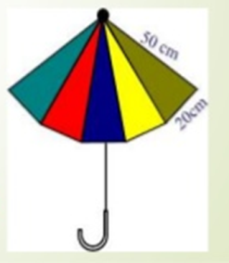
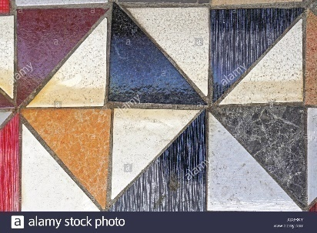
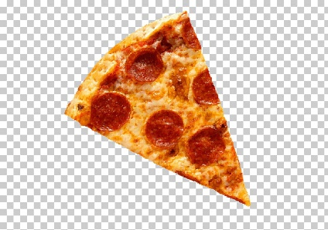
Why will we study Heron’s Formula ?
To find area of cloth required for an umbrella
To find the area of tiles required for the floor
To find the area of a triangular shaped pizza .

Slide 5
INTRODUCTION
In earlier classes , we have studied areas of some plane figures such as rectangle , square , perimeter , right angled triangle , quadrilateral , etc.
The length of the boundary of a closed figure is called the perimeter of the plane figure . A part of the plane enclosed by a simple closed figure is called plane region and the measurement of the plane region is called its area . Area is usually measured in square meter (m²) or square centimeter (cm²) .

Slide 6
REVIEW OF SOME IMPORTANT FORMULAE
RECTANGLE :
Perimeter = 2(l+b)
Area = l X b
SQUARE :
Perimeter = 4 X side = 4a
Area = side x side = a²
TRAPEZIUM:
area = ½ X h x (a+b)
RHOMBUS :
Area = ½ x d₁ x d₂
b
l
a
a
a
a
a
d₁
h
d₂
b

Slide 7
TRIANGLE
A
1. SCALENE TRIANGLE
Perimeter = a+b+c
Area = ½ x a x h
2. EQUILATERAL TRIANGLE :
Area = a²
Height =
3. RIGHT ANGLED TRIANGLE :
Area = ½ x a x b
c
b
h
B
a
C
A
a
a
h
A
B
C
b
a
B
C
a

Slide 8
some useful conversions for area
1m² = 1m x 1m = 100cm x 100cm = 10000cm²
1dm² = 1dm x 1dm =10cm x 10cm = 100cm²
1 Hectare = 100m x 100m = 10000m²

Slide 9
HERON’S
FORMULA

Slide 10
What is Herons Formula ?
The famous formula derived by Heron for the area of a scalene triangle when height is not given is Heron’s formula .

Slide 11
ABOUT HERON

Slide 12
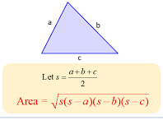
a ,b , c are sides of the triangle . Perimeter of the triangle = a + b + c S is semi-perimeter .

Slide 13
PROOF OF HERON’S FORMULA
Semi-perimeter , s = => s-a = , s-b = , s-c =
In right , we have (i) h²= c² – x² (by Pythagoras theorem )
In right triangle ADC , we have ,
h² = b² – (a-x)²
From equations (I) and (ii) , we get
c² – x² = b² – (a-x)²
on simplification,
x =
substituting the value of x in (I) , we get
h² = c² - => h =
. area of triangle ABC is
= ½ x a x =
on simplification,
= =
A
b
c
h
B
x
a-x
D
a
C

Slide 14
VIDEO-HERONS FORMULA
VID-20200430-WA0016.mp4

Slide 15
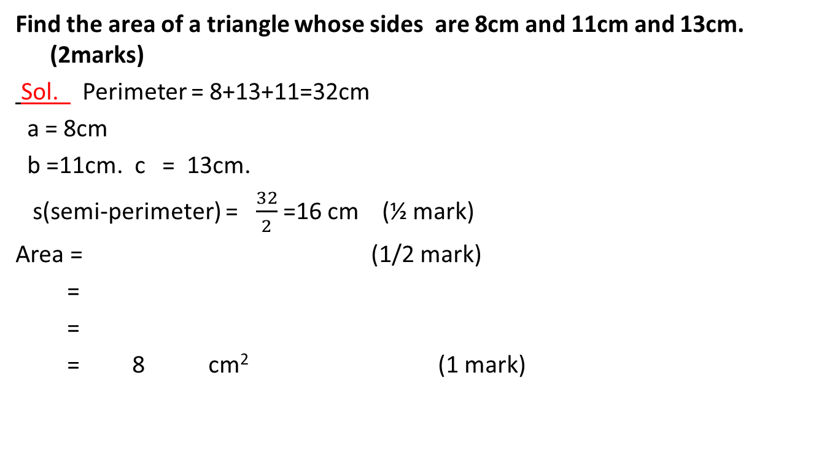
EXAMPLE
Find the area of a triangle whose sides are 8cm and 11cm and 13cm. (2marks)
Sol. Perimeter = 8+13+11=32cm
a = 8cm
b =11cm. c = 13cm.
s(semi-perimeter) = $\frac{32}{2}$ =16 cm (½ mark)
Area = (1/2 mark)
=
=
= 8 cm² (1 mark)
A
13cm
11cm
B
C
8cm

Slide 16
EXAMPLE

Slide 17
REMARK
Heron’s formula was derived specially for scalene triangles . But it is applicable to all type of triangles .

Slide 18
QUESTIONS

Slide 19
APPLICATION OF HERON’S FORMULA IN FINDING AREAS OF QUADRILATERALS

Slide 20
QUESTION

Slide 22
QUESTION
A kite in the shape of a square with a diagonal 32 cm and an isosceles triangles of base 8 cm and sides 6 cm each is to be made of three different shades as shown in the given figure. How much paper of each shade has been used in it? (3 mark)

Slide 23
A
I
B
o
D
II
C
6cm
III
8cm

Slide 24
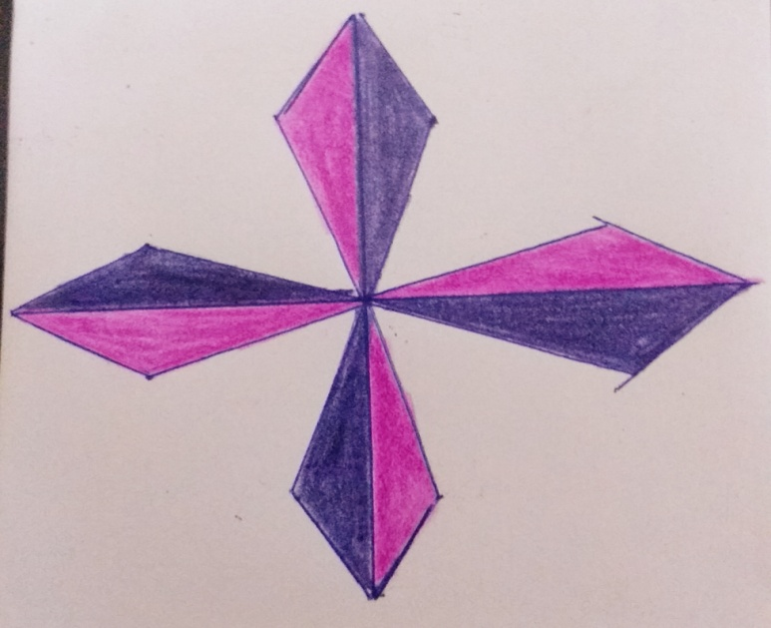
Student will be asked to cut eight equal triangles of given sides by using two different colours .
2. They will paste the triangular papers to make the above floral design.
3. They will find area of different color papers used by them

Slide 25
HERON’S FORMULA
Heron’s formula = Where a , b , c are the length of the sides s = semi perimeter =
Right angled triangle = X b X h
Equilateral triangle =
Application
h
a
a
b
a = side of the triangle
a
Base= b, height = h
Find area of a triangle of side 122cm, 22cm, 120cm.
By Herons formula:
Area of Quadrilateral ABCD = Area of ABC + Area of ACD
9cm
D
Where s =
=
Area of ABC= X 12 X 5=30m².
A
12cm
9cm
=
= 132.
=
B
C
Area=
=
5cm
= 1320cm².
=
= 35.496
Where s =
=
=
= 15m.

Slide 26
THANK YOU

