Slide 1
MATHEMATICS-CLASS-IV
CHAPTER - FRACTIONS

Slide 2
Book Link
Std. IV
Chapter – 9
(FRACTIONS)
https://drive.google.com/open?id=1eWBOF-GspccikBWPsM5W6lr2TxPWfnxF

Slide 3
Learning Objectives
Understand and explain the concept of fraction - As a part of a whole.
Understand the types of Fractions.
Find equivalent fractions from a given fraction.
Conversion of Mixed fraction into improper fraction.
Conversion of Improper fraction into mixed number

Slide 4
EXAMPLE OF FRACTION CONCEPT IN REAL LIFE
Time Telling - Each minute is a fraction of an hour.
Baking - Proper fraction of ingredients are used for a sweet cake or biscuits.
Sales and Discounts - Fraction of discounts are provided on MRP during seasonal sale.
Chocolate Distribution on Birthday in Class – Each child gets equal number of chocolate from the whole packet.
Manufacture of Jewellery - 24 karats is pure gold, and 18 karats is which equals 75% gold.Using fractions to understand jewellery purity could save your money .
Photography - Shutter speed of a camera is calculated in fraction unit of time.
Pizza for the kids - Mealtime doesn’t have to be a battle about who got more. Use fractions to split the pie evenly.

Slide 5

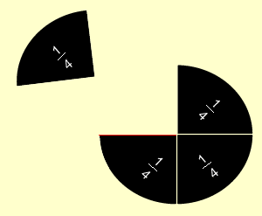
INTRODUCTION TO FRACTION
The word ‘Fraction’ comes from the Latin word ‘Fractus’ which means ‘Broken part’.
Fractions Mean
Parts

Slide 6
What are Fractions ?
Parts of a Whole
Example:
Numerator
(Nr)
Denominator
(Dr)

Slide 7
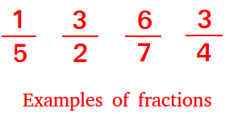
Fractions
What do they mean …
We have 1 of those parts. The whole is split into 2 parts
We have 3 of those parts. The whole is split into 4 parts.

Slide 8
TYPES OF FRACTIONS
Equivalent Fraction.
Like Fraction.
Unlike Fractions.
Proper Fraction.
Improper Fraction.
Unit Fraction.
Mixed Number.

Slide 9
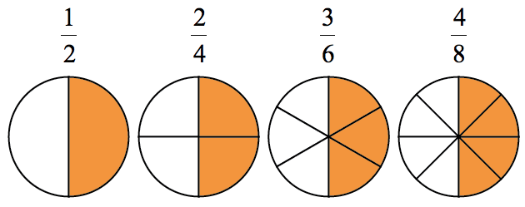

EQUIVALENT FRACTION
Fractions which express the same part of a whole
but have different names are called
Equivalent Fractions.
x
=
Q .Change into an equivalent fraction with numerator as 20. (2 mark)
Ans: 4x5 = 20
9x5 =45

Slide 10
MISSING NUMERATOR OR DENOMINATOR OF EQUIVALENT FRACTIONS
14 is 2 times 7
So, the missing numerator must be 2 times 3.
3x2= 6
x 2
=
=
x 2
=
30 is 6 times 5
So, the missing numerator must be 6 times 9.
9x6= 54
x 6
=
x 6
÷ 5
30 ÷ 5 = 6
So, We divide 45 by 5.
45 ÷ 5 = 9
=
÷ 5

Slide 11
CHECK FOR THE EQUIVALENCE
OF TWO FRACTIONS
Is equivalent to
Cross product of 2x15 = 30
Cross product of 3x10 = 30
They are same

Slide 12
QUESTIONS

Slide 13
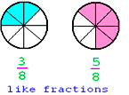
LIKE FRACTION
Fractions having the same denominators are called
Like Fractions.
Addition and Subtraction of Like Fraction
Add the Numerators
5 + 9 = 14
Subtract the Numerators
15 – 12 = 3
Denominators are same,
So we can add the numerators
Denominators are same,
So we can subtract the numerators
Q. The fractions with same denominator are called as _____________ fractions. (1 Mark)
Proper (ii) Like (iii) Unit (iv) Unlike
Ans: Like

Slide 14
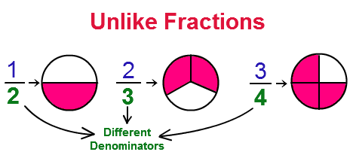
UNLIKE FRACTION
Fractions having the different denominators are called
Unlike Fractions.

Slide 15
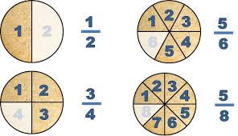
PROPER FRACTION
Fractions where numerators are smaller than
denominators are called
Proper Fractions
Value Of a Proper Fraction is always less than 1.

Slide 16
IMPROPER FRACTION
Fractions where numerators are greater than denominators are called Improper Fractions
Value Of a Proper Fraction is always greater than 1.

Slide 17

UNIT FRACTION
Fractions having 1 in the numerator are called
Unit Fractions.
Q. What is a Unit Fraction? Give an example. ( 1 Mark)
Ans: Fractions having 1 in the numerator are called Unit Fractions.
Example:

Slide 18
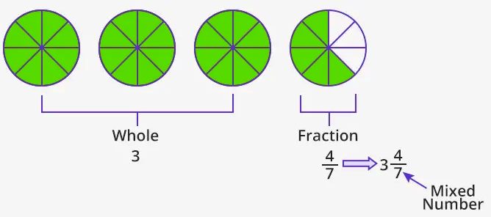
MIXED NUMBER
Improper fraction written as a combination of a natural number and a proper fraction is called a
Mixed Number.
3 Whole
Proper fraction
Q. Convert into mixed number. (1 ½ Mark)
Ans: Natural Number Part = 5
Proper fraction =
Natural number

Slide 19
FRACTION AS DIVISION
Pasha has 4 marbles. He distributes these marbles
equally among 2 of her friends.
Each gets = 4 ÷ 2
= 2 Marbles
If Tobo has 2 mangoes to distribute equally among 2 of his friends.
Each gets = 2 ÷ 2
= 1 Mango
If Dobo has 1 apple to distribute equally among 2 of his friends.
Each gets = 1 ÷ 2
= Apple
Some Other Examples
= 17 ÷ 5
= 9 ÷ 5

Slide 20
CHANGING FRACTIONS
1. Improper fraction into mixed number.
Natural Number Part
Divisor
2
Example
5
1 4
1 0
14 ÷ 5
Remainder
4
Remainder
Q. Convert into improper fraction. (1 ½ Mark)
Ans:
Divisor
Natural Number Part

Slide 21
2. Mixed Number into Improper fraction
Step1: First multiply the whole number with denominator.
Step2: Then add product of whole number and denominator with numerator
Step3: Write the resultant number as numerator. Also write the denominator.
Natural Number Part x Denominator
(33 x 3) = 99
Example
Natural Number Part x Denominator + Numerator
(33 x 3) = 99 + 1 = 100
Natural Number Part x Denominator + Numerator
Numerator
=

Slide 22
ACTIVITY ON EQUIVALENT FRACTION
Give 3 coloured paper strips to every student of the class.
Let’s make a fraction strip for 1/2. (Student fold their strips into 2 pieces)
Cut of the pieces to show 1/2.
Fold both 1/2 pieces into half. Now we have 4 pieces.
We should have 4ths now. How many of your 4ths equal to
1/2? (Ans-2) . So,1/2 is equivalent to 2/4.
Try folding each of your 1/2 pieces twice. So what fractions do
you get? (Ans-8ths)
How many 8ths are equivalent to 1/2? (Ans-4)
At the end we clear that multiplying the numerator and
denominator by 2 is one good way to create equivalent
fractions.
Click Here
https://youtu.be/9k-7Kbf5GzU

Slide 23
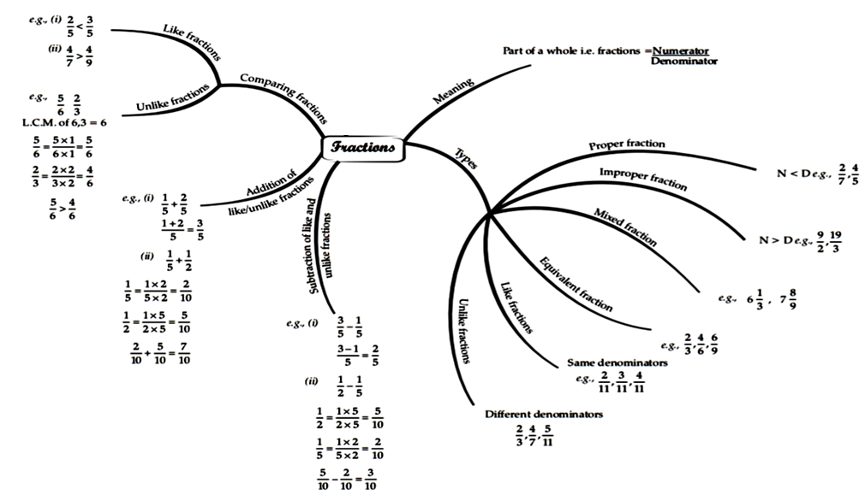
Mind Map

Slide 24
TYPES OF FRACTION
FRACTIONS
Like and Unlike: In Like fractions denominators are same and in Unlike fractions denominators are different.
Part of a whole is a fraction. e.g.
Proper and Improper: In Proper fractions Numerators are smaller than Denominators.
A fraction is made up of a numerator and a denominator. The numerator says how many equal parts are represented and the denominator says into how many equal parts it is divided.
Unit: Fractions having 1 in the numerator.
Addition of like fractions:
Subtraction of like fractions:
Mixed Number: Improper fractions written as a combination of a natural number and a proper fraction is called a mixed number.

Slide 25
FRACTIONS
What are Fractions
Fractions are a PART of a WHOLE
Equivalent Fraction
Like Fraction
Unlike Fractions
Proper Fraction
Improper Fraction
Unit Fraction
Mixed Number
Examples

Slide 26
Learning Outcomes
Fractions and use of fraction in real life.
Finding of Fraction from a given fraction.
Adding and Subtracting of like fractions.
Converting fraction into mixed number.
Converting mixed number into improper fraction.

Slide 27
BASIC WORKSHEET
1. A number representing a part of a __________ is called a fraction.
2. Fractions with same denominators are called __________.
3. is read as ________.
4. A proper fraction is __________ than 1.
5. Improper fraction written as a combination of a natural number and a
proper fraction is called a __________ number.
Fractions having __________ in the numerator are unit fractions.
Fractions, where numerators are smaller than the denominators are
called__________.
8. Encircle the Improper fraction –
If cross products of numerator of one fraction __________ of the
other fraction are same, then the two fractions are called equivalent fractions.
10. What will be the fraction for ten – nineteenths ________.

Slide 28
_______ makes a whole. (3 Halves, 2 Halves, 2 Fourths or 3 Fifths).
12. Encircle the equivalent fractions for the given fraction –
13. Fractions with different denominators are called _____.
When we multiply the numerator and denominator of a fraction by a common number other than 0 and 1, we get an _______ fraction.
Use the proper symbol ‘<’, ‘>’, or ‘=’in the blank:
16. Arrange in ascending order:
17. An improper fraction is __________ than 1.
18. What will be the fraction for six – elevenths _____.
19. Encircle the proper fraction –
20. Arrange in descending order:

Slide 29
Add the following fractions:
22. Express as a division sum.
23. The fraction is read as ______________.
24. Add:
25. Subtract the following fraction:
26. Encircle the mixed number:
27. Subtract :
28. Encircle the unit fraction –

Slide 30
29. What number will replace the “?” mark:
30. can be written as 15 ÷ ____

Slide 31
STANDARD WORKSHEET
Convert the following into improper fractions:
a) b)
2. Write ‘<’, ‘>’, ‘=’ for the following fractions:
a) b)
3. Write fraction in words for the following:
a) Three – fifths b. Seven – eighths
In the word “DAV COLLEGE MANAGING COMMITEE” write the fraction of
consonants in the given word.
5. What number will replace the “?” mark:

Slide 32
6.Write the next four equivalent fraction for :
7. Find the equivalent fraction of with denominator as 90.
8. Encircle the set of Proper fractions –
a) b)
9. Subtract the following fractions:
10. Check whether the following fraction is equivalent or not:
11. Convert the following to improper fraction:
12. Arrange in descending order:

Slide 33
13. Arrange in ascending order:
14. Convert the following Improper fractions into mixed number:
a) b)
15. When reduced to lowest term to be ______.
16. Convert the following mixed number into improper fraction:
17. What is an Unit Fraction? Give an example.
18. What will be placed in the question mark:
19. Complete the pattern for:
20. Subtract the following fractions:

Slide 34
ADVANCE WORKSHEET
1.Change with numerator as 91.
2. For a given fraction , divide 4 to the numerator and divide 5 to the
denominator. What will be the new fraction?
3. Verify if the following pair of fractions are equivalent or not:
4. Complete the pattern:
5. For a given fraction , add 3 to the numerator and subtract 5 from the denominator. What will be the new fraction?
6. Convert the following improper fractions into mixed number:
a) b) c)

Slide 35
7. Add the Following:
Dia ate 4 pieces out of 6 pieces of pizza. What fraction of pizza
did she eat?
9. Ravi had 100 rupees. He spent 20 rupees to buy an ice cream.
What fraction of money he spend on ice cream?
10. There are 8 apples. Out of which 3 are rotten. What fraction of apples is rotten?

Slide 36


