Slide 1
CLASS IV – MATHEMATICS
CHAPTER – FUN WITH PATTERNS

Slide 2
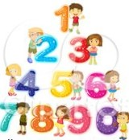
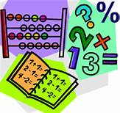
FUN WITH PATTERNS

Slide 3
CHAPTER TEXT BOOK LINK
FUN WITH PATTERN
https://drive.google.com/file/d/1-00O1Zl10fIQeuu251NibKN0qcmRae5e/view?usp=drivesdk

Slide 4
LEARNING OBJECTIVES
After the completion of chapter students will be able to
Identify pattern and understand the rule behind its construction.
Extend a pattern and also construct a new pattern using various objects.
Create patterns by using leaves ,vegetables , coins etc.
Understand the presence of pattern in day to day life.
Understand and construct simple patterns.

Slide 5
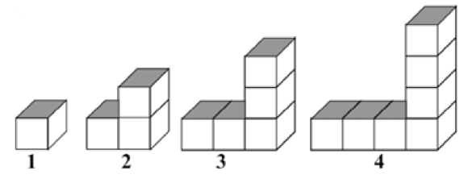
INTRODUCTION
A pattern is something that is arranged by rules.

Slide 6
ART INTEGRATION

Slide 7
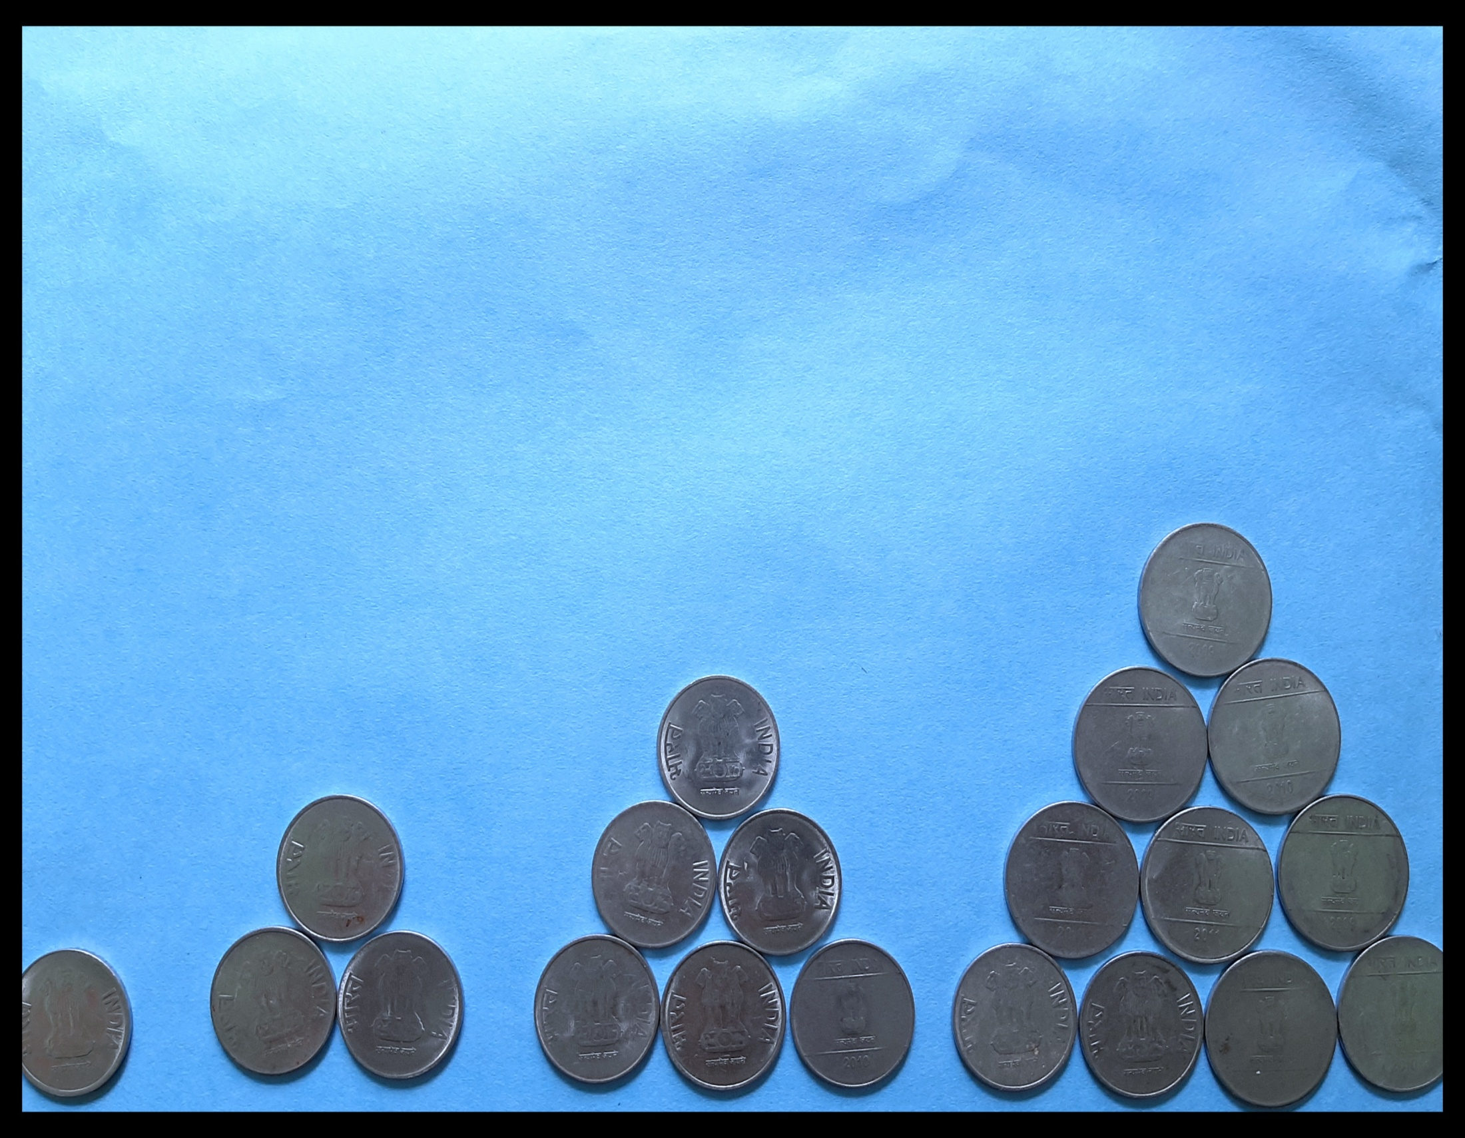

Slide 8
Explore your creativity by making some patterns with flowers, leaves or any daily used materials.

Slide 9
Magic Square Look at the number box , can you see any pattern ???
1 | 2 | 3
3 | 1 | 2
2 | 3 | 1
No number
comes twice
in one line

Slide 10
Worksheet - 1
Now you try to write the letters – A, B, C in the box so that no letter comes twice in any line.

Slide 11
Magic pattern
Look at the pattern of numbers 1 to 7 .
Each line adds up to 12.
2
3
7
4
1
5
6

Slide 12
Worksheet - 2
Now you fill these stars using numbers 1–9 in such a way that the numbers on each line adds up to 15.

Slide 13
Magic Triangle
Can you see any pattern in the triangle ???
Each side adds up to 9
3
4
5
2
6
1

Slide 14
Worksheet - 3
Put the below balls at their appropriate place such that sum of each side of the triangle will be 12.
5
2
1
3
7
4

Slide 15
.
EXAMPLE
Q- Put the number 1, 2,3,4,5,7 at their appropriate place such that sum of each side of the triangle will be 12. (3 marks)
5
(0.5 mark)
Ans -
1
3
(0.5 mark)
(0.5 mark
6
2
4
(0.5 mark)
(0.5 mark)
(0.5 mark)

Slide 16
Number Tower
Numbers can be arranged as a tower. We start from below and get this number pattern.
80
30
50
Can you see the rule for this pattern?
10
20
30
Rule: Consecutive 2 boxes are added to get the number in their above box.

Slide 17
Worksheet – 4
Using the number tower rule, complete it.
72
36
19
19
8
7
3
6
9

Slide 18
Number Patterns
Can you guess the pattern in the box.
1
3
5
7
9
11
13
1
2
3
3
2
5
1
2
Increased by 2
5
2
7

Slide 19
Worksheet - 5
Complete it following number patterns.
52
57
62
67
9
109
209
309
30
27
24
21

Slide 20
EXAMPLE
Q- Complete the number series 5, 10, 15, --------,------- (2 marks)
Ans – 20 (1 mark)
25 (1 mark)
Q- Complete the number pattern 1,3,5,7, --------,---------,------(3 Marks)
Ans – 9(1 mark)
11(1 mark)
13 (1 mark)

Slide 21
SECRET MESSAGE
I am trying to read the note my friend gave me but I can not understand it.
Hey! What are you doing ?
Ok, Let me see it looks like a secret message
7 15 15 4 9 7 8 20
Rule - Numbers have been used for letters. For example ‘J’ is 10 , ‘P’ is 16. So JUMP is 10 21 13 16

Slide 22
Worksheet – 6
Complete this list of letters and numbers to help you.
A | B | C | D
1 | 2 | 3 | 4
Chhota Bhim wants to write ‘ Good Morning ’ to his friend.
What will he write by using the same rule ???

Slide 23
TEASE YOUR BRAIN

Slide 24
Complete the following pattern
--------------,--------------
----------,------------,----------
69, 71,73,75, ------,------,------,------
What will you write ‘Let us dance’ in secret message ?

Slide 25
https://youtu.be/r1OK-OPGa0s
Patterns in art craft video.
Let’s form a pattern using circles and squares.
Watch the video

Slide 26
SUMMARY
A pattern is a series of objects or numbers which repeat in a pre- decided manner.
Patterns can be formed using shapes, numbers and letters of the alphabet.
Patterns can be deciphered in addition.
Coded secret messages also have a pattern in them.

Slide 27
CONCEPT MAP
MAGIC SQUARE(RULE- no number comes twice in any line)
SECRET MESSAGES (RULE - Numbers have been used for letters. For example ‘A’ is 1 , ‘P’ is 16
MAGIC PATTERN(RULE - the numbers on each line add up to a particular number
NUMBER PATTERN(RULE –the number series continue by increasing or decreasing of a particular number .
PATTERNS
NUMBER TOWERS(RULE -consecutive 2 boxes are added to get the number in their above box.
MAGIC TRIANGLE(RULE –numbers on each side must add up to a particular number

Slide 28
LEARNING OUTCOMES
Representing and explaining pattern .
Relating patterns to various geometrical shapes.
Relating addition and subtraction to patterns.
Relating patterns to alphabets

Slide 29
WORKSHEETS (BASIC) CLASS – IV
1. 2, 4, 6,8,10, -------------, -------------
2. 11, 22, 33, ---------------,--------------
3. 100,150,250,300, -------------, ------------.
4. 586, 686, 786, ----------,----------,---------
5. 52, 57, 62, 67, ----------, ----------,------------.
6. 100, 90, 80, 70, ------------, ----------, -----------
7. AA, BBB, AA----------, ----------, -----------, -------
8. 5,10,15 -------------,----------,----------
9.
----------------,----------------
10.
----------------,-----------------
11. Create your own patterns begins with
12. Create your patterns with

Slide 30
13. Give 3 examples where you can see different patterns.
14.
---------------,-----------------
15.
------------,---------
16.
---------------,----------------
17.
vv
vv
vv
vv
--------------,-----------------
18.1,3,5,7,9, ---------------,--------------,--------------
19.12,15,18,21, ------------------,---------------,-------------
20. 30,27,24,21 -------------------, -------------------, ------------
AB, DE, GH, -------------, ------------,--------
22. 14, 19, 24,29,--------------,--------------.
23. 3, 6, 9, 12, ------------------, -------------------
24. 20, 19, 18, 17, --------------------, -----------------.
25. 100,200,300,---------------,---------------,------------

Slide 31
26. In the below magic square each row, column and diagonal add up so that sum will be 15.
8 | 1
 | 5 | 7
4 |  | 2
27 .Complete the magic square with numbers A,B,C so that no number should Comes twice in any row or column.
A
 | A
 |  | A
28. Complete the magic square with numbers 1,2,3 so that no number should Comes twice in any row or column.
1
 |  | 2
 | 3

Slide 32
29. Six lollipops are arranged as given below. Write digits 1 to 7 in lollipops So that each row with 3 digits adds up to 12.
30. Put the missing number to complete the number tower.
10
20
30

Slide 33
WORKSHEET (STANDARD)
CLASS - IV
1.
---------------,--------------
2. 35, 40, 45, -----------------, -------------------
3. 386, 486, 586, ----------------, -------------
4. a1b, c2d, e3f, ---------------, -----------
5. 13, 26, 39, 52, ------------------, -----------------, ----------
6. AC, EF, HI, --------------, --------------
8,16,24,32 ----------, --------
ABC, DEF,----------------,---------------
9. ZYX, WVU, TSR, ------------, -------------
10. 1150, 1050, 950, ----------------, ------------
11. 1, 4,9,16, ------------, -------------,
12. 5, 10, 15, 20, --------------, --------------, -----------
13. 750, 650, 550, 450, -------------------, -------------, ------------
14. Write two examples from your environment where we can see different
Patterns.

Slide 34
15. Put the missing number to complete the series.1 , 4, 10 ,19,-------------,46,---------------
16.
------------------,-------------
17.
-----------------,----------------
18. Here is a magic square with number 11 to 19 , so that the sum of each row and column is 45.
14 |  | 12
 | 18

Slide 35
19. Complete the magic triangle so that sum of each side is equal to 10.
20. By using addition rule complete the pyramid
800
300
700
100
100
300
400

Slide 36
WORKSHEET (ADVANCED)
CLASS - IV
1. 2,7,9,3,8,11,4,9,13, ------------,10,15
2. 2, 3, 4,9,8,27,16, -------------
3. 21,23,27,33 ----------, --------
4. 5,7,12,6,8,14,7-----------,16,8,10,18
5.
C
C
---------------,----------------
C
6.
--------------,----------
7. Fill up the magic square so that sum of each line is 3.
0.7 |  | 0.9
1.1 |  | 1.3

Slide 37
8. What will you write 'Meet me on the moon' in secret message.
9. By using addition rule complete the pyramid.
72
c
36
c
19 19
c
c
8
7777777
vv
vv
7 3 6 9

Slide 38
.
10. Put the number 1, 2,3,4,5,7 at their appropriate place such that sum of each side of the triangle will be 12.

Slide 39
