Slide 1
SUBJECT-MATHEMATICS CLASS-IV TOPIC-PERIMETER

Slide 2
CHAPTER TEXT BOOK LINK PERIMETER https://s.docworkspace.com/d/AI66ZSbYhNxF4eP9_MadFA

Slide 3
LEARNING OBJECTIVES:
Students will be able to
Differentiate between closed and open figures.
Distinguish closed figures made up of line segments.
Understand the concept of perimeter.
Calculate perimeter of closed shapes made up of only line segments.
Calculate perimeter of rectangle and square using formula.
Apply the concept of perimeter in their daily life situations.

Slide 4
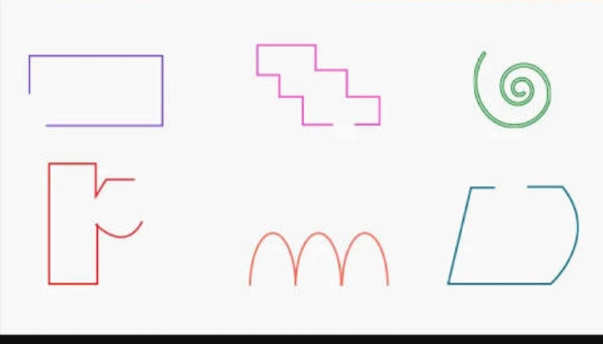
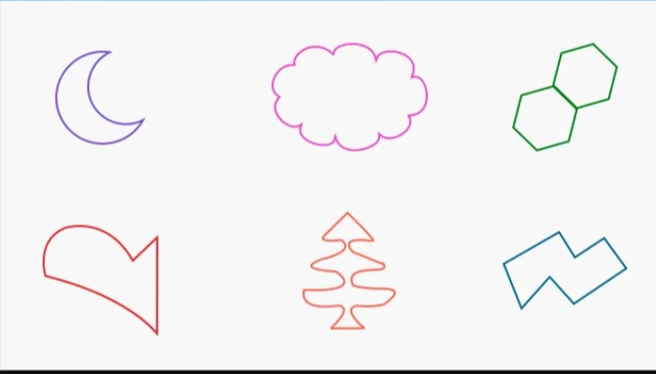
INTRODUCTION
Observe these figures
Can you tell the difference between these figures ?

Slide 5
In left side figures the starting point and ending point are different. These figures are called as Open Figures
Let’s sing !
Open figures are incomplete.
Scribble away figures on a sheet.
But the ends never meet.

Slide 6
In right side figures the starting point and ending point are same. These figures are called as Closed Figures.
Let’s sing !
Closed figures are all complete
Circles, triangles and many more on a sheet
Look close! All their ends meet.

Slide 7
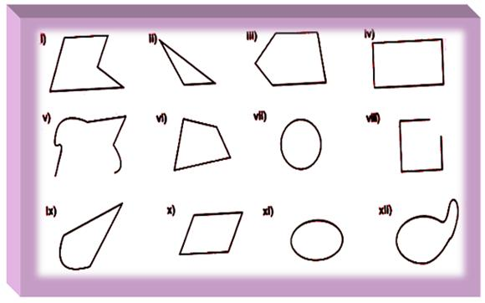
TICK THE CLOSED FIGURES

Slide 8
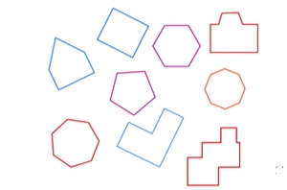
HERE ARE SOME CLOSED FIGURES MADE UP OF ONLY LINE SEGMENTS

Slide 9
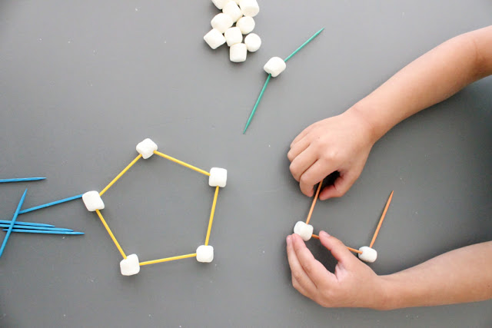
ART INTEGRATION ACTIVITY-1
Make closed figures of line segments using matchsticks / toothpicks/ice-cream sticks and play dough.

Slide 10
WHAT IS PERIMETER?
The length of boundary of a closed figure is called as its perimeter.
We add all the sides of a closed figure to get its perimeter.
WATCH THE VIDEO
https://www.youtube.com/watch?v=JAy_CETEyUM&t=11s

Slide 11
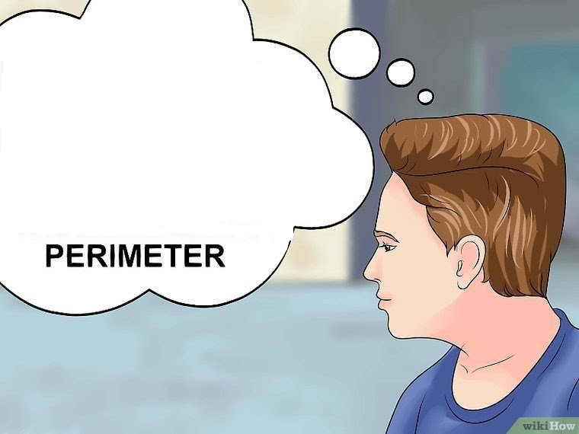
How will you find the length of boundary of this ludo board?
25cm
A
B
By adding all the sides
AB+BC+CD+DA
=25cm+25cm+25cm+25cm
=100cm
25cm
25cm
D
C
25cm
So, Perimeter of ludo board= 100cm

Slide 12
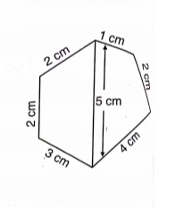
Perimeter = AB+BC+CD+DA =5cm+1cm+2cm+4cm =12cm
EXAMPLES
Perimeter
= 1cm+ 2cm+4cm+3cm+2cm+2cm
=14cm
(Why are you not adding 5cm? Think!)

Slide 13
Find the perimeter of the following figures:

Slide 14
ACTIVITY-2
SELF MADE VIDEO
https://www.youtube.com/watch?v=N2wiNh4b8kM&feature=youtu.be
Find the perimeter of
Your bedroom floor.
Top surface of your study table.
A photo frame.
A handkerchief.
Cover page of a story book.

Slide 15
WHAT IS A RECTANGLE?
A rectangle has
4 sides
4 right angles
4 corners
Opposite sides of a rectangle are equal

Slide 16
PERIMETER OF A RECTANGLE
Length (l)
Breadth (b)
Breadth (b)
Length (l)
Perimeter
= l+b+l+b
= l+l+b+b
=2×l+2×b

Slide 17
EXAMPLE
Q. Find the perimeter of the given figure. (2 marks)
Ans-Length=9cm
Breadth=5cm
Perimeter=2×l+2×b
=2×9cm+2×5cm (0.5 mark)
=18cm+10cm (0.5 mark)
=28cm (1 mark)

Slide 18
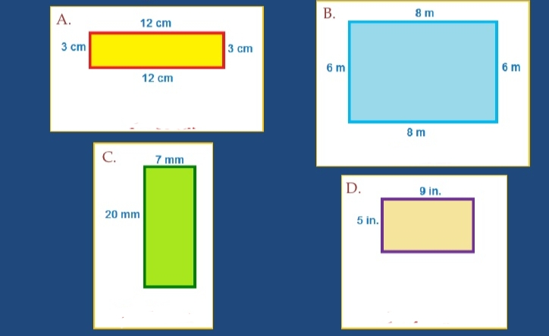
Find the perimeter of the following rectangles

Slide 19
WHAT IS A SQUARE?
A square has
4 sides
4 right angles
4 corners
All the sides of a square are equal

Slide 20
PERIMETER OF A SQUARE
Perimeter
= side+side+side+side
=4× side
Side
Side
Side
Ex- Find the perimeter of a square whose each side is 12cm.
Ans-
Side=12cm
Perimeter=4×side
=4×12cm
=48cm
Side

Slide 21
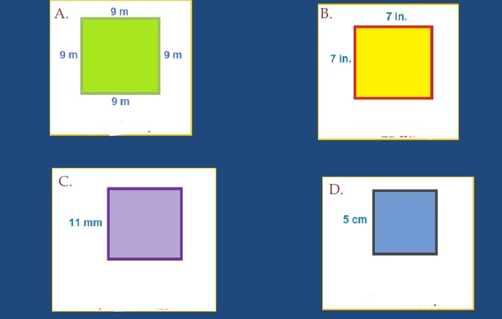
Find the perimeter of the following squares.

Slide 22
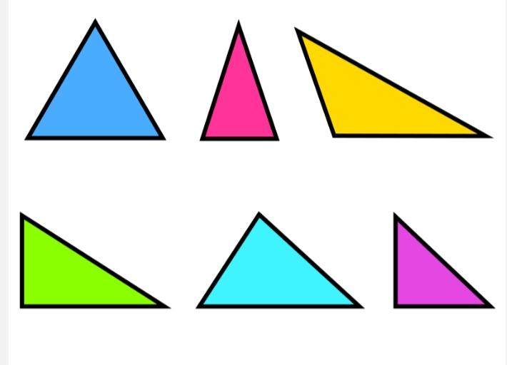
WHAT IS A TRIANGLE?
A triangle has
3 sides, 3 angles and 3 corners
Perimeter of a triangle:
All these triangles may not look similar but for finding perimeter of each one the rule is same.
Rule-
Perimeter of a triangle
= Sum of its 3 sides

Slide 23
Find the perimeter:
Perimeter of the triangle
= AB+BC+CA
=5cm+7cm+8cm
=20cm

Slide 24
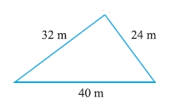
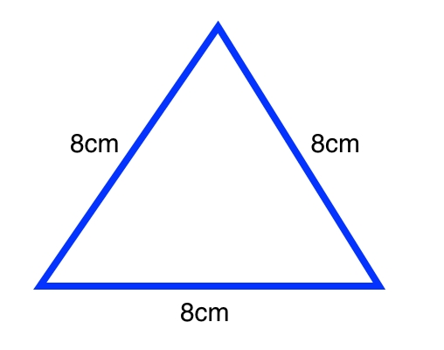
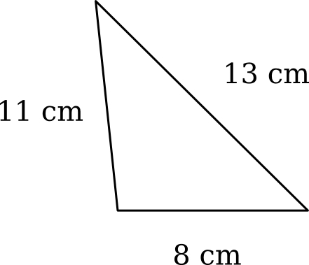
Find the perimeter of the following triangles.

Slide 25
WORD PROBLEMS
Ex-1: Mita has 155cm of lace. She wants to stitch it around the border of a square sized cloth. If each side of the cloth measures 37cm, find the length of lace left with her. (3 marks)
Ans- Length of lace Mita has = 155cm
Side of cloth = 37cm
Perimeter of cloth = 4×side (0.5 mark)
= 4×37cm (0.5 mark)
=148cm (1 mark)
Length of the cloth left with her = 155cm- 148cm = 7cm (1mark)
Therefore, 7cm of lace is left with her.

Slide 26
Ex-2 Rohan ran around a rectangular field of length 28 m and breadth 24m thrice. Find the total distance ran by him. (4 marks) Ans- Length of the field= 28m Breadth of the field=24m Perimeter= 2×l+2×b (0.5 mark) = 2×28m + 2×24m (0.5 mark) = 56m+ 48m (0.5 mark) =104m (1 mark) Total distance ran by him= 3× 104m = 312m (1.5mark) Therefore, the total distance ran by him is 312m.

Slide 27
ART INTEGRATION ACTIVITY-3
Materials required-
Square sheet/ graph paper and drawing materials( pencil, eraser, color etc)
Steps-
Draw a figure of your own choice on a square sheet using the horizontal and vertical lines.
Count the side of each square of the border lines as 1 unit to get the perimeter of the figure.

Slide 28
Let’s play a game:

Slide 29
Perimeter=2×l + 2×b
= 2×10m + 2×5m
=20m + 10m = 30m

Slide 31
LIVE EXAMPLES RELATED TO THE CONCEPT
Frame required for framing a photo.
Stitching lace around a saree.
Fencing a Vegetable field with wire.
Decorating a chart paper by putting colorful cello tape around it.
The distance covered after running 1 round around a park.
Putting tiles around a swimming pool.
Fitting door and window into door and window frames.
Putting yarn around the border of a greeting card.
WATCH THE VIDEO
https://www.youtube.com/watch?v=efTBMoAav9o

Slide 32
LEARNING OUTCOMES
After completion of the chapter students
Can calculate the perimeter of rectangle, square, triangle and other closed shapes made up of line segments.
Can solve the word problems related to perimeter.
Can relate the concept of perimeter in their daily life situations.
Can apply the concept of perimeter in their day today life activities.

Slide 33
CONCEPT MAP:
P
We can find perimeter of a closed figure made up of only line segments by adding its sides.
Perimeter of a rectangle
=2×l+2×b
Perimeter
We apply the concept of perimeter in many real world uses.
Perimeter of a square= 4×side
Perimeter of a triangle is sum of it’s three sides.

Slide 34
THANK YOU

