Slide 1
SUBJECT-MATHEMATICS
CLASS-IV
TOPIC-CAPACITY

Slide 2
CHAPTER TEXT BOOK LINK
CHAPTER-CAPACITY
https://drive.google.com/file/d/1a5OehyvnERsPzuvEkFw8moMEjUcaevI7/view?usp=drivesdk

Slide 3
LEARNING OBJECTIVE
Students will be able to compare the capacity of different containers based on the containers attributes.
Converting ‘litres’ into ‘Millilitres’ and vice versa.
Recognising the different units of capacity such as litres, Millilitres and Killolitres.
Understanding the conversion of units for solving word problems.
Applying the concept of capacity in real life problems.

Slide 4
Introduction-Capacity

Slide 5
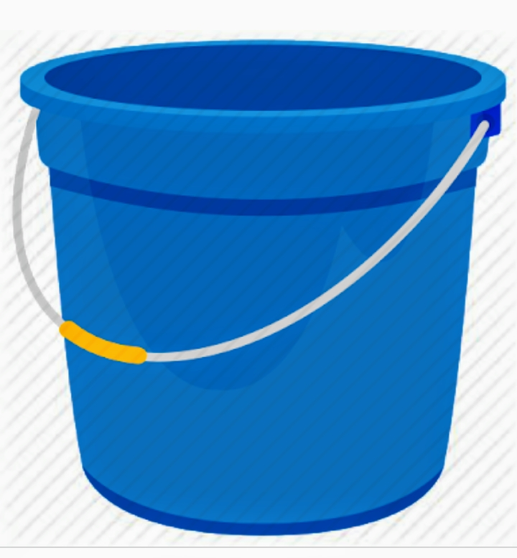
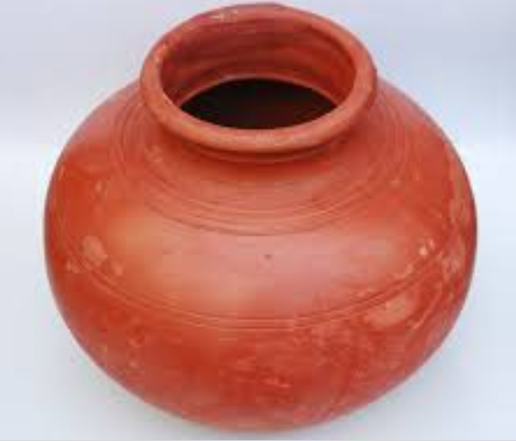
Introduction
Students ,look at these objects
All these objects has an ability to contain some substance.

Slide 6
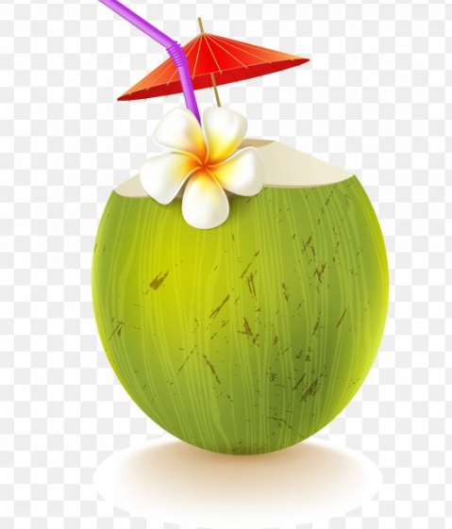
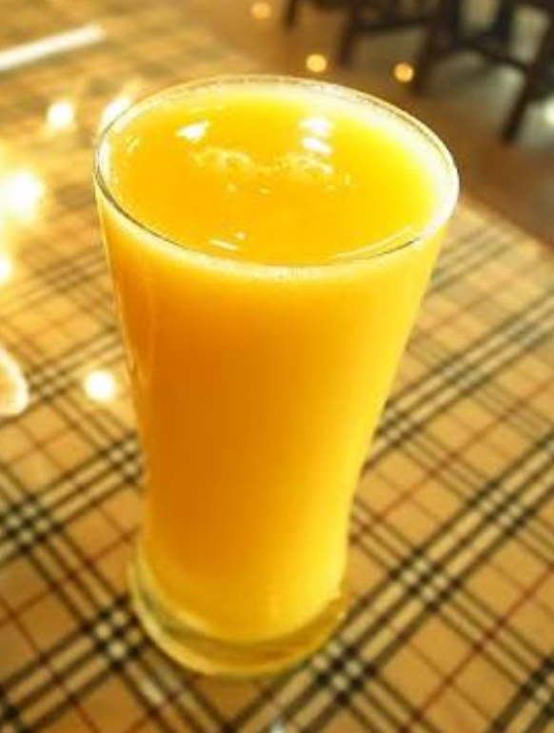
Now you can answer
1. Which of the following objects can hold more ?
OR
Glass
Coconut

Slide 7
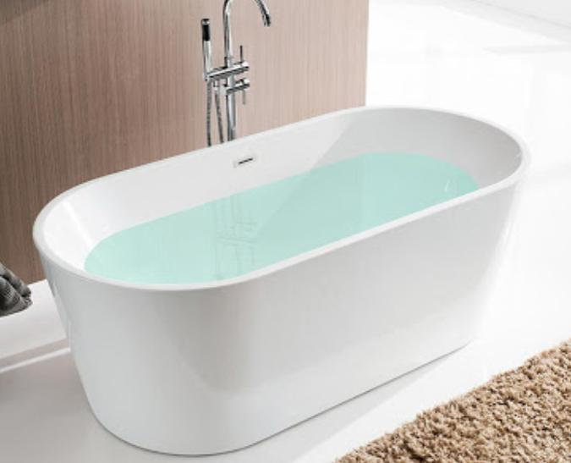
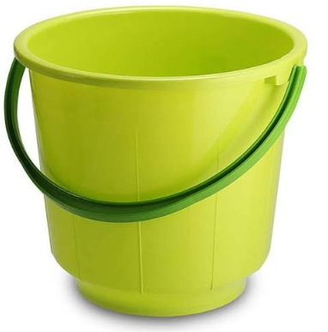
Now you can answer
2.Which of the following objects can hold more ?
OR
Bucket
Bathtub

Slide 8
In No-1, the coconut can hold more than the glass. So the Coconut has more Capacity than the glass.
In No-2, the bathtub can contain more water than the bucket.
So the bathtub has more capacity than the bucket.
What is capacity?
The amount that a container can hold

Slide 9
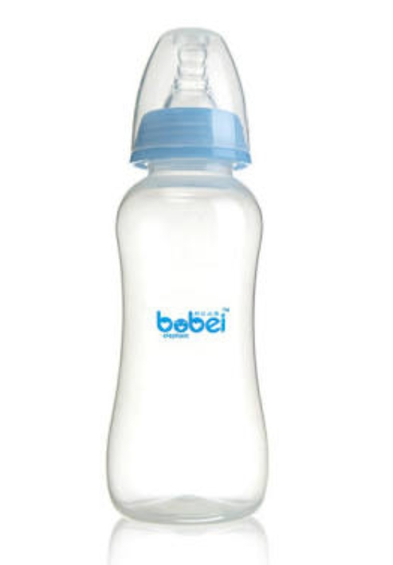
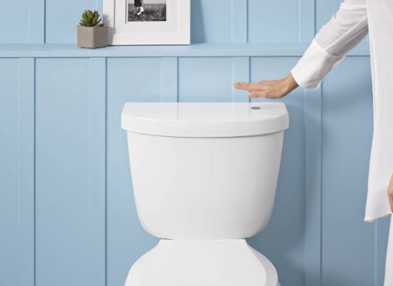
Introduction - capacity
Millilitres and Litres!
1000ml=1 L
That is one thousand tea spoon of water
Equals to a whole jug which is 1 litre.
Examples of capacity amounts:
Cup of water=250 ml
Standard milk bottle=1 litre
Shower = 5 litres a minute
Flushing the toilet=12 litre of water
Bath =140 litres of water
CAPACITY IS MEASURED IN

Slide 10
Video on Capacity-An introduction
https://youtu.be/QMpkm4dAB4w

Slide 11
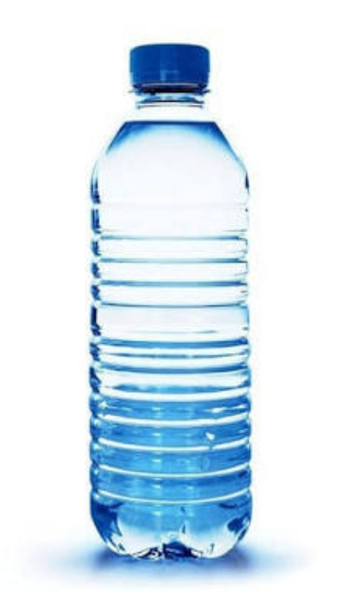
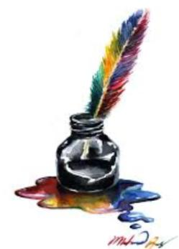
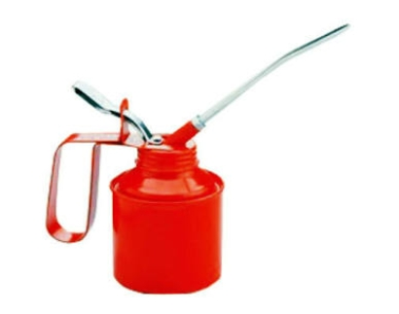
Questions
Which unit will you choose to express the following.
A. Water in a water bottle.
B. Ink in an ink pot.
C. Oil in a can.
2. Fill in the blanks.
A. The standard unit of capacity is _________.
B. 1 Kilolitre=________litre.
C. The biggest unit of capacity is__________.

Slide 12
Converting bigger unit into smaller unit.
Converting liters into Millilitres.
Example-1 : Convert 9 litres into Millilitres
Ans: 9 litres
=9 X 1000 ml. ( 1 litre= 1000 Millilitres)
= 9000 ml.
Example-2: Convert 25 litres into Millilitres.
Ans: 25 litres
. =25 X 1000 ml
=25000 ml
When we are converting litres into Millilitres. We multiply the number of litres by 1000 to convert “litres” into “Millilitres”

Slide 13
Converting litres and Millilitres into Millilitres
Example-1: Convert 7L 750 ml Into Millilitres.
Ans: 7L 750 ml
=7000 ml 750 ml
=(7000+750)ml
=7750 ml.
Example-2 Convert 52L 600ml into Millilitres.
Ans:52L 600 ml
=52000ml 600 ml
=(52000+600)ml
=52600 ml
When we are Converting litres and Millilitres into Millilitres.convert the number of “litres” into “Millilitres” and add to it the number of Millilitres.

Slide 14
QUESTIONS
1.Convert the following into Millilitres.
a. 8 litres.
b.325 liters.
c. 2L 675ml
d.543L 8706ml.
2. State “true” or “false”.
a.150 L = 1500 ml (T/F)
b.7L 25ml=7025ml (T/F)
c.34L 6504ml= 40504 ml (T/F)
1 litre=1000 ml

Slide 15
Converting smaller unit into bigger unit
Converting Millilitres into Litres
Example-1 : convert 8000ml into litres.
Ans:8000ml
=8000 ÷1000 litres
=8 Litres.
Example-2: Convert 53000 ml into litres
Ans:53000ml
=53000 ÷1000 litres
=53Litres.
Q. how to convert?
Ans. Divide the number of Millilitres by 1000 to convert the “Millilitres” into litres

Slide 16
Converting Millilitres into Litres and Millilitres.
Example-1: convert 5678 Millilitres into litres
Q. How to convert?
Ans: -Split 5678 ml into 5000ml and 678ml
- Divide 5000ml by 1000ml and convert this into litres.
=5678ml
=5000ml+678ml
=5000÷1000 L + 678 ml
=5L 678ml

Slide 17
Questions
Convert the following into litres and Millilitres.
a.5000 ml.
b. 123000 ml.
c. 5670 ml.
d. 91776 ml.
2. Compare using <,> and =
a.5678ml______5789ml.
b.3420ml______3L 400ml.
c. 5630ml______4L 1630ml.
The standard unit of capacity is litre.
The biggest unit of capacity is Killolitre.
1 Killolitre= 1000 litres.

Slide 18
Addition of capacity By regrouping.
Example1: Add 63L 473ml and 35L 275 ml.
Ans: L. ml
63 472
+ 35 275
98L. 747 ml
Procedure: First add Millilitres with Millilitres.if result is more than thousand,then that thousand place will go to Litre column.Add litres to find the sum.

Slide 19
subtraction of capacity By regrouping
Example-1: Find the difference between 29L 635ml and 23L 824ml.
Ans: L ml L. ml
28 28 1635
29 635 - 23 824
- 23 824 5L 791 ml
Here we can not Subtract 824 ml from 635 ml. Letus borrow 1 litre from the litre column.

Slide 20
Questions
1. Add the following
a. 12L 78ml and 39L 857ml
b. 40L 6ml,83L 62ml and 33L 231ml.
2.Find the difference.
a. 7L 364ml and 4L 274ml
b.257L 750ml and 114L 895ml

Slide 21
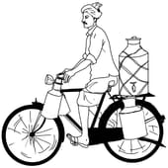
Word problem
Q1: Three milkmen are separately carrying 36L 250ml, 58L 396ml
and 66L 324 ml of milk on their containers. Find out what is the total quantity of milk with them.
Ans.Here, we will add all the quantities to get the total quantity.
First milkman carrying = 36L 250ml
Second milkman carrying= 58L 396ml +
Third milkman carrying = 66L 324 ml
Total Quantity= 160 L 970ml
So 160L 970ml is the total quantity of milk with them.

Slide 22
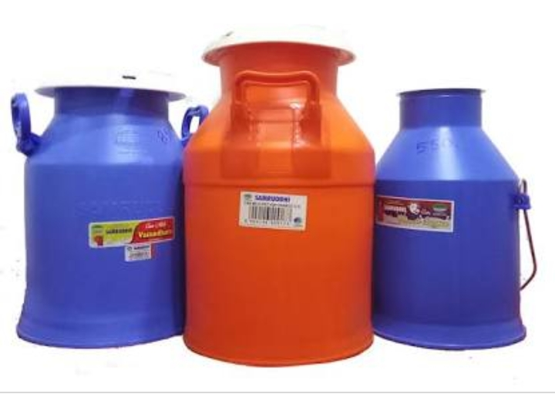
Word problem
2. A can holds 15 l and 500 ml of milk. Out of it 8 l and 350 ml milk is consumed. How much milk is left in the can now?
Solution:
Quantity of milk in the can = 15 L 500 ml
Quantity of milk consumed = 8 L 350 ml
Quantity of milk left = 15 L 500 ml – 8 L 350 ml.
Thus 15 L 500 ml
- 8 L 350 ml
7 L 150 ml
Therefore, quantity of milk left = 7 L 150 ml

Slide 23
Questions
Word problem:
1.Raju mixes 2L 750ml of cow’s milk in 1L 5ml of buffalow’s milk. How much milk did Raju have in all?
2.Swastik‘s bucket holds 9L 350ml of water and Abhilasha‘s bucket holds 12L 875ml of water. Whose bucket holds more and how much?
3.A barrel can hold 29L 66ml of oil.14L 78ml oil was taken out. What is the remaining quantiy of oil in the barrel?

Slide 24
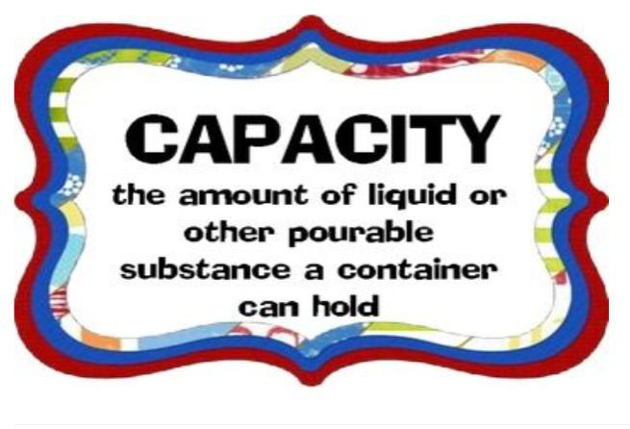
Capacity in art and craft-videos
SELF-MADE VIDEO
https://youtu.be/ylDD9xT1MZo

Slide 25
Summary
The standard unit of capacity is litre.
1 Litre= 1000ml
The biggest unit of capacity is Killolitre.
1 Killolitre= 1000 litres.
Multiply the number of litres by 1000 to convert litres into Millilitres.
Divide the number of Millilitres by 1000 to convert the “Millilitres” into litres.

Slide 26
LEARNING OUTCOMES
Students Can compare the capacity of different containers based on the containers attributes.
Students can Convert ‘litres’ into ‘Millilitres’ and vice versa.
Students can Recognise the different units of capacity such as litres, Millilitres and Killolitres.
Students can solve word problems related to capacity.
Sudents can solve real life problems related to capacity.

Slide 27
Mind map

Slide 28
Basic worksheet
Fill in the blanks.
1.The standard unit of capacity is -----------
2.5L 200ml=---------- ml.
3.The ink of a pen is measured in ---------.
4.The Biggest unit of capacity is ----------.
5.15L+2L 500ml+2L= ----------.
6.1 Kilolitre--------Litres.
7.5L200ml+------=5L200ml.
8.5003ml=------L-----ml.
9.------+5L 786ml=15L 800ml.
10. Water in a water bottle measured in ____.
Convert the following into litres and Millilitres.
11) 5000 ml=_______Litres.
12) 123000 ml=______ Litres.
13)34068ml=_______ Litres.
14) 5670 ml=______L and ____ml.

Slide 29
15) 91776 ml=______L and ____ml.
Compare using <,> and =
16)5678ml______5789ml.
17)3420ml______3L 400ml.
18) 5630ml______4L 1630ml.
Choose the correct option.
19. $\frac{1}{5}$ Litre=-------ml.
(A) 250 ml (B) 200 ml (C) 350 ml (D) 500 ml
20. 1720L 5ml equals to ------ ml.
(A) 1725ml (B) 172005ml (C) 172500ml (D) 172050ml.
21. 2$\frac{1}{4}$ Litre=-------ml
(A)2150ml. (B) 2250ml. (C) 2350ml. (D) 2450ml.
22. 5L 200ml +2L 200ml -7L400ml=---------.
(A) 0 ml (B) 7L 400ml (C) 8L 800ml (D) 14L 800ml.

Slide 30
Answer the following questions.
23.Find the sum of 4L300ml,6L900ml and 104 L99ml.
24. Find the difference of 89L361ml and 320L 372ml.
25.A shopkeeper sold 20L 530ml of oil on first day,39L 400ml on the second day.What is the total quantity sold on two days.
26.Subtract 25L 250 ml from the sum of 50L895ml and 250L 895ml and 250L 396ml.
27.There was 500L750ml of water in a tank. The family used 100L 790ml of water for daily activities. How much water is left in the tank?
28. Convert into litres and Millilitres
A.14099 ml.
B. 334326 ml.
Long answer type question.
29.A gas station had 3700 litres of petrol. First day it sold 1200L650 ml and second day it sold 981L 230ml. On third day how much petrol is available in the gas station?
30.Sillu’s bottle holds 2L 250ml of water and milu's bottle holds 1L 500ml of water. Whose bottle holds more water and by how much?

Slide 31
Standard Worksheet
Fill in the blanks.
1.One quarter of 1L is------- ml.
2.--------500ml bottles contains 2L milk.
3.The medicine syrup is measured in----------.
4.---------- Litres of oil is present in 3 Kilolitre of oil jam.
5. 4 L 400ml +400 ml +2L=--------.
6.____ml of ink is present in 1L ink pot.
7.5L 5430ml+3L300ml=_____.
8.34L5640ml=_____ml.
Choose the correct option.
9. $\frac{4}{5}$ of 2000L=------Litres.
(A)1600ml. (B) 1600L (C)1006L (D) 1600ml.
10. 250632ml=---------.
(A) 250L632ml (B)2506L 32ml. (C) 25L632ml (D) None.
11. Oil is measured in---------
(A) Kilograms (B) Litres ( C) metres (D) gram.

Slide 32
Answer the following questions.
12. Subtract 18 L200ml from the sum of 20L 500 ml and 200L.
13. Subtract the sum of 5L 465ml and 7L 563ml from 32L768ml.
14. Convert these into L and ml and add 536003ml and 25632ml.
15. John bought 42L 750 ml mustard oil,62 L olive oil and 25 L 200ml sunflower oil. How much total capacity of oil did he buy.
Long answer type question.
16.The capacity of a drum is 200 litres. It contains 132 litres of water. How much much more water is required to fill it?
17.Among 40 Students,20 litres of juice was distributed.How much juice did each student get.
18.Raju mixes 2L 750ml of cow’s milk in 1L 5ml of buffalow’s milk. How much milk did Raju have in all?
19.Swastik‘s bucket holds 9L 350ml of water and Abhilasha‘s bucket holds 12L 875ml of water. Whose bucket holds more and how much?
20.A barrel can hold 29L 66ml of oil.14L 78ml oil was taken out. What is the remaining quantiy of oil in the barrel?

Slide 33
Advance Worksheet
Fill in the blanks.
1. $\frac{2}{5}$of 2L+$\frac{5}{2}$ of 2L=----------.
2.A jar contains 1200ml of milk. So in the jar ------L and -------ml of milk is present.
3.200 ml=------of a litre.
4. $\frac{3}{4}$ of 20L=--------ml.
Choose the correct option.
5. How many 100ml measures of oil will fill the 5 L vessel ?
(A)50. (B) 5 (C)10. (D)500.
6. The cost 2L milk is Rs 64. What is the cost 200 ml milk ?
(A) Rs 7.40 (B)Rs 5.40 (C) Rs 8.45. (D) Rs 6.40.
Answer the following questions.
7.One water bottle can carry 5L122ml. How much water 12 such bottles can carry ?
8. Solve this.
(2x35L130 ml) +85L 240 ml -20L 5ml.
9. 10 litres milk cost is Rs. 300. What is the price of 15000ml of milk?
Long answer type question.
10. 3 drums holds 255 litre 750ml of water. How many litres 9 similar drums will hold?

