Slide 1
MATHEMATICS-CLASS=IV
TOPIC -AREA

Slide 2
AREA CHAPTER LINK https://s.docworkspace.com/d/AD16npaW-05G4eeipcedFA

Slide 3
LEARNING OBJECTIVES
know the measurement of things.
Enhance the thinking and reasoning power.
Develop interest in the subject.
Able to distinguish between perimeter and area.
Able to define area.
to list the formulas for finding area of different rectangles.
apply formula to calculate the area of any given rectangle or square.
Solve problems relating to the areas of rectangles and squares easily.
Distinguish whether to find perimeter or area in the word problems.

Slide 4
INTRODUCTION
Introduction of the topic can be done by asking the students to do Activity-1 (Tear and Paste).
This activity will make the students interested to know about the topic Area by a play way method.
Art Integration is also applied by this activity.
Materials required: Plain Chart Paper, colour papers or colour magazine, glue and sketch pens.
Objective : Covering the area and understanding the concept of area before calculating it.
Procedure : 1. Each student will tear different colour papers and paste them on the whole sheet, it implies that the child is covering the whole area by colour papers.
2. Each student can be asked to draw any drawing and fill them with different colour papers to colour their drawing instead of painting it.

Slide 5
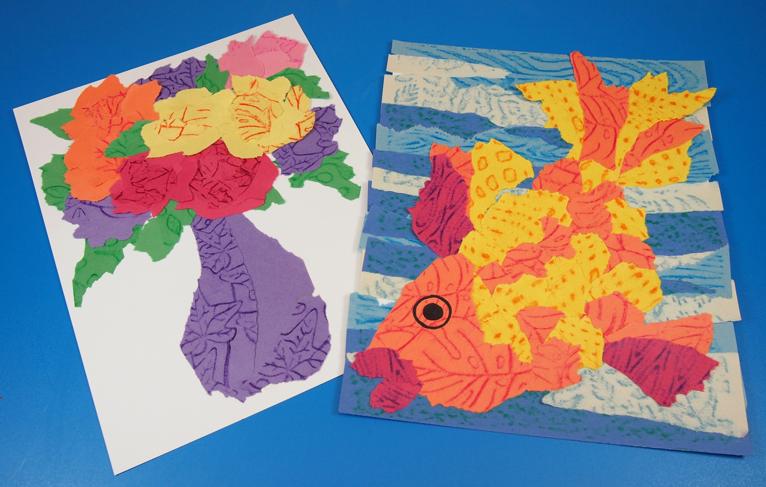
ACTIVITY – 1 (TEAR AND PASTE )
1. Tear and paste different colour papers to fill the area of a plain paper.
2. Tear and paste different colour papers to draw any object.

Slide 6
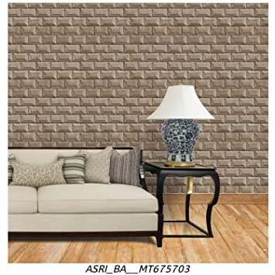
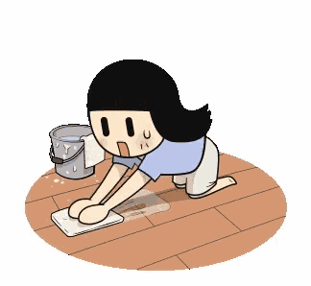
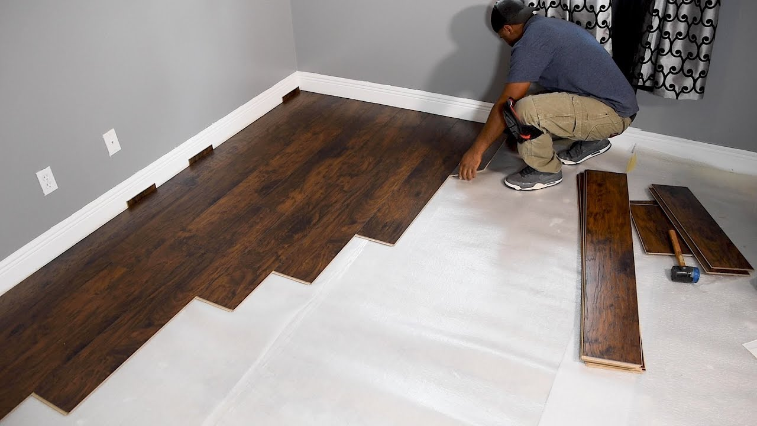
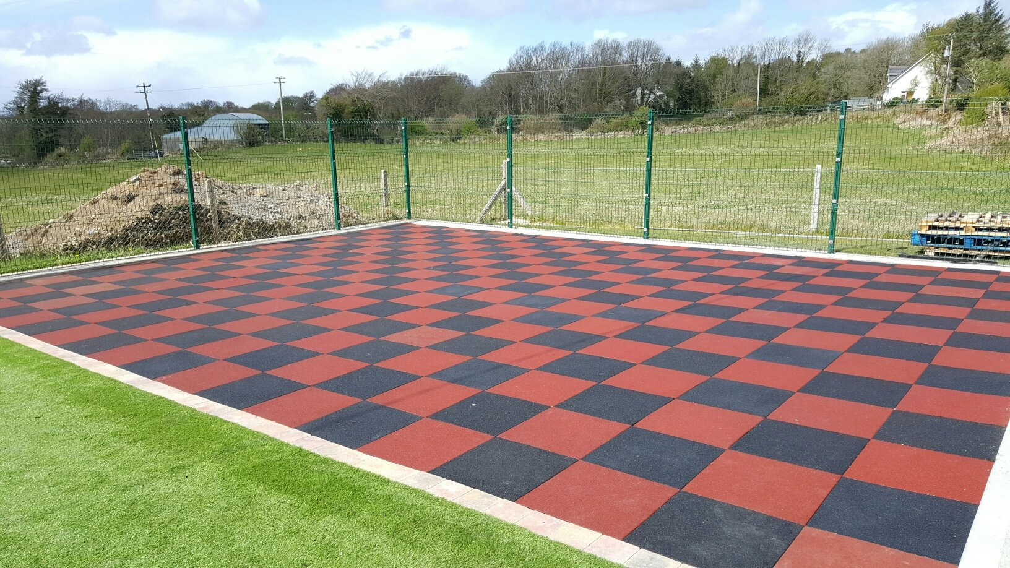
LIVE EXAMPLES
PAINTING THE WALLS
TILIING OF FLOORS AND WALLS
CLEANING OF FLOOR

Slide 7
PREVIOUS KNOWLEDGE
Identify the shapes of the geometrical figures.
2. Measure the sides of the following figure :-
3. Measure the length and breadth of the following figure :-

Slide 8
4. Tick ( ) the figure which has larger surface.

Slide 9
DEFINITION OF AREA
Area is the measure of surface enclosed
by a closed figure.
OR
The area can also be defined as the space occupied by a flat shape or the surface of an object.

Slide 10
ACTIVITY TO FIND THE AREA OF CARDBOARD
Use of coins
Let us place ten rupee coins to cover the area of the cardboard.
We can see 8 coins are used but still we could not completely cover it.
We can see the left out areas between the coins.
So, this is not the accurate area.
Use of square tiles
Let us now place the square tiles on the same cardboard.
We can see we have used 8 square tiles .
We can see no area is left between the tiles.
So, we choose Square as the best unit for measuring area.

Slide 11
Count the number of squares in each figure to find the area in square units :-

Slide 12
NAME ACTIVITY Students will be asked to write their names on a square paper and colour it. Then they will count how many squares they have used to write their names. They shall enjoy doing this and will be able to count the squares to find area of any given shape.

Slide 13
UNITS OF AREA
To find the area of a figure let us use squares having each side equal to 1 centimetre (1 cm ).
The units to measure area are :-
Square millimetre ( sq.mm)
Square centimetre ( sq. cm)
Square metre (sq. m)
Square kilometre ( sq. km)

Slide 14
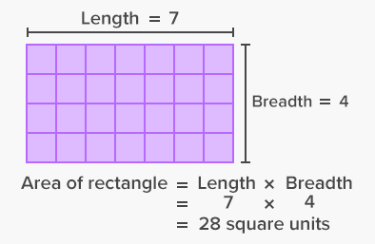
AREA OF A RECTANGLE
Here is a rectangle whose length is 7 units and breadth is 4 units.
Let us divide the rectangle into squares.
There are 7 columns of 4 squares each.
Total number of columns = 7
In one column, there are 4 squares.
In order to find the area of a rectangle , we can also multiply
Number of columns x Number of squares in each column
= 7 x 4 squares
= 28 squares
= 28 sq. units
Area of a Rectangle = Length x Breadth

Slide 15
Example 1: Find the area of a rectangle whose length and breadth are 12 cm and 4 cm respectively.
Solution :-
Length of rectangle = 12 cm
Breadth of rectangle = 4 cm
Area of rectangle = Length x Breadth
= 12 cm x 4 cm
= 48 square cm
= 48 sq. cm

Slide 16
WORD PROBLEM Example 2: A rectangular field whose length is 20 m and breadth is 15 m is to be irrigated. Find the area to be irrigated.
Solution :-
Length of rectangular field = 20 m
Breadth of rectangular field = 15 m
Area of rectangle = Length x Breadth
= 20 m x 15 m
= 300 square m
= 300 sq. m
Therefore, the total area of the rectangular field to be irrigated is 300 sq. m.
B = 15 m
L = 20 m

Slide 17
AREA OF A SQUARE
Here is a square whose length and breadth are same.
Let us divide the square into squares.
There are 3 columns of 3 squares each.
Total number of columns = 3
In one column, there are 3 squares.
In order to find the area of a square, we can also multiply
Number of columns x Number of squares in each column
= 3 x 3 squares
= 9 squares
= 9 sq. Units
Area of a Square = Side x Side

Slide 18
Example 3: Find the area of a square whose sides are 9 m.
Solution :-
Side of square = 9 m
Area of Square = Side x Side
= 9 m x 9 m
= 81 square m
= 81 sq. m

Slide 19
WORD PROBLEM Example 4: An wooden board is to be painted. If one side is 40 cm, find the area to be painted.
Solution :-
Side of the wooden board = 40 cm
Area of square = Side x Side
= 40 cm x 40 cm
= 1600 square cm
= 1600 sq. cm
Therefore, the total area of the wooden board to be painted is 1600 sq. cm.
S = 40 cm
S = 40 cm

Slide 20
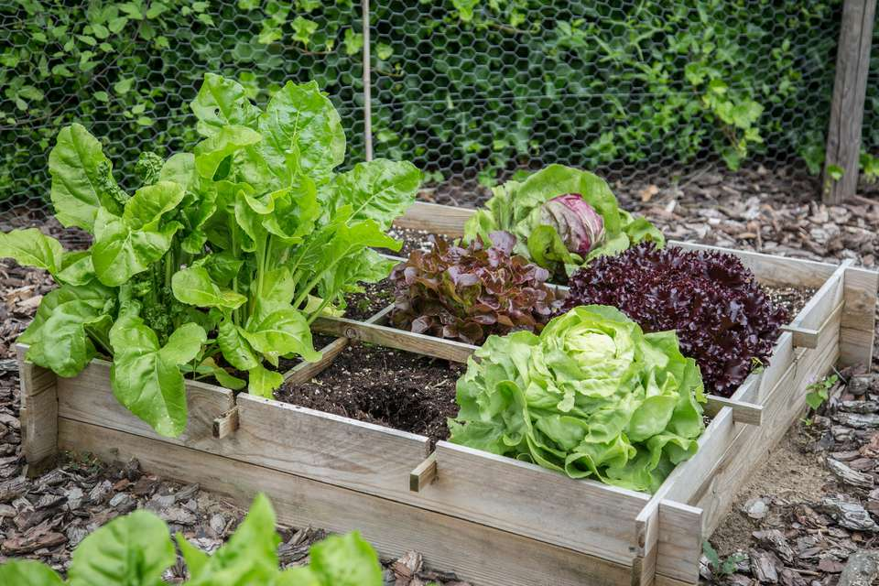
LET’S SING !!
To plant vegetables in the garden backside,
Find the area of the field – the whole of inside.
Multiply its length with how much it is wide,
And, that’s the area formula, you have applied !!

Slide 21
HOTS EXAMPLE : A floor is 5 m long and 4 m wide. A square carpet of sides 3 m is laid on the floor. Find the area of the floor that is not carpeted.
SOLUTION : Area of floor that is not carpeted
= Area of rectangular floor – Area of square carpet
Rectangular floor
Length of floor = l = 5 m
Breadth of floor = b = 4 m
Area of floor = l x b
= 5 x 4
= 20 sq. m
Square carpet
Side of carpet = 3 m
Area of carpet = s x s
= 3 x 3
= 9 sq. M
So, Area of the floor that is not carpeted = 20 sq. m – 9 sq. m
= 11 sq. m

Slide 22
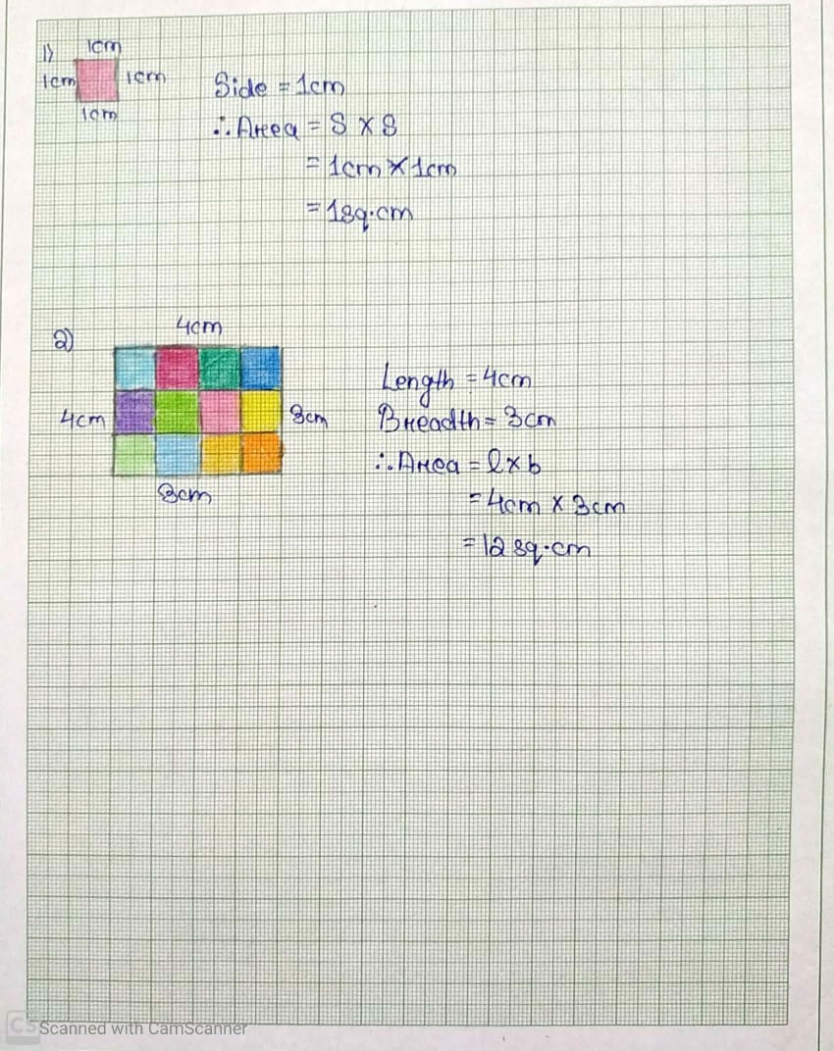
Use of Graph Paper to find the area.

Slide 23
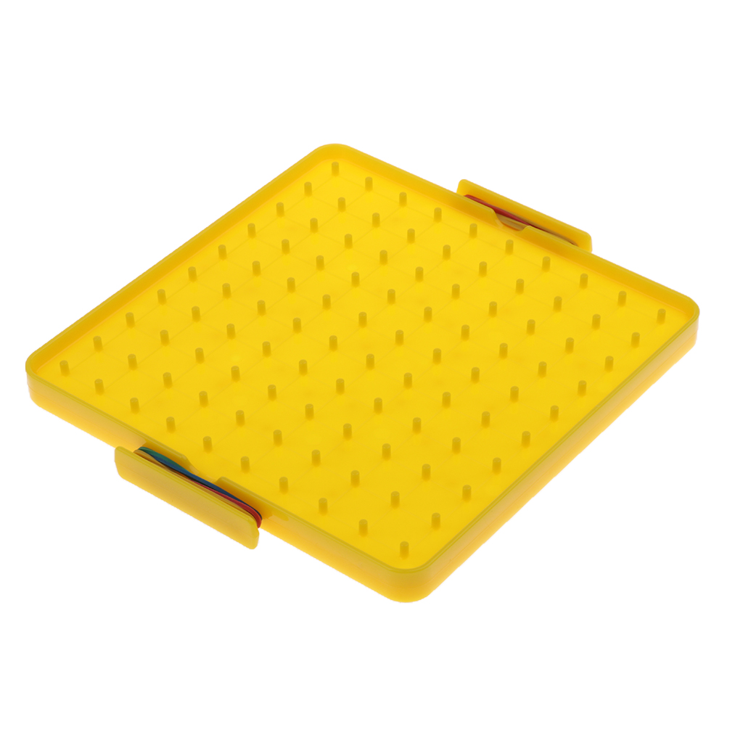
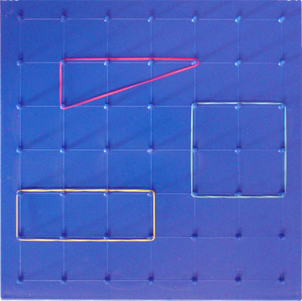
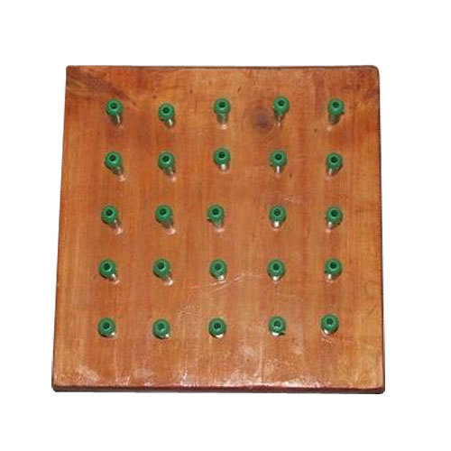
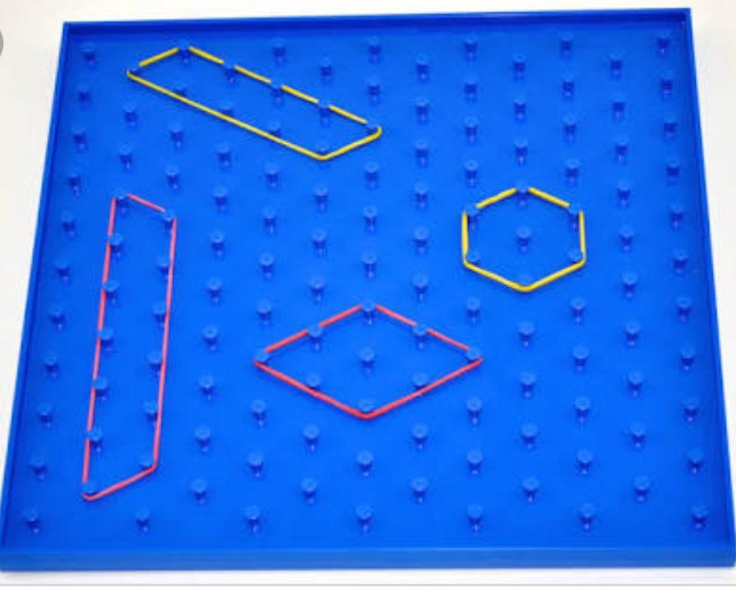
Geo Board
Geo board was invented by the Egyptian Mathematician and Pedagogist Caleb Gattegno (1911-1988).
A geo board is a very useful device for introducing different topics related to geometry. It enhances the method of teaching through Art Integration.
It is used to form different shapes to understand basic concepts of plane geometry such as shapes, perimeter, area etc.
It consists of a physical board made up of wood or acrylic with a certain number of nails half driven in, around which are wrapped geo bands that are made of rubber.

Slide 24
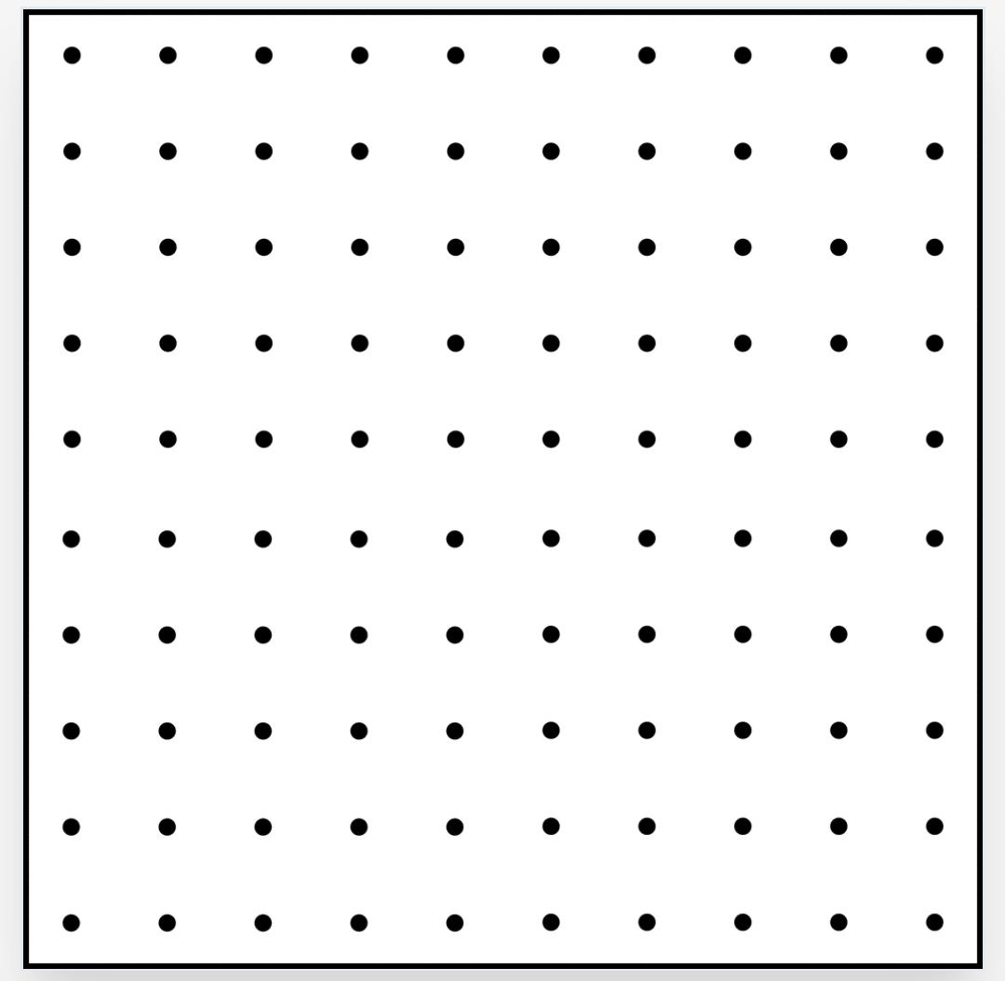
Finding the area of a square by using geo board.
Area of square = Side x Side
= 4 units x 4 units
= 16 square units
= 16 sq. units
4 units
4 units

Slide 25
Finding the area of a rectangle by using geo board.
Area of Rectangle = Length x Breadth
= 6 units x 4 units
= 24 square units
= 24 sq. units
6 units
4 units

Slide 26
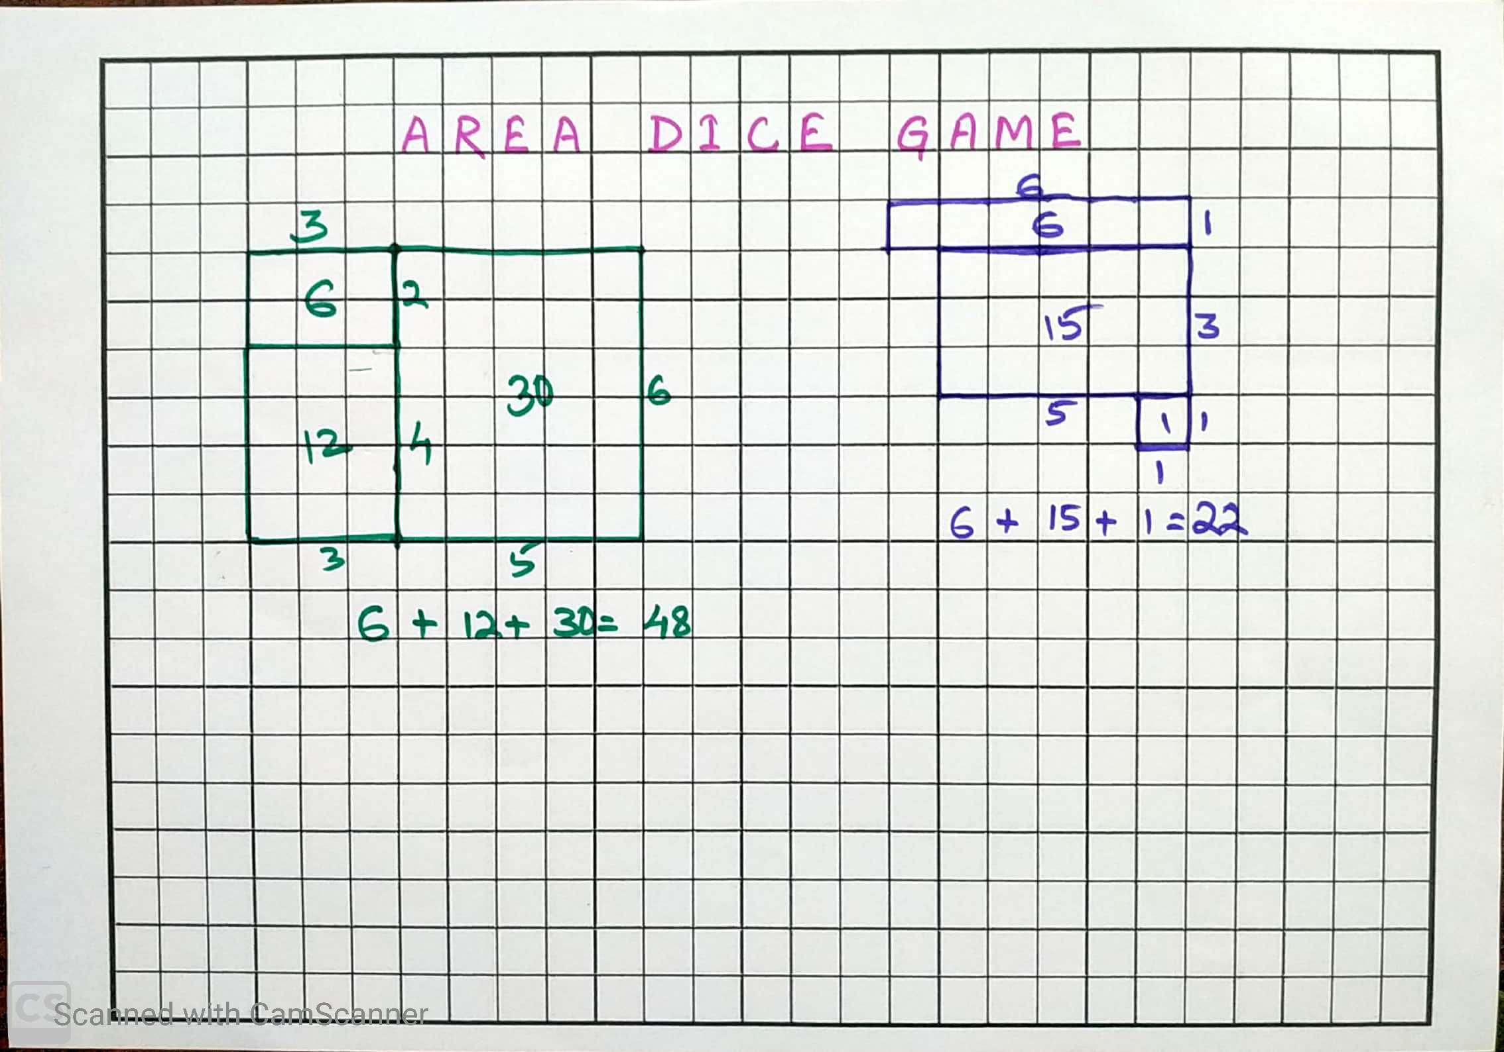
ACTIVITY AREA DICE GAME
https://youtu.be/QaYJzFOHEhg
Materials required : two colour pens,
a square paper
and two dices
Procedure : Two students can play by choosing
a different colour pen for each.
They shall roll the dices and then with the
two numbers on dices they shall draw
the figure by counting the squares.
After 3 chances each the total area
will be calculated and the once
having more area will be the winner
of the game.

Slide 27
LEARNING OUTCOMES
Students can calculate the area of rectangles and squares.
They can determine the area of any rectangular shapes.
They can solve the word problems related to find the area.
They can also distinguish whether to find perimeter or area in the word problems.
They can relate the concept of area to the real life situations.
They can decide which units to be used to measure area such as Square millimetre ( sq.mm), Square centimetre ( sq. cm), etc.

Slide 29
AREA WORD WALL
Measurement
Squares
Sides
Rectangles
Length
Closed figure
Breadth
Area
Shaded parts
Square Units

Slide 30
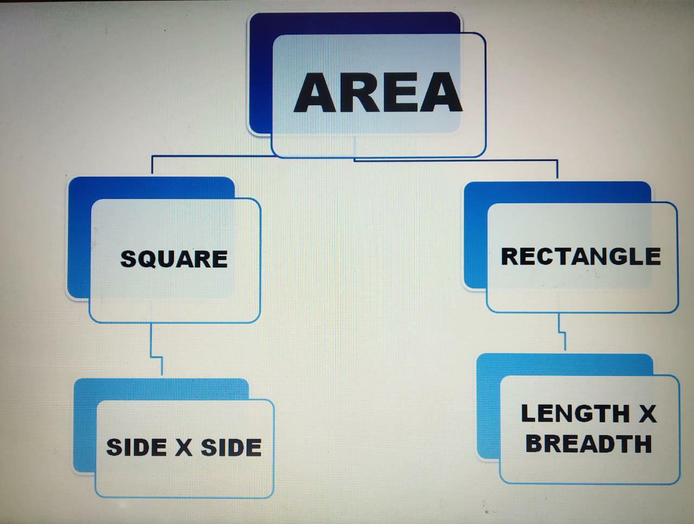
MIND MAPPING OF AREA

Slide 31
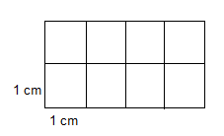
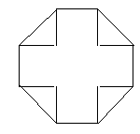
BASIC LEVEL
Section – A
(Each Question carries 1 marks)
Fill in the blanks.
1. A _____________ is the best unit to measure the area.
2. Length is multiplied with ___________ to get the area of a rectangle.
3. Area of a square having one side equal to 1 mm is ________.
4. Area of a field having length 8 m and breadth 5 m is _______.
5. Area of a square = _________ × ___________.
6. Area of a bed sheet is measured in _______.
Section – B
(Each Question carries 2 marks)
7. A square sized handkerchief having length of one side is 1 m. Find its area.
8. Find the area of squares whose sides are given below :-
(i) 7 cm (ii) 9 m
9. Find the area of rectangles whose dimensions are given below :-
(i) Length = 12 m Breadth = 4 m
(ii) Length = 6 cm Breadth = 3 cm
10. Length and breadth of a carpet is 5m and 4m respectively. What is the total area of the carpet?
11. Find the area of the given figure.
12. Find the area of the figure in terms of unit area(squares)

Slide 32
Section – C
(Each Question carries 3 marks)
13. Find the breadth of a rectangle whose area is 200 sq. m and length is 20 m.
14. A garden is 800 cm long and 300 cm broad. Half of it is ploughed for cultivation. Find the cultivated area.
15. The door of your classroom is 200 cm long and 100 cm wide. Find the area of the door.
16. Length and breadth of your Mathematics Book is 30 cm and 25 cm. Find the area of your Mathematics Book.
17. A farmer planted corn in a square field of side 75 m. Another field of same area is planted wheat . Find the area of both the fields.
Section – D
(Each Question carries 4 marks)
18. Length and breadth of a rectangular field is 500 m and 600 m. What is the half of the area of this field ?
19. Length and breadth of a rectangular field is 25 m and 20 m. Length of another square field is 15 m. Find the total area of these two fields.
20. A lawn is 30 m long and 26 m wide. Find the area of the lawn to be watered.
21. Find the area of a square painting on the wall, whose side is 5 m.
22. Find the length of a playground whoase area is 513 sq. m and breadth is 19 m.

Slide 33
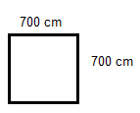
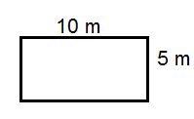
STANDARD LEVEL
Section – A
(Each Question carries 1 marks)
Fill in the blanks
1. Area of surface of a dice is measured in ____________.
2. If length of a rectangle is 20 m and breadth is 14 m, then its area is __________.
3. Area of a square whose each side is 3 m = __________.
4. 72 sq. m. + 4568 sq. m. + 399 sq. m. + 8 sq. m. = _________ sq. m.
5. Total area of 3 squares each having side 1 m = ____________.
Section – B
(Each Question carries 2 marks)
6. Length of a rectangle is 7 cm. If its breadth is 2 cm more than its length, find the area of the rectangle.
7. Length and breadth of a rectangular paper is 80cm and 50cm respectively. If it is cut into two equal halves, find the area of each equal half.
8. Whose area is bigger and by how much?
9. A rectangular piece of cardboard has length 21 m and width 12m.
What is the area of the cardboard in sq. m?

Slide 34
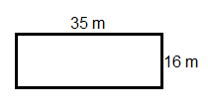
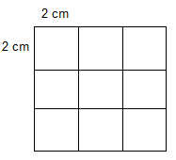
Section – C
(Each Question carries 3 marks)
10. Length and breadth of a big piece of land is 90 m and 80 m. One fourth part of the land is cleaned for a tribal fair. Findthe area prepared for the tribal fair.
11. The side of a square is 5 m. If its each side is doubled, find the area of the new square.
12. A rectangular field is 64 m long and its area is 3008 sq. m. Find its breadth in cm.
13. Compare the area of the given fields and find the biggest one.
14. In your classroom there are two doors and four square sized windows. Length and breadth of each door is 2m and 1m respectively. Length of each window is 100 cm. Find the total area of the doors and windows present in the room.
Section – D
(Each Question carries 4 marks)
15. A painter started painting a black board of length 4 m and breath 2 m. After painting 3 m of length and half of the breadth in one day and kept the rest for the next day. What area of the black board is left for the next day?
16. Find the cost of tiling a court yard 30m long and 15m broad at the rate of Rs. 5 per sq. m.
17. Mr. Ram has a big piece of land of length 30m and breadth 29m. He has distributed the land equally among his three sons. Find the area of land each son gets?
18. Find the cost of flooring a room of length 10 m and breadth 6 m at the cost of Rs. 8 per sq. m.
19. There are nine equal boxes in the figure. If each box is of length 2 cm and breadth 2cm, find the area of half of the given figure.

Slide 35
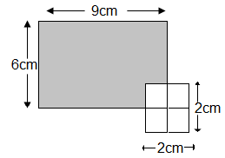
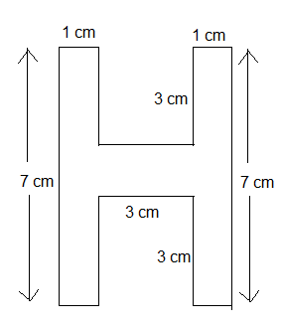
ADVANCED LEVEL
Section – A
(Each Question carries 1 marks)
Fill in the blanks
1. Area of a road between two cities is measured in ______.
2. A rectangle has length = 3m , breadth = 100cm. Its area =_______.
Section – B
(Each Question carries 2 marks)
3. Eight squares having each side 3cm joined together to form a rectangle. Find the length, breadth and area of the rectangle.
4. A tile has length 6cm and width 4cm. If 16 such tiles are required to cover a wall, then what is the area of the wall?
Section – C
(Each Question carries 3 marks)
5. The length of a rectangle is 20cm and breadth is 16cm. If the breadth of the rectangle is reduced to 8cm, what would be the length of the rectangle if the area remains the same.
6. A square sized wooden sheet has to be painted in black and white. Half of it is painted black and rest half is painted white. If one side of the wooden sheet is 6 m, find the area of the wooden sheet painted in black.
7. Harish owns a square field which has length 25m. He ploughs th of his field in a day and leaves the rest. Find the area of the unploughed field.
Section – D
(Each Question carries 4 marks)
8. The floor of a hall is to be paved with black and white square tiles. Each side of the white tile is 100cm and black tile is 90cm. Find the area of the floor in sq. cm of the hall, if the no. of white tiles is 8 and the no. of black tiles is 10.
9. Find the area of the shaded portion.
10. Find the area of the given figure.
*******

Slide 36
MARKING SCHEME
1. A _____________ is the best unit to measure the area. (1 mark question)
Ans :- Square (1 mark)
2. A rectangular piece of cardboard has length 21 m and width 12m.
What is the area of the cardboard in sq. m? (2 mark question)
Ans :- Length of the cardboard = 21 m
Breadth of the cardboard = 12 m
Area = Length X Breadth (1/2 mark)
= 21 m X 12 m (1/2 mark)
= 252 sq. m (1 mark)
3. The side of a square is 5 m. If its each side is doubled, find the area of the new square. (3 mark question)
Ans :- Side of a square = 5 m
Side of the new square = 5 m X 2 = 10 m ( 1 mark)
Area = Side X Side. (1/2 mark)
= 10 m X 10 m. (1/2 mark)
= 100 sq. m. (1 mark)
4. Find the cost of flooring a room of length 10 m and breadth 6 m at the cost of Rs. 8 per sq. m. (4 mark question)
Ans :- Length of the floor = 10 m
Breadth of the floor = 6 m
Area of the floor = Length X Breadth (1 mark)
= 10 m X 6 m. (1/2 mark)
= 60 sq. m. (1/2 mark)
Cost of flooring for one sq. m = Rs. 8 (1/2 mark)
Cost of flooring for 60 sq. m = Rs. 8 X 60. (1/2 mark)
= Rs. 480. ( 1 mark)

