Slide 1
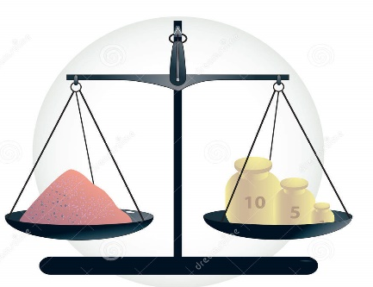
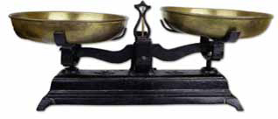
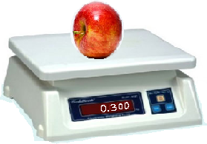
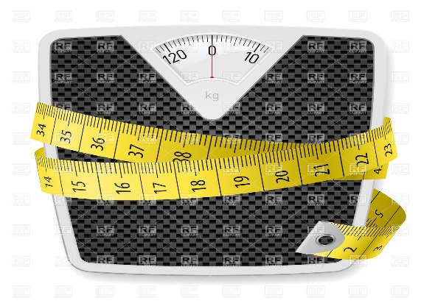
DAV INSTITUTIONS ODISHA ZONE-1
SUBJECT - MATHEMATICS
CLASS – III
TOPIC – WEIGHT

Slide 2
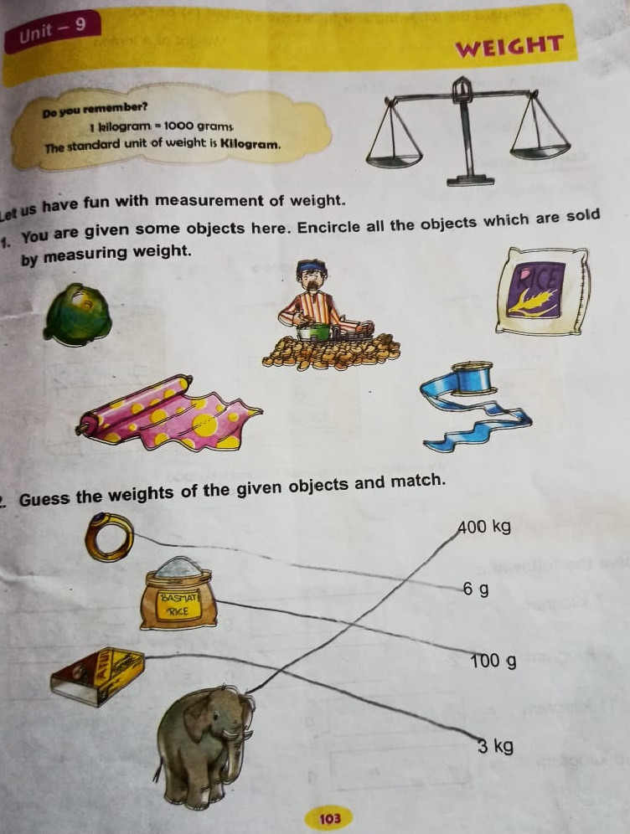
PDF CHAPTER LINK

Slide 3
LEARNING OBJECTIVES
Identification of objects which are sold by measuring weight.
Comparison between heavy and light objects.
Recognition of the basic unit of measuring weight.
Conversion of the units of weight – from kilogram to gram.
Addition and Subtraction of the weights with grouping.
Use of the basic concepts of weight in day to day life.
Application of the concept of weight in solving word problems.

Slide 4
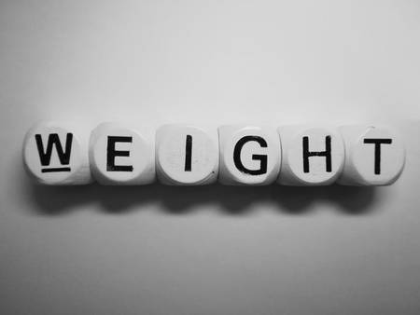
EXAMPLE OF WIEGHT IN REAL LIFE

Slide 6
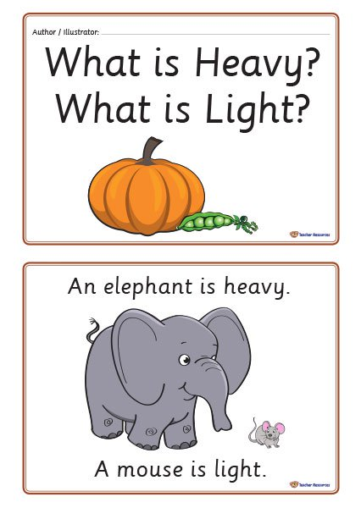

Slide 7
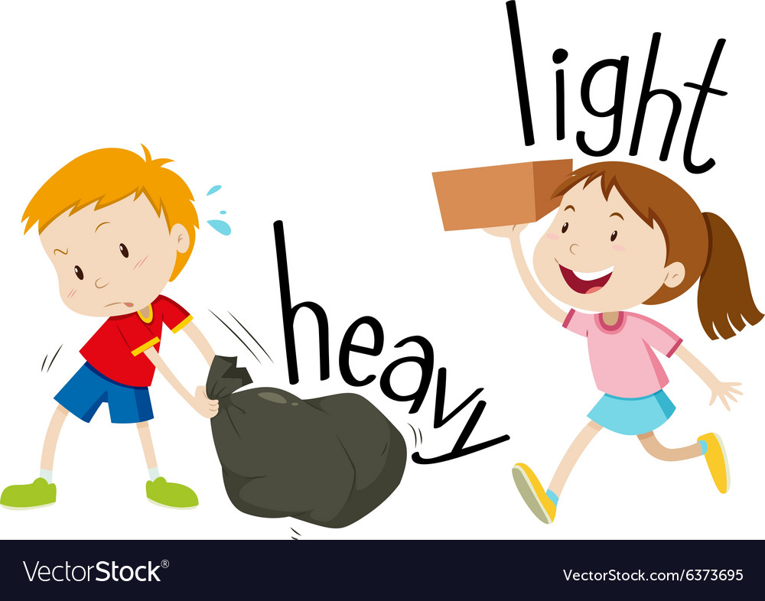
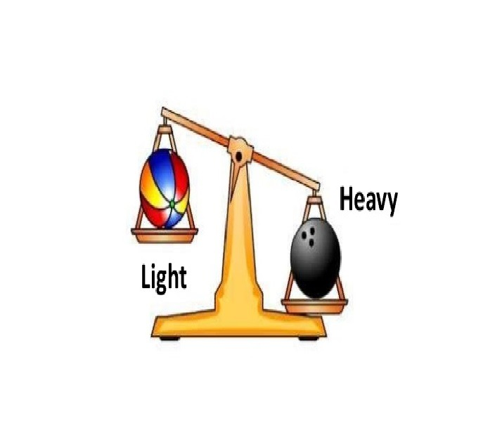

Slide 8
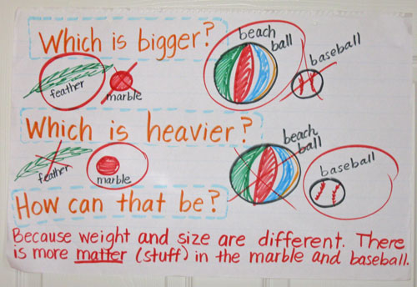

Slide 12
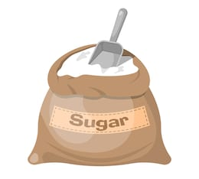
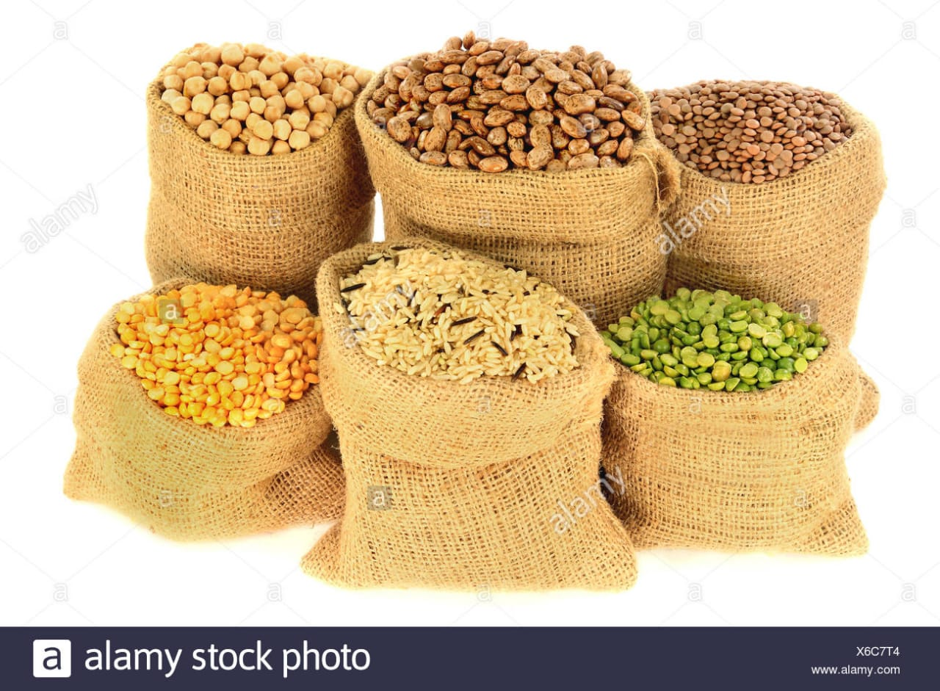
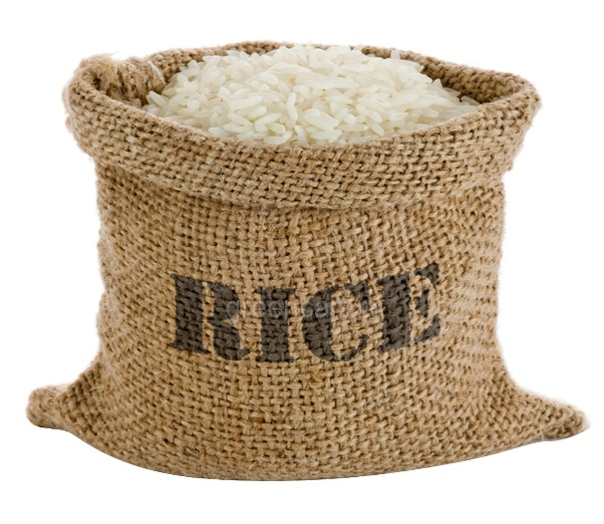
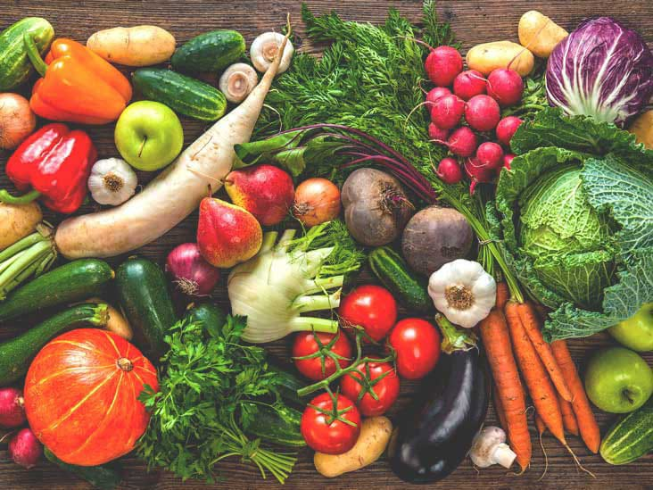
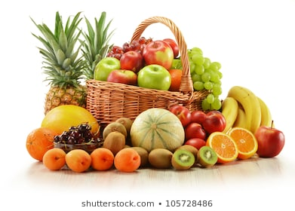
We measure the WEIGHT of…..

Slide 13
And to measure the quantity of these things we need to measure their WEIGHT

Slide 17
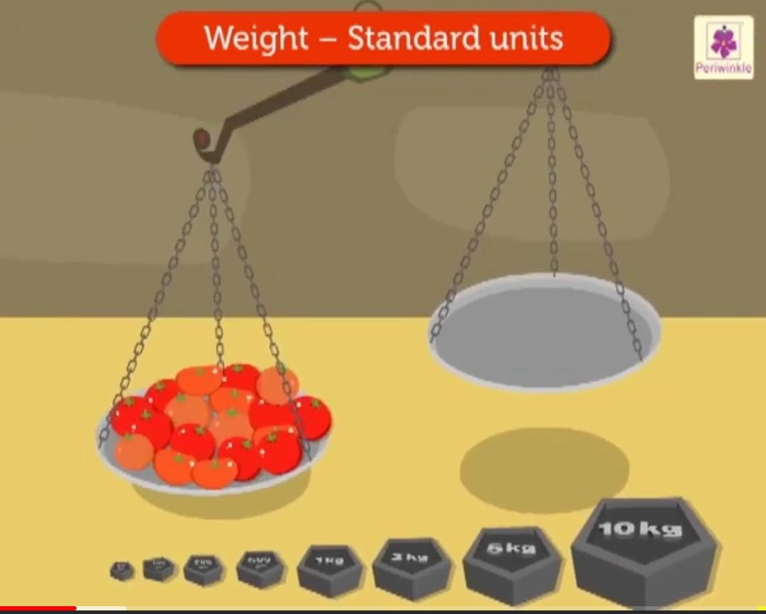
So we use the STANDARD UNITS of weight…

Slide 20
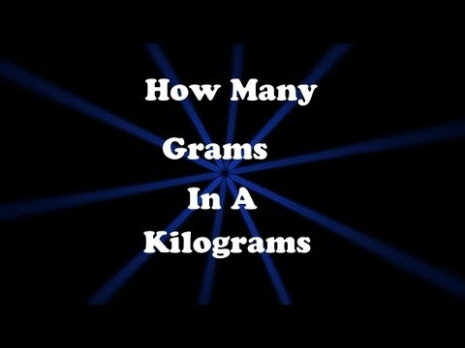
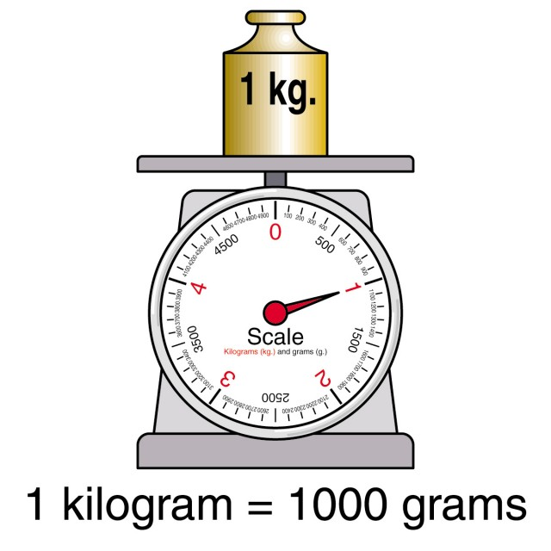

Slide 21
CONVERSION OF KILOGRAMS ‘kg’ INTO GRAMS ‘g’
STEPS TO CONVERT:-
STEP 1 Multiply the given number with 1000
STEP 2 Add three zero after the given number in the result part
STEP 3 Replace kg by g

Slide 22
AUDIO -VISUAL EXPLANATION OF THE CONVERSION USING SOME EXAMPLES

Slide 23
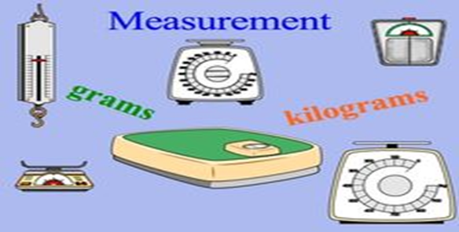

Slide 24
1 Kilogram = 1000 gram.
The standard unit of weight is kilogram.
Kilogram can be written as kg.
Gram can be written as g.
We multiply the number of kilograms by 1000 to convert kilograms into grams.

Slide 25
ADDITION AND SUBTRACTION OF WEIGHTS
Separate the kg and g in two columns and then do the addition or subtraction as given in the question.
Addition and subtraction in grams and kilograms is done in the similar way as in the case of ordinary numbers.
In the result part mention kg in the kilogram part and g in the gram part.

Slide 28
WORD PROBLEMS
Q- Jason purchased 7 kg 200 g of sugar, 9 kg 395 g of rice. What is the total weight which Jason carried?
ANS- Weight of sugar Jason purchased = 7 kg 200 g
Weight of rice he purchased = 9 kg 395 g
Total weight he carried = 7 kg 200 g + 9 kg 395 g
kg g
9 200
+ 7 395
16kg 595g
Thus, Jason carried 16kg 595g in all.

Slide 29
Q- Father bought 18 kg 750 g of fruits (mangoes and apples). He had 6 kg 320 g of mangoes. What is the weight of apples?
ANS- Total weight of fruits father bought = 10 kg 750 g
Weight of mangoes = 6 kg 320 g
Weight of apples = 10kg 750g – 6kg 860g
kg g
18 750
── 6 320
12 kg 430 g
Thus, father bought 4kg 430g apples.

Slide 30
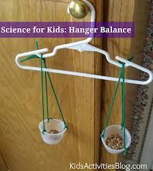
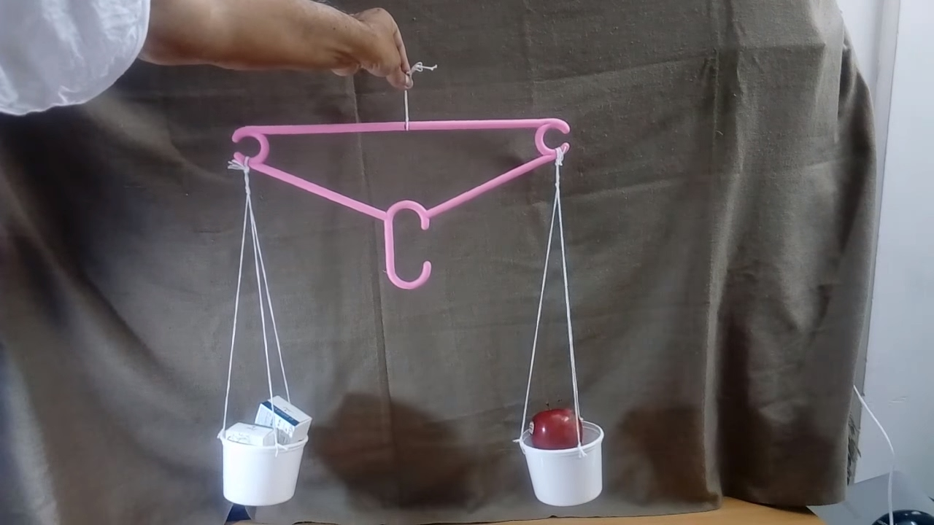
ACTIVITY
(through Art-Integration)
So here we will learn how to make a home made Physical Balance.
STEP 1 : Take a hanger.
STEP 2 : On the two ends attach two binder clips.
STEP 3 : On each clip attach thread.
STEP 4 : Attach two thermocol bowls at the end of the threads on both the sides.
STEP 5 : Then we can measure the weight of the objects.

Slide 31
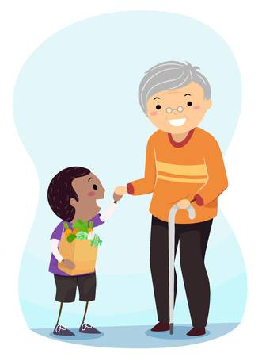
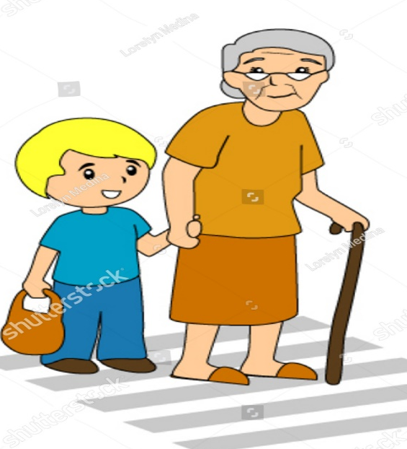
VALUE BASED QUESTIONS
Rohan and his father went to a market to buy some books and copies. Rohan saw an old lady carrying two bags of weight 6kg 300g. It was difficult for the lady to carry the bags all alone. Rohan seeing this carried one bag for her which weighed 3kg 110g. They reached the old lady’s house and Rohan kept the bag in her house. She was very happy and blessed Rohan.
Q1 – Find the weight of the other bag.
Q2 – What values does Rohan exhibit here?

Slide 32
SAMPLE QUESTION PAPER
DAV PUBLIC SCHOOL RAJABAGICHA
SUB- MATH F.M- 10
CLASS- III TIME- 30 mints
Fill in the blanks:- [1x1=1]
2 kilogram = ____________ grams.
B. Do as directed:- [2x1=2]
Arrange in column and add the following :
23 kg 007 g and 9 kg 150 g
C. Answer the following questions:- [3x1=3]
Mr. Rahul bought 8kg 350g apples. He found that 1 kg 240 g of apples were unripe. Find the weight of ripe apples.
D. Answer the following:- [4x1=4]
Anuj went to market to buy vegetables. There he saw an old man carrying two bags of vegetables weighing 6kg 500g. Anuj wanted to help the old man so he took one bag from him. It weighed 2kg 750g. Anuj accompanied the old man to his house.
Find the weight of the other bag the old man was carrying.
How you offer help to old people?

Slide 33
MARKING SCHEME
QUESTION NUMBER ANSWER MARKS ALLOTED
A. 1) 2000g 1mark
B. 1) 32 kg 157 g arranging in columns – 1 mark
answer – 1 mark
C. 1) 7 kg 110 g statement – 1 mark
operation – 0.5 mark
answer – 1.5 marks (arranging in column- 0.5 marks and answer – 1mark)
D. 1) 3kg 750g statement – 1 mark
operation – 0.5mark
answer – 1.5 marks
2) any valid answer 1 mark

Slide 34
SUMMARY
Weight is a measure of mass. It shows the heaviness of an object.
We measure the weight of an object or our own weight in grams or kilograms.
Kilograms and grams are the basic units of measurement of weight.
The standard unit of weight is ‘kilogram’.
Heavy items are weighed in kilograms
Light items are weighed in grams.
Gram is denoted as ‘g’.
Kilogram is denoted as ‘kg’.
Different objects having the same weight can be of different sizes and shapes.
1 kg = 1000g
Half ($1/2)$ kg = 500g
A Physical Balance or Digital Balance is used to measure the weight of objects.

Slide 35
