Slide 1
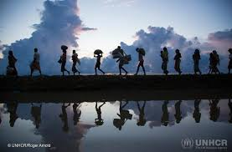
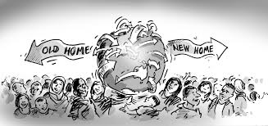
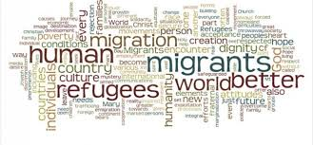
Migration
Move from one place to another

Slide 2
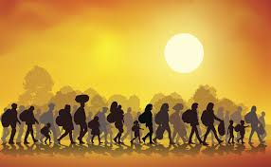
What is HUMAN MIGRATION?
THE SYSTEMATIC MOVEMENT OF PEOPLE FROM ONE PLACE TO ANOTHER

Slide 3
MIGRATION IN EARLIER TIMES
In earlier times the migration by people was carried out within a limited area : 1 . As there were no means of transport.
2 . People had to walk or carry their goods
3 . They were scared to travel far away places due to difficulties, many myths and superstitions.

Slide 4
TYPES OFMIGRATION
VOLUTARY MIGRATION
FORCED MIGRATION
For better job
For educational opportunities
To be close to family or friend
Due to natural disaster
Due to man-made disaster

Slide 5
VOLUNTORY MITGRATION
VOLUNTORY MIGRATION is when people move to another place on THEIR OWN WISH
It may be for BETTER JOB, EDUCATIONAL OPPORTUNITIES or to BE CLOSE TO THEIR FAMILY OR FRIENDS in another village, town, city, state or country.

Slide 6
Seasonal migration: WORK AS EXTRA LABOUR DURING THE SOWING AND HARVESTING SEASONS

Slide 7
VOLUNTARY MIGRATION
FOR EXAMPLE- The Anand couple was not happy when their son, Hiten was transferred to Bengaluru. They missed the grandchildren and were lonely in Patiala. Hiten and his wife Avnee also missed the companionship and help of their parents. Their two children were upset as they were used to having the grandparents at home when they came back from school. So the Anand couple happily migrated to Bengaluru to be with their children.

Slide 8
FORCED MIGRATION
Flood
Terrorist
Activities
Tsunami
Earthquake
Fire
Draught

Slide 9
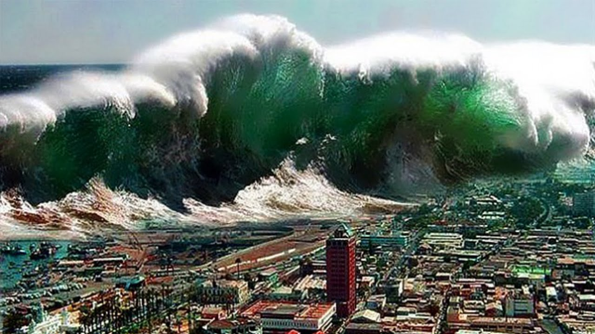
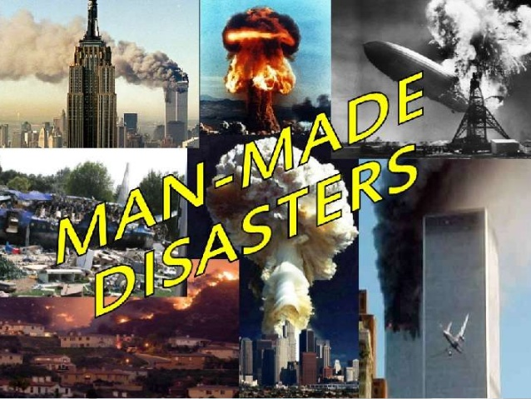
Forced migration:
Naural disaster:
Man made disaster

Slide 10
FLOOD

Slide 11
HURRICANES

Slide 12
ANIMAL MIGRATION

Slide 13
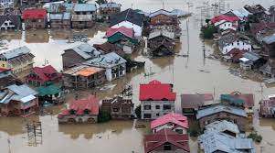
FLOOD
SEPTEMBER 2014 KASHMIR VALLEY
FLOODS WERE CAUSED BY HEAVY RAIND AND OVERFLOWING OF RIVER JHELUM

Slide 14
ANIMAL MIGRATION
Animals migrate with change in seasons. They migrate to find warm weather , better food supply or safe place to give birth to their young ones.
For Example-Wilderbeets of Africa migrate in search of green pastures ,crossing many crocodiles filled rivers . This great migration is known as one of the “seven wonders of the natural world”.

Slide 15
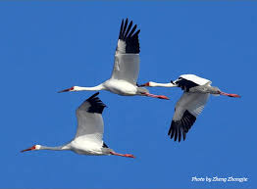
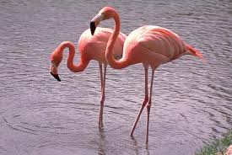
MIGRATORY BIRDS
Siberian crane
Great Flamingo
Stork
Falcon
Bluethroat

