Slide 1
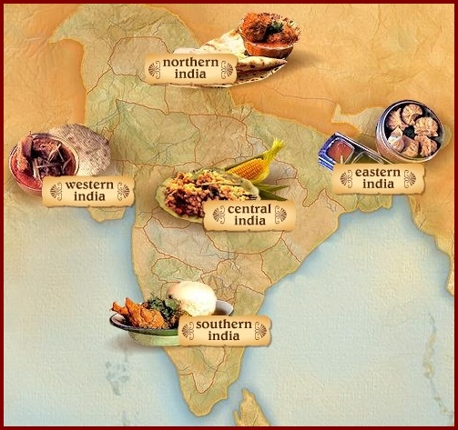
Our food

Slide 2
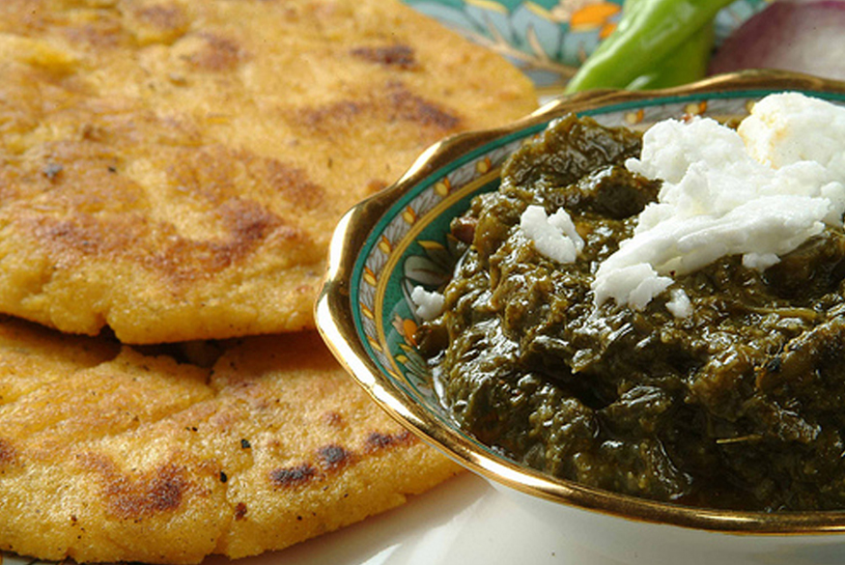
Makki-ki-roti
From
Punjab

Slide 3
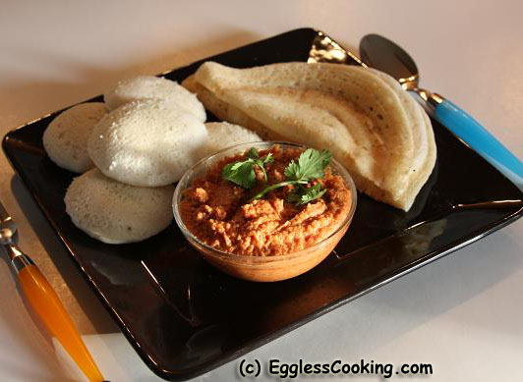
DOSA SAMBHAR
FROM
TAMIL NADU

Slide 4
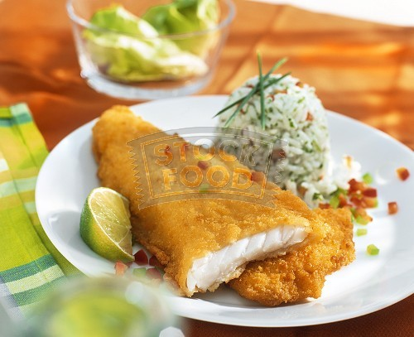
FISH AND RICE
FROM
BENGAL

Slide 5
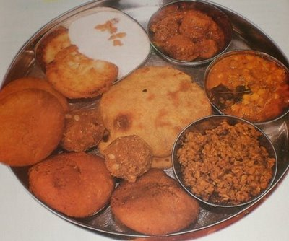
DAL-BATTI CHURMA
FROM
RAJASTHAN

Slide 6
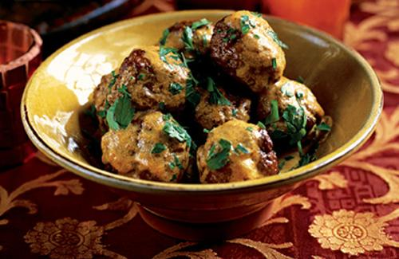
GOSTABA
FROM
KASHMIR

Slide 7
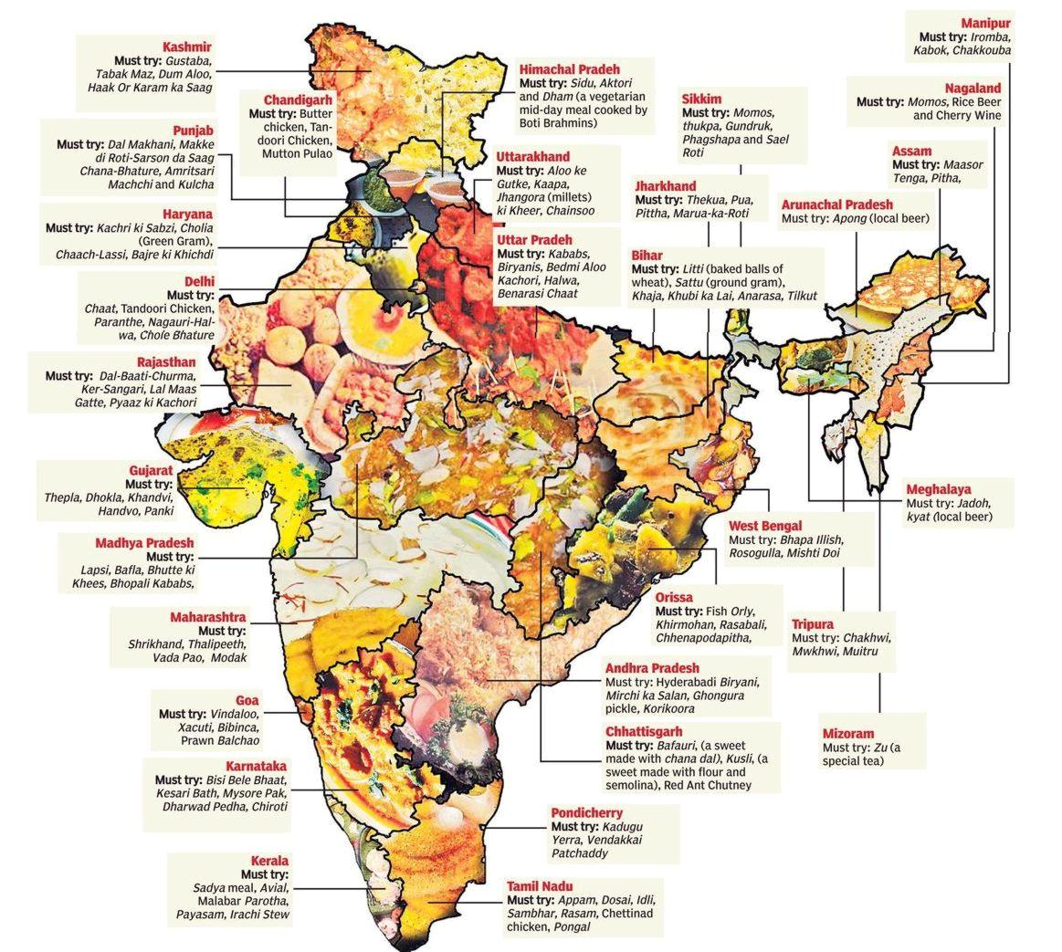
PEOPLE EAT DIFFERENT
VARIETY OF FOOD IN INDIA

Slide 8
DIFFERENT DISHES
ARE MADE ON
DIFFERENT OCCASIONS LIKE
FESTIVALS,MARRIAGES OR BIRTH OF A CHILD.

Slide 9
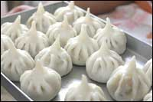
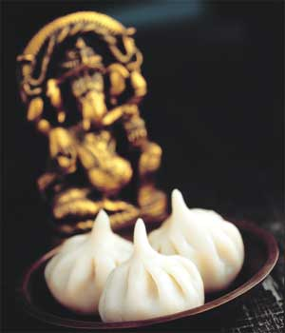
MODAK IS MADE
DURING THE FESTIVAL
OF GANESH CHATURTHI

Slide 10
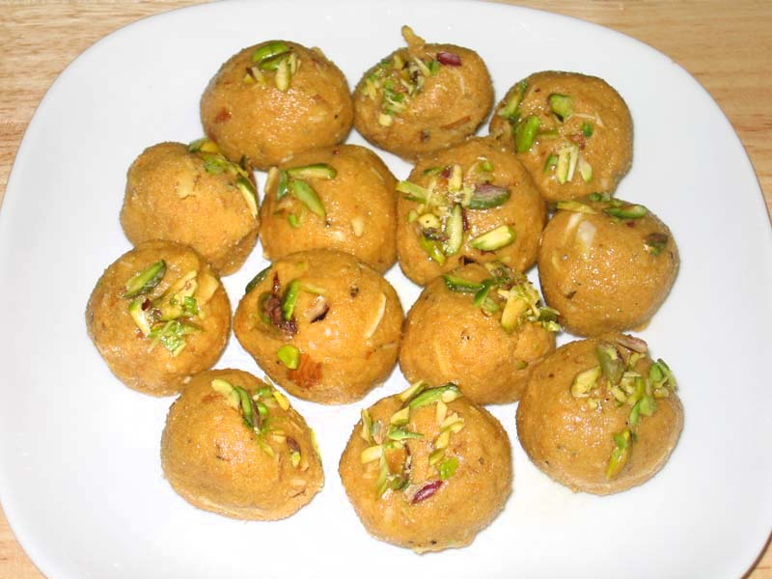
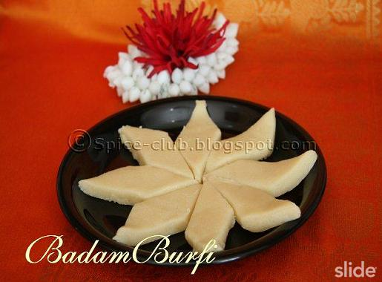
LADOO AND BURFI
ARE MADE IN
MARRIAGES

Slide 11
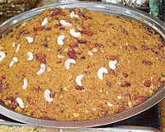
MOTHER OF A NEW
BORN BABY IS FED
PANJIRI

Slide 12
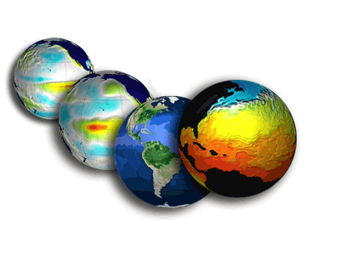
FOOD HABITS DEPENDS UPON
CLIMATE

Slide 13
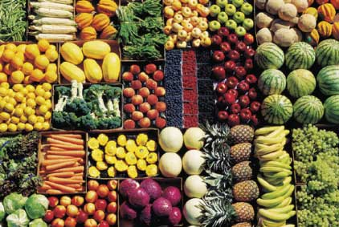
CROPS GROWN IN THAT AREA.

Slide 14
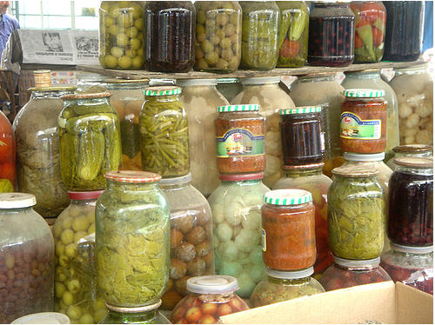
PEOPLE OF RAJASTHAN
AND GUJARAT USE GREAT
VARIETY OF DALS AND
ACHARS.

Slide 15
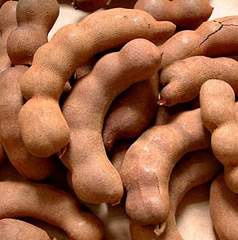
PEOPLE OF TAMIL NADU USE A LOT OF
TAMARIND.

Slide 16
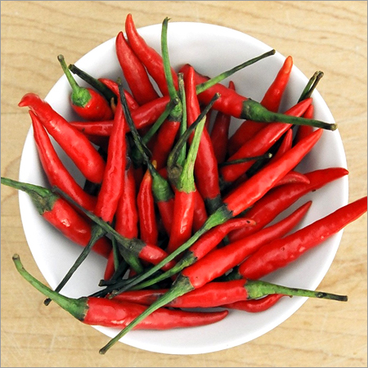
PEOPLE OF
ANDHRA PRADESH
USE A LOT OF CHILLIES.

Slide 17
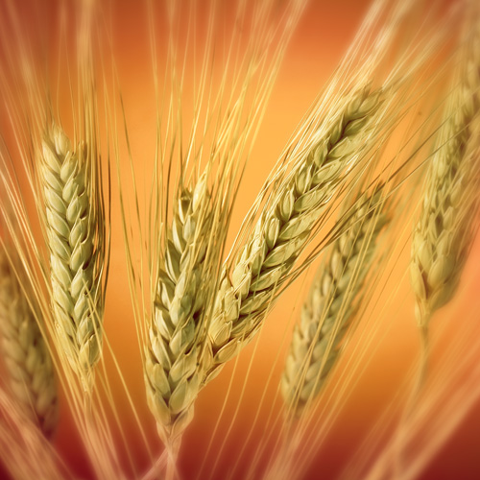
PEOPLE OF PUNJAB
GROW A LOT OF
WHEAT .

Slide 18
WHAT IS THE STAPLE
DIET OF PUNJAB?

Slide 19
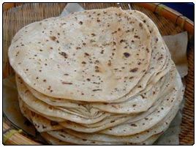
THE STAPLE DIET OF
PUNJAB IS
CHAPPATTIS.

Slide 20
WHAT IS THE STAPLE
DIET OF
SOUTH INDIA?

Slide 21
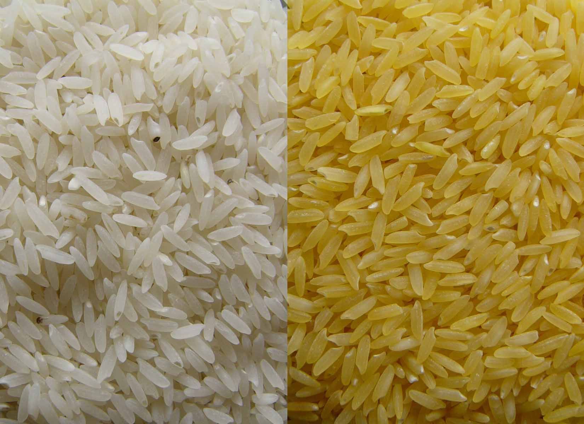
RICE IS THE STAPLE
DIET OF SOUTH
INDIA

Slide 22
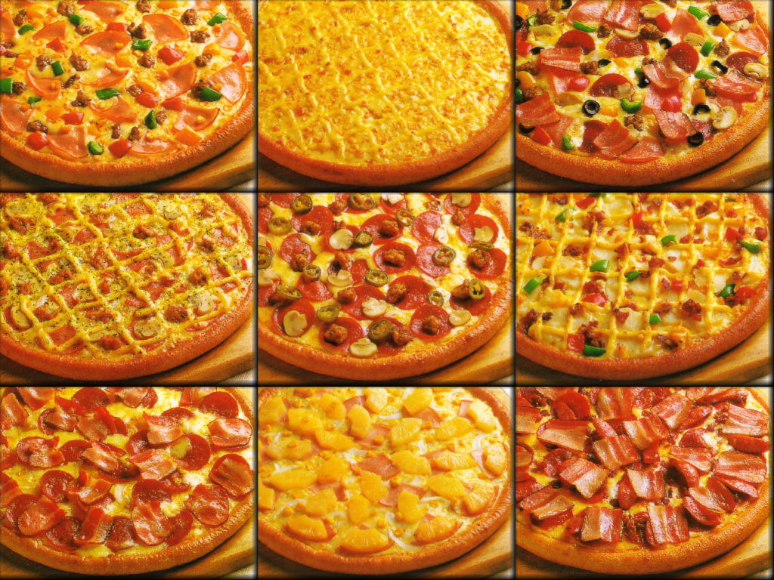
NOW A DAYSKIDS
EAT A LOT OF
PIZZAS.

Slide 23
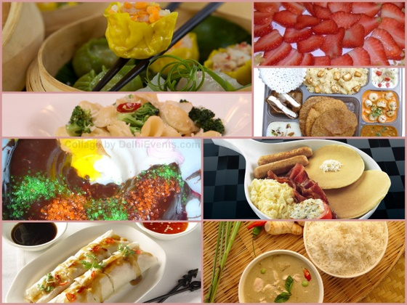
FOOD WHICH IS NOT
HAVING ANY KIND OF
MEAT IS VEGETARIAN
FOOD.

Slide 24
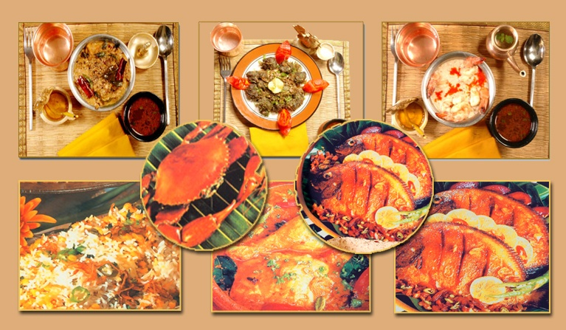
FOOD WHICH IS HAVING
MUTTON,EGGS AND FISH
IS NON-VEGETARIAN
FOOD

Slide 25
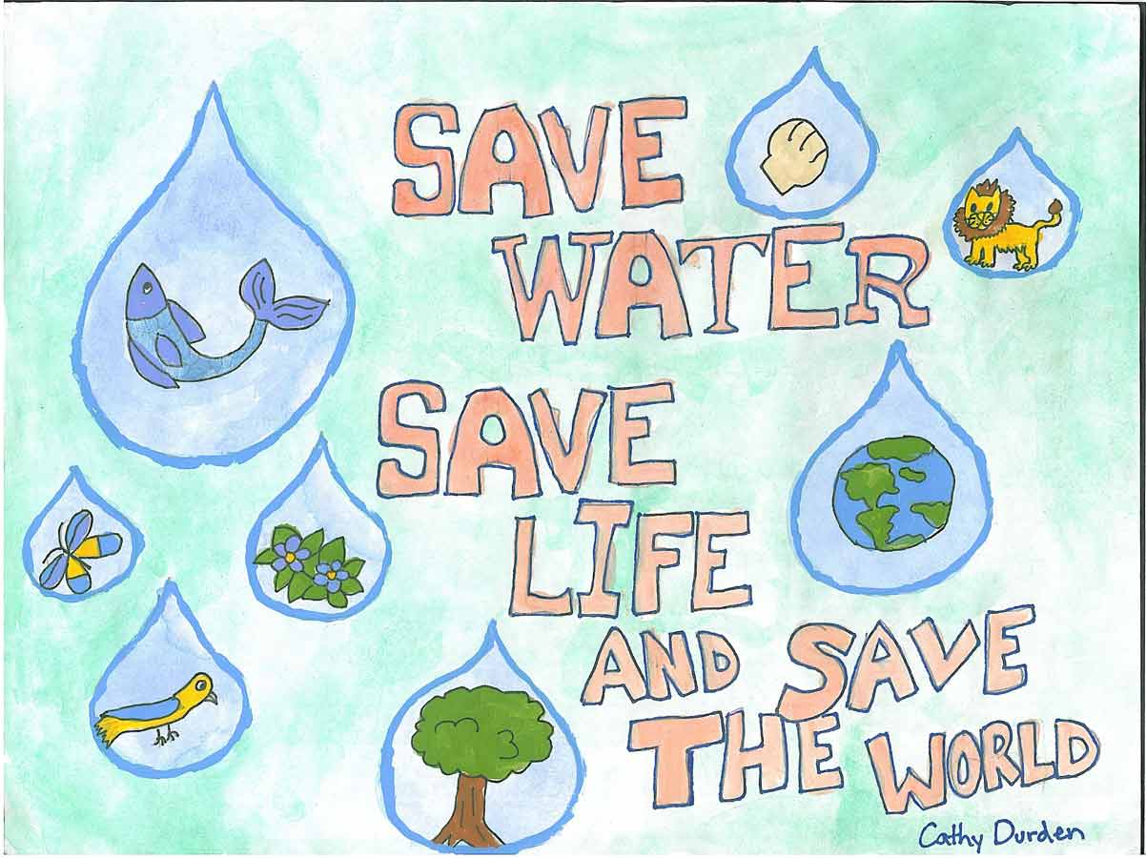

Slide 26
SAVE ELECTRICITY

Slide 27
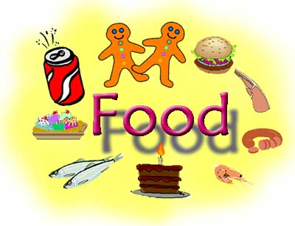
SAVE

