Slide 1
LEARNING MATERIAL
STD -IV
MULTIPLICATION

Slide 2
OBJECTIVES
Understanding multiplication
Multiplying a 3- digit number with a 3- digit number.
Multiplying a 4-digit number by a 3-digit number
Understanding properties of multiplication.
Multiplying numbers by multiples of 10,100,1000
Solving of word problems based on multiplication

Slide 3
INTRODUCING MULTIPLICATION
Multiplication is a quick way to add equal numbers.
Ex. 3+3+3+3+3 = 15
We can write it as 5 times 3
OR
5 X 3 = 15

Slide 4
4 times 2 OR 4 x 2 = 8
Multiplication is also known as repeated addition

Slide 5
DO YOU KNOW
MULTIPLICAND: The number to be multiplied.
MULTIPLIER: The number by which we multiply.
PRODUCT : The answer we get after multiplication.
8
× 4
32
➔ MULTIPLICAND
➔ MULTIPLIER
➔ PRODUCT

Slide 6
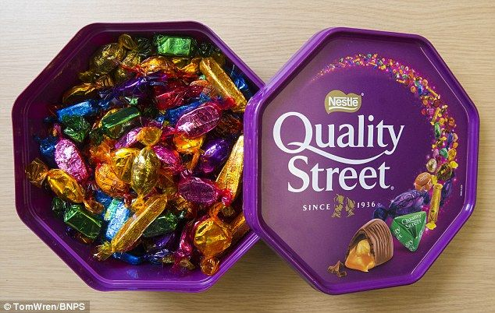
LET’S RECALL FOM STD III
Example-1: In a box contains 25 toffees, how many toffees are in 28 such boxes ?

Slide 7
ANSWER:
Number of toffees in one box = 25
Number of boxes = 28
Number of toffees in 28 boxes = 25 × 28
H | T | O
 | 2 | 5
× | 2 | 8
2 | 0 | 0
+ 5 | 0 | 0
7 | 0 | 0
So, 28 boxes contains 700 toffees

Slide 8
Example-2: In an orchard, mango trees are planted in rows. There are 118 trees in one row and there are 24 such rows. How many mango trees are there in the orchard?

Slide 9
ANSWER:
Number of mango trees in one row = 118
Number of rows = 24
Total number of mango trees = 118 × 24
TH | H | T | O
 | 1 | 1 | 8
 | × | 2 | 4
 | 4 | 7 | 2
+2 | 3 | 6 | 0
2 | 8 | 3 | 2
Hence, there are 2832 mago trees in the orchard.

Slide 10
Multiplying a 3-digit number by a 3-digit number

Slide 11
Multiply 958 by 876
876 ( the multiplier) can be written as :
L | T Th | TH | H | T | O
 |  |  | 9 | 5 | 8
 |  | × | 8 | 7 | 6
 |  | 5 | 7 | 4 | 8
+ | 6 | 7 | 0 | 6 | 0
+7 | 6 | 6 | 4 | 0 | 0
8 | 3 | 9 | 2 | 0 | 8
876 = 800 +70 +6
Step 1: Find 958 × 6
Step 2: Find 958 × 70
Step 3: Find 958 × 800
Step 4: Product of Step1 + Product of Step 2 + Product of Step 3

Slide 12
Multiplying a 4-digit
number by a
3-digit number

Slide 13
Example: Multiply 2,135 by 327
327 ( the multiplier) can be written as :
L | T Th | TH | H | T | O
 |  | 2 | 1 | 3 | 5
 |  | × | 3 | 2 | 7
 | 1 | 4 | 9 | 4 | 5
+ | 4 | 2 | 7 | 0 | 0
+ 6 | 4 | 0 | 5 | 0 | 0
6 | 9 | 8 | 1 | 4 | 5
327 = 300 +20 +7
Step 1: Find 2,135 × 7
Step 2: Find 2,135 × 20
Step 3: Find 2,135 × 300
Step 4: Product of Step1 + Product of Step 2 + Product of Step 3

Slide 14
ACTIVITY (ART INTEGRATION)

Slide 15
PROPERTIES
OF
MULTIPLICATION

Slide 16
PROPERTY 1
If you change the order of the
numbers , the product remains the same.
Ex. 6x4 = 24
4x6 = 24
It is also known as commutative property

Slide 17
PROPERTY 2
MULTIPLICATION OF THREE NUMBERS
In order to multiply three numbers first we multiply two of them and then, multiply the product obtained by the third number.
Examples:
5 × 7 × 3 = 35 × 3 = 105
2 × 8 × 5 = 16 × 5 = 80

Slide 18
PROPERTY 3
MULTIPLICATION OF THREE NUMBERS
Examples:
i) 1 × 9 × 5 = 5 × 9 × 1 = 45
If three numbers are multiplied in any order, the product remains the same.
ii) 3× 9 × 4 = 4 × 9 × 3 = 108

Slide 19
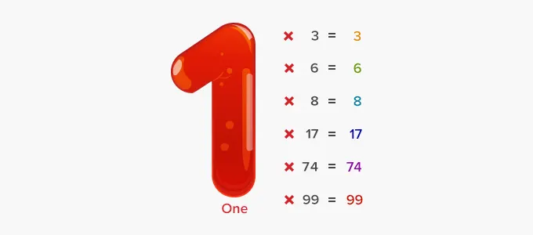
PROPERTY - 4
The product of a number and 1 is the number itself.
Ex. 23 x 1 = 23
123 x 1 = 123
It is also known as identity property of multiplication.

Slide 20
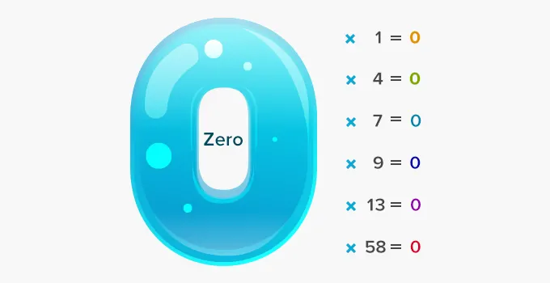
PROPERTY – 5
The product of any number and zero is 0.
Ex. 56 x 0 = 0
143 x 0 = 0
It is also known as zero property of multiplication.

Slide 21
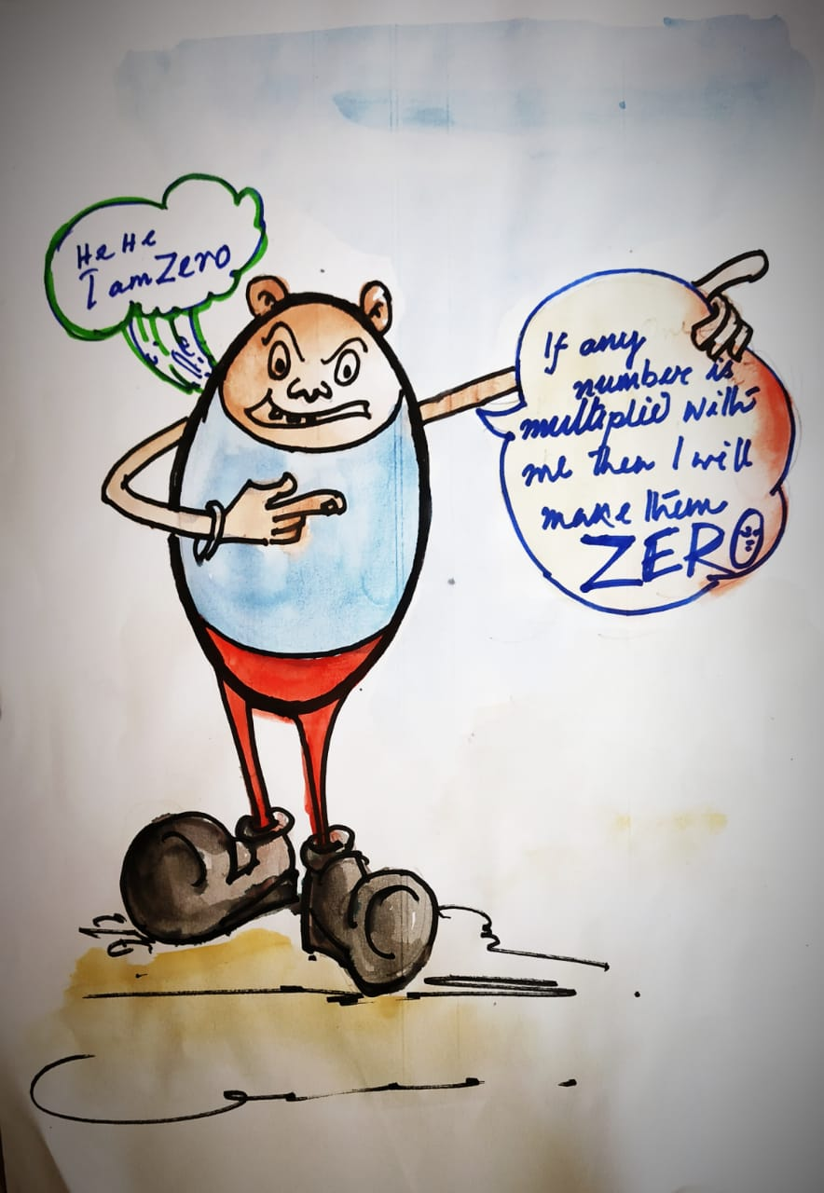
ART INTEGRATION

Slide 22
MULTIPLICATION (ORALLY)
Let us see the following multiplications.
36 × 100 = 3600
3 × 60 = 180
4 × 700 = 2800
5 × 8000 = 40,000
42 × 3000 = 126,000
36 × 1 = 36 with two zeroes on right side.
3 × 6 = 18 with one zero on right side.
4× 7 = 28 with two zeroes on right side.
5 × 8 = 40 with three zeroes on right side.
42 × 3 = 126 with three zeroes on right side.
Remember: In order to multiply a number by 100, 200….. 900, we multiply the number by 1,2…. 9 respectively and put two zeroes on the right of the product.

Slide 23
ACTIVITY (Slanting line Method)
VIDEO LINK:
https://youtu.be/T0-s7pfEU18
(EXPLANATION BY TEACHER)

Slide 24
Example-1: In a library, there are 1,250 books in each almirah. There are 62 almirahs in the library. Find the total number of books in the library.
Word Problems

Slide 25
Solution:
Number of books in each almirah = 1250 Number of almirahs = 62 Total number of books in 62 almirahs = 1250 × 62
 |  | 1 | 2 | 5 | 0
 |  |  | × | 6 | 2
 |  | 2 | 5 | 0 | 0
+ | 7 | 5 | 0 | 0 | 0
 | 7 | 7 | 5 | 0 | 0
Thus, the number of books in 62 almirahs is 77,500.

Slide 26
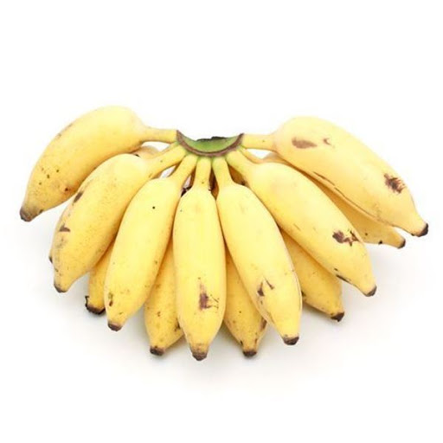
Example-2: One dozen bananas cost ₹ 36. What is the cost of 720 dozen bananas ?
Word Problems

Slide 27
Solution:
Cost of one dozen banana = ₹ 36 Number of dozen of bananas = 720 Cost of 720 dozen bananas = 720 × 36
 |  |  | 7 | 2 | 0
 |  |  | × | 3 | 6
 |  | 4 | 3 | 2 | 0
+ | 2 | 1 | 6 | 0 | 0
 | 2 | 5 | 9 | 2 | 0
The cost of 720 dozen bananas is Rs25,920.

Slide 28
ACTIVITY (Break the code)

Slide 29
Let’s have a quick review
Multiplication
Properties
Application of Multiplication
(word problems)
Of a 3 digit number with a 3
digit number
111 x 111 = 12321
With multiples of 10, 100, 1000, etc.
5 X 10= 50
5 X100= 500
5 X 1000=5000
$$25 x 3=3 x 25$$
25 x 0 = 0
Of a 3 digit number with a 4 digit number
1111 x 256 = 2,84,416
2 x3x 4= 4 x 2 x3
25 x 1 = 25

Slide 30
PROJECT
Make a multiplication coding sheet with your favorite cartoon character name hidden inside it and ask your friend to break the code and get the name.
(Refer to activity “ BREAK THE CODE”)

