Slide 1
CLAS-IX
SUBJECT-MATHEMATICS
NAME OF THE TOPIC:CIRCLES

Slide 2
CIRCLES(NCERT)
PDF

Slide 3
CONTENTS…
LEARNING OBJECTIVES
INTRODUCTION
CIRCLES IN DAILY LIFE
BASIC TERMS AND DEFINITIONS OF PARTS OF CIRCLES
SOME AXIOMS AND THEOREMS ON CIRCLES
SOME PRACTICE QUESTIONS BASED ON THE THEOREMS
SUGGESTED ACTIVITIES
CONCEPT MAPPING
KEY POINTS TO REMEMBER

Slide 4
Learning Objectives..
Students will be able to
learn about circle and it’s various parts.
Recognize and define ; radius,diameter,chord,sector,segment,arc of the circle.
Understand the concept of cyclic quadrilateral and it’s properties.
Understand theorems having key concepts such as angle sutended by the chord, chord radius relation,circle through three points,angles in the segments etc.
Apply the concepts to solve geometrical problems and use it in daily life.

Slide 5
INTRODUCTION
Circles are involved in nearly every aspect of our daily lives. It’s is important for students to be confident on Circles it’s properties ,terminology of it’s different parts, measuring angles by the chord or segments and they also need to have a solid knowledge on properties of different parts and the use of those in daily life.
We meet many real life situations based on circles. For example, in construction industry, the making of the watch and the movement of it’s hands, motion of wheel and it’s shape ,shape of a pizza ,many floral designs etc.
Wee can say the shape and motion of the planets and other celesatial bodies are also circular. This is the shape which has the maximum use in every field and every work in our daily life.

Slide 6
INTRODUCTION. Video

Slide 7
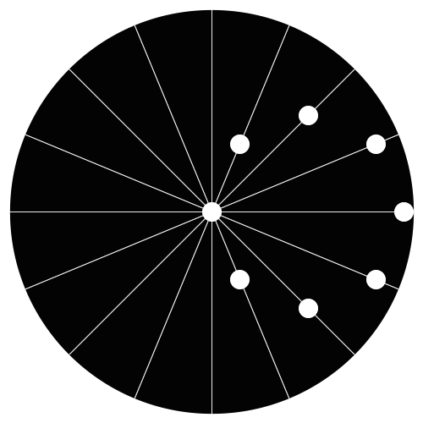
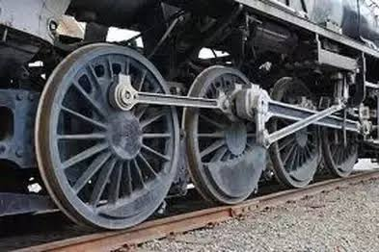

Slide 8
DEFINITION OF CIRCLE The entire geometry begins with a point. A point is a dimensionless entity which specifies the location or position. It is represented using a dot symbol and its length is zero. What is a circle?????? The set of all the points on a plane those are at a fixed distance from a fixed point makes a circle. A circle divides a plane into three parts such as exterior , interior and the circle te-EXTERIOR, green-INTERIOR, red-THE CIRCLE red + green=circular region The locus of a point which is at a constant distance from a fixed point forms a circle. The fixed point of reference is the centre and the fixed distance between centre and any point on the circle is termed as radius. Video-------------------
centre
O

Slide 9
Video Showing Radius ,Diameter
Notes:
Video showing radius and diameter

Slide 10
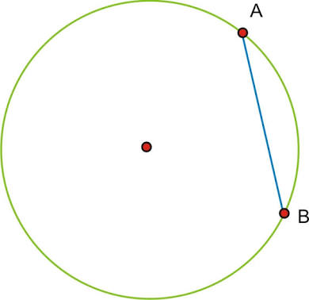
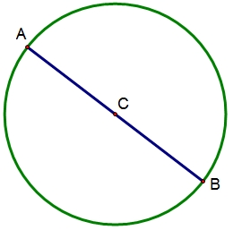
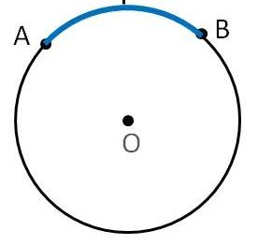
BASIC TERMS & DEFINITIONS:
Chord - The line joining any two points on the circle
is termed as chord. In the figure AB is the chord.
Diameter-The longest chord of the circle
is the diameter which passes through the
centre of it. AB is the diameter .
Diameter=2 x Radius
Arc-Apart of the circle is an arc. AB is an arc.

Slide 11
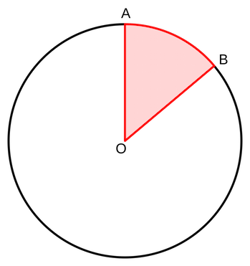
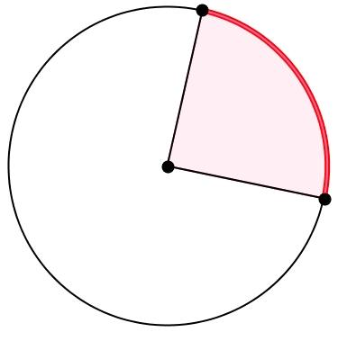
BASIC TERMS & DEFINITIONS:
Semicircle-
The half of a circle then it is semicircle.
Sector-Apart of the circle enclosed by any two radii and
the corresponding arc is termed as sector of the circle.
Quarter/Quadrant-One fourth part of the circular
region in the form of a sector is termed as
quarter of the circle.

Slide 12
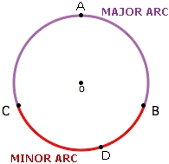
Major and Minor Sector- The circle is divided into two parts by any two radii and each part is called a sector. The larger part is the major sector(white) and the smaller part is the minor sector (red) I Major and Minor Segment-A chord divides a circle into two parts called segments. The smaller part is minor segment (blue) and bigger part is major segment(white) . Major and Minor Arc- The red part (BDC arc)is called minor arc and the rest part of the circle (BAC arc)is called Major Arc.

Slide 13
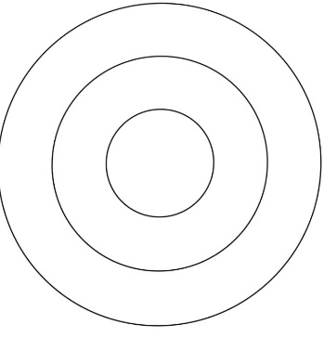
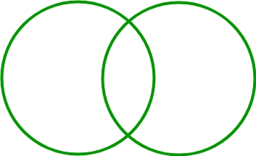
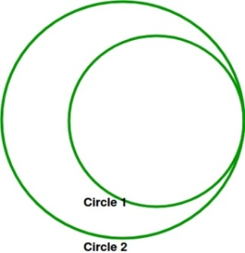
The length of the circle(boundary )is the perimeter of the circle or Circumference. (C=2π times the radius or π times the diameter)
The region(part of the plane)enclosed by the circle is termed as it’s
area.(A=π times square of the radius)
There are infinite points present on the circle .So infinite radii, Chords,arcs,sectors etc can be drawn.
Types of Circles
Two or more circles having common centre are called
concentric circles.
Two circles having any two common points
are called intersecting circles.
Two circles having oncommon
point are called
touching circles.
Two Or more circles having radii of same length are known as congruent circles.

Slide 14
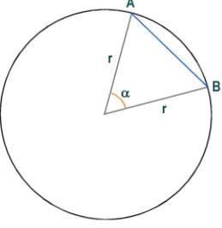
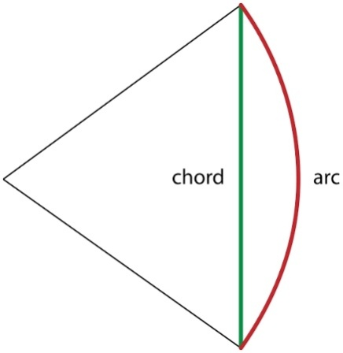
Angle Subtended by the Chord
The angle made at the centre of a circle by the radii touching the end points of the chord is termed as angle subtended by the chord.
It is also called as the angle subtended by the corresponding arc or the segment associated with the chord.
In the figure angleAOB(α)
is the angle subtended by the
chord AB at centre of the circle.

Slide 15
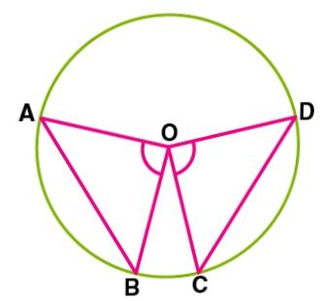
Theorem-1
Statement-Equal chords of a circle subtend equal angles at the centre.
Given- AB and CDdare two chords of equal
Lengths AB subtends ∠AOB and CD
subtends ∠COD at the centre.
To Prove-∠AOB =∠COD
Proof- AB and CD are the 2 equal chords.
In Δ AOB and Δ COD
OB = OC [Radii of same circle]
OA = OD [Radii of same circle]
AB = CD [Given]
ΔAOB ≅ ΔCOD (SSS rule)
Hence, ∠AOB = ∠COD [CPCT]

Slide 16
Theorem-2(converse)
Statement-If the angle subtended by the chords are equal, the the chords are equal .
Given-Angles subtended by the chords AB
and CD are∠ AOB and ∠COD such that
∠AOB=∠COD
To Prove- AB=CD
Proof-In Δ AOB and Δ COD
OB = OC [Radii of same circle]
OA = OD [Radii of same circle]
∠AOB = ∠COD[Given]
ΔAOB ≅ ΔCOD (SAS rule)
Hence, AB = CD [CPCT] hence proved…….

Slide 17
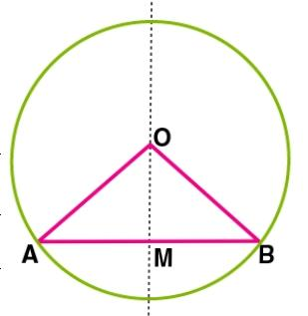
Theorem-3
Statement-
The Perpendicular from the centre of a circle to a chord bisects the chord.
Given-The line passing through the centre of the circle
. Is perpendicular to the chord AB at M.
To Prove-AM=BM
Construction-Join the radii OA and OB.
Proof-AB is a chord and OM is the perpendicular
drawn from the centre.
From ΔOMB and ΔOMA,
∠OMA=∠OMB=90⁰
OA = OB (radii)
OM = OM (common)
Hence, ΔOMB ≅ ΔOMA (RHS rule)
Therefore AM = MB [CPCT]

Slide 18
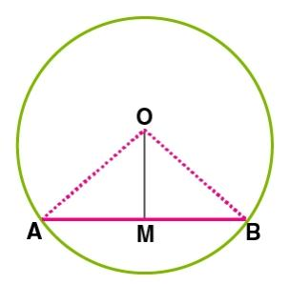
Theorem-4(converse)
Statement- The line passing through the centre of a circle to bisects a chord is perpendicular to the chord.
Given-OM bisects the chord AB i.e AM=BM
.
TO Prove- OM ⊥ AB
Construction-Join OA and OB.
Proof-From ΔOMA and ΔOMB,
OA = OB (Radii)
OM = OM (common)
AM = BM (Given)
Therefore, ΔOMA ≅ ΔOMB (SSS rule)
⇒∠OMA=∠OMB (C.P.C.T)
But, ∠OMA+∠OMB=180⁰
Hence, ∠OMA=∠OMB=90⁰ ⇒OM⊥AB

Slide 19
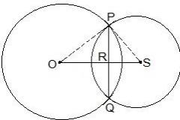
Practice Question-
Two circles of radii 5 cm and 3 cm intersect at two points and the distance between their centres is 4 cm. Find the length of the common chord.
Given parameters are OP = 5cm,OS = 4cm and,PS = 3cm.Also, PQ = 2PR
Now, suppose RS =“x. The diagram for the same is shown below
Consider the ΔPOR, OP² = OR² + PR²
⇒ 5² = (4-x)² + PR²
⇒ 25 = 16 + x² – 8x + PR²
∴ PR² = 9 – x² + 8x — (i)
Now consider ΔPRS,
PS² = PR² + RS²
⇒ 3² = PR² + x²
∴ PR² = 9 – x² — (ii)
By equating equation (i) and equation (ii) we get,
9 – x² + 8x = 9 – x²
⇒ 8x = 0
⇒ x = 0
Now, put the value of x in equation (i)
PR² = 9 – 0²
⇒ PR = 3cm
∴ The length of the cord i.e. PQ = 2PR
So, PQ = 2×3 = 6cm

Slide 20
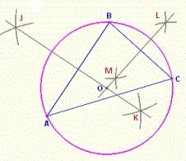
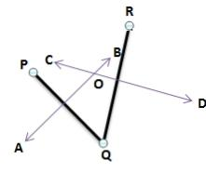
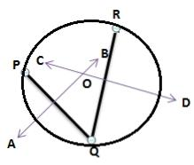
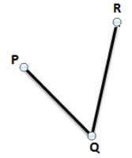
Circle Through Three Points
Infinite circles pass through one point or two given points.
A unique circle passes through any three non collinear points.
A unique circle passes through 3 vertices of a triangle ABC called as the circumcircle. The centre and radius are called the circumcenter
and circumradius of this triangle, respectively.
Construction of circle through three non colliner Points:
Join up the points to form two lines
Construct the perpendicular bisector of the other line
Where they cross is the center of the circle
Place compass on the center point, adjust its length to reach any point, and draw your circle!

Slide 21
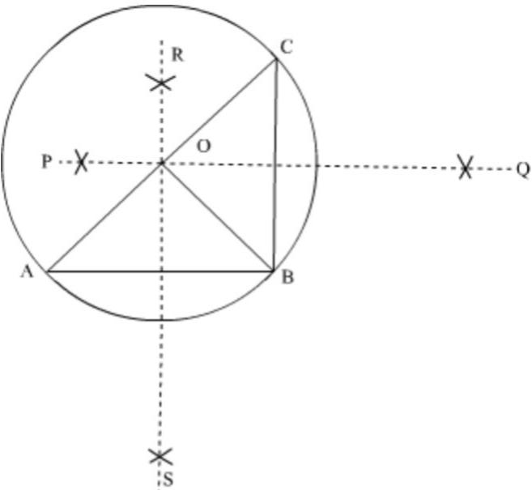
Theorem-5
Statement-There is one and only one circle passing through
three given noncollinear points.
Given: A, B and C are three non-collinear points.
To prove: There is one and only one circle passing through
A,B and C.
Construction: Join AB and BC.
Draw the perpendicular bisectors RS and PQ
of the chords AB and BC respectively.Let PQ and RS intersect in O. Joint OA, OB and OC.
Proof:O lies on the perpendicular bisector of AB.∴ OA = OBAgain, O lies on the perpendicular bisector BC.∴ OB = OC.
Thus, OA = OB = r (Say).

Slide 22
Taking O as centre, draw a circle of radius r. C(0, r) passes through A, B and C. Thus, a circle passes through the point A, B and C.If possible,
Suppose there is another circle with centre O' and radius r, passing through A, B and C. Then, O' will lie on the perpendicular bisector PQ and RS.
We know that, two lines cannot intersect at more than one point, So O' must coincide with O.Hence, there is one and only one circle passing through three non collinear points.

Slide 23
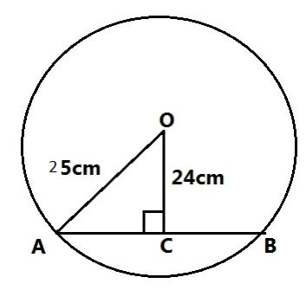
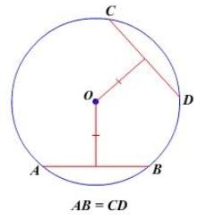
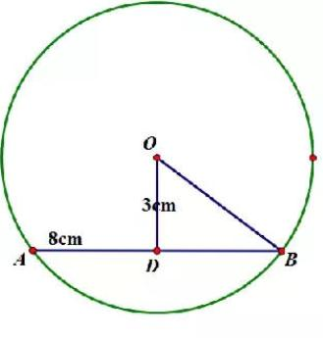
Equal Chords and their distances from centre:
The perpendicular length between a point and another line is the distance between the line and the point.(shortest path)
If the point lies on the given line the distance becomes Zero.
In a circle the perpendicular distance between the chord and the centre is the required length which bisects the given chord.
The chord of shorter length is farther to centre and the chord of greater length is nearer to the centre.(We can observe by drawing)
If chords are equal in length they are equidistant from the centre.

Slide 24
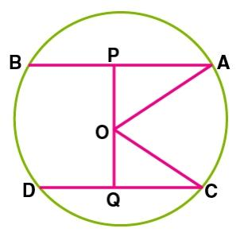
Theorem-6
Statement-Equal chords of a circle are equidistant from the centre.
Given-AB and CD are two chords of a circle.
Such that AB=CD
To Prove-OP=OQ
Construction-Join OA and OC
Proof: Given, AB = CD, O is the centre. Join OA and OC.
Draw, OP⊥AB, OQ⊥CD
In ΔOAP and ΔOCQ,
OA=OC (Radii)
AP=CQ. [ AB = CD ⇒(1/2)AB = (1/2)CD ]
(since OP and OQ bisects the chords AB and CD.)
ΔOAP ≅ ΔOCQ (RHS rule)
Hence, OP=OQ (C.P.C.T.C)

Slide 25
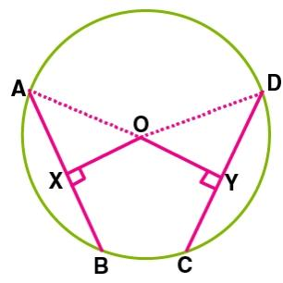
Theorem -7(Converse)
Statement- Chords equidistant from the centre of a circle are equal in length.
Given-Given OX = OY (The chords AB and CD are at equidistant)
OX⊥AB, OY⊥CD
To prove- AB=CD
Construction-Join OA and OD
Proof-In ΔAOX and ΔDOY
∠OXA =∠OYD (Both 90⁰)
OA = OD (Radii)
OX = OY (Given)
ΔAOX ≅ ΔDOY (RHS rule)
Therefore AX = DY (CPCT)
Similarly XB = YC
So, AB = CD

Slide 26
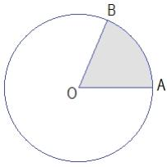
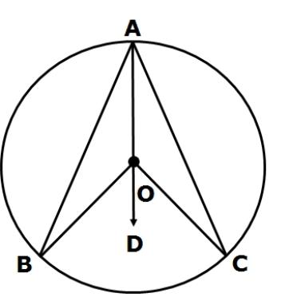
Angle Subtended by an Arc:
The angle subtended by an arc at the centre is same as the
angle subtended by the corresponding chord.
If the chords are of equal length ,the corresponding
arcs are also congruent and vice versa.
Congruent arcs subtend equal angles at the centre.
The arcs can also subtend angles on the circle.
In fig-1 ∠AOB=Angle subtended by the arc AB at the centre
In fig-2 ∠BOC=Angle subtended by the arc BC at the centre
∠BAC=Angle subtended by the arc BC at a point C
on the circle
Fig-1
Fig-2

Slide 27
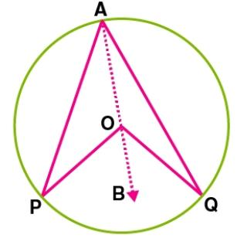
Theorem-8
Statement-The angle subtended by an arc at the centre is double the angle subtended by it on any part of the circle.
Given-Here PQ is the arc of a circle with centre O, that subtends
∠POQ at the centre.
To Prove-⇒∠POQ = 2∠PAQ
Construction- Join AO and extend it to B.
In ΔOAQ OA = OQ….. [Radii]
Hence, ∠OAQ = ∠OQA ……..[Property of isosceles triangle]
Implies ∠BOQ = 2∠OAQ …..[Exterior angle of triangle = Sum of 2 interior angles]
Similarly, ∠BOP = 2∠OAP
⇒∠BOQ + ∠BOP = 2∠OAQ + 2∠OAP
⇒∠POQ = 2∠PAQ

Slide 28
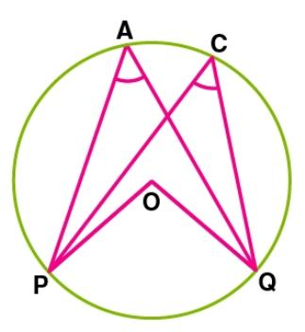
Theorem -9
Statement-Angles in the same segment of a circle are equal in measure.
Given-Consider a circle with centre O.
∠PAQ and ∠PCQ are the angles formed in the
major segment PACQ with respect to the arc PQ.
To Prove- ∠PCQ = ∠PAQ
Construction-Join OP and OQ
∠POQ = 2∠PAQ…………….(1)
∠POQ = 2∠PCQ ………. ………(2)[ Angle subtended by an arc at
. the centre is double the angle subtended by it in any part of the circle]
⇒∠PCQ = ∠PAQ
Hence proved

Slide 29
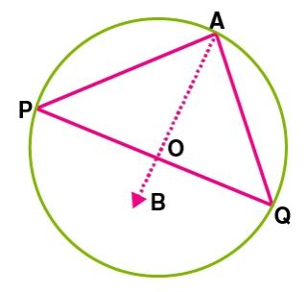
The angle subtended by diameter on the circle
The angle subtended in a semicircle by the diameter is a
right angle.
Proof-Consider a circle with centre O, POQ is the diameter of the circle.
∠PAQ is the angle subtended by diameter PQ at the circumference.
∠POQ is the angle subtended by diameter PQ at the centre.
∠PAQ = (1/2)∠POQ……..[Angle subtended by arc at the centre is
double the angle at any other part]
∠PAQ = (1/2) × 180⁰ = 90⁰

Slide 30
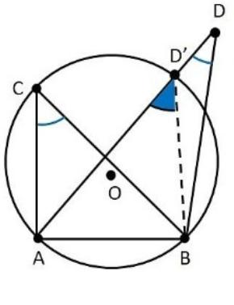
Theorem-10
Statement-If a line segment joining two points subtends equal angles at two other points lying on the same side of the line containing the line segment, the four points lie on a circle (i.e they are concyclic).
Given: AB is a line segment and C and D are two points lying on the same side of AB such that ∠ACB = ∠ADB.
To prove: A, B, C and D are concyclic.
Proof:If possible, suppose D does not lie on this circle.
Let D´ be the point which lies on the circle.Since, C and D´ are
two point on the circle lying on the same side of AB.
∴ ∠ACB = ∠AD´B (Angles in the same segment are equal)
∠ADB = ∠AD´B (∠ACB = ∠ADB)∴ An exterior of ΔDBD´ is equal to the interior opposite angle
But, an exterior angle of a triangle can never be equal to its interior opposite angle.∴ ∠ADB = ∠AD´B⇒ D coincides with D´
.⇒ D lies on the circle passing through the points A, B and C.Hence, the points A, B, C and D are concyclic.

Slide 31
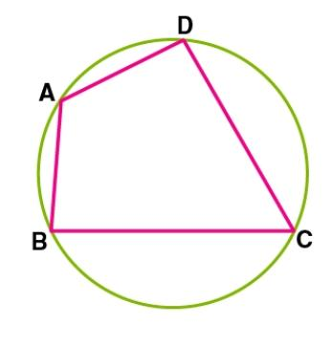
Cyclic Quadrilateral
A Quadrilateral is called a cyclic quadrilateral if all the four vertices lie on a circle.
The quadrilateral never becomes cyclic for any
one vertex lying interior
or exterior to the circle.

Slide 32
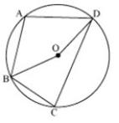
Theorem-11
Statement
In a cyclic quadrilateral theopposite angles are supplementary.
Or
Thesum of either pairs of the opposite angles of a cyclic quadrilateral is180°.
Given : Let ABCD is cyclic quadrilateral.
To prove : ∠A + ∠C = 180° and ∠B + ∠D = 180°.
Construction : join OB and OD.
Proof : reflex∠BOD = 2 ∠BAD
Or ∠BAD = ½ reflex ∠ BOD…….(1)
Similarly ∠BCD = 1/2 ∠BOD….……..(2)
∠BAD + ∠BCD = 1/2reflex∠BOD + 1/2 ∠BOD
=1/2(∠ BOD + ∠DOB)
=(1/2)X360° = 180°
So ∠A+∠C=180
Similarly ∠B + ∠D = 180°

Slide 33
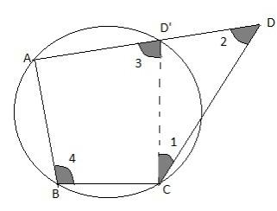
Theorem-12(Converse)
Statement-
If the sum of either opposite angles of a quadrilateral
are supplementary,it is cyclic.
*Proof-Let us assume that the quadrilateral ABCD is not cyclic
i.e Let the point D does not lie on the circle which makes the
quadrilateral non-cyclic.
Now, let us do a construction such that join CD' where D' is the point of intersection of side AD with the circle.
.Now, ABCD' is cyclic⇒ ∠3 + ∠4 = 180°
Now, it is given that the sum of pair opposite angles of a quadrilateral ABCD is 180°
Therefore, ∠2 + ∠4 = 180°
From above two equations we get∠3 + ∠4 = ∠2 + ∠4
⇒ ∠3 = ∠2
Now, in triangle CDD', by external angle property∠3 = ∠1 + ∠2⇒ ∠1 = 0(zero)
, hence the side CD' and CD coincides⇒ Point D lies on circleHence, our supposition is wrong quadrilateral ABCD is cyclic.

Slide 34
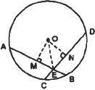
Example-1
If two equal chords of a circle intersect within the circle, prove that the segments of one chord are equal to corresponding segments of the other chord.
Given- We have a circle with centre O.
Equal chords AB and CD intersect at E.
To prove - AE = DE and CE = BE, -----------(1)
Construction- draw OM ⊥ AB and ON ⊥ CD.
Proof- Since AB = CD [Given]
∴ OM = ON [Equal chords are equidisitant from the centre.]
Now, in right ΔOME and right ΔONE,
OM = ON [Proved]
OE = OE [Common]
∴ ΔOME ≌ ΔONE [RHS criterion]
ME = NE [c.p.c.t]
1/2 AE=1/2 BE(Perpendiculars drawn to the chord bisects it) -----------(2)
⇒ AE = DE ...(1)
Since AB = CD [Given]
∴ AB – AE = CD – DE
⇒ CE = BE ...(2)
From (1) and (2), we have
AE = DE and CE = BE

Slide 35
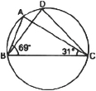
Example-2
In the figure, ∠ABC = 69° ∠ACB 31°, find ∠BDC.
( 1 mark)
Sol: We have, in ΔABC,
∠ABC = 69° and ∠ACB = 31°
But ∠ABC + ∠ACB + ∠BAC = 180° -------(1/2)
∴ 69° + 31° + ∠BAC = 180°
⇒ ∠BAC = 180° – 69° – 31° = 80°
Since, angles in the same segment are equal.
∴ ∠BAC = ∠BAC
⇒ ∠BDC = 80° ---------------------------(1/2)

Slide 36
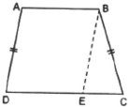
Example-3
If the nonparallel sides of a trapezium are equal, prove that it is cyclic. (4 marks)
Given: We have a trapezium ABCD such that AB || CD and AD = BC.
To prove-The trapezium ABCD is a cyclic.
Construction-Let us draw BE || AD such that ABED is a parallelogram. -----------------(1.5)
Proof-The opposite angles of a parallelogram are equal.
∴ ∠BAD = ∠BED ...(1)
and AD = BE [Opposite sides of a parallelogram] ...(2)
But AD = BC [Given] ...(3)
∴ From (2) and (3), we have
BE = BC
⇒ ∠BEC = ∠BCE
[Angles opposite to equal sides of a triangle Δ are equal] ...(4) -----------------(2.5)
Now, ∠BED + ∠BEC = 180° [Linear pairs]
⇒ ∠BAD + ∠BCE = 180° [Using (1) and (4)]
i.e. A pair of opposite angles of quadrilateral ABCD is 180°.
∴ ABCD is cyclic.
⇒ The trapezium ABCD is a cyclic.

Slide 37
Suggested Activities
1.Take any three non collinear points and draw a circle passing through them.
2. Draw a circle and draw its chords(may be two or more than two).Measure the perpendicular distances of the chords from the centre.Again you take any two chords of equal length on the same circle or another circle.Measure the perpendicular distance from the centre.What do you observe?????????
3.Draw a circle and draw a quadrilateral on it such that all the vertices lie on the circle(cyclic quadrilateral).Measure the angles of the quadrilateral and make an observation table for the relation between either pair of opposite angles.What do you observe?Are they supplementary?

Slide 38
Activity of drawing a circle through Three points

Slide 39
CONCEPT

Slide 40
Key points to Remember
Equal chords of a circle subtend equal angles at the centre.
If the angles subtended by the chords of a circle at the centre are equal, then the chords are equal.
The perpendicular from the centre of a circle to a chord bisects the chord.
The line drawn through the centre of a circle to bisect a chord is perpendicular to the chord.
There is one and only one circle passing through three given non-collinear points.

Slide 41
Key points to Remember
Chords equidistant from the centre of a circle are equal in length.
The angle subtended by an arc at the centre is double the angle subtended by it at any point on the remaining part of the circle.
Angles in the same segment of a circle are equal.
If a line segment joining two points subtends equal angles at two other points lying on the same side of the line containing the line segment, the four points lie on a circle (i.e. they are concyclic).
The sum of either pair of opposite angles of a cyclic quadrilateral is 180°.
If the sum of a pair of opposite angles of a quadrilateral is 180°, the quadrilateral is cyclic.

Slide 42
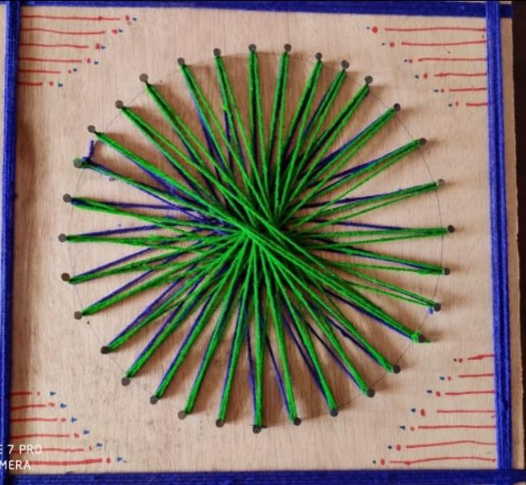
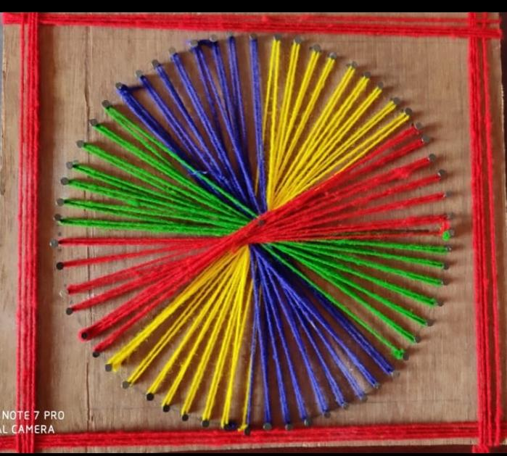
Art Integration in CIRCLES

