Slide 1
CHAPTER-3
BUSINESS ENVIRONMENT

Slide 2
MEANING
Business Environment refers to forces, factors, individuals
and institutions which are outside the control of business
enterprise but these may effect its performance.
In simple words, its is the surroundings in which business
exists.

Slide 3
Environment Scanning
It refers to complete awareness and understanding of
business environment. With environment scanning
Business enterprises can anticipate the effect of
environment forces and factors on their enterprises.

Slide 4
Features
Totality of external forces
Specific and general forces
Inter-relatedness
Dynamic nature
Uncertain
Complexity
Relativity

Slide 5
Importance
Enables the firm to identify opportunities and getting first mover advantage.
Helps the firm to identify the threats and give early warning signals.
Helpful in tapping and assembling resources
Copes up with rapid changes
Assist in planning and policy formulation
Improves performance

Slide 6
Dimensions Of Business Environment

Slide 7
Economic
Social
Legal
Technological
Political

Slide 8
Economic Environment
Change in tax rates
Interest Rates
Inflation
Income/Saving/investment etc

Slide 9
Social Environment :
Change in taste, fashion
Change in social trend
Customs and traditions
Values followed
Celebrations and festivals etc

Slide 10
Political Environment:
Attitude of elected Govt. representatives
Agenda of political parties
Ideology and practices of ruling party
Relation with other countries etc

Slide 11
Legal Environment:
Any Act, statute, legislature
Court judgment
Administrative orders issued by govt. authorities

Slide 12
Technological Environment:
Change in method of production
New machinery, new equipment
Scientific improvements and innovations
New techniques and methods of operating Business

Slide 13
New Economic Policy (1991)

Slide 14
Elements
Liberalization
Privatization
Globalization

Slide 15
Impact of changes in Economic Policy on Business
Increasing Competition
More demanding Customers
Rapidly changing technological environment
Necessity for change
Need for developing Human Resources
Market Orientation
Loss of budgetary to Public Sector
Export a matter of Survival

Slide 16
Managerial Response to Changes in Business Environment
Diversification
Joint Venture/Collaboration and consolidation of MNCs
Brand Building
Use of latest technology
Improved compensation level
Customer Focus

Slide 17
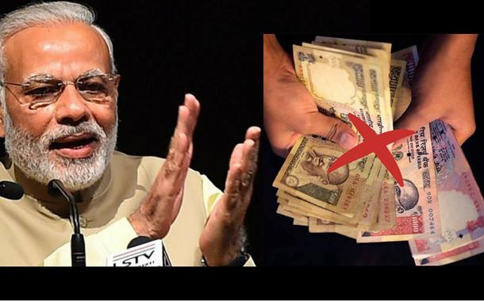
Demonetization

Slide 18
Feature
A Tax administration measure
Non tolerance of Tax Evasion
Channelizing saving into formal financial system
Creating less cash or digital Cash Lite Economy

