Slide 1
APPLICATION OF PERCENTAGE
)

Slide 2
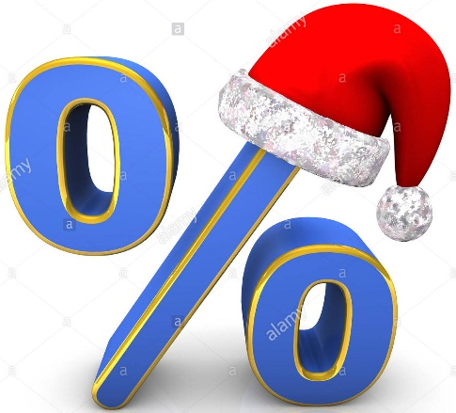
INTRODUCTION
Percentages are an important part of our everyday life.
Different components of the fresh air that we breathe are shown with the help of percentage.
Shops advertise discounts on products in percentage.
Educational institutes and Multinational companies describe their success or failure in percentage.
Financial institutes quote interest charged to the client on loans or interest paid for money invested with the help of percentages .

Slide 3
LEARNING OBJECTIVES
After this lesson, students will be able to
Convert the percentage into a fraction.
Convert the percentage into a decimal
Convert the ratio into percentage
Convert different fractions and decimals into percentage.
Apply percentage in solving different practical word problems.
Calculate profit / loss per cent in a particular transaction.
Calculate simple interest , amount , rate of interest and time duration on a particular deposit or loan.

Slide 4
chapter outline
Introduction
Simple applications of percentages
Profit and Loss
Simple Interest
Brain Teaser and HOTS Questions

Slide 5
Percentage – a brief introduction
A fraction with denominator 100 is called per cent.
Symbol used for percentage is $\%$.
The word per cent is an abbreviation of the Latin word percentum which means per hundred or hundredths.
Percentageis the result obtained by multiplying a quantity by a per cent. Ex : 10 per cent of 50 apples is 5 apples: the 5 apples is the percentage.
Per cent can be :
Converted into a fraction
Expressed as a ratio
Converted into a decimal

Slide 6
Conversion of percentages
Convert 35 $\%$into a fraction in lowest term.
35$\%$ = $\frac{35}{100}$ = $\frac{7}{20}$
17$\%$ = $\frac{17}{100}$
Express 7$\%$ as a ratio.7$\%$ = 7$:100$
25$\%$ = 25:100 = 1:4
Convert 1.2$\%$ into decimal.
1.2$\%$ = $\frac{12}{10}$ x $\frac{1}{100}$
= $\frac{12}{1000}$ = 0.012
{To convert percentage into fraction/ratio/decimal
We have to divide by 100 or multiply by $\frac{1}{100}$ .}

Slide 7
Now try these questions:
Convert 2$\frac{4}{5}$ into percentage.
2$\frac{4}{5}$ = $\frac{14}{5}$ x 100 { To convert a fraction into
percentage , multiply by 100}
= 280$\%$
Convert 0.24 into percentage.
0.24 = 0.24 x 100
= 24$\%${ To convert a decimal into percentage,
multiply by 100.}

Slide 8
LET US TRY TO APPLY …….
In which subject, did Rina score the highest percentage?
Maths = 325 out of 500, English= 240 out of 400
History = 84 out of 150, Science = 132 out of 200
Percentage of marks in Maths = $\frac{325}{500}$ x 100 =65$\%$
Percentage of marks in English= $\frac{240}{400}$x100 = 60$\%$
Percentage of marks in History = $\frac{84}{150}$x100= 56$\%$
Percentage of marks in Science = $\frac{132}{200}$x100 = 66$\%$
$∴$Rina scored highest percentage in science.

Slide 9
APPLICATION CONTINUED………..
Tina has a collection of bangles. She has 20 gold bangles and 10 silver bangles. What is the percentage of each type of bangles?
SOLUTION :
Total no of bangles = 20+10 = 30
Percentage of gold bangles = $\frac{20}{30}$ x 100 = $\frac{200}{3}\%$
= 66$\frac{2}{3}\%$
Percentage of silver bangles = $\frac{10}{30}$ x 100= $\frac{100}{3}\%$
= 33 $\frac{1}{3}\%$

Slide 10
APPLICATION CONTINUED………..
A crate contains 400 apples, 8dozen apples were found spoiled. Find the percentage of good apples in the crate.
SOLUTION : Total no of apples = 400
Number of spoiled apples = 8 x 12 =96
Number of good apples left = 400 – 96 = 304
So, percentage of good apples = $\frac{304}{400}$ x 100 = 76$\%$
$∴76\% good apples are there in the crate.$

Slide 11
APPLICATION CONTINUED………

Slide 14
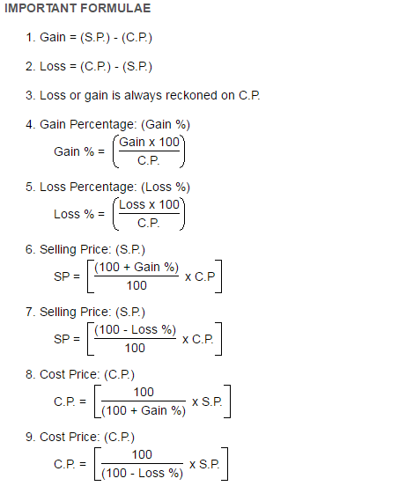

Slide 15
0VERHEAD EXPENSES
The additional amount spend on transportation, rent , labour charges, repairing etc. are known as OVERHEAD EXPENSES.

Slide 16
DISCOUNTS

Slide 17
Let us apply again……

Slide 18
TRY THIS……………….
By selling an article for Rs 400, a man gains Rs 25. At what price should he sell the article to gain 20?
Solution: S.P. = Rs400, C.P. = Rs 25
So, C.P. = S.P. – gain = Rs 400 – Rs 25
= Rs 375
S.P. = C.P. X { $\frac{100+gain\%}{100}$}
= 375 x {$\frac{100+20}{100}$ }= Rs 450
$∴$ The man should sell the article at Rs 450.

Slide 19
NOW SOLVE THIS QUESTION…..
A manufacturer sells an item to an agency at a profit of 25$\%.$The agency sells the item to a shopkeeper at 10$\%$ profit and the shopkeeper sells the item at a profit of 20$\%$.If the selling price of the item is Rs 594,find the manufacturing price.
SOLUTION; C.P. of the shopkeeper= S.P. of the agency
= 594 x {$\frac{100}{100+profit \%}$ }
= 594 x ($\frac{100}{120} )$ = Rs 495
C.P. of the agency = S.P. of the manufacturer
= 495 x{ $\frac{100}{100+profit\%}$}
= 495 x $\frac{100}{110}$ = Rs 450
Manufacturing price = 450 x {$\frac{100}{100+profit \%}$ }
=450 x $\frac{100}{125}$ = Rs 360

Slide 20
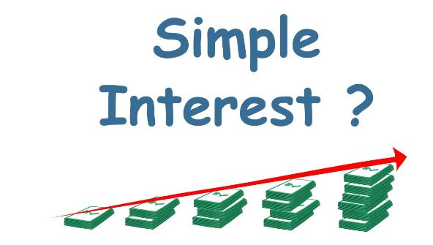
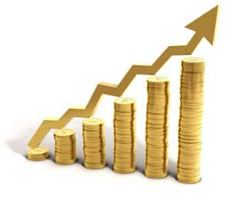

Slide 21
SIMPLE INTEREST - IN BRIEF
Simple Interest = S.I. = P X R X T
Where P = Principal
R = Rate of Interest per annum = r$\%$
T = Time duration ( in years)
Amount = A = P + S.I.
P = $\frac{S.I.X100}{rX T}$
R = $\frac{S.I. X 100}{P X T}$
T = $\frac{S.I. X 100}{P X r}$

Slide 22
Remember………………..
If time T is in months, then convert it
into year by dividing it by 12.
If time T is in weeks, then convert
it into year by dividing it by 52.
If time T is in days, then convert
it into year by dividing it by 365.
If rate of interest is per rupee and
not per cent, then convert it into
per cent by multiplying it by 100.
Amount = P + I

Slide 23
LET US APPLY AGAIN…………………………….
In how many years will Rs 900 yield an interest of Rs 324 at 12$\%$ per annum simple interest?
SOLUTION : P = Rs 900
R = 12$\%$ p.a.
S.I. = Rs 324
Using the formula, S.I.= P X R X T
We get, 324 = $\frac{900 x 12 x T}{100}$
$⟹324$= 108 T
$⇒$ T = $\frac{324}{108}$ = 3 years

Slide 24
APPLICATION CONTINUED…………
If Rs 9000 becomes Rs 18000 at simple interest in 8 years, find the rate percent per annum.
SOLUTION: Given,P = Rs 9000
A = Rs 18000
T = 8years
So, S.I.= A – P = Rs 18000 – Rs 9000 = Rs 9000
We know, S.I. = $\frac{P X R XT}{100}$
So, R = $\frac{100 X S.I.}{P X T}$
= $\frac{100 X 9000}{9000 x 8}$ = 12.5 $\%$

Slide 25
Evaluate???
1.The strength of a school is 3000. If 60$\%$ of them are girls , find the number of boys in the school.
2. A sum of Rs 400 amounts to Rs 480 in 4 years . What will it amount to , if the rate of interest is increased by 2$\%$ per annum ?
3. Shyam sold two washing machines at Rs 12000 each. On one he gains 25$\%$and on the other he loses 25$\%$. How much does he gain or lose in this whole transaction ?

Slide 26
PERCENTAGE - AT A GLANCE
mkkh,ui

Slide 27
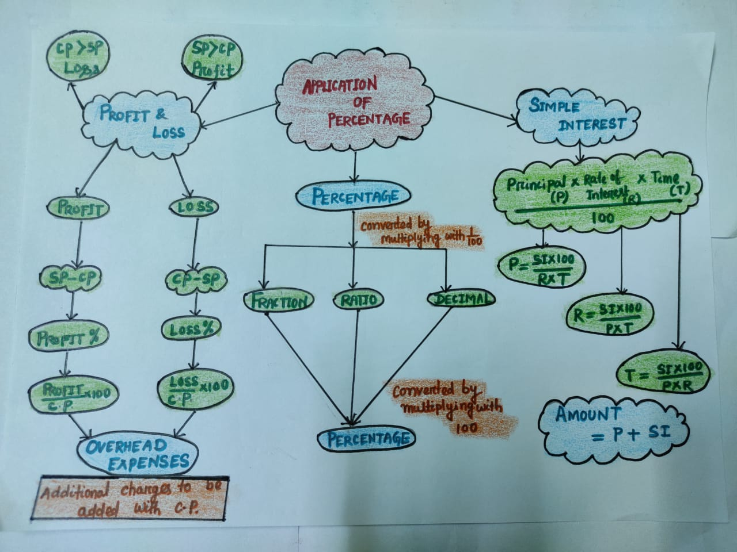
CONCEPT MAPPING

Slide 28
ART INTEGRATION IN PERCENTAGE

Slide 29
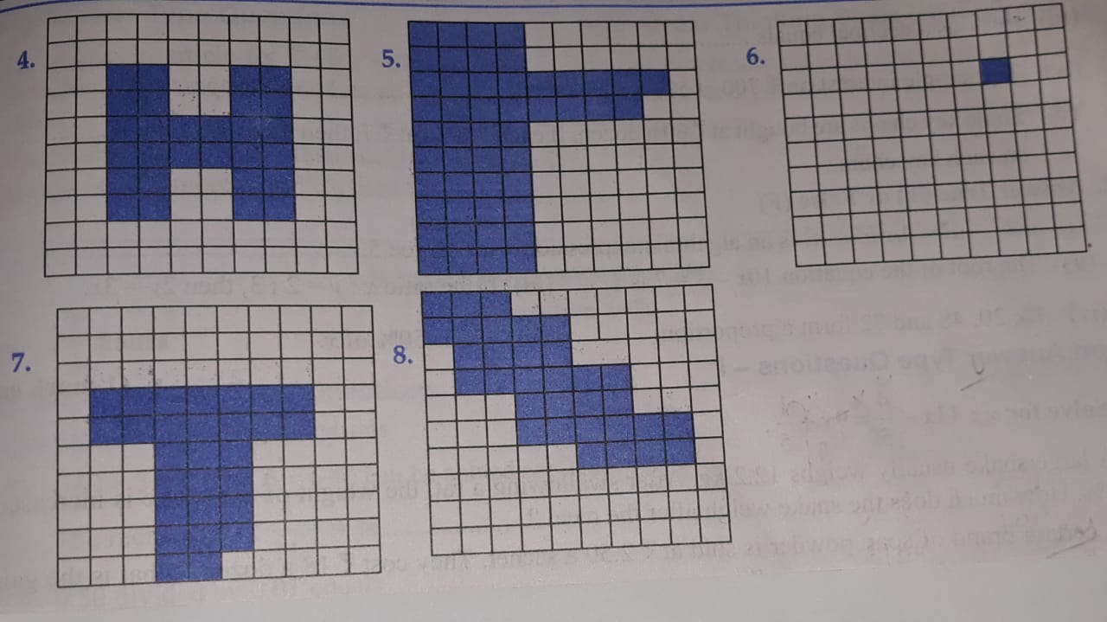
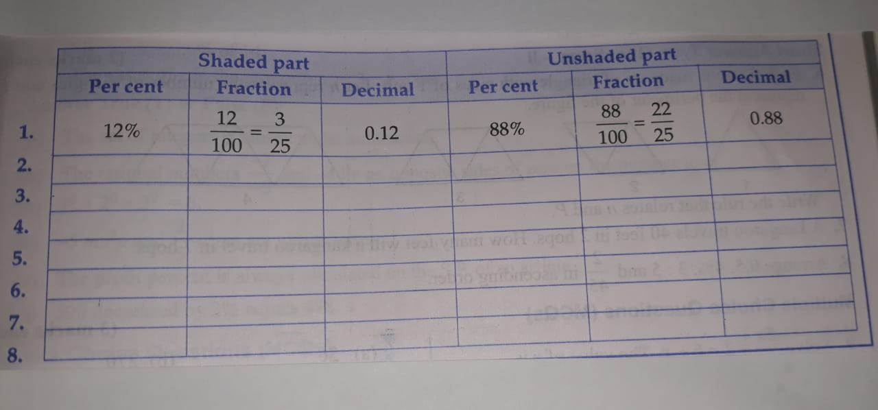
Activity -1 look at the figures and complete the table:-

Slide 30
ACTIVITY – 2
Based on Profit and loss per cent:
Students will be asked to collect the names of
5 grocery items .
They will be asked to collect the cost price and selling price of the items.
They will be instructed to prepare a chart of profit/ loss per cent on each item.
SL.NO | NAME OF ITEMS | SP | CP | PROFIT | LOSS | PROFIT% | LOSS%

