Slide 1
PHOTOSYNTHESIS
It is a process where solar is trapped by autotrophic organisms and converted in to chemical energy in the form of food .
Notes:
Photosynthetic phosphorylation or photophosphorylation is the process of phosphate group transfer According to chemi osmotic hypothesis (Mitchell 1961) the ATP is synthesized on ATPase complexes into ADP to synthesize energy rich ATP molecule making use of light as external energy source. located on the non appressed portions of thylakoid membranes particularly towards margins.

Slide 2
PHOTOSYNTHETIC PHOSPHORYLATION Photosynthetic phosphorylation or photophosphorylation is the process of phosphate group transfer According to chemiosmotic hypothesis (Mitchell 1961) the ATP is synthesized on ATPase complexes into ADP to synthesize energy rich ATP molecule making use of light as external energy source. located on the non appressed portions of thylakoid membranes particularly towards margins.

Slide 3
NON CYCLIC PHOTOPHOSPHORYLATION
PRIMARY ACCEPTOR , Q
PROTON GRADIENT
PRIMARY ACCEPTOR , X
2e-
2e-
PQ
Fd
ADP+Pi
CYTOCHROME COMPLEX
ATP
NADP +
2e-
P680
PC
H2O
NADPH + H+
1/2O2
2H+
P700

Slide 4
Non cyclic photophosphorylation takes place at photosystem II or PS II which includes P 680 along with pigments molecule which absorb at or below 680 nm in the grana of chloroplasts.

Slide 5
1. After trapping solar energy (2 photons), excited 2e- are ejected from P680. These excited 2e- flow down an electron transport chain to P700. 2. During flow of electrons from P680 to P700 through electron transport chain , there is synthesis of ATP. 3. The oxidised P68O regains its electron by the photolysis of water into 2H+,2e- and oxygen. The O2 is given out by the plant.
PROCESS:

Slide 6
4. 2e- are accepted by the PS II centre. 5. The protons H+ accumulate inside the Thyllakoid membrane , resulting in a Proton Gradient . The energy released by the protons , when they diffuse across the thyllakoid membrane into stroma , is used to produce ATP. 6. The electrons lost by P680 do not come back to it. There is a need of constant supply of water molecule for photolysis – to supply lost electron to P680 and protons to reduce NADP. This process is called non cyclic photophosphorylation.

Slide 7
CYCLIC PHOTOPHOSPHORYLATION
PROTON GRADIENT
ADP + Pi
PRIMARY
ACCEPTORS,X
ATP
Fd
PQ
CYTOCHROME
COMPLEX
ADP + Pi
PC
P700
ATP

Slide 8
Cyclic photophosphorylation occurs at reaction centre or photo system I P700 or Ps along with pigment molecules which absorb at or below 700 nm.
Photo System I (P700 )is located in the Thyllakoid membranes of the chloroplast.

Slide 9
PROCESS:
P700 after trapping 2 photons ejects electron which undergo electron transport chain, losing the energy at each step.
The energy released is utilised in the synthesis of ATP.
The 2e- after losing energy are accepted back by the P700.
This process with P700 and the ultimate acceptor of the de-energised electron is also accepted back by P700.Thus the process is a cyclic one.

Slide 10
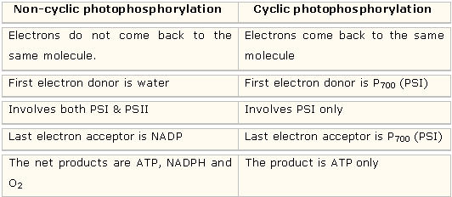
DIFFERENCE BETWEEN CYCLIC AND NON CYCLIC PHOTOPHOSHORYLATION

